Slide 1
Mobile Communications
Chapter 4: Wireless Telecommunication Systems
Market
GSM
TETRA
UMTS/IMT-2000
LTE/LTE advanced

Slide 2
Mobile phone subscribers worldwide (we were all wrong)
approx. 1.7 bn
1600
2016: 7.8 bn total
4.7 bn unique human
4.7% growth/year
1400
1200
GSM total
1000
TDMA total
CDMA total
Subscribers [million]
PDC total
800
Analogue total
600
W-CDMA
Total wireless
Prediction (1998)
400
200
0
1996
1997
1998
1999
2000
2001
2002
2003
2004
year

Slide 3
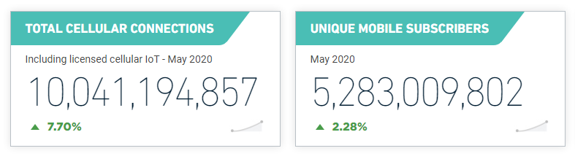
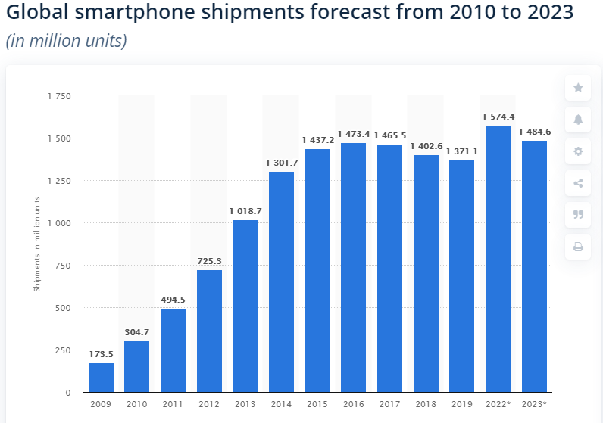
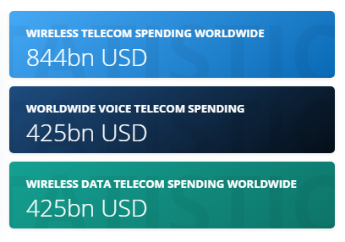
Some current numbers (2019/2020)
Source: GSMAIntelligence
Source: statista
Source: statista

Slide 4
World largest mobile network operators 2019
2014: $10.25 ARPU/month
However: -2.8% growth/year
2018: $8.45 ARPU/month
-0.8% growth/year
Source: The Daily Records

Slide 5
Development of mobile telecommunication systems
CT0/1
FDMA
AMPS
NMT
CT2
IMT-FT
DECT
LTE
advanced
New Radio
LTE
IS-136
TDMA
D-AMPS
+ OFDM
+ beamforming
EDGE
IMT-SC
IS-136HS
UWC-136
TDMA
GSM
GPRS
PDC
IMT-DS
UTRA FDD / W-CDMA
HSPA
IMT-TC
UTRA TDD / TD-CDMA
CDMA
IMT-TC
TD-SCDMA
IS-95
cdmaOne
cdma2000 1X
IMT-MC
cdma2000 1X EV-DO
1X EV-DV
(3X)
1G
2G
2.5G
2.75G
3G
3.9G
4G
5G

Slide 6
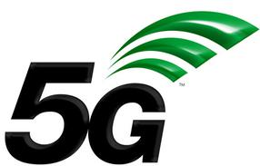
Some press news…
16th April 2008: The GSMA, the global trade group for the mobile industry, today announced that total connections to GSM mobile communications networks have now passed the 3 Billion mark globally. The third billion landmark has been reached just four years after the GSM industry surpassed its first billion, and just two years from the second billionth connection. The 3 Billion landmark has been surpassed just 17 years after the first GSM network launch in 1991. Today more than 700 mobile operators across 218 countries and territories of the world are adding new connections at the rate of 15 per second, or 1.3 million per day.
11 February 2009: The GSMA today announced that the mobile world has celebrated its four billionth connection, according to Wireless Intelligence, the GSMA’s market intelligence unit. This milestone underscores the continued strong growth of the mobile industry and puts the global market on the path to reach a staggering six billion connections by 2013.
By 2014 3.4bn people have broadband, 80% mobile!
2018: more than 8.5 billion mobile connections, more than 5 billion
unique subscribers, $9,49 ARPU/month (https://www.gsmaintelligence.com/)
2020: 5G networks and phones start spreading worldwide

Slide 7
How does it work?
How can the system locate a user?
Why don’t all phones ring at the same time?
What happens if two users talk
simultaneously?
Why don’t I get the bill from my neighbor?
Why can an Australian use her phone in
Berlin?
Why can’t I simply overhear the neighbor’s communication?
How secure is the mobile phone system?
What are the key components of the mobile phone network?

Slide 8
Questions & Tasks
  Why do we have so many more connections compared to subscribers?
  Who/what is driving mobile communications in the future?
  What are consequences of a shrinking ARPU? What can companies do?
  Who defines the generations of mobile telecommunication systems?
  Visit some of the statistics pages and check-out the newest numbers!
  Go through the simple questions and keep them in mind. These are the questions you definitively have to able to answer after this chapter for all systems presented!

Slide 9
GSM – the most successful 2G system: Overview
GSM
    formerly: Groupe Spéciale Mobile (founded 1982)
    now: Global System for Mobile Communication
    Pan-European standard (ETSI, European Telecommunications Standardisation Institute)
    simultaneous introduction of essential services in three phases (1991, 1994, 1996) by the European telecommunication administrations (Germany: D1 and D2)
    ➔ seamless roaming within Europe possible
2008: many providers all over the world use GSM (almost all countries in Asia, Africa, Europe, Australia, America)
    more than 4.2 billion subscribers in more than 700 networks
    more than 75% of all digital mobile phones use GSM
    over 29 billion SMS in Germany in 2008 (> 10% of the revenues for many operators)
    [be aware: these are only rough numbers…]

Slide 10
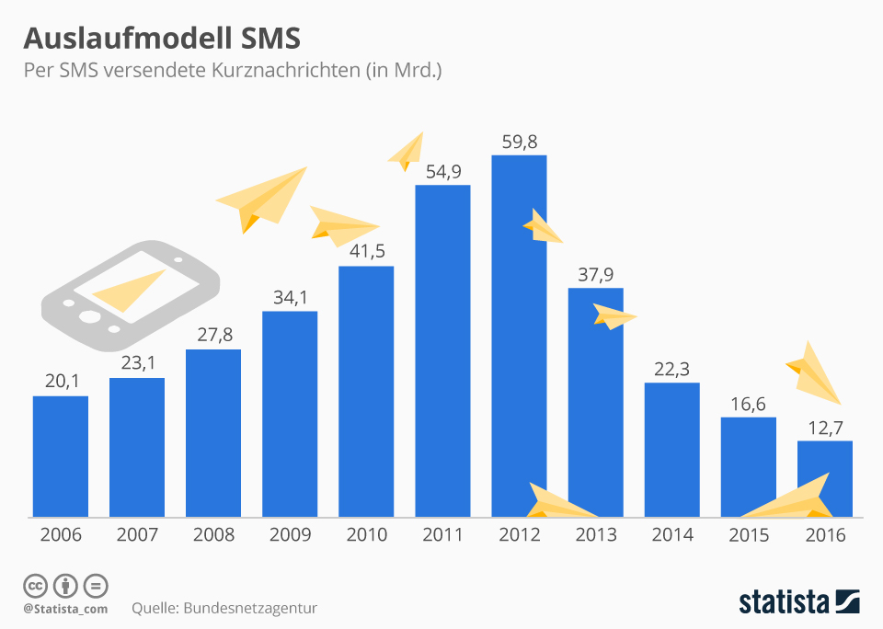
Good bye SMS!?

Slide 11
Performance characteristics of GSM (wrt. analog sys.)
Communication
    mobile, wireless communication; support for voice and data services
Total mobility
    international access, chip-card enables use of access points of different providers
Worldwide connectivity
    one number, the network handles localization
High capacity
    better frequency efficiency, smaller cells, more customers per cell
High transmission quality
    high audio quality and reliability for wireless, uninterrupted phone calls at higher speeds (e.g., from cars, trains)
Security functions
    access control, authentication via chip-card and PIN

Slide 12
Disadvantages of GSM
There is no perfect system!!
  no end-to-end encryption of user data
  no full ISDN bandwidth of 64 kbit/s to the user, no transparent B-channel
  reduced concentration while driving
  electromagnetic radiation
  abuse of private data possible
  roaming profiles accessible
  high complexity of the system
  several optional capabilities within the GSM standards

Slide 13
GSM: Mobile Services
GSM offers
    several types of connections
    voice connections, data connections, short message service
    multi-service options (combination of basic services)
Three service domains
    Bearer Services
    Telematic Services
    Supplementary Services
bearer services
MS
GSM-PLMN
transit
network
(PSTN, ISDN)
source/
destination
network
TE
MT
TE
R, S
U_{m}
(U, S, R)
telematic services

Slide 14
Bearer Services
Telecommunication services to transfer data between access points
Specification of services up to the terminal interface (OSI layers 1-3)
Different data rates for voice and data (original standard)
    data service (circuit switched)
        synchronous: 2.4, 4.8 or 9.6 kbit/s
        asynchronous: 300 - 1200 bit/s
    data service (packet switched)
        synchronous: 2.4, 4.8 or 9.6 kbit/s
        asynchronous: 300 - 9600 bit/s
Today (classical GSM!):
    data rates of approx. 50 kbit/s possible – will be covered later!
    far more with new modulation scheme

Slide 15
Tele Services I
Telecommunication services that enable voice communication via mobile phones
All these basic services have to obey cellular functions, security measurements etc.
Offered services
    mobile telephony
        primary goal of GSM was to enable mobile telephony offering the traditional bandwidth of 3.1 kHz
    emergency number
        common number throughout Europe (112)
        mandatory for all service providers
        free of charge
        connection with the highest priority (preemption of other connections possible)
    multi-numbering
        several ISDN phone numbers per user possible

Slide 16
Tele Services II
Additional services
    Non-Voice-Teleservices
        group 3 fax
        voice mailbox (implemented in the fixed network supporting the mobile terminals)
        electronic mail (MHS, Message Handling System, implemented in the fixed network)
        ...
    Short Message Service (SMS)
        alphanumeric data transmission to/from the mobile terminal (160 characters) using the signaling channel, thus allowing simultaneous use of basic services and SMS
        almost ignored in the beginning then the most successful add-on!
            but more and more replaced by IP-based messaging

Slide 17
Supplementary services
Services in addition to the basic services, cannot be offered stand-alone
Similar to ISDN services besides lower bandwidth due to the radio link
May differ between different service providers, countries and protocol versions
Important services
    identification: forwarding of caller number
    suppression of number forwarding
    automatic call-back
    conferencing with up to 7 participants
    locking of the mobile terminal (incoming or outgoing calls)
    ...

Slide 18
Questions & Tasks
  What is SMS still used for? What do the replacements require?
  Why was GSM such a big success?
  What are the main differences between GSM and ISDN (at a high level)?
  What is required in the background of 112?
  Look at the characteristics of GSM and its disadvantages. What has changed, what is the same if you compare GSM with today’s systems?

Slide 19
Architecture of the GSM system
GSM is a PLMN (Public Land Mobile Network)
    several providers setup mobile networks following the GSM standard within each country
    components
        MS (mobile station)
        BS (base station)
        MSC (mobile switching center)
        LR (location register)
    subsystems
        RSS (radio subsystem): covers all radio aspects
        NSS (network and switching subsystem): call forwarding, handover, switching
        OSS (operation subsystem): management of the network

Slide 20
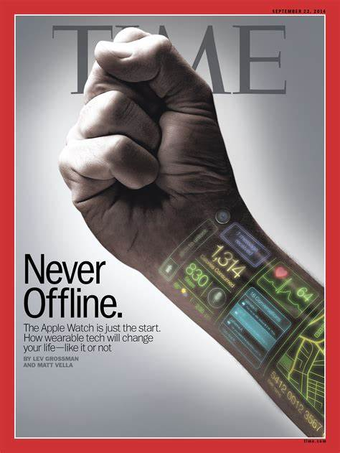

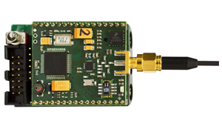
Ingredients 1: Mobile Phones, Smartphones & Co.
Source: Tech Best, https://www.youtube.com/watch?v=g7i00InEzhI
Source: Time Magazine, 09/14
The visible but smallest
part of the network!
Source: www.riot-os.org

Slide 21
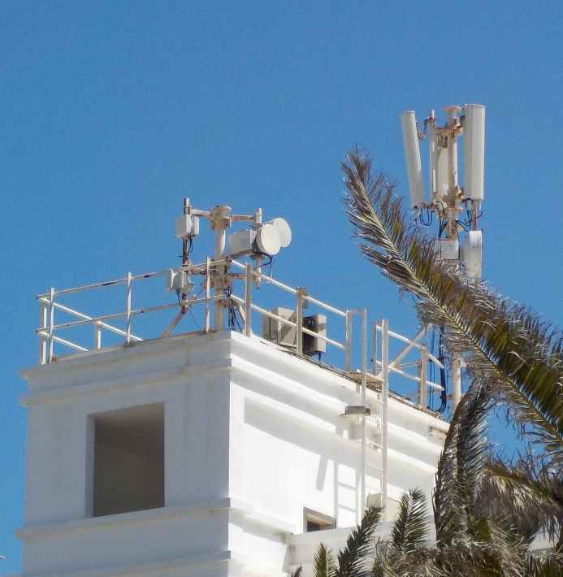
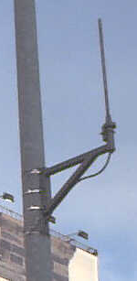
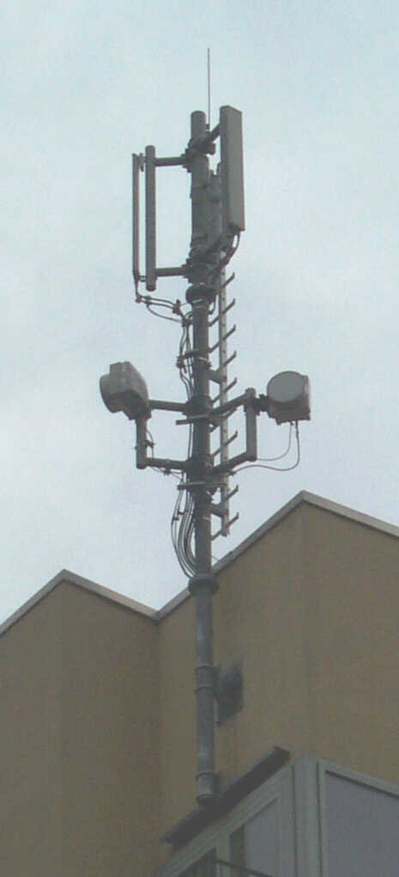
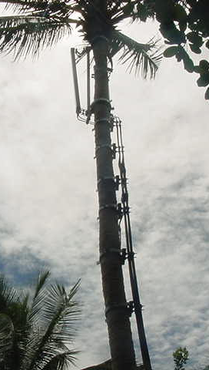
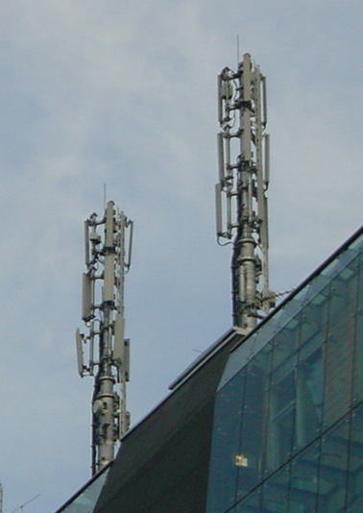
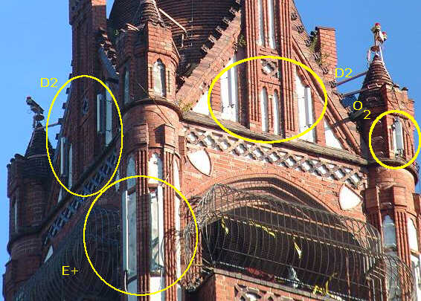
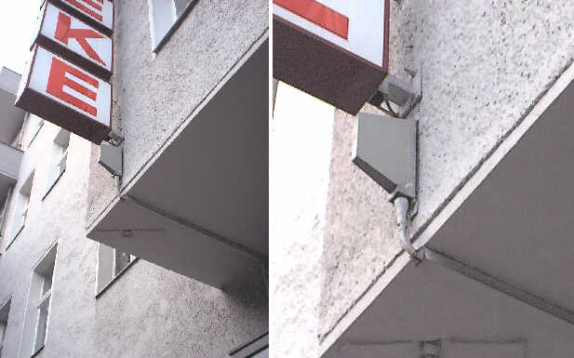
Ingredients 2: Antennas
Still visible – cause many discussions…

Slide 22
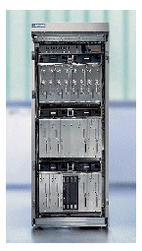
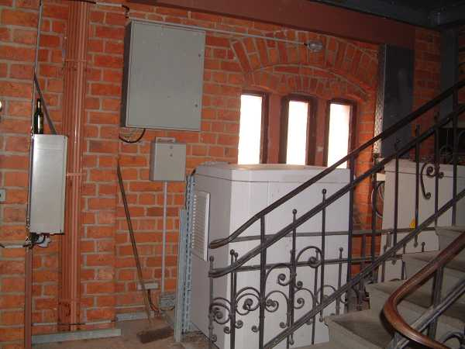
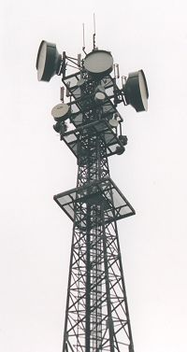
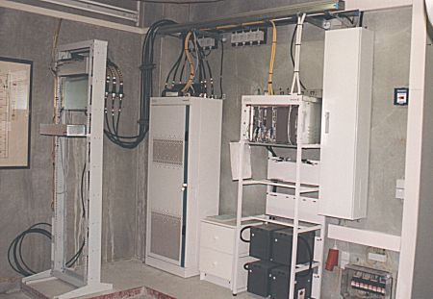
Ingredients 3: Infrastructure 1
Base Stations
Cabling
Microwave links

Slide 23
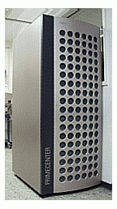
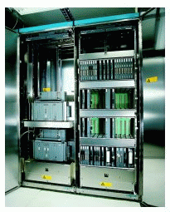
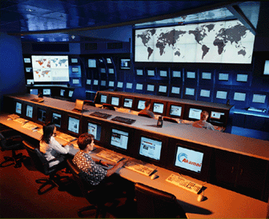
Ingredients 3: Infrastructure 2
Not „visible“, but comprise the major part of the network (also from an investment point of view…)
Management
Data bases
Switching units
Monitoring

Slide 24
GSM: overview
OMC, EIR,
AUC
HLR
fixed network
GMSC
NSS
with OSS
VLR
MSC
VLR
MSC
BSC
BSC
RSS

Slide 25
GSM: elements and interfaces
radio cell
MS
MS
BSS
U_{m}
radio cell
RSS
BTS
MS
BTS
A_{bis}
BSC
BSC
A
MSC
MSC
NSS
VLR
VLR
signaling
HLR
GMSC
ISDN, PSTN
IWF
PDN
O
OSS
EIR
AUC
OMC

Slide 26
GSM: system architecture
radio
subsystem
network and switching subsystem
fixed
partner networks
MS
MS
ISDN
PSTN
U_{m}
MSC
BTS
A_{bis}
BSC
EIR
BTS
SS7
HLR
BTS
VLR
BSC
ISDN
PSTN
BTS
A
MSC
BSS
IWF
PSPDN
CSPDN

Slide 27
System architecture: radio subsystem
radio
subsystem
network and switching
subsystem
Components
  MS (Mobile Station)
  BSS (Base Station Subsystem):
  consisting of
    BTS (Base Transceiver Station):
    sender and receiver
    BSC (Base Station Controller):
    controlling several transceivers
Interfaces
  U_{m} : radio interface
  A_{bis} : standardized, open interface with
  16 kbit/s user channels
  A: standardized, open interface with
  64 kbit/s user channels
MS
MS
U_{m}
BTS
A_{bis}
BSC
MSC
BTS
A
BTS
MSC
BSC
BTS
BSS

Slide 28
System architecture: network and switching subsystem
network
subsystem
fixed partner
networks
Components
  MSC (Mobile Services Switching Center):
  IWF (Interworking Functions)
  ISDN (Integrated Services Digital Network)
  PSTN (Public Switched Telephone Network)
  PSPDN (Packet Switched Public Data Net.)
  CSPDN (Circuit Switched Public Data Net.)
Databases
  HLR (Home Location Register)
  VLR (Visitor Location Register)
  EIR (Equipment Identity Register)
ISDN
PSTN
MSC
EIR
SS7
HLR
VLR
ISDN
PSTN
MSC
IWF
PSPDN
CSPDN

Slide 29
Radio subsystem
The Radio Subsystem (RSS) comprises the cellular mobile network up to the switching centers
Components
  Base Station Subsystem (BSS):
    Base Transceiver Station (BTS): radio components including sender, receiver, antenna - if directed antennas are used one BTS can cover several cells
    Base Station Controller (BSC): switching between BTSs, controlling BTSs, managing of network resources, mapping of radio channels (U_{m}) onto terrestrial channels (A interface)
    BSS = BSC + sum(BTS) + interconnection
  Mobile Stations (MS)

Slide 30
GSM: cellular network
segmentation of the area into cells
possible radio coverage of the cell
idealized shape of the cell
cell
use of several carrier frequencies
not the same frequency in adjoining cells
cell sizes vary from some 100 m up to 35 km depending on user density, geography, transceiver power etc.
hexagonal shape of cells is idealized (cells overlap, shapes depend on geography)
if a mobile user changes cells handover of the connection to the neighbor cell

Slide 31
GSM frequency bands (examples)
Type | Channels | Uplink [MHz] | Downlink [MHz]
GSM 850 | 128-251 | 824-849 | 869-894
GSM 900 classical extended | 0-124, 955-1023 124 channels +49 channels | 876-915 890-915 880-915 | 921-960 935-960 925-960
GSM 1800 | 512-885 | 1710-1785 | 1805-1880
GSM 1900 | 512-810 | 1850-1910 | 1930-1990
GSM-R exclusive | 955-1024, 0-124 69 channels | 876-915 876-880 | 921-960 921-925
Additionally: GSM 400 (also named GSM 450 or GSM 480 at 450-458/460-468 or 479-486/489-496 MHz)
Please note: frequency ranges may vary depending on the country!
Channels at the lower/upper edge of a frequency band are typically not used

Slide 32
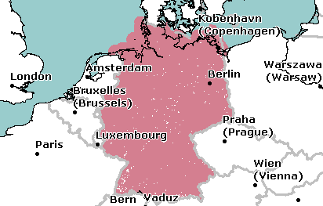
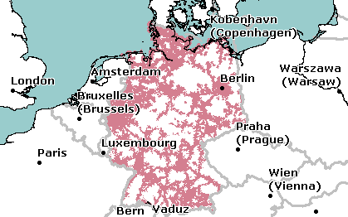
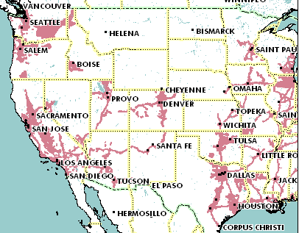
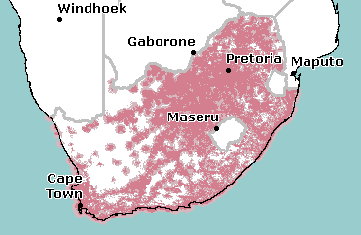
Example coverage of GSM networks (historical from www.gsmworld.com)
T-Mobile (GSM-900/1800) Germany
O₂ (GSM-1800) Germany
AT&T (GSM-850/1900) USA
Vodacom (GSM-900) South Africa

Slide 33
Base Transceiver Station and Base Station Controller
Tasks of a BSS are distributed over BSC and BTS
BTS comprises radio specific functions
BSC is the switching center for radio channels

Slide 34
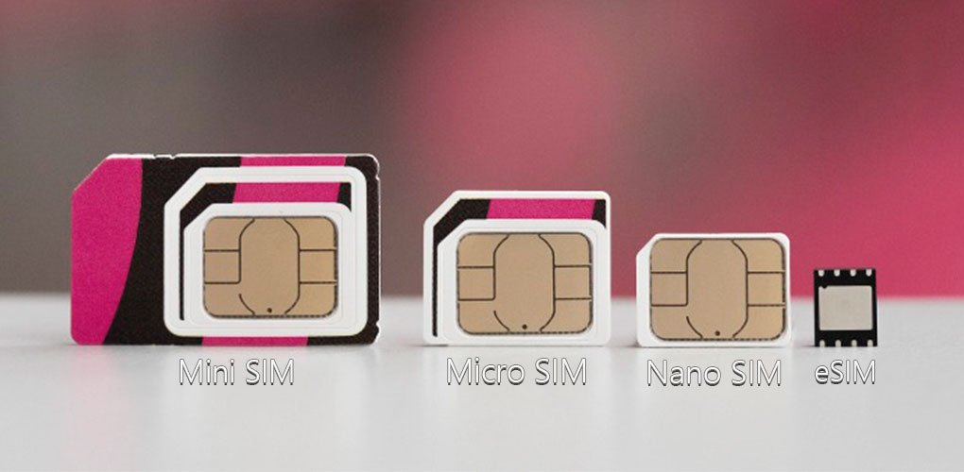
Mobile station
Terminal for the use of GSM services
A mobile station (MS) comprises several functional groups
  MT (Mobile Terminal):
    offers common functions used by all services the MS offers
    corresponds to the network termination (NT) of an ISDN access
    end-point of the radio interface (Um)
  TA (Terminal Adapter):
    terminal adaptation, hides radio specific characteristics
  TE (Terminal Equipment):
    peripheral device of the MS, offers services to a user
    does not contain GSM specific functions
  SIM (Subscriber Identity Module):
    personalization of the mobile terminal, stores user parameters – more and more replaced by eSIM
Source: geektrooper.wordpress.com
TE
TA
MT
R
S
U_{m}

Slide 35
Network and switching subsystem
NSS is the main component of the public mobile network GSM
  switching, mobility management, interconnection to other networks, system control
Components
  Mobile Services Switching Center (MSC)
  controls all connections via a separated network to/from a mobile terminal within the domain of the MSC - several BSC can belong to a MSC
  Databases (important: scalability, high capacity, low delay)
    Home Location Register (HLR)
    central master database containing user data, permanent and semi-permanent data of all subscribers assigned to the HLR (one provider can have several HLRs)
    Visitor Location Register (VLR)
    local database for a subset of user data, including data about all user currently in the domain of the VLR

Slide 36
Mobile Services Switching Center
The MSC (mobile services switching center) plays a central role in GSM
  switching functions
  additional functions for mobility support
  management of network resources
  interworking functions via Gateway MSC (GMSC)
  integration of several databases
Functions of an MSC
  specific functions for paging and call forwarding
  termination of SS7 (signaling system no. 7)
  mobility specific signaling
  location registration and forwarding of location information
  provision of new services (fax, data calls)
  support of short message service (SMS)
  generation and forwarding of accounting and billing information

Slide 37
Operation subsystem
The OSS (Operation Subsystem) enables centralized operation, management, and maintenance of all GSM subsystems
Components
  Authentication Center (AUC)
    generates user specific authentication parameters on request of a VLR
    authentication parameters used for authentication of mobile terminals and encryption of user data on the air interface within the GSM system
  Equipment Identity Register (EIR)
    registers GSM mobile stations and user rights
    stolen or malfunctioning mobile stations can be locked and sometimes even localized
  Operation and Maintenance Center (OMC)
    different control capabilities for the radio subsystem and the network subsystem

Slide 38
Questions & Tasks
  You should be able to draw the architecture of the classical GSM system and to describe the functionality of the components!
  What are the advantages of specifying not only the radio interface but also all internal interfaces of the GSM system?
  Could there be a single point of failure in the GSM architecture? How to avoid it?
  In which database is a roaming tourist registered?
  How could the system block all stolen GSM phones?
  How can the system localizes mobile phones (at least to a certain precision…)?
  Why does GSM separate the MS and SIM?
  What is the advantage/disadvantage of an eSIM?

Slide 39
GSM - TDMA/FDMA
935-960 MHz
124 channels (200 kHz)
downlink
frequency
890-915 MHz
124 channels (200 kHz)
uplink
higher GSM frame structures
time
GSM TDMA frame
1
2
3
4
5
6
7
8
4.615 ms
GSM time-slot (normal burst)
guard
space
guard
space
tail
user data
S
Training
S
user data
tail
3 bits
57 bits
1
26 bits
1
57 bits
3
546.5 µs
577 µs

Slide 40
GSM hierarchy of frames
hyperframe
0
1
2
...
2045
2046
2047
3 h 28 min 53.76 s
superframe
0
1
2
...
48
49
50
6.12 s
0
1
...
24
25
multiframe
0
1
...
24
25
120 ms
0
1
2
...
48
49
50
235.4 ms
frame
0
1
...
6
7
4.615 ms
slot
burst
577 µs

Slide 41
GSM protocol layers for signaling
U_{m}
A_{bis}
A
MS
BTS
BSC
MSC
CM
CM
MM
MM
RR
RR’
BTSM
BSSAP
BSSAP
RR’
BTSM
SS7
SS7
LAPD_{m}
LAPD_{m}
LAPD
LAPD
radio
radio
PCM
PCM
PCM
PCM
16/64 kbit/s
64 kbit/s /
2.048 Mbit/s

Slide 42
Questions & Tasks
  Go once more through the channel/slot structure and understand where GSM applies what type of multiplexing!
  How does GSM adapt to varying distances between MS and BTS? What is the role of the guard spaces?
  What limits the radius of a GSM cell?
  What is the maximum data rate per time slot? Why is the real data rate offered that much lower?

Slide 43
Mobile Terminated Call
1: calling a GSM subscriber
2: forwarding call to GMSC
3: signal call setup to HLR
4, 5: request MSRN from VLR
6: forward responsible
MSC to GMSC
7: forward call to
current MSC
8, 9: get current status of MS
10, 11: paging of MS
12, 13: MS answers
14, 15: security checks
16, 17: set up connection
4
HLR
VLR
5
8
9
3
6
14
15
calling
station
7
PSTN
GMSC
MSC
1
2
10
10
13
10
16
BSS
BSS
BSS
11
11
11
11
12
17
MS

Slide 44
Mobile Originated Call
1, 2: connection request
3, 4: security check
5-8: check resources (free circuit)
9-10: set up call
VLR
3
4
6
5
PSTN
GMSC
MSC
7
8
2
9
1
MS
BSS
10

Slide 45
MTC/MOC
MS
MTC
BTS
MS
MOC
BTS
paging request
channel request
channel request
immediate assignment
immediate assignment
paging response
service request
authentication request
authentication request
authentication response
authentication response
ciphering command
ciphering command
ciphering complete
ciphering complete
setup
setup
call confirmed
call confirmed
assignment command
assignment command
assignment complete
assignment complete
alerting
alerting
connect
connect
connect acknowledge
connect acknowledge
data/speech exchange
data/speech exchange

Slide 46
4 types of handover
1
2
3
4
MS
MS
MS
MS
BTS
BTS
BTS
BTS
BSC
BSC
BSC
MSC
MSC

Slide 47
Handover decision
receive level
BTS_{old}
receive level
BTS_{new}
HO_MARGIN
MS
MS
BTS_{old}
BTS_{new}

Slide 48
Handover procedure
MS
BTS_{old}
BSC_{old}
MSC
BSC_{new}
BTS_{new}
measurement
report
measurement
result
HO decision
HO required
HO request
resource allocation
ch. activation
HO request ack
ch. activation ack
HO command
HO command
HO command
HO access
Hard handover
Link establishment
HO complete
HO complete
clear command
clear command
clear complete
clear complete

Slide 49
Questions & Tasks
  How does the GSM system locate an MS? How precise is the localization?
  Why does the system use a handover margin?
  Why is the hand over called “hard”?
  How and where is user-related data represented/stored in the GSM system?

Slide 50
Security in GSM
Security services
  access control/authentication
    user ⬄ SIM (Subscriber Identity Module): secret PIN (personal identification number)
    SIM ⬄ network: challenge response method
  confidentiality
    voice and signaling encrypted on the wireless link (after successful authentication)
  anonymity
    temporary identity TMSI
    (Temporary Mobile Subscriber Identity)
    newly assigned at each new location update (LUP)
    encrypted transmission
3 algorithms specified in GSM
  A3 for authentication (“secret”, open interface)
  A5 for encryption (standardized)
  A8 for key generation (“secret”, open interface)
“secret”:
A3 and A8 available via the Internet
network providers can (and do) use stronger mechanisms

Slide 51
GSM - authentication
mobile network
SIM
RAND
K_{i}
RAND
RAND
K_{i}
AC
128 bit
128 bit
128 bit
128 bit
A3
A3
SIM
SRES* 32 bit
SRES 32 bit
MSC
SRES* =? SRES
SRES
32 bit
SRES
K_{i}: individual subscriber authentication key SRES: signed response

Slide 52
GSM - key generation and encryption
mobile network (BTS)
MS with SIM
RAND
K_{i}
RAND
RAND
K_{i}
AC
128 bit
128 bit
128 bit
128 bit
SIM
A8
A8
cipher
key
K_{c}
64 bit
K_{c}
64 bit
data
SRES
BSS
encrypted
data
data
MS
A5
A5

Slide 53
Questions & Tasks
  What is protected by the GSM security mechanisms?
  What is missing compared to today’s communication systems?
  What are reasons for this decision?

Slide 54
Data services in GSM I
Data transmission standardized with only 9.6 kbit/s
  advanced coding allows 14.4 kbit/s
  not enough for Internet and multimedia applications
HSCSD (High-Speed Circuit Switched Data)
  mainly software update
  bundling of several time-slots to get higher AIUR (Air Interface User Rate, e.g., 57.6 kbit/s using 4 slots @ 14.4)
  advantage: ready to use, constant quality, simple
  disadvantage: channels blocked for voice transmission

Slide 55
Data services in GSM II
GPRS (General Packet Radio Service)
  packet switching
  using free slots only if data packets ready to send
  (e.g., 50 kbit/s using 4 slots temporarily)
  standardization 1998, introduction 2001
  advantage: one step towards UMTS, more flexible
  disadvantage: more investment needed (new hardware)
GPRS network elements
  GSN (GPRS Support Nodes): GGSN and SGSN
  GGSN (Gateway GSN)
    interworking unit between GPRS and PDN (Packet Data Network)
  SGSN (Serving GSN)
    supports the MS (location, billing, security)
  GR (GPRS Register)
    user addresses

Slide 56
GPRS quality of service

Slide 57
Examples for GPRS device classes
Class | Receiving slots | Sending slots | Maximum number of slots
1 | 1 | 1 | 2
2 | 2 | 1 | 3
3 | 2 | 2 | 3
5 | 2 | 2 | 4
8 | 4 | 1 | 5
10 | 4 | 2 | 5
12 | 4 | 4 | 5

Slide 58
GPRS user data rates in kbit/s
Coding scheme | 1 slot | 2 slots | 3 slots | 4 slots | 5 slots | 6 slots | 7 slots | 8 slots
CS-1 | 9.05 | 18.1 | 27.15 | 36.2 | 45.25 | 54.3 | 63.35 | 72.4
CS-2 | 13.4 | 26.8 | 40.2 | 53.6 | 67 | 80.4 | 93.8 | 107.2
CS-3 | 15.6 | 31.2 | 46.8 | 62.4 | 78 | 93.6 | 109.2 | 124.8
CS-4 | 21.4 | 42.8 | 64.2 | 85.6 | 107 | 128.4 | 149.8 | 171.2

Slide 59
GPRS architecture and interfaces
SGSN
G_{n}
MS
BSS
SGSN
GGSN
PDN
U_{m}
G_{b}
G_{n}
G_{i}
HLR/
GR
MSC
VLR
EIR

Slide 60
GPRS protocol architecture
MS
U_{m}
BSS
G_{b}
SGSN
G_{n}
GGSN
G_{i}
apps.
IP/X.25
IP/X.25
SNDCP
SNDCP
GTP
GTP
LLC
LLC
UDP/TCP
UDP/TCP
RLC
RLC
BSSGP
BSSGP
IP
IP
MAC
MAC
FR
FR
L1/L2
L1/L2
radio
radio

Slide 61
Questions & Tasks
  What multiplexing schemes are used in GSM for what purposes? Think also of other layers apart from the physical layer.
  How is synchronisation achieved in GSM? Who is responsible for synchronisation and why is synchronisation very important?
  How is the shift from voice-only to Internet-style traffic reflected in the GSM system?
  Why is a new infrastructure needed for GPRS, but not for HSCSD? Which components are new and what is their purpose?
  Only few operators offered HSCSD – why?
  What are the reasons for the delays in a GSM system for packet data traffic? Distinguish between circuit-switched and packet-switched transmission.
  Relatively high delay, low reliability – why was GPRS yet a break-through in the GSM world?
  What are the limitations of a GSM cell in terms of diameter and capacity (voice, data) for the traditional GSM, HSCSD, GPRS? How can the capacity be increased?
  What determines the coding scheme?
  Give reasons for a handover in GSM and the problems associated with it. Which are the typical steps for handover, what types of handover can occur? Which resources need to be allocated during handover for data transmission using HSCSD or GPRS respectively? What about QoS guarantees?

Slide 62

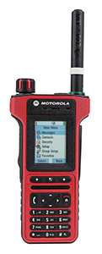
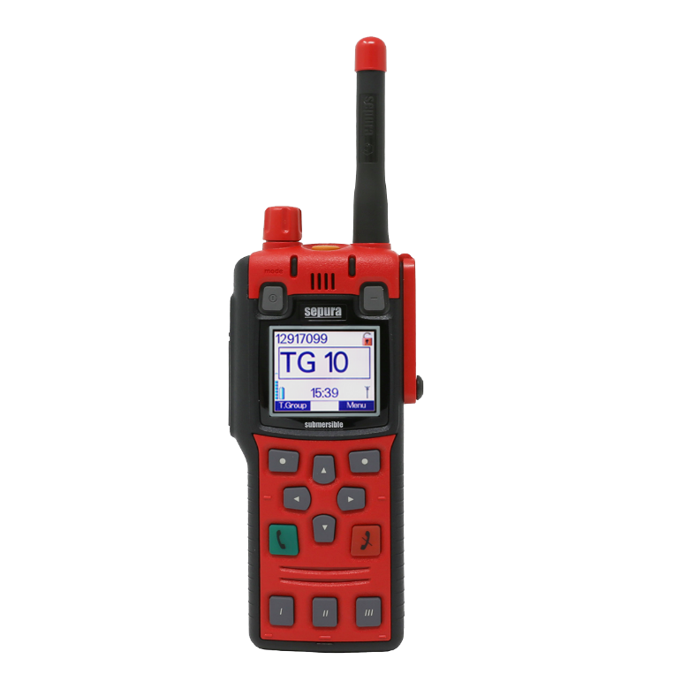
TETRA - Terrestrial Trunked Radio
Trunked radio systems
  many different radio carriers
  assign single carrier for a short period to one user/group of users
  taxi service, fleet management, rescue teams
  interfaces to public networks, voice and data services
  very reliable, fast call setup, local operation
TETRA - ETSI standard, 2G system, EN 300 392
  formerly: Trans European Trunked Radio
    https://www.etsi.org/technologies/tetra
  point-to-point and point-to-multipoint
  encryption (end-to-end, air interface), authentication of devices, users and networks
  group call, broadcast, sub-second group-call setup
  ad-hoc (“direct mode”), relay and infrastructure networks
  call queuing with pre-emptive priorities
  Push-To-Talk (PTT)
Source: tcca.info
Source: www.motorolasolutions.com
Source: www.sepura.com

Slide 63
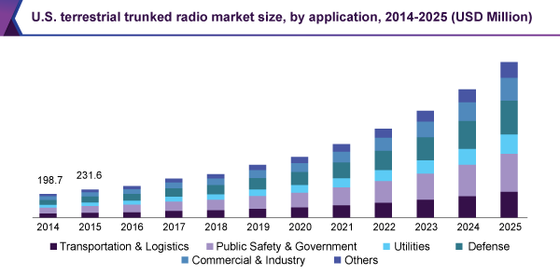
TETRA – Markets by sector
Estimated 5 mio. terminals in 2020
Used in over 120 countries
Source: www.grandviewresearch.com

Slide 64
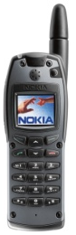

TETRA – Network Architecture
TETRA infrastructure
PSTN, ISDN,
Internet, PDN
switch
NMS
switch
switch
BS
ISI
other TETRA networks
BS
BS
AI
AI: Air Interface
BS: Base Station
DMO: Direct Mode Operation
ISI: Inter-System Interface
NMS: Network Management
System
PEI: Peripheral Equipment
Interface
DMO
PEI

Slide 65
TETRA – Direct Mode I
Direct Mode enables ad-hoc operation and is one of the most important differences to pure infrastructure-based networks such as GSM, cdma2000 or UMTS.
network
Individual Call
“Dual Watch” – alternating participation in
Infrastructure and ad-hoc
network
Authorizing
mobile station
Group Call
Managed Direct Mode

Slide 66
TETRA – Direct Mode II
An additional repeater may increase the transmission range (e.g. police car)
network
Direct Mode with Repeater
Direct Mode with Gateway
network
network
Authorizing
Repeater
Direct Mode with Repeater/Gateway
Managed Repeater/Gateway

Slide 67
TETRA – Technology
Services
  Voice+Data (V+D) and Packet Data Optimized (PDO)
  Short data service (SDS)
Frequencies
  Duplex: FDD, Modulation: DQPSK
  Europe (in MHz, not all available yet)
    380-390 UL / 390-400 DL; 410-420 UL / 420-430 DL, 450-460 UL / 460-470 DL; 870-876 UL / 915-921 DL
  Other countries
    380-390 UL / 390-400 DL; 410-420 UL / 420-430 DL, 806-821 UL / 851-866 DL

Slide 68
TDMA structure of the voice+data system
hyperframe
0
1
2
...
57
58
59
61.2 s
multiframe
0
1
2
...
15
16
17
1.02 s
CF
frame
0
1
2
3
56.67 ms
Control Frame
₀ slot ₅₀₉
14.17 ms

Slide 69
TETRA – Data Rates
Infrastructure mode, V+D in kbit/s
No. of time slots 1 2 3 4
No protection 7.2 14.4 21.6 28.8
Low protection 4.8 9.6 14.4 19.2
High protection 2.4 4.8 7.2 9.6
TETRA Release 2 – Supporting higher data rates
  TEDS (TETRA Enhanced Data Service)
  up to 100-500 kbit/s
    depends on modulation (DQPSK, D8PSK, 4/16/64QAM) and channel width (25/50/100/150 kHz)
  backward compatibility
Future of TETRA?
Data rates to low compared to e.g. LTE
Specialized devices very expensive (no COTS)
LTE Public Safety Broadband

Slide 70
Questions & Tasks
  Why using a separated, specialized system like TETRA? Why not using the “normal” cellular phone network with some “extras”? There are reasons for and against such an approach!
  What else could be problematic using e.g. current LTE/UMTS/GSM systems?
  Check the current approaches of 3GPP towards a public safety mobile network! What is a general trend?

Slide 71
UMTS and IMT-2000 – The 3rd Generation
Proposals for IMT-2000 (International Mobile Telecommunications)
  UWC-136, cdma2000, WP-CDMA
  UMTS (Universal Mobile Telecommunications System) from ETSI
UMTS
  UTRA (was: UMTS, now: Universal Terrestrial Radio Access)
  enhancements of GSM
    EDGE (Enhanced Data rates for GSM Evolution): GSM up to 384 kbit/s
    CAMEL (Customized Application for Mobile Enhanced Logic)
    VHE (virtual Home Environment)
  fits into GMM (Global Multimedia Mobility) initiative from ETSI
  requirements
    min. 144 kbit/s rural (goal: 384 kbit/s)
    min. 384 kbit/s suburban (goal: 512 kbit/s)
    up to 2 Mbit/s urban

Slide 72
Frequencies for IMT-2000
1850
1900
1950
2000
2050
2100
2150
2200
MHz
ITU allocation
(WRC 1992)
IMT-2000
MSS
↑
IMT-2000
MSS
↓
Europe
GSM
1800
DE
CT
T
D
D
UTRA
FDD ↑
MSS
↑
T
D
D
UTRA
FDD ↓
MSS
↓
GSM
1800
IMT-2000
MSS
↑
IMT-2000
MSS
↓
China
Japan
PHS
cdma2000
W-CDMA
MSS
↑
cdma2000
W-CDMA
MSS
↓
North
America
PCS
MSS
↑
rsv.
MSS
↓
1850
1900
1950
2000
2050
2100
2150
2200
MHz

Slide 73
IMT-2000 family
Interface
for Internetworking
IMT-2000
Core Network
ITU-T
GSM
(MAP)
ANSI-41
(IS-634)
IP-Network
Initial UMTS
(R99 w/ FDD)
Flexible assignment of
Core Network and Radio Access
IMT-DS
(Direct Spread)
UTRA FDD
(W-CDMA)
3GPP
IMT-TC
(Time Code)
UTRA TDD
(TD-CDMA);
TD-SCDMA
3GPP
IMT-MC
(Multi Carrier)
cdma2000
3GPP2
IMT-SC
(Single Carrier)
UWC-136
(EDGE)
UWCC/3GPP
IMT-FT
(Freq. Time)
DECT
ETSI
IMT-2000
Radio Access
ITU-R

Slide 74
GSM, UMTS, and LTE Releases
Stages
  (0: feasibility study)
  1: service description from a service-user’s point of view
  2: logical analysis, breaking the problem down into functional elements and the information flows amongst them
  3: concrete implementation of the protocols between physical elements onto which the functional elements have been mapped
  (4: test specifications)
Note
  "Release 2000" was used only temporarily and was eventually replaced by "Release 4" and "Release 5"
Additional information:
  www.3gpp.org/releases
Rel | Spec version no. | Functional freeze date, indicative only
Rel-12 | 12.x.y | Stage 1 freeze March 2013
 |  | Stage 2 freeze December 2013
 |  | Stage 3 freeze June 2014, RAN: Sept. 2014
Rel-11 | 11.x.y | Stage 1 freeze September 2011
 |  | Stage 2 freeze March 2012
 |  | Stage 3 freeze September 2012
Rel-10 | 10.x.y | Stage 1 freeze March 2010
 |  | Stage 2 freeze September 2010
 |  | Stage 3 freeze March 2011
Rel-9 | 9.x.y | Stage 1 freeze December 2008
 |  | Stage 2 freeze June 2009
 |  | Stage 3 freeze December 2009
Rel-8 | 8.x.y | Stage 1 freeze March 2008
 |  | Stage 2 freeze June 2008
 |  | Stage 3 freeze December 2008
Rel-7 | 7.x.y | Stage 1 freeze September 2005
 |  | Stage 2 freeze September 2006
 |  | Stage 3 freeze December 2007
Rel-6 | 6.x.y | December 2004 - March 2005
Rel-5 | 5.x.y | March - June 2002
Rel-4 | 4.x.y | March 2001
R00 | 4.x.y | see note 1 below
 | 9.x.y
R99 | 3.x.y | March 2000
 | 8.x.y
R98 | 7.x.y | early 1999
R97 | 6.x.y | early 1998
R96 | 5.x.y | early 1997
Ph2 | 4.x.y | 1995
Ph1 | 3.x.y | 1992

Slide 75
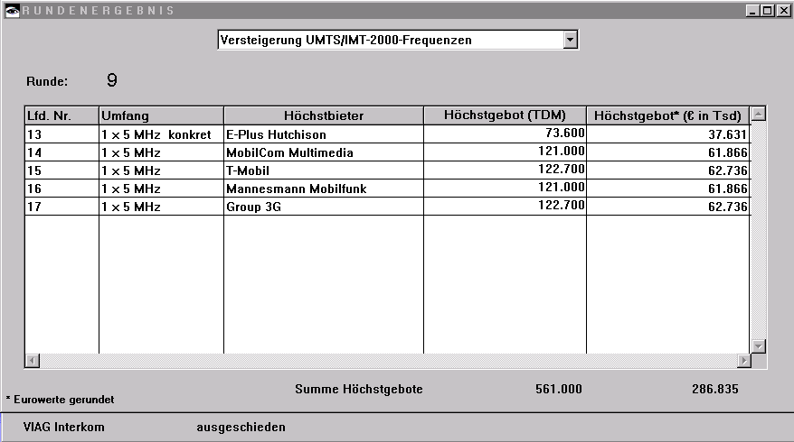
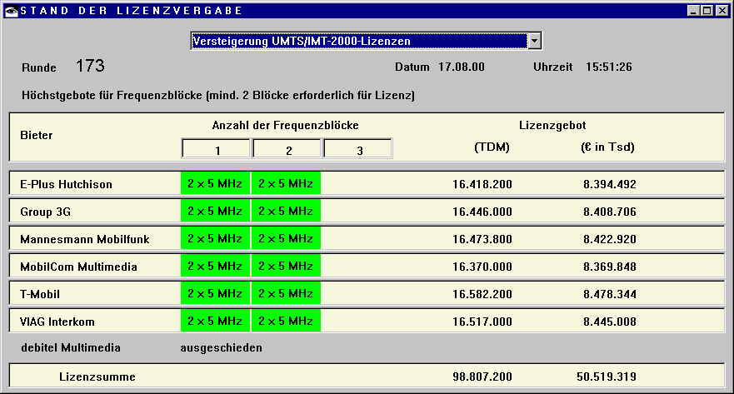
Licensing Example: UMTS in Germany, 18. August 2000
UTRA-FDD:
  Uplink 1920-1980 MHz
  Downlink 2110-2170 MHz
  duplex spacing 190 MHz
  12 channels, each 5 MHz
UTRA-TDD:
  1900-1920 MHz,
  2010-2025 MHz;
  5 MHz channels
Coverage of the population
  25% until 12/2003
  50% until 12/2005
Sum: 50.81 billion €

Slide 76
UMTS architecture
Release 99 used here as starting point
  Shows the key differences
  Newer releases explained in the context of LTE
UTRAN (UTRA Network)
  Cell level mobility
  Radio Network Subsystem (RNS)
  Encapsulation of all radio specific tasks
UE (User Equipment)
CN (Core Network)
  Inter system handover
  Location management if there is no dedicated connection between UE and UTRAN
U_{u}
I_{u}
UE
UTRAN
CN

Slide 77
UMTS domains and interfaces I
Home
Network
Domain
User Equipment Domain
  Assigned to a single user in order to access UMTS services
Infrastructure Domain
  Shared among all users
  Offers UMTS services to all accepted users
Z_{u}
C_{u}
U_{u}
I_{u}
Y_{u}
USIM
Domain
Mobile
Equipment
Domain
Access
Network
Domain
Serving
Network
Domain
Transit
Network
Domain
Core Network Domain
User Equipment Domain
Infrastructure Domain

Slide 78
UMTS domains and interfaces II
Universal Subscriber Identity Module (USIM)
  Functions for encryption and authentication of users
  Located on a SIM inserted into a mobile device
Mobile Equipment Domain
  Functions for radio transmission
  User interface for establishing/maintaining end-to-end connections
Access Network Domain
  Access network dependent functions
Core Network Domain
  Access network independent functions
  Serving Network Domain
    Network currently responsible for communication
  Home Network Domain
    Location and access network independent functions

Slide 79
Questions & Tasks
  What defines the 3rd generation? What was the initial idea?
  What led to the different developments? – There are many reasons!
  Check www.3gpp.org/releases and understand the ideas of stages and releases!
  What was the focus of early UMTS on? How is this reflected in the spectrum?
  What is the problem of the condition “coverage of the population in %”?
  Why did most operators already using GSM pick UMTS as 3rd generation and cdmaOne operators cdma2000?

Slide 80
Spreading and scrambling of user data
Constant chipping rate of 3.84 Mchip/s
Different user data rates supported via different spreading factors
  higher data rate: less chips per bit and vice versa
User separation via unique, quasi orthogonal scrambling codes
  users are not separated via orthogonal spreading codes
  much simpler management of codes: each station can use the same orthogonal spreading codes
  precise synchronization not necessary as the scrambling codes stay quasi-orthogonal
data₁
data₂
data₃
data₄
data₅
spr.
code₁
spr.
code₂
spr.
code₃
spr.
code₁
spr.
code₄
scrambling
code₁
scrambling
code₂
sender₁
sender₂

Slide 81
OVSF (Orthogonal Variable Spreading Factor) coding
1,1,1,1,1,1,1,1
1,1,1,1
...
1,1,1,1,-1,-1,-1,-1
1,1
1,1,-1,-1,1,1,-1,-1
1,1,-1,-1
...
X,X
1,1,-1,-1,-1,-1,1,1
X
1
1,-1,1,-1,1,-1,1,-1
X,-X
1,-1,1,-1
...
1,-1,1,-1,-1,1,-1,1
SF=n
SF=2n
1,-1
1,-1,-1,1,1,-1,-1,1
1,-1,-1,1
...
1,-1,-1,1,-1,1,1,-1
SF=1
SF=2
SF=4
SF=8

Slide 82
UMTS FDD frame structure
W-CDMA
1920-1980 MHz uplink
2110-2170 MHz downlink
chipping rate:
3.840 Mchip/s
soft handover
QPSK
complex power control
(1500 power control
cycles/s)
spreading: UL: 4-256;
DL:4-512
Radio frame
10 ms
0
1
2
...
12
13
14
Time slot
666.7 µs
Pilot
TFCI
FBI
TPC
uplink DPCCH
2560 chips, 10 bits
666.7 µs
Data
uplink DPDCH
2560 chips, 10*2^{k} bits (k = 0...6)
666.7 µs
Data₁
TPC
TFCI
Data₂
Pilot
downlink DPCH
FBI: Feedback Information
TPC: Transmit Power Control
TFCI: Transport Format Combination Indicator
DPCCH: Dedicated Physical Control Channel
DPDCH: Dedicated Physical Data Channel
DPCH: Dedicated Physical Channel
DPDCH
DPCCH
DPDCH
DPCCH
2560 chips, 10*2^{k} bits (k = 0...7)
Slot structure NOT for user separation
but synchronization for periodic functions!

Slide 83
Typical UTRA-FDD uplink data rates
User data rate [kbit/s] | 12.2 (voice) | 64 | 144 | 384
DPDCH [kbit/s] | 60 | 240 | 480 | 960
DPCCH [kbit/s] | 15 | 15 | 15 | 15
Spreading | 64 | 16 | 8 | 4

Slide 84
UMTS TDD frame structure (burst type 2)
Radio frame
10 ms
0
1
2
...
12
13
14
Time slot
666.7 µs
Data
1104 chips
Midample
256 chips
Data
1104 chips
GP
Traffic burst
GP: guard period
96 chips
2560 chips
TD-CDMA
2560 chips per slot
spreading: 1-16
symmetric or asymmetric slot assignment to UL/DL (min. 1 per direction)
tight synchronization needed
simpler power control (100-800 power control cycles/s)

Slide 85
UTRAN architecture
RNS
RNC: Radio Network Controller
RNS: Radio Network Subsystem
UE₁
Node B
I_{ub}
I_{u}
RNC
CN
UE₂
Node B
Node B
UTRAN comprises several RNSs
Node B can support FDD or TDD or both
RNC is responsible for handover decisions requiring signaling to the UE
Cell offers FDD or TDD
UE₃
I_{ur}
Node B
I_{ub}
Node B
RNC
Node B
Node B
RNS

Slide 86
UTRAN functions
Admission control
Congestion control
System information broadcasting
Radio channel encryption
Handover
SRNS moving
Radio network configuration
Channel quality measurements
Macro diversity
Radio carrier control
Radio resource control
Data transmission over the radio interface
Outer loop power control (FDD and TDD)
Channel coding
Access control

Slide 87
Core network: protocols
VLR
MSC
GMSC
PSTN/
ISDN
RNS
GSM-CS
backbone
HLR
RNS
SGSN
GGSN
PDN (X.25),
Internet (IP)
Layer 3: IP
GPRS backbone (IP)
Layer 2: ATM
SS 7
Layer 1: PDH,
SDH, SONET
UTRAN
CN

Slide 88
Core network: architecture
VLR
A_{bis}
BSS
BTS
I_{u}
BSC
MSC
GMSC
PSTN
Node B
BTS
  I_{u}CS
AuC
EIR
HLR
GR
Node B
I_{ub}
Node B
RNC
SGSN
GGSN
G_{n}
G_{i}
Node B
Node B
  I_{u}PS
RNS
CN

Slide 89
Core network
The Core Network (CN) and thus the Interface I_{u}, too, are separated into two logical domains:
Circuit Switched Domain (CSD)
  Circuit switched service incl. signaling
  Resource reservation at connection setup
  GSM components (MSC, GMSC, VLR)
  I_{u}CS
Packet Switched Domain (PSD)
  GPRS components (SGSN, GGSN)
  I_{u}PS
Release 99 uses the GSM/GPRS network and adds a new radio access!
  Helps to save a lot of money …
  Much faster deployment
  Not as flexible as newer releases (5, 6, … 12, 13, 14, …)

Slide 90
UMTS protocol stacks (user plane)
UE
U_{u}
UTRAN
I_{u}CS
3G
MSC
apps. &
protocols
Circuit
switched
RLC
RLC
SAR
SAR
MAC
MAC
AAL2
AAL2
radio
radio
ATM
ATM
UE
U_{u}
UTRAN
I_{u}PS
3G
SGSN
G_{n}
3G
GGSN
apps. &
protocols
IP, PPP,
…
IP tunnel
IP, PPP,
…
Packet
switched
PDCP
PDCP
GTP
GTP
GTP
GTP
RLC
RLC
UDP/IP
UDP/IP
UDP/IP
UDP/IP
MAC
MAC
AAL5
AAL5
L2
L2
radio
radio
ATM
ATM
L1
L1

Slide 91
Questions & Tasks
  How do higher/lower data rates influence the robustness of the transmission in UMTS? How do typical applications fit to these effects?
  How does UTRA-FDD counteract the near-far effect?
  What is a drawback of OVSF? How is it compensated?
  How are different data streams from different users separated?
  Compare the UTRAN architecture with that of GSM. What is a major difference in the radio subsystem (BSS/RNS)? What is it used for?

Slide 92
Support of mobility: macro diversity
Multicasting of data via several physical channels
Enables soft handover
FDD mode only
Uplink
simultaneous reception of UE data at several Node Bs
Reconstruction of data at Node B, SRNC or DRNC
Downlink
Simultaneous transmission of data via different cells
Different spreading codes in different cells
UE
Node B
Node B
RNC
CN

Slide 93
Support of mobility: handover
From and to other systems (e.g., UMTS to GSM)
  This is a must as UMTS coverage is/was poor in the beginning
RNS controlling the connection is called SRNS (Serving RNS)
RNS offering additional resources (e.g., for soft handover) is called Drift RNS (DRNS)
End-to-end connections between UE and CN only via I_{u} at the SRNS
  Change of SRNS requires change of I_{u}
  Initiated by the SRNS
  Controlled by the RNC and CN
Node B
SRNC
CN
I_{ub}
I_{u}
UE
I_{ur}
Node B
DRNC
I_{ub}

Slide 94
Example handover types in UMTS/GSM
UE₁
Node B₁
RNC₁
3G MSC₁
UE₂
I_{u}
Node B₂
I_{ub}
I_{ur}
UE₃
Node B₃
RNC₂
3G MSC₂
UE₄
BTS
BSC
2G MSC₃
A_{bis}
A

Slide 95
Breathing Cells
GSM
  Mobile device gets exclusive signal from the base station
  Number of devices in a cell does not influence cell size
UMTS
  Cell size is closely correlated to the cell capacity
  Signal-to-nose ratio determines cell capacity
  Noise is generated by interference from
    other cells
    other users of the same cell
  Interference increases noise level
  Devices at the edge of a cell cannot further increase their output power (max. power limit) and thus drop out of the cell
  ⇨ no more communication possible
  Limitation of the max. number of users within a cell required
  Cell breathing complicates network planning

Slide 96
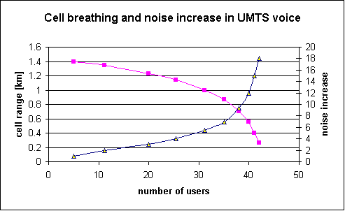
Breathing Cells: Example

Slide 97
UMTS services (originally)
Data transmission service profiles
Virtual Home Environment (VHE)
  Enables access to personalized data independent of location, access network, and device
  Network operators may offer new services without changing the network
  Service providers may offer services based on components which allow the automatic adaptation to new networks and devices
  Integration of existing IN services
Service Profile
Bandwidth
Transport mode
High Interactive MM
128 kbit/s
Circuit switched
Bidirectional, video telephone
High MM
2 Mbit/s
Packet switched
Low coverage, max. 6 km/h
Medium MM
384 kbit/s
Circuit switched
asymmetrical, MM, downloads
Switched Data
14.4 kbit/s
Circuit switched
Simple Messaging
14.4 kbit/s
Packet switched
SMS successor, E-Mail
Voice
16 kbit/s
Circuit switched

Slide 98
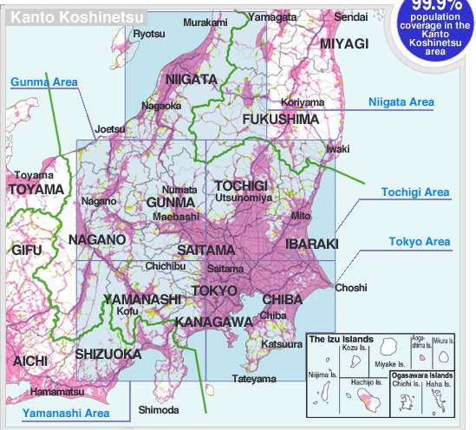
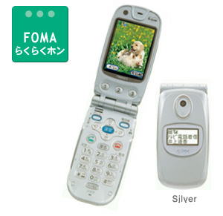
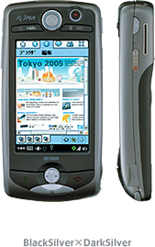
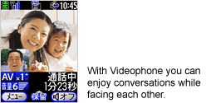
Early 3G Networks: Japan
FOMA (Freedom Of Mobile multimedia
Access) in Japan
Examples for FOMA phones

Slide 99
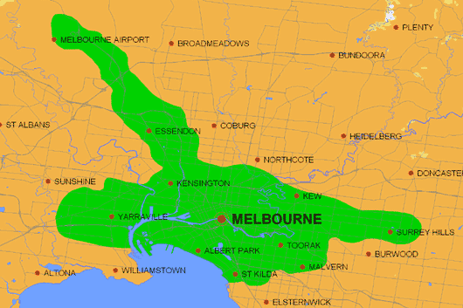
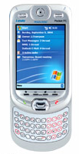
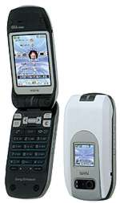
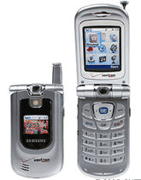
Early 3G networks: Australia
cdma2000 1xEV-DO in Melbourne/Australia
Examples for 1xEV-DO devices

Slide 100
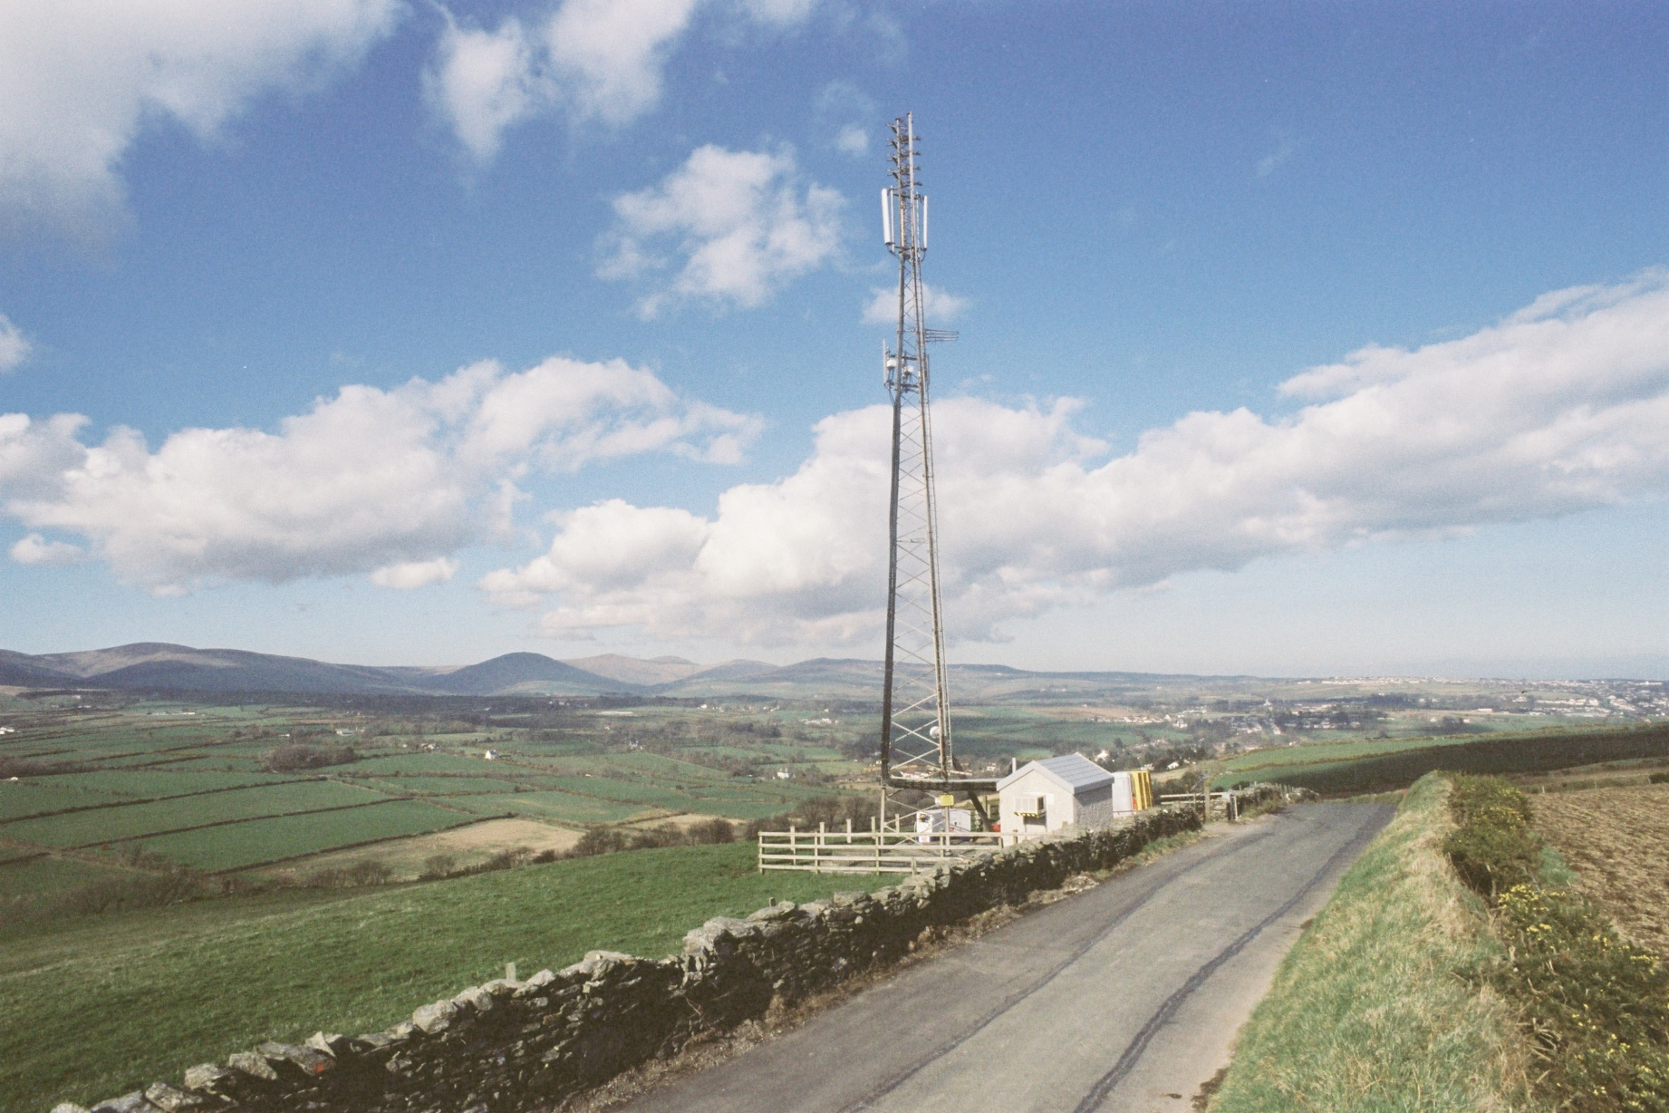
Isle of Man – Start of UMTS in Europe as Test

Slide 101
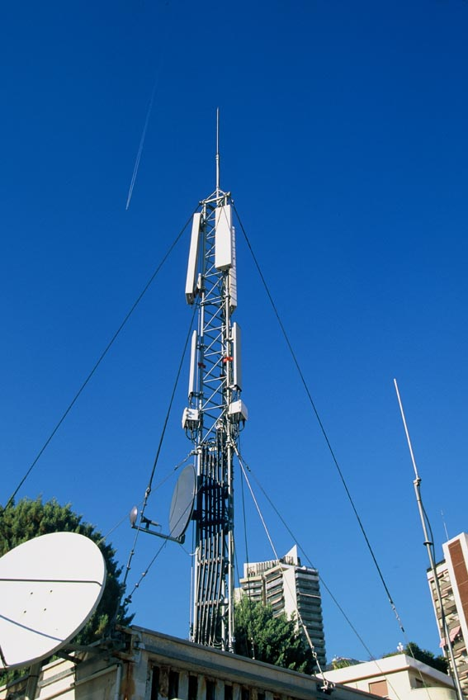
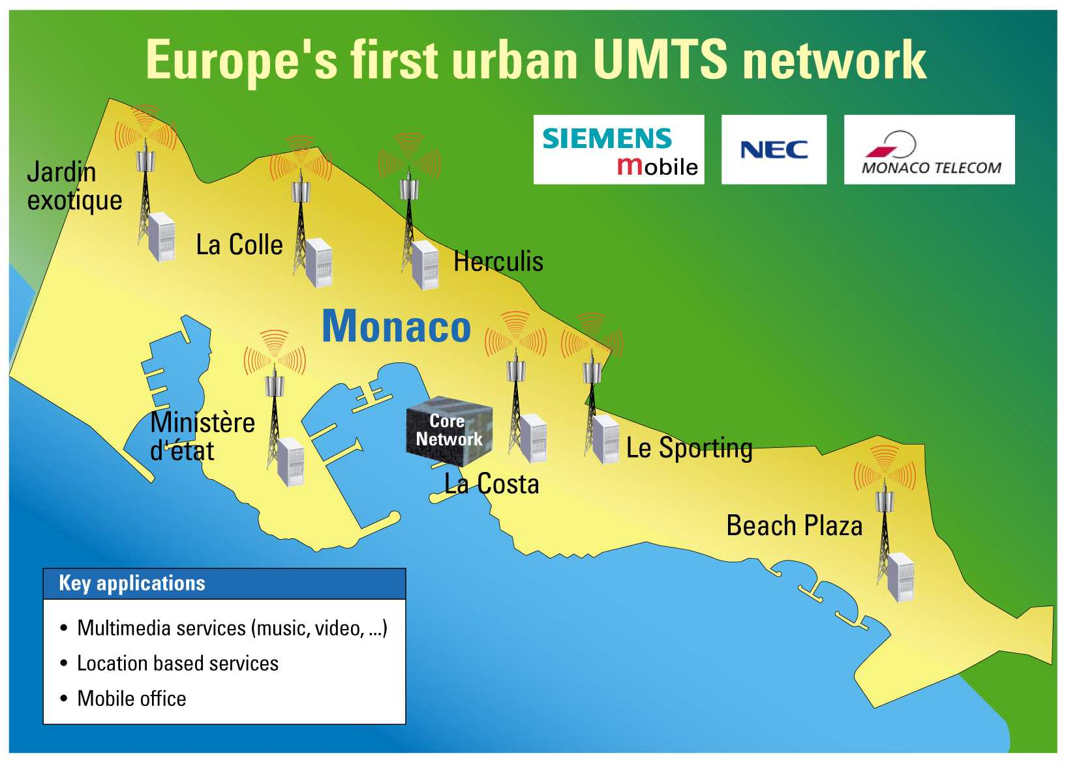
UMTS in Monaco

Slide 102
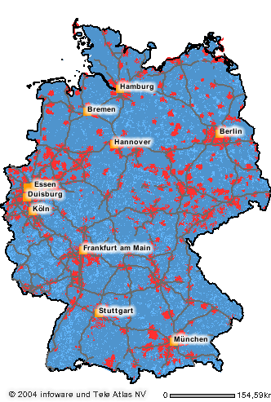
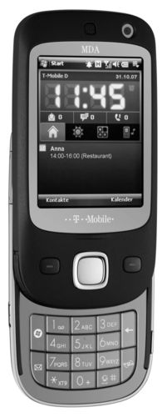


Early UMTS in Europe
Orange/UK
Vodafone/Germany

Slide 103
Some current GSM enhancements
EMS/MMS
  EMS: 760 characters possible by chaining SMS, animated icons, ring tones, was soon replaced by MMS (or simply skipped)
  MMS: transmission of images, video clips, audio
    see WAP 2.0 – not really successful, typically substituted by email with attached multimedia content
  Today, more and more IP-based messaging used, less specialized services offered by the network
EDGE (Enhanced Data Rates for Global [was: GSM] Evolution)
  8-PSK instead of GMSK, up to 384 kbit/s
  new modulation and coding schemes for GPRS ➔ EGPRS
    MCS-1 to MCS-4 uses GMSK at rates 8.8/11.2/14.8/17.6 kbit/s
    MCS-5 to MCS-9 uses 8-PSK at rates 22.4/29.6/44.8/54.4/59.2 kbit/s

Slide 104
Some current UMTS enhancements
HSDPA (High-Speed Downlink Packet Access)
  initially up to 10 Mbit/s for the downlink, later > 20 Mbit/s using MIMO- (Multiple Input Multiple Output-) antennas
  can use 16-QAM instead of QPSK (ideally > 13 Mbit/s)
  user rates e.g. 3.6 or 7.2 Mbit/s
HSUPA (High-Speed Uplink Packet Access)
  initially up to 5 Mbit/s for the uplink
  user rates e.g. 1.45 Mbit/s
HSPA+ (Evolved HSPA)
  Rel-7/Rel-8/Rel-9/…
  Downlink 28/42/84/> 100 Mbit/s
  Uplink 11/23/>23 Mbit/s
  2x2 MIMO, 64 QAM
Dual-/Multi-Carrier HSPA (DC-/MC-HSPA)
  Connect 2 (Rel-8/9) or more carriers (Rel-11) e.g. of two cells offering up to 672 Mbit/s (4x4 MIMO)

Slide 105
Questions & Tasks
  Compare the handovers in GSM with the ones in UMTS. Why are they called hard or soft, respectively?
  How much is the core network aware of the type of handover?
  What are the consequences of introducing IP-based packet transmission?
  What is the key to higher data rates in UMTS?
  While the data rates increased over time, the delay remained more or less constant at about 100-150 ms from a mobile device to the base station. What problem arises if e.g. downloading content using TCP via these fast connections? Think of congestion avoidance/RTT!

Slide 106

Long Term Evolution (LTE)
Initiated in 2004 by NTT DoCoMo,
focus on enhancing the Universal
Terrestrial Radio Access (UTRA) and
optimizing 3GPP’s radio access architecture
Targets: Downlink 100 Mbit/s, uplink 50 Mbit/s, RTT<10ms
2007: E UTRA progressed from the feasibility study stage to the first issue of approved Technical Specifications
2008: stable for commercial implementation
2009: first public LTE service available (Stockholm and Oslo)
2010: LTE starts in Germany
LTE is not 4G – sometimes called 3.9G
  Does not fulfill all requirements for IMT advanced

Slide 107
LTE High-level Architecture
User Equipment (UE)
  Mobile Termination (MT) handles wireless/mobile communication
  Terminal Equipment (TE) handles data streams
  Universal Integrated Circuit Card (UICC): the SIM for LTE, runs the USIM
Evolved UMTS Terrestrial Radio Access Network (E-UTRAN)
  comprises the eNodeBs (i.e. the base stations including controllers)
  interfaces to the EPC via a user interface (S1-U) and signaling interface (S1-MME)
Evolved Packet Core (EPC)
  comprises the central database for subscribers, equipment identity
  routes data to/from other Packet Data Networks (PDN)
  functions for policing, charging, authentication
UE
E-UTRAN
S1-U
EPC
PDNs
U_{u}
S1-MME
SGi

Slide 108
Initial typical data rates (Release 8)
UE Category | Max. data rate downlink | Max downlink MIMO | Max data rate uplink
1 | 10.3 | 1 | 5.2
2 | 51.0 | 2 | 25.5
3 | 102.0 | 2 | 51.0
4 | 150.8 | 2 | 51.0
5 | 299.6 | 4 | 75.4
Higher (and lower) data rates with LTE advanced!

Slide 109
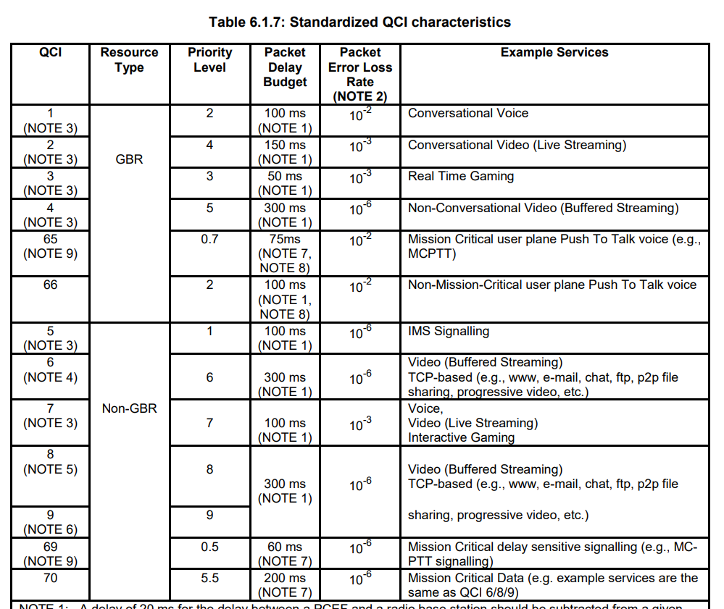
QoS Classes
3GPP TS 23.203
(only part shown here)

Slide 110
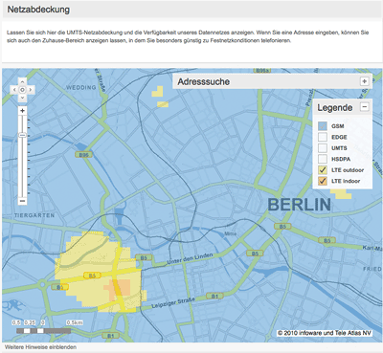
May 2011, Berlin gets LTE

Slide 111
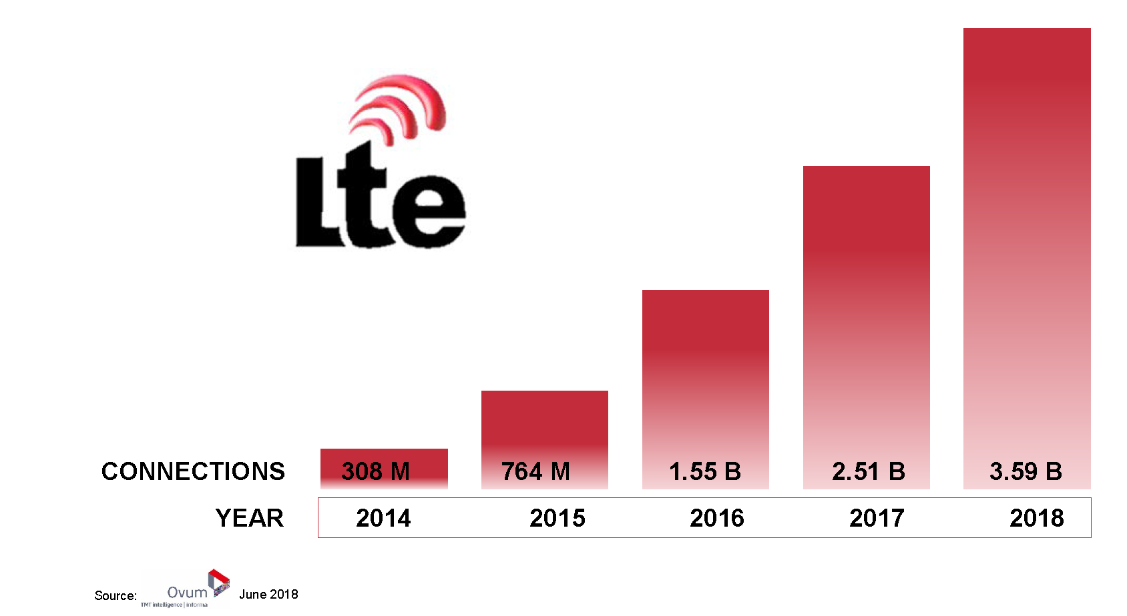
Fast growth rates of LTE

Slide 112
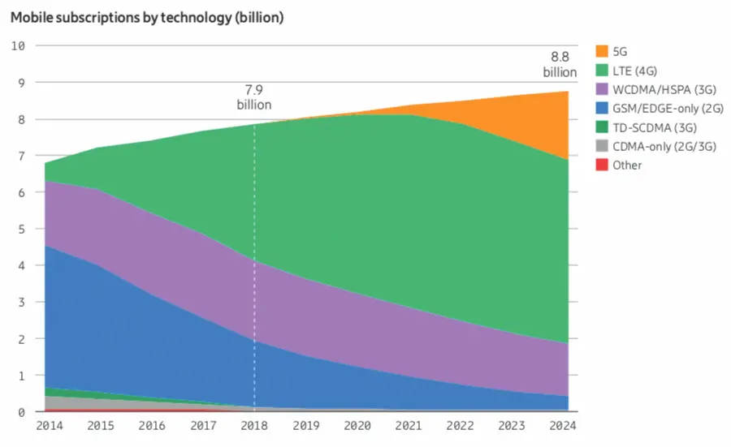
LTE will stay for a while
source: Heise-Verlag, c’t 15/2019

Slide 113

LTE today – THE global standard (only 9 countries without LTE in 2019)
May 2020
797 operators
325 LTE advanced/pro
210 VoLTE networks
106 NB-IoT networks
80 operators offering 5G
https://gsacom.com/technology/5g/
“LTE-Not-Spots” (source: GSA/Heise-Verlag, c’t 15/2019)

Slide 114
Key LTE features
Simplified network architecture compared to GSM/UMTS
  Flat IP-based network replacing the GPRS core, optimized for the IP-Multimedia Subsystem (IMS), no more circuit switching
Network should be in parts self-organizing
Scheme for soft frequency reuse between cells
  Inner part uses all subbands with less power
  Outer part uses pre-served subbands with higher power
Much higher data throughput supported by multiple antennas
Much higher flexibility in terms of spectrum, bandwidth, data rates
Much lower RTT – good for interactive traffic and gaming
Smooth transition from W-CDMA/HSPA, TD-SCDMA and cdma2000 1x EV-DO – but completely different radio!
Large step towards 4G – IMT advanced
See www.3gpp.org for all specs, tables, figures etc.!

Slide 115
High flexibility
E-UTRA (Evolved UMTS Terrestrial Radio Access)
  Operating bands 700-2700MHz
  Channel bandwidth 1.4, 3, 5, 10, 15, or 20 MHz
  TDD and FDD
Modulation
  QPSK, 16QAM, 64QAM
Multiple Access
  OFDMA (DL), SC-FDMA (UL)
Peak data rates (cat 5 UE)
  300 Mbit/s DL (4x4 MIMO, 20 MHz)
  75 Mbit/s UL
  Depends on UE category
Cell radius
  From <1km to 100km
Mobility
  up to 350km/h
source: 3GPP TS 36.101

Slide 116
Questions & Tasks
  Why is LTE such a world-wide success? Think of parameters, architecture …
  Name high-level differences between LTE and GSM/GPRS/UMTS! What do they have in common?
  What is the idea of soft frequency reuse?

Slide 117
LTE architecture
Mobility Management Entity Serving Gateway
Packet-data network Gateway Home Subscriber Server
Policy and Charging Rules Function
U_{u}
UE₂
GPRS
MME
eNode B
S10
S3
X2-U/-C
MME
HSS
eNode B
X2-U/-C
S1-MME
S6
UE₁
S1-MME
S11
X2-U/-C
eNode B
S4
U_{u}
PCRF
S1-U
eNode B
X2-U/-C
S-GW
S7
Rx+
S1-U
S5 S8 (roaming)
Internet,
Operators…
eNode B
P-GW
SGi
E-UTRAN
EPC (Evolved Packet Core)

Slide 118
Components of the LTE architecture I – Evolved-UTRAN
eNode B
Radio resource management
QoS management
Interference management
Admission control
Signal measurements
Scheduling/resource allocation
IP header compression
Encryption
Comprises former NodeB plus RNC functionality,
now for LTE to reduce latency
UE communicates only with one eNodeB, the serving eNodeB
Connection to EPC (via S1-U and S1-MME) and
to other eNodeBs (via X2-U and X2-C)
Home eNodeBs possible (e.g. to create a femtocell at home)
U_{u}
UE₂
eNode B
eNode B
X2-U/-C
X2-U/-C
UE₁
X2-U/-C
eNode B
U_{u}
eNode B
X2-U/-C
eNode B
E-UTRAN

Slide 119
Components of the LTE architecture II - EPC (Evolved Packet Core)
GPRS
MME (Mobility Management Entity)
Signaling between UE and EPC
Security, Mobility Handling
Bearer Control
S-GW (Serving Gateway)
Mobility Anchor for all user IP packets
Buffering during UE paging
Charging, lawful interception
P-GW (PDN Gateway)
IP address allocation for the UE
Packet filtering, QoS enforcement
HSS (Home Subscriber Server)
Subscriber information (allowed PDNs, QoS profile,
roaming restrictions)
MME identity of current location
Includes authentication center
PCRF (Policy and Charging Rules Function)
QoS authorization, policy control, controls flow-based charging
MME
S10
S3
MME
HSS
S1-MME
S6
S1-MME
S11
S4
PCRF
S1-U
S-GW
S7
Rx+
S1-U
S5 S8 (roaming)
Internet,
Operators…
P-GW
SGi
EPC (Evolved Packet Core)

Slide 120
LTE protocol stack (user plane)
LTE U_{u}
S1-U
S5/S8
UE
eNodeB
S-GW
P-GW
apps. &
protocols
IP
IP tunnel
IP
Packet
switched
only!
PDCP
PDCP
GTP-U
GTP-U
GTP-U
GTP-U
RLC
RLC
UDP/IP
UDP/IP
UDP/IP
UDP/IP
MAC
MAC
L2
L2
L2
L2
radio
radio
L1
L1
L1
L1

Slide 121
LTE frame structure
Radio frame (10 ms)
UL
0
1
2
...
7
8
9
FDD
Subframe (1 ms)
DL
0
1
2
...
7
8
9
Synchronization is part of subframe 0 and 5
0
1
2
...
7
8
9
TDD
UL/DL
...
Downlink Pilot Time Slot
(data plus pilot signal)
Uplink Pilot Time Slot
(random access plus pilot signal)
Guard Period

Slide 122
LTE multiple access
Scheduling of UEs in time and frequency (very simplified) using resource blocks (180kHz in 1 ms)
f
UE₁
UE₁
UE₁
UE₁
UE₁
UE₁
UE₂
UE₂
UE₁
UE₁
UE₃
UE₃
UE₃
UE₄
UE₂
UE₄
UE₃
UE₃
UE₄
UE₃
UE₂
UE₂
UE₂
UE₄
180 kHz
UE₁
UE₄
UE₂
UE₁
UE₁
UE₄
1 ms
t

Slide 123
TDM requires Timing Alignment
Similar to GSM – the further away a UE from the eNodeB is, the earlier it transmits
Configurable at a granularity of 0.52µs from 0 to 0.67 ms (corresponding to a max. cell radius of 100 km)
UE₂
UE₁
t₁
t₂
➔
➔
➔
t₁
⬅
⬅
t₂
⬅
⬅

Slide 124

LTE handover via S1
MME
S1-MME
U_{u}
eNode B
S-GW
UE
S1-U
X2-U/-C
S1-MME
MME
eNode B
S1-U
S-GW
Source: The LTE Network Architecture, Strategic White Paper, Alcatel Lucent 2009

Slide 125

LTE handover via X2 interface
MME
S1-MME
U_{u}
eNode B
S-GW
UE
S1-U
X2-U/-C
S1-MME
MME
eNode B
S1-U
S-GW
Seamless or lossless handovers possible as well as
multiple target eNodeBs
Source: The LTE Network Architecture, Strategic White Paper, Alcatel Lucent 2009

Slide 126
Questions & Tasks
  Compare the architecture of LTE/UMTS/GSM – what is new, what is basically the same?
  What is the purpose of the X2 connections between eNodeBs? How can LTE support seamless / lossless handover?
  How can LTE guarantee data rates, delays?
  Compare the multiplexing/multiple access in LTE with UMTS/GSM – differences/similarities?

Slide 127

IMT Advanced – from www.itu.int
Key features of ´IMT-Advanced´:
a high degree of commonality of functionality worldwide while retaining the flexibility to support a wide range of services and applications in a cost efficient manner;
compatibility of services within IMT and with fixed networks;
capability of interworking with other radio access systems;
high quality mobile services;
user equipment suitable for worldwide use;
user-friendly applications, services and equipment;
worldwide roaming capability; and,
enhanced peak data rates to support advanced services and applications (100 Mbit/s for high and 1 Gbit/s for low mobility were established as targets for research).
These features enable IMT-Advanced to address evolving user needs and the capabilities of IMT-Advanced systems are being continuously enhanced in line with user trends and technology developments.

Slide 128


LTE Advanced (Pro)
GSM – UMTS - LTE
  LTE advanced as candidate for IMT-advanced, 3GPP Rel 10/11/12
  LTE-A Pro: 4.5G/Pre 5G…, 3GPP Rel 13/14 – steps towards 5G
Worldwide functionality & roaming, compatibility of services
Interworking with other radio access systems (e.g. WiFi), use of unlicensed spectrum
Enhanced peak data rates to support advanced services and applications (100 Mbit/s for high and 1/3 Gbit/s for low mobility)
3GPP will be contributing to the ITU-R towards the development of IMT-Advanced via its proposal for LTE-Advanced.
Relay Nodes to increase coverage, Machine-Type-Communications, Public Safety Features (e.g. D2D)
100 MHz bandwidth (5x LTE with 20 MHz), carrier aggregation, increased battery life …

Slide 129


LTE for the Internet of Things I
LTE as scaleable platform
Source: www.qualcomm.com

Slide 130

LTE for the Internet of Things II
Low power LTE – run-times > 10 years based on battery
Source: www.qualcomm.com

Slide 131
Questions & Tasks
  What is “evolutionary” in LTE?
  How does LTE reflect the variety of different demands?
  Check out the current status of LTE and the smooth transition towards 5G e.g. on 3GPP!

