Slide 1
TI II: Computer Architecture
Memories
logical address
physical
address
CPU
MMU
Memory
Cache
data
Hierarchy
Types
Physical & Virtual Memory
Segmentation & Paging
Caches
address
data
t_{access}
t_{cycle}
Notes:
In diesem Kapitel werden die folgenden Themen behandelt:
Speicherhierarchie
Main memory
Cache
Virtueller Speicher
Paging
Segmentierung

Slide 2
Content
Introduction
  Single Processor Systems
  Historical overview
  Six-level computer architecture
Data representation and Computer arithmetic
  Data and number representation
  Basic arithmetic
Microarchitecture
  Microprocessor architecture
  Microprogramming
  Pipelining
Instruction Set Architecture
  CISC vs. RISC
  Data types, Addressing, Instructions
  Assembler
Memories
  Hierarchy, Types
  Physical & Virtual Memory
  Segmentation & Paging
  Caches

Slide 3
Memory Hierarchy

Slide 4
Motivation for a memory hierarchy
A single memory with low latency AND large capacity is technologically feasible, but very expensive
Solutions
  Layered architecture of different types of memory and transfer of data between these different layers
  Cache memory: Relatively low access times ➔ speed-up of load/store instructions
  Virtual memory: Increase of real memory size to support, e.g., simultaneous execution of multiple processes
Fast, but small
Large, but slow

Slide 5
Memory hierarchy
Desktop
Desktop environment
Shelves
Archive
Remote
archive
Register
On-Chip-Cache
Secondary level Cache
(SRAM)
Main memory
(DRAM)
Secondary memory
(Hard disks)
Archive memory
(Tapes, disks)

Slide 6
Memory hierarchy
Register
On-Chip-Cache
Secondary level Cache
(SRAM)
Main memory
(DRAM)
Secondary memory
(Hard disks)
Archive memory
(Tapes, disks)
Increasing cost per byte
Decreasing capacity
Decreasing access time

Slide 7
Memory hierarchy
Behavior: like a single, large and ultra-fast memory, if
  Locality of program execution
  Transfer of data happens fast/early enough (replacement and prefetching strategies)
  Non-homogeneous layers of memory are “invisible” to the user (virtual memory)
Performance of the whole hierarchy very much depends on the
  characteristics of the memory technology (access time),
  addressing of the memory cells (random, sequential) and
  organization by the operating system/virtual memory management

Slide 8
Memory hierarchy - parameters
256-1024 byte
Register
ps
16-512 kbyte
1st level Cache
ps
1-16 Mbyte
Second/Third Level Cache
ns
(SRAM)
ns
256 Mbyte - 64 Gbyte
Main Memory
(DRAM)
128-1024 Gbyte SolidStateDisk
<ms
200-8000 Gbyte
Secondary Memory
ms
(harddisk, virtual disk, ...)
100-100000 Tbyte
Archive
(disks, tapes, optical storage)
min

Slide 9
Memory hierarchy
The system transfers data only between neighboring layers of the hierarchy.
Main
memory
L1- Cache
L2- Cache
Secondary
storage
Register
μP
Single byte/word access
Block/line access
Page access
Program, compiler (1-8 byte)
Cache controler
(8-128 byte)
Operating system
512 byte – 16 kbyte

Slide 10
Main memory

Slide 11
Overview
Two different basic types of memory:
  Permanent storage of data
  ➔ long term memory
  Read Only Memory (ROM), used for e.g. firmware, operating system of controllers, system tables, boot loaders…
  Temporary storage of data
  ➔ short term memory
  Random Access Memory (RAM), volatile, used for user programs, temporary data, …

Slide 12
Terminology
Memory cell
  Typically 1 bit – the fundamental building block of memory
  The bit is stored e.g. in a DRAM cell (one transistor/capacitor), SRAM cell (4 or 6 transistors) or flip-flop
  https://en.wikipedia.org/wiki/Memory_cell_(computing)
Byte
  Fixed number of memory cells accessible via a single address, typically 8 bit (smallest addressable unit)
Memory word
  Maximum number of memory elements transferred in a single bus cycle between processor and memory (e.g., 32 bit, 64 bit, depending on the width of the data bus)
Random access
  Direct and individual access of each memory cell possible (without the need to address other cells before)
  Selection of a cell is based on an address decoder (address -> signals to address a cell).

Slide 13
Terminology
Characterization of the performance of memories
  Access time
    Maximum latency between the availability of an address at the address bus of the memory until it outputs the desired data on the data bus
  Cycle time
    Minimum waiting time between two consecutive memory accesses
address
data
t_{access}
t_{cycle}

Slide 14
Access time vs. cycle time
Cycle time can be much larger than access time!
Reasons
  Memory cells must “recover” after access
  Reading out a memory cell destroys the stored data in some technologies and, thus, this data has to be written back into the cell
Ideal case: cycle time = access time
Reality: cycle time > access time (up to 80%)

Slide 15
Classification of semi-conductor memory
Semi-conductor memory
Read only memory
Random access memory
Non-reversible
Reversible
Static RAM
Dynamic RAM
ROM
PROM
EPROM
EEPROM
pseudo-static
RAM
RAM Random Access Memory
ROM Read-Only Memory
PROM Programmable ROM
EPROM Erasable PROM
EEPROM Electrically EPROM
Non-volatile RAM
“Flash RAM”

Slide 16
Types of DRAM
No real revolutionary designs of new memories up to now. Integration density increases, DRAM stays as no. 1 type of memory.
August 12th, 1981
  First IBM PC (Model 5150 with Intel 8086 processor),
  16 kbyte RAM on 8 single chips with 16 kbit capacity each.
Today
  The size of this historical RAM easily fits into a L1-cache of a wristwatch…
https://en.wikipedia.org/wiki/Dynamic_random-access_memory

Slide 17
Synchronous DRAM (SDRAM)
First generation RAM operated in an asynchronous fashion
  Output data not in sync with clock, delay depends on technology
SDRAM
  All I/O signals synchronous to the rising edge of a clock signal
  Today the dominating technology – comes in many different versions / enhancements
  CPU, chips-set on motherboard and memory communicate via a bus system in a synchronous fashion determined by a clock
Typically, SDRAMs use 2 or more internal memory banks to overlap access
  This hides the access latency (keeps the data bus continuously busy)
  The internal memory controller automatically switches banks for subsequent addresses

Slide 18
Double Data Rate (DDR) SDRAM and more …
Next step in the SDRAM development early 2000: use both edges of the clock signal to transfer data
  System uses rising and falling edge of the clock to transfer data
  Requires more internal banks to keep the bus busy
  https://en.wikipedia.org/wiki/DDR_SDRAM
Performance
  Current dominating DDR4 standard: up to 25.6 Gbyte/s per 64 bit module
  New (2020) DDR5 standard: up to 67.2 Gbyte/s per 64 bit module (2 channels with up to 33.6 Gbyte/s) including error correction
  But that pretty much depends on the workload and the overall system performance…
Versions
  Low Power (LPDDR) for e.g. smart phones
  Graphics (GDDR) for GPUs
    Typically faster due to shorter lines, optimized GPU/RAM configuration, no interconnects but soldered
      GDDR6 offers up to 64 Gbyte/s, GDDR6X about 84 Gbyte/s per chip (about 1 Tbyte/s for a system…)
Notes:
Das DQS-Signal dient dem Chipsatz und dem Speicher als Referenz, um korrespondierende Daten zu holen.

Slide 19
Questions & Tasks
  What are disadvantages of a memory hierarchy? So, why do we do it at all?
  Why are SSDs that successful?
  Why is the cycle time of RAM typically higher than the access time?
  ROM is not flexible – are there still reasons for using it?
  What determines the speed of RAM?

Slide 20
Organization of main memory
Main memory

Slide 21
Organization of memory
Memory
  Linear list of memory words
  Consists of one ore more memory chips
  Access time depends on technology (latencies in the range of 5-15 ns)
  Memory width typically the same as width of data bus (e.g. 8, 16, 32, 64 bit, but also 384 bit in e.g. graphics adapters). This typically equals the amount of bits transferred in a bus cycle.
    Depends on coding of memory bus etc.
Memory
Address | 0 | 1 | 2 |  |  |  |  |  |  | 2^{n}-1

Slide 22
History: What is a byte?
… or why a byte/smallest addressable unit has not always equaled 8 bits
Computer | bit/cell
Burroughs B1700 | 1
IBM PC | 8
DEC PDP-8 | 12
IBM 1130 | 16
DEC PDP-15 | 18
XDS 940 | 24
Electrologica X8 | 27
XDS Sigma 9 | 32
Honeywell 6180 | 36
CDC 3600 | 48
CDC Cyber | 60
https://en.wikipedia.org/wiki/Byte

Slide 23
Byte Ordering – Endianness: Big endian vs. little endian
0xAF3E47C1
C1
47
3E
AF
AF
3E
47
C1
Bi-endianness:
Switchable
endianness
SPARC, IBM mainframes,
Internet, ARM, RISC-V
Intel (thus the PC world), ARM,
RISC-V
Address
0
1
2
3
AF
3E
47
C1
C1
47
3E
AF

Slide 24
Organization of Memory
Processors with data bus width > 8 bit can quite often still access or manipulate single bytes
  Often data fetched as word, then byte selected
  Memory capacity still measured in bytes
The width n of the address bus typically determines the maximum capacity of the memory 2^{n}
Typical maximum memory capacities:
  8-bit processor with 16-bit address bus: 64 KiB
    note: this equals 2¹⁶ = 65536 byte, thus kibibyte according to the IEC standard instead of the former KB or kbyte or kByte or Kbyte as kilo means 1000, https://en.wikipedia.org/wiki/Kilobyte
    In the networking world kilo is used (e.g. kbit/s) meaning 10³ bit
  16-bit processor with 24-bit address bus: 16 MiB (mebibyte)
  32-bit processor with 32-bit address bus: 4 GiB (gibibyte)
  64-bit processor with 64-bit address bus: 16 EiB (exbibyte)

Slide 25
Memory Map
Indicates which type of memory is used for which address range, where I/Os are, or which component is responsible for a certain address range
bit
31
0
address
2^{n}-1
0xFFFF
ROM
Interrupts
(FFE0)
0xFE00
R/W
I/O
…
Flash ROM
…
(60 K)
PROG1 Text
PROG2 Text
address
DRAM
Data bus
Firmware Text
1-of-(n-2) decoder
n-2 bits
a_{n} … a₂
0x1100
8, 16, or 32 bit
Infomem
…
0x1000
Bootloader
0x09FF
SRAM
Stack
RAM
PROG2
Data
(2 K)
PROG1
Data
0
0x0200
Firmware
Data
I/O
2 address bits a₁, a₀
0x0000
1-of-4 decoder

Slide 26
Example Memory Map
Here
  Higher addresses
    ROM, e.g. as FLASH for the non-volatile parts of the operating system (bootstrap, BIOS)
  Followed by
    I/O assuming a processor with memory-mapped I/O
  Lower addresses
    RAM, typically DRAM due to the low cost and large capacity
    Disadvantage: DRAMs are relatively slow (require e.g. refresh)
    Thus, parts of the addresses could be mapped onto SRAM that does not require wait cycles
      Or: hide delay via caches – covered later

Slide 27
Questions & Tasks
  How long does it take to transfer the content of a 16 Gbyte RAM via a 1 Gbit/s connection? Why is Gbyte misleading? (And what should we know about communication overhead etc. …)
  When is the endianness of importance?
  What is a memory map needed for?

Slide 28
Cache memory

Slide 29
Cache Memory
Problem
  Clock cycles of fast processors are much shorter than cycle times of large and cheap DRAMs
  Additionally, DRAMs require refresh cycles (e.g. every row in DRAM every 64 ms)
    This requires wait cycles
  SRAM does not require wait cycles, but requires more space per bit (4 or 6 transistors instead of 1) and, thus is more expensive and has a higher power dissipation
    Therefore, SRAMs typically have less capacity
Solution
  Insert a fast, but smaller memory consisting of SRAM between the registers of the processor the relative slow, but larger DRAM
  This is called a cache memory
In general, a cache is a small, but fast buffer in front of a larger, but slower memory to enhance access performance (read and/or write).

Slide 30
Cache Application
Application
  Hiding the access time of the main memory (DRAM) of a computer by avoiding wait cycles
    Between CPU registers and DRAM, can be separated as data and instruction cache (or unified)
    This is common today as level 1, level 2, level 3 cache on-chip
  Lowering the access time of disk drives by integrating RAM (disk cache)
In this lecture we focus on the first: How to avoid wait cycles when accessing the main memory?
https://en.wikipedia.org/wiki/CPU_cache

Slide 31
Cache Architecture (high level)
The cache comprises a (relatively) small but fast memory plus a controller.
It stores with a high probability copies of those parts of the main memory the CPU will access in the near future.
In the ideal case the controller swaps these copies into the cache before the CPU wants to read them to avoid wait cycles.
μP
Address bus
Memory
Control bus
Cache
memory
Controller
Read/write
Swap in/out
Data bus

Slide 32
Basic questions for cache design
Where to place a block of data (cache line)?
  Cache placement policies
  Fully associative, set associative, direct-mapped
How to find a block of data?
  Block identification
  Tags per block
Which block to replace in case of a cache miss?
  Cache replacement policies
  Random, FIFO, LRU
What happens in case of a cache write?
  Write policies
  Write back or write through (w/o write buffer)

Slide 33
Cache Location I
The cache memory is located between CPU (registers) and main memory.
The CPU should be able to access the cache memory (almost) as fast as the registers.
The cache memory can be on-chip (i.e. integrated on the die of the processor) or off-chip using fast SRAM technology.
Example: Today’s processor comprise level 1, 2 and 3 cache on-chip
  E.g. each core has its own L1 as separated data and instruction cache (Harvard), a unified L2 (v. Neumann) and a single L3 for all cores of the CPU
  Sometimes even level 4 on-chip…
Specialized caches exist, e.g., branch target cache, trace cache…

Slide 34
Cache Location II
On-Chip-Cache
  Integrated on the processor die
  Very low access times (similar to registers)
  Depending on the die size quite limited capacity
Off-Chip-Cache
  External to the CPU
  Higher access times due to e.g. power level conversion, distance
Example (be aware: L2, L3, … can be on-chip as well!)
Main
memory
L1- Cache
L2- Cache
Background memory (HD)
Register
μP
Single word access
Block / line access
Page access

Slide 35
Cache Controller
The controller of the cache has to make sure that the data needed by the CPU is most likely stored in the cache
  With a high probability, the CPU can fetch required data from the fast cache and does not have to access the much slower main memory.
How to achieve this behavior?
  The cache controller has to copy all required data into the cache from main memory
  In an ideal operation this happens before the CPU accesses the data
  Otherwise, this happens at the time of accessing the data
In case of size restrictions (the cache is much smaller than the main memory) the cache controller has to replace cache content.
  In an ideal setting this is content the processor does not need anymore.
  Otherwise, the content the processor does not need in the near future.

Slide 36
Cache – Why does it work?
The efficiency of a cache mainly depends on the locality of the cached data (locality of reference). This means that the CPU repeatedly accesses the same/neighboring data (e.g. in loops, sequential access)
https://en.wikipedia.org/wiki/Locality_of_reference
Temporal locality
  Data that will be accessed in the near future has
  already been accessed with high probability (e.g. in loops).
Spatial locality
  A future access to data happens within close storage
  locations with a high probability (e.g. sequential access).

Slide 37
Operation of a cache: read
Read access
  Before accessing the main memory the cache controller checks if the data is available in the cache memory.
If available: Cache Hit
  The CPU can read the data without wait cycles directly from cache memory.
If not available: Cache Miss
  The CPU must read the data from main memory with wait cycles plus the cache controller inserts the data into cache memory.

Slide 38
Operation of a cache: read
adress
μP
DRAM
Cache
Hit
data
address
μP
DRAM
Miss
Cache
data

Slide 39
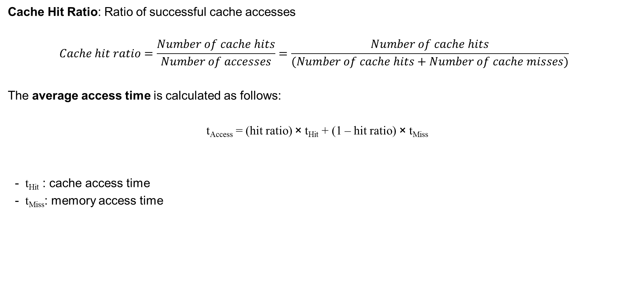
Definitions
Cache Hit Ratio: Ratio of successful cache accesses
$$Cache hit ratio=\frac{Number of cache hits}{Number of accesses}=\frac{Number of cache hits}{(Number of cache hits+Number of cache misses)}$$
The average access time is calculated as follows:
  t_{Access} = (hit ratio) × t_{Hit} + (1 – hit ratio) × t_{Miss}
  t_{Hit} : cache access time
  t_{Miss}: memory access time

Slide 40
Operation of a cache: write
Write access
  In case of a cache miss the CPU writes the data into the cache memory and the main memory.
    This may require a cache replacement strategy.
  In case of a cache hit, i.e., writing into the cache may change the stored data, several policies exist.

Slide 41
Write through policy
  The CPU always writes data into cache and main memory.
Advantage
  Guaranteed consistency between cache memory and main memory.
Disadvantage
  A write access always requires wait cycles and blocks the data bus.
address
μP
DRAM
Cache
data

Slide 42
Buffered write through policy
  Modification of the write through policy.
  A small write buffer for temporary storage of data mitigates the disadvantage of the write through policy.
  The cache controller transfers the data from this small buffer to main memory while the processor continues with its operation.

Slide 43
Write back policy
  The CPU writes data in the cache memory only and marks it with a special bit (altered / modified / dirty bit).
  The cache controller writes back data into main memory only if altered data has to be replaced.
address
μP
DRAM
CPU write
Cache
data
address
μP
DRAM
Write back
Cache
data

Slide 44
Write back policy – pros and cons
Advantage
  Write access can happen without wait cycles at cache memory speed
Disadvantage
  Consistency issues between cache and main memory
  Examples
    Other components of the computer system (e.g. DMA controller) may read outdated data from the main memory, i.e., data the CPU has changed in the cache but not yet transferred to the main memory
    Other components of the computer system may have changed data in main memory, while the CPU still operates on old data stored in the cache
  Relatively complex mechanisms needed to avoid inconsistencies, e.g., by informing the cache controller about changes in main memory – see end of this chapter!

Slide 45
Questions & Tasks
  Where can you find caches? Also outside of computers?
  What is an ideal cache?
  Why using Harvard or v. Neumann for caches?
  Why having caches on-chip?
  What is the role of a cache controller?
  What makes caches efficient?
  Write back seems to be more complex – why using this scheme?

Slide 46
Architecture of cache memory
Cache

Slide 47
General architecture of cache memory
Address bus
Comparator
Data memory
Address
Data
Address memory
Data bus

Slide 48
Components of cache memory 1
A cache memory consists of (at least) two memory units
  Data memory
    Contains all data stored in the cache
  Address memory
    Contains the addresses in main memory of the stored data in the cache
Typically,
  each entry in the cache memory consists of a block of data, the so-called cache line (e.g. 64 byte)
  with each word the CPU accesses, the cache controller loads a larger part of the main memory comprising this word to benefit from spatial locality
  the address stored in the address memory is the base address of this larger copy of the main memory

Slide 49
Components of cache memory 2
A comparator checks, if the data belonging to an address on the address bus is stored in the cache memory
  this requires a comparison of the address on the address bus with the base address plus the range of the memory it represents
This comparison must be very fast (within a cycle) – otherwise the cache would not be efficient.
Associative memory (also known as content addressable memory) plays an important role (for smaller caches).

Slide 50
Blocks, lines, sets, frames …
Block frame
  Memory in the cache for data plus address tag and status bits.
  The address tag contains the memory address (physical or virtual) of the currently stored copy of data from the main memory.
  The status bits indicate if the entry is valid.
Block size or line size
  Number of bytes within a block frame
Block or cache line
  The data that fits into a block frame,
  e.g., 32, 64 or 128 byte
All the block frames can be subdivided into sets.
line size
adr
s
cache line
s
adr
s
cache line
frames
sets
adr
s
cache line
s
s

Slide 51
Associativity
Number of block frames per set
The total number c of block frames in a cache is the product of the number s of sets and the associativity n, thus c = s * n.
A cache is called
  fully associative, if it consists of a single set only (s = 1, n = c)
  direct mapped, if each set consists of a single frame only (n = 1, s = c)
  n-way set associative, otherwise (s = c / n)
Cache memory
n
Set 1
n
Set 2
n
Set s

Slide 52
Replacement policies
In case of a cache miss the controller may have to evict a cache line to make room for the new entry.
  May require a write back into main memory if changed.
The replacement policy determines which entry to evict.
Only fully or n-way set associative caches need a replacement policy.
Typically, caches use simple policies
  Least Recently Used (LRU)
  Least Frequently Used (LFU)
  Optimum: evict the entry that will not be needed for the longest time in the future
  https://en.wikipedia.org/wiki/Cache_replacement_policies

Slide 53
Fully associative cache
Main memory
Block 1023
≈
≈
Cache
Tag Block 63
Associative
mapping
≈
≈
Tag Block 1
Tag Block 0
Block 0

Slide 54
Fully associative cache
Capacity: 256 byte
Block = 4 words = 16 byte
31
Address
0
Tag
Byte selection
2
2
28
Word selection
0
Frame
=
Tag
V
D
1
=
2
=
≈
≈
≈
≈
15
=
Valid hit
AND
32
32
32
32
Tag hit
32
Data bus

Slide 55
Fully associative cache
Comparison with all addresses in the address memory of the cache in parallel in a single cycle
Advantage
  A cache line can be placed in an arbitrary frame
  Optimal usage of the cache, choice of replacement policies
Disadvantage
  Requires more hardware (one comparator per frame)
  ➔ feasible only for small caches
  The large flexibility for the mapping requires additional hardware for the replacement policy (which entry to evict if the cache if full)

Slide 56
Direct mapped cache
Main memory
Each block of the main memory is directly mapped
to a certain frame in the cache.
Simple mapping using, e.g., n out of m
bits to determine the frame (m bit addresses).
Block 1023
≈
≈
Block 128
Cache
≈
≈
Index Block 63
Block 64
≈
≈
≈
≈
Index Block 1
Block 1
Index Block 0
Block 0

Slide 57
Direct mapped cache
Capacity: 256 byte
Block = 4 words = 16 byte
Address
31
0
Tag
Index
Byte selection
2
24
4
2
Frame selection
Word selection
0
Tag
V
D
Frame
1
2
≈
≈
≈
≈
≈
≈
15
Valid hit
AND
32
32
32
32
Data bus
=
Tag hit
32

Slide 58
Characteristics of direct mapped caches
Advantages
  Very simple hardware implementation
    A single comparator plus a tag memory
  No replacement policy needed as the mapping is fully determined by a selection of address bits.
Disadvantages
  Eviction of cache entries may be needed even if the cache is not full!
  Thrashing
    If the CPU alternately reads parts of the memory with identical index, those parts evict each other
      E.g. calling subroutines at C000, D600, A200, C000, D700 etc. using bits 4 to 7 as index

Slide 59
N-way set associative cache
N frames together for a set.
Compromise between direct mapped and fully associative cache.
Main memory
Block 1023
≈
≈
Block 64
Cache
≈
≈
Index Block
Set 31
Index Block
≈
≈
Block 32
Index Block
≈
≈
Set 1
Index Block
Set 0
Index Block
Block 1
Index Block
Block 0

Slide 60
2-way set associative cache
Capacity: 256 byte
Block = 4 words = 16 byte
Address
31
0
Tag
Index
Byte selection
2
25
3
2
Set selection
Word selection
Tag
V
D
Frame
Set 0
Set 1
≈
≈
≈
≈
≈
≈
Set 7
=
Valid hit
AND
32
32
32
32
Data bus
=
Tag hit
32

Slide 61
Characteristics of n-way set associative caches
Increased hit ratio due to the possibility to select an entry
  A replacement policy can selected the entry to evict out of n entries
Replacement policies
  Similar to fully associative caches
  Could also be FIFO or random instead of LRU
To find an entry a check of all n tags in parallel having the same index is necessary
  The effort increases with n, for larger n the behavior is similar to an fully associative cache
  Thus, this is a compromise between direct mapped and fully associative caches

Slide 62
Example: Organization of a cache with 8 cache lines capacity
Direct mapped 2-way set associative Fully associative
search search search
only one place for two possible places cache line 12
cache line 12 for cache line 12 can be anywhere
Block # 0 1 2 3 4 5 6 7
Set # 0 1 2 3
Data
Data
Data
1
2
1
2
Tag
1
2
Tag
Tag

Slide 63
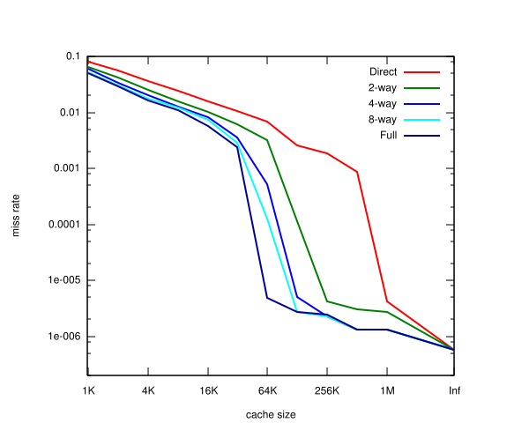
Example: cache hit ratios
Miss rate versus cache size on the Integer portion of SPEC CPU2000
https://www.cs.mcgill.ca/

Slide 64
Some more examples
According to Agarwal, Hennessy and Horowitz:
  A cache hit ratio of 94% can already be achieved with a 64 KiB cache (however, the larger the cache the higher the hit ratio)
  Harvard architecture is helpful for small caches, however do not show big benefits for caches 8 KiB or larger
  For caches 64 KiB or larger direct mapped caches perform similar to 2- or 4-way set associative caches
Only relatively small caches with 32-128 entries are fully associative. Larger caches use direct mapped or 2-/4-way set associative organization.
Be aware: it very much depends on the working set!

Slide 65
Questions & Tasks
  What makes fully associative caches more complex? Why using them at all?
  How could systems avoid thrashing of direct mapped caches?
  What is a typical replacement policy of direct mapped caches?
  What would be the optimal replacement policy?
  What is the trade-off between different n-way set associative caches?

Slide 66
Virtual Memory

Slide 67
Virtual Memory: Motivation
Applications typically need more memory than available as physical RAM
  Especially multi-user, multi-tasking operating systems running many processes in parallel
The operating system has to be able to relocate processes in memory, i.e., fixed physical base addresses are not practical.
Therefore, memory references in instructions of the object code use so-called virtual or logical addresses. Typically, a memory management unit (MMU) translates these addresses into physical addresses during program execution.
  A single process sees a single large address space independent of the other processes.
  This supports memory protection among the processes (one process is not allowed to directly access the memory space of another process; simpler systems come with such a MPU, Memory Protection Unit, only).
  https://en.wikipedia.org/wiki/Memory_management_unit

Slide 68
Basic idea of virtual memory management
CPU
Main memory
Background memory
swapping,
paging
Working sets
Process 1
Process 2
Programs and data

Slide 69
Virtual memory management 1
Operating system
  Manages all free and used fragments of the memory
  Swaps changed fragments of the main memory to the background memory in case of scarce free memory, deletes unchanged fragments to free memory otherwise
  Swaps required fragments of the background memory into main memory on demand.
Translation tables
  Store all the required address mappings
The whole process is transparent to users
  i.e., the working memory appears to be much larger to a user (process) than the RAM is in reality (thus virtual memory)
MMU (Memory Management Unit)
  Supports the OS management of virtual memory by dedicated hardware
  Fast translation of virtual (logical) addresses to physical addresses

Slide 70
Virtual memory management 2
Efficiency is based on the principle of locality of programs (instructions) and data (operands)
  Programs typically used only a small part of the address space during a short time interval.
  This locality during program execution ensures with high probability that data requested by the CPU is stored in the main memory.
Temporal locality
  Data that will be accessed in the near future has
  already been accessed with high probability (e.g. in loops).
Spatial locality
  A future access to data happens within close storage
  locations with a high probability (e.g. sequential access).
That’s basically the same already discussed in the context of caches - but now with a larger granularity!

Slide 71
Mapping of addresses
Name space of
a process
Virtual
address space
Physical address space
Name
Virtual
address
Physical
address
Operating
system and
MMU
Compiler
User: identifies all objects programs, subroutines, variables, … by names
Compiler: translates all names into virtual (logical) addresses
Virtual memory management: translates virtual addresses into physical addresses during runtime depending on the current memory mapping (current real location of the object in the physical memory)

Slide 72
Mapping of virtual addresses
16 bit addresses, e.g. 2¹⁶ addressable memory places.
Real memory only 2¹² byte = 4KiB,
12 bit addresses are enough!

Slide 73
Example
Name JMP somewhere
JMP -128
Logical address 4583
Physical address 23112
Compiler/Assembler
Dynamic address calculation
((PC) - 128)
Virtual memory
management (MMU)

Slide 74
Questions & Tasks
  Considering the memory hierarchy – what does a virtual memory hide?
  What is the role of the OS and the MMU in the context of virtual memory? What else is the MMU good for?
  Compare cache and virtual memory – what do they have in common?

Slide 75
Paging
Virtual memory

Slide 76
Segmentation and paging
There are two basic mechanisms for virtual memory management:
  Paging
  Segmentation – considered legacy (https://en.wikipedia.org/wiki/Memory_segmentation)
Subdivision of the memory into pages
  Subdivide the logical (virtual) and physical address space into segments of fixed length, the so-called pages.
  The pages are relatively small (e.g. 4 KiB, 64 KiB, …) or sometimes large (1 GiB, 16 GiB, …)
  The OS splits a process across several pages without any special context (i.e., a page contains data, no matter what this data represents)
  For more details see OS course!

Slide 77
Pages in virtual and real memory
P
age
Virtual addresses
15
61440 - 65535
14
57344 - 61439
13
53248 - 57343
12
49152 - 53247
11
45056 - 49151
10
40960 - 45055
Bottom 32K of
9
36864 - 40959
P
age
main memory
8
32768 - 36863
fr
ame
Physical addresses
7
28672 - 32767
Mapping of the virtual addresses onto physical addresses!
7
28672 - 32767
6
24576 - 28671
6
24576 - 28671
5
20480 - 24575
5
20480 - 24575
4
16384 - 20479
4
16384 - 20479
3
12288 - 16383
3
12288 - 16383
2
8192 - 12287
2
8192 - 12287
1
4096 - 8191
1
4096 - 8191
0
0 - 4095
0
0 - 4095
(a)
(b)

Slide 78
Translation of virtual to real addresses

Slide 79
Possible mapping of virtual pages
Page table
Virtual page
Page
frame
15
0
0
14
1
4
13
0
0
12
0
0
11
1
5
10
0
0
9
0
0
P
age
8
1
3
Main memory
fr
ame
7
0
0
Vir
tual page 6
7
6
1
7
Vir
tual page 5
6
5
1
6
Vir
tual page 11
5
4
0
0
Vir
tual page 14
4
3
1
2
Vir
tual page 8
3
2
0
0
Vir
tual page 3
2
1
1
0
Vir
tual page 0
1
0
1
1
Vir
tual page 1
0
1 = Present in main memory
0 = Absent from main memory

Slide 80
Paging
Advantages
  Small pages allow for a better use of memory (the OS swaps only those parts of a program that are really needed into RAM)
  Less management overhead compared to segmentation
Disadvantages
  More frequent data transfers compared to segmentation

Slide 81
Challenges
Virtual Memory

Slide 82
Challenges for the virtual memory management
Two main challenges for the swapping of data between main memory and background memory
1. When to swap a page?
  When is the best point in time to swap a page into main memory?
  Common approach
    On demand paging
      Swap a page into main memory as soon as a process tries to access data stored on this page
      The access to data located on a page that is currently not stored in the main memory is called a page fault.
      Page faults cause an interrupt that triggers the OS to suspend the faulting process and to swap the required page into main memory.

Slide 83
Challenges for the virtual memory management
2. Which page to replace?
  In case of a full main memory, which page should the OS replace to free some space for a new page?
  The most common approaches:
    FIFO (first-in-first-out): Replace the oldest page
    LIFO (last-in-first-out): Replace the newest page
    LRU (least recently used): Replace the page that has not been referenced for the longest time
    LFU (least frequently used): Replace the page with the lowest number of references
    LRD (least reference density): Mixture of LRU and LFU – replace the page with the lowest ratio of
    references / age of page in main memory
    Random: As the name indicates – replace an arbitrary page
    https://en.wikipedia.org/wiki/Page_replacement_algorithm
  Additionally, favor unchanged pages
    No writing back required!

Slide 84
Internal fragmentation
Pages always fit into main memory if there is free space (assuming a fixed page size)
However, depending on the page size and typical size of a process or block of data internal fragmentation may happen.
  The OS distributes a process or data in general over several pages
  Assuming a fixed page size the last page of a process will most likely contain unused space
Using different page sizes can give more flexibility but comes with higher complexity.
Process A
File B

Slide 85
Questions & Tasks
  What are the pros and cons of small vs. large page sizes?
  What are the two main challenges of paging?
  Who detects a page fault and what happens in case of a page fault?
  In which situations could random replacement be better than LRU?
  Pages can be “pinned”, i.e. never swapped to secondary storage. Which type of content could be a candidate for such non-swappable (or locked/fixed/wired) pages?

Slide 86
Virtual Memory and Caches

Slide 87
Location of cache and memory management unit
Two possible ways for the integration of a cache using virtual memory management:
Virtual cache
  The cache is located between the CPU and the MMU and operates on virtual addresses, i.e., the cache uses the more significand bits of the virtual address as tags.
Virtual address
Physical
address
CPU
MMU
Main
memory
Cache
Data

Slide 88
Location of cache and memory management unit
2. Physical cache
  The cache is located between MMU and memory and operates on physical addresses, i.e., the cache uses the more significand bits of the physical address as tags
Virtual address
Physical
address
CPU
MMU
Main
memory
Cache
Data

Slide 89
Virtual vs. physical cache
Advantages of a virtual cache
  Cache hits do not require the MMU and, thus, are faster
Advantages of a physical cache
  Often, the physical address uses less bits compared to a virtual address. Therefore, the cache needs to store fewer bits as tag.
  If the MMU is integrated on the CPU chip, only physical cache can be extended.

Slide 90
Memory protection
Many processors offer protection mechanisms to block illegal memory accesses caused by processes during runtime
  integrated features of an MMU or a simplified MPU (Memory Protection Unit)
  The MMU supports the OS for all time-critical functions (fast look-up and translation of addresses, checking legal/illegal memory accesses)
How to protect the memory?
  The MMU knows which process is allowed to access which addresses
  Separation of system software (OS, I/O-system etc.) from user processes
  Separation of different user processes with clear interfaces and controlled methods for data exchange (e.g. via the OS)
  Several protection layers with dedicated access rights.
  More information given in the OS course!

Slide 91
Questions & Tasks
  Many different processes can operate in their respective virtual address spaces in parallel. The OS and MMU separate these address spaces. But what happens with a virtual cache in case of a process (context) switch?
  What is the idea of an MPU and why should even the simplest “thing” in the Internet of Things have one?

Slide 92
Memory in multi processor systems

Slide 93
Basics
Multiprocessor systems or multiprocessor computers belonging to the MIMD class according to Flynn’s classification.
Shared memory multiprocessor systems
  Shared address space between all processors
  Communication and synchronization via shared variables
  Symmetric multiprocessor system
    Common address space, single global memory
  Distributed shared memory system
    Common address space, physically distributed memory
Message passing multiprocessor systems
  Physically distributed memory only plus local address spaces for all processors
  Communication and synchronization done via message passing between the processors
N.B.: “memory” here references to the main memory of a system, not caches

Slide 94
Configurations
Global memory
Physically distributed memory
Processor
Processor
Processor
Processor
Local
memory
Local
memory
Shared address space
Interconnect
Shared memory
Interconnect
Symmetric multiprocessor
Distributed shared memory multiprocessor
Prozessor
Prozessor
Local
memory
Local
memory
Distributed address space
Empty
send
receive
Interconnect
Message passing (shared nothing)
multiprocessor

Slide 95
Shared memory multiprocessor systems
Uniform memory access (UMA)
  All processors access the same common memory.
  Particularly, the access time to the common memory is the same for all processors
  Each processor may additionally have a local cache.
  Typical example: symmetric multiprocessing (SMP, https://en.wikipedia.org/wiki/Symmetric_multiprocessing)
  https://en.wikipedia.org/wiki/Uniform_memory_access
Non-uniform memory access (NUMA)
  The memory access time depends on the memory location relative to the processor.
    Access time to local memory lower compared to remote memory access.
  The different memory modules are physically distributed over the computer system.
  Typical example: distributed shared memory systems (DSM)
  https://en.wikipedia.org/wiki/Non-uniform_memory_access

Slide 96
Message passing multiprocessor systems
Similar to shared memory one can distinguish between
  Uniform communication architecture / uniform message passing
    The transmit time of equal sized messages is the same between all processors
  Non-uniform communication architecture / non-uniform message passing
    The transmit time of equal sized messages depends on the sending and receiving processor

Slide 97
Performance metrics for parallel systems
  The overall execution time T of a parallel program is the time between the start of the program on one of the processors P_{i} until the final execution of the program on the last processor running that program.
  During program execution all processors are in one of the three states: computing, communicating or idle.
P₁
P₂
P₃
P₄
T
time

Slide 98
Execution time T
The execution time T of a parallel program on a dedicated computer (i.e., we do not consider the OS, multi user, interrupts etc. here) comprises:
  Computation time T_{comp}
    Time for the “real” operations needed for the problem
  Communication time T_{comm}
    Time for sending and receiving messages including overheads
  Idle time T_{idle}
    Waiting time (waiting for sending, receiving, synchronization)
Overall execution time: T = T_{comp} + T_{comm} + T_{idle}

Slide 99
Transmission time of a message T_{msg}
The time required for sending a message of a certain size between two (or more) processors.
Each message is comprised of several words or data packets of typically equal size.
The communication time of a message comprises
  Message startup time t_{s}
    Initialization of the communication
  Transfer time t_{w} for each transmitted word or data packet
    Depends on the data rate of the communication medium

Slide 100
Transmission time of a message T_{msg}
The overall transmission time of a message consisting of L words: T_{msg} = t_{s} + t_{w} L
time
t_{w}
t_{s}
L

Slide 101
Some definitions
P(1): Number of executed operations of a program on a single processor system.
P(n): Number of executed operations of a program on a multiprocessor system with n processors.
  Both programs, the one on the single processor system and the one on the multiprocessor system have the identical functionality.
  Furthermore, for simplification we assume operations of equal duration.
T(1): Execution time on a single processor system in cycles or time units.
T(n): Execution time on a multi processor system with n processors in cycles or time units.

Slide 102
Basic findings
T(1) = P(1)
  Assuming a simple single processor system (not super scalar etc.) a single operation requires on cycle.
T(n) ≤ P(n)
  A multi processor system with n processors (n ≥ 2) can execute in a single cycle more than one operation.
This is all simplified: assuming an average operation, no super scalar processors etc.

Slide 103
Speed-up and efficiency
Speed-up
Efficiency
T(1): Execution time on a single processor system in cycles or time units.
T(n): Execution time on a multi processor system with n processors in cycles or time units.
Normal case: 1 ≤ S(n) ≤ n
Degradation: S(n) < 1
Synergy: S(n) > n
Typically: 1/n ≤ E(n) ≤ 1

Slide 104
The speed-up depends on the algorithm
The definition of the terms speed-up and efficiency can be independent of the algorithm or dependent of the algorithm.
Absolute speed-up / absolute efficiency
  Compare the best known sequential algorithm on a single processor system with the best known parallel algorithm on a multiprocessor system
Relative speed-up / relative efficiency
  Use the best known parallel algorithm in a sequential fashion and measure the run-time on a single processor system.
  This includes the required overhead for parallelization such as communication and synchronization (although not needed on a single processor system).

Slide 105
Scalability of parallel computer systems
Adding more computing resources (cores, processors) leads to reduced execution time without changing the program.
Ideal: Linear increase of the speed-up with an efficiency close to 1.
  Example: double the number of processors to half the execution time
Important for the scalability is the problem size.
  If the problem is too small it will not scale.
If the number of processors increases and the problem size is fixed, the system will go into saturation at a certain number of processors.
  Scalability is limited – even worse, after saturation performance degradation may take place.
  If the problem can be scaled with the number of processors this effect should not happen

Slide 106
Definitions
Overhead for the parallelization:
Always some overhead for parallel programming:
Parallel index I(n) (How “parallel” is my program?)

Slide 107
Definitions
Utilization
  Normalized parallel index
  Describes how many operations each
  Processor executed on average per time unit
  R(n): Overhead for parallelization
  E(n): Efficiency
  P(n): Number of executed operations of a program on a multiprocessor system with n processors
  T(n): Execution time on a multi processor system with n processors in cycles or time units.

Slide 108
Conclusions
All expressions equal 1 for a single processor (n = 1).
The parallel index gives an upper limit for the speed-up
The utilization gives an upper limit for the efficiency:

Slide 109
Example I
A (simplified) single processor system requires for the execution of 1000 operations 1000 cycles.
A multiprocessor system with 4 processors may require 1200 operations, but needs only 400 cycles to execute.
Therefore
  P(1) = T (1) = 1000, P(4) = 1200 and T(4) = 400
This results in
  S(4) = 2.5 und E(4) = 0.625
This means that each processor contributes with 62.5% to the speed-up.
  Again, assuming a problem and algorithm that distributed equally over all processors.

Slide 110
Example II
I(4) = 3 und U(4) = 0.75
  That means, that on average only 3 processors compute at the same time or each processor is active only 75% of the time.
R(4) = 1.2
  The overhead using the parallel computer is 20%, i.e., the computation on the parallel computer requires 20% more operations compared to the computation on the single processor system.

Slide 111
Amdahl’s Law (1967, Gene Amdahl)
a = Portion of the program that can only be executed sequentially
Remark: Synchronization and communication ignored!
https://en.wikipedia.org/wiki/Amdahl%27s_law

Slide 112
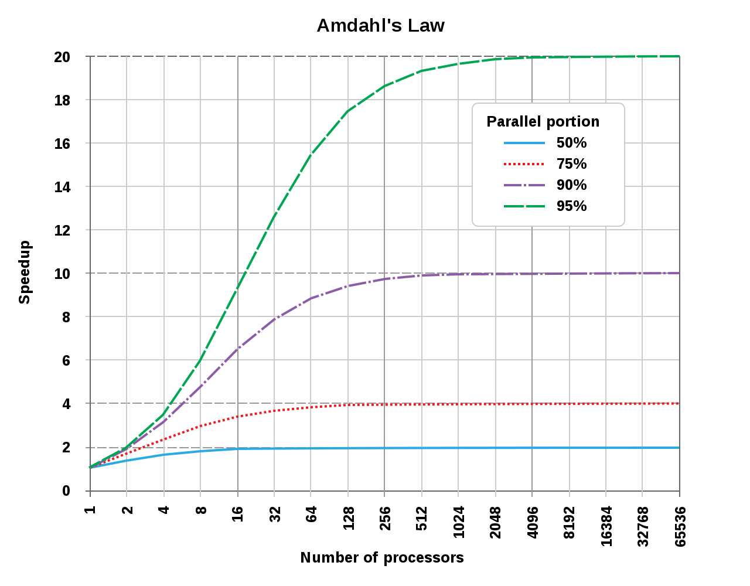
Discussion of Amdahl’s Law
Following Amdahl’s Law a small portion of sequential operations can limit the speed-up of a parallel computer significantly.
Example:
  a = 1/10, i.e. the computer can execute 10% of the program only in a sequential fashion
  ➔ The maximum speed-up of the program can be 10 compared to a purely sequential program.
This can bee seen as an argument against multiprocessor systems
However:
Many parallel programs have only a very small sequential portion
Caches not considered
https://en.wikipedia.org/wiki/Amdahl%27s_law#/media/File:AmdahlsLaw.svg

Slide 113
Synergetic effects or super linear speed-up (S>n, E>1)
Theory: a super linear speed-up is impossible
  A single processor system can simulate every parallel algorithm by emulating all the operations of the parallel processors in a loop.
However, a super linear speed-up can be observed in real systems, e.g.,
  A single processor computer can not keep all data in the main memory thus requiring frequent paging.
  Using a multiprocessor system the data is distributed over different main memories and may even fit into the caches thus paging is not necessary and sometimes even fewer main memory accesses.

Slide 114
Consequences
It is difficult to directly compare single and multi processor systems as the latter quite often come with n times the memory for n processors.
If the problem scales, more processors can compute the same problem in less time plus due to higher memory capacity larger problems can be computed.
Quite often theory assumes an infinite memory, but real systems may show a super linear behavior!

Slide 115
Potential problems of multiprocessor systems
Management overhead with an increasing number of processors
Deadlocks due to resource conflicts
Bottlenecks, effects of saturation due to limited resources

Slide 116
Questions & Tasks
  From a programmer’s perspective, what are the main differences between shared memory and message passing multiprocessor systems?
  What are the pros and cons of a single global memory compared to a distributed memory?
  What about scalability when you compare shared memory vs. message passing systems?
  How does the “ideal” problem look like when executed via a highly distributed parallel computer system? Which parameters of the execution time should be optimized?
  Why is there a saturation effect – or sometimes even performance degradation in parallel systems?
  What is a scalable problem?

Slide 117
Interconnects
Memory in multi processor systems

Slide 118
Interconnects
Connection between processors and/or memories
Static networks
  Hard-wired interconnects between different pairs of nodes (processor, memory) of a network
Dynamic networks
  Contain some switching component that interconnects all nodes
  There is no hard-wired connection between two components

Slide 119
Classification of interconnects
Interconnect
static
dynamic
…
…
One
dimensional
Two
dimensional
Three
dimensional
N-
dimensional
Banyan
network
Bus
Crossbar
switch

Slide 120
A classical dynamic interconnect: bus
Shared memory multiprocessor with a single bus and local caches
Pro
-
Pro
-
cessor
...
cessor
Cache
Cache
Cache
Cache
Bus
Shared memory

Slide 121
Dynamic high performance interconnect: crossbar switch
A crossbar switch
  Hardware that enables the communication between disjoint pairs of components (processors and/or memories) to communicate simultaneously without blocking.
  A single switch in the switching matrix connects dynamically two components for a certain time.
  An n x n crossbar switch allows for the simultaneous, non-blocking communication of n disjoint sender/receiver pairs.

Slide 122
Cache coherence
Memory in multi processor systems

Slide 123
The cache coherence problem
What happens if several components read and write the content of the same addresses in main memory and/or caches?
  Which write is valid? What to read after several writes? Does this depend on the memory or cache?
Coherence
  Defines the behavior of reads and writes to a single address (word, variable, memory location)
  The computer system has to proceed in a deterministic way by guaranteeing that each read operation always fetches the most current update of the content at a single address location.
  Outdated content, eventually stored in a cache or main memory, must not be used!
  However, the content of a single address location stored at several caches and the main memory may be inconsistent (as long as no processor reads this data…)
  https://en.wikipedia.org/wiki/Cache_coherence
Consistency
  A memory system is consistent if all copies of the content of a single address are identical at all locations (i.e. all caches and the main memory)
  This guarantees coherence, but at a high effort …

Slide 124
Why differentiating between consistency and coherence?
As soon as a processor updates a variable in the cache only and not in main memory a data inconsistency occurs between main memory (old data) and cache (updated data).
  This is caused by the more efficient write-back cache policy that tries to minimize main memory access.
  The alternative write through policy avoids this problem, but puts a heavy load on the data bus and main memory.
In order to keep all copies of a variable/memory word consistent (in all caches and main memory) the system would require many (potentially useless) update operations!
Trick
  Allow inconsistencies in a limited fashion.
  Use a dedicated so-called cache coherence protocol to ensure cache coherence.
  This protocol has to ensure that the system always reads the newest content of a variable and never outdated content.

Slide 125
Cache coherence protocols
Write update protocol
  As soon as one processor updates a copy of the content of single address location (e.g. a variable) in a cache the system has to update all copies in all other memories
  The system may delay this updating up to an access to the content of this address
  This requires sending the data over an interconnect to the other memory location
Write invalidate protocol
  Before changing the copy of data in a cache memory the system declares all other copies in caches as invalid
  No direct updates, but … see MESI!
Symmetric multiprocessor systems quite often use a write invalidate cache coherence protocol with write back caches. This puts only minimal load on the system interconnect.

Slide 126
The MESI protocol: basics
Snooping
  All caches monitor all read and write accesses
  on a common bus (or other type of broadcasting interconnect)
The snooping logic monitors all addresses other processors put on the common bus
If the snooped address matches with an address stored in the cache
  In case of a snooped write and the cache entry is unmodified (only read so far)
    Declare cache entry as invalid
  In case of a snooped read or write and the cache entry is modified
    Snoop logic takes over bus control, writes back the cache entry to main memory and then allows the snooped transaction to proceed
MESI – the foundation of the most prominent write invalidate protocols (comes in many flavors)
  https://en.wikipedia.org/wiki/MESI_protocol

Slide 127
The MESI protocol: states
The following states of a cache line form the acronym MESI:
  (Exclusive) Modified
    A write modified the cache line from the content in main memory (i.e. the line is dirty)
    The cache line is present in this cache only
    A write back to main memory is required before any other cache reads the cache line from main memory
  Exclusive unmodified
    The cache line is present in this cache only and matches the content in main memory (i.e. it is clean)
    A read access transferred the cache line from main memory
  Shared (unmodified)
    Copies of the cache line are in more than one cache for read access
    But all copies of the cache line still match the content in main memory (i.e. they are all clean)
  Invalid
    The cache line is invalid or unused

Slide 128
The MESI state diagram – two bits per cache line in each cache
SHR
RH
Read hit
RMS
Read miss, shared
SHW
Shared
RME
Read miss, exclusive
Invalid
unmodified
WH
Write hit
RMS
RH
WM
Write miss
SHR
Snoop hit on a read
SHW
Snoop hit on a write or
RME
WH
read-with-intent-to modify
WM
SHR
SHW
+
Dirty line
copyback
SHW
SHR
Invalidate transaction
+
Exclusive
Exclusive
Read-with-intent-to-modify
WH
modified
unmodified
RH
RH
Cache line fill
WH

Slide 129
MESI example
ld 4711
ld 4711
st 4711
P1
P2
ld 4711
RH
Read hit
RMS
Read miss, shared
RME
Read miss, exclusive
WH
Write hit
Shared
unmodified
Exclusive
modified
Shared
unmodified
Exclusive
unmodified
Shared
unmodified
Shared
unmodified
WM
Write miss
5
Invalid
1
5
SHR
Snoop hit on a read
1
SHW
Snoop hit on a write or
read-with-intent-to modify
WH
RME
SHR
SHR
RMS
SHW
RMS
5
1
Main memory
4711
4711

Slide 130
Yet another MESI example I
CPU1
CPU2
CPU3
CPU4
CPU5
I
CPU 1 reads block A
into cache
A
Exclusive
CPU1
CPU2
CPU3
CPU4
CPU5
CPU 2 reads block A
⇒ CPU 1 broadcasts on bus
that it holds a copy of A
II
A
A
Shared
Shared
CPU1
CPU2
CPU3
CPU4
CPU5
CPU 2 writes block A
(only in cache, not in main memory!)
⇒ CPU 2 broadcasts an invalid signal
III
A
Modified

Slide 131
Yet another MESI example II
CPU1
CPU2
CPU3
CPU4
CPU5
CPU 3 reads block A
⇒ CPU2 snoops write access
CPU2 stops CPU3 via a signal
CPU2 writes back to main memory,
CPU3 reads from main memory
IV
A
A
Shared
Shared
CPU1
CPU2
CPU3
CPU4
CPU5
V
A
CPU 2 writes block A
Modified
CPU1
CPU2
CPU3
CPU4
CPU5
CPU 1 writes block A
CPU2 stops CPU1 via a signal
CPU2 writes back to main memory
CPU1 reads from main memory
with intend to modify
VI
A
Modified
Invalid

Slide 132
Questions & Tasks
  What are the pros and cons of static vs. dynamic interconnects?
  What would cache consistency mean for the system?
  Why is a write invalidate protocol so efficient?
  What is a prerequisite for snooping to be effective?
  Why is there no shared modified state in MESI? What would this mean?
  Why to distinguish between shared and exclusive unmodified? Why not simply a state unmodified?
  MESI has no problems if two consecutive writes take place on the same cache line done by two different processors. What can happen? Who has to solve potential problems?

Slide 133
Configurations
Global memory
Physically distributed memory
Processor
Processor
Processor
Processor
Local
memory
Local
memory
Shared address space
Interconnect
Shared memory
Interconnect
Symmetric multiprocessor
Distributed shared memory multiprocessor
Prozessor
Prozessor
Local
memory
Local
memory
Distributed address space
Empty
send
receive
Interconnect
Message passing (shared nothing)
multiprocessor

Slide 134
Distributed shared memory multiprocessor systems
DSM (Distributed shared memory)
  All processors share a single address space, i.e. the same physical address on two different processors belong to the same location in memory
  However, the systems distributes the memory modules over all processors
  https://en.wikipedia.org/wiki/Distributed_shared_memory
Consequence
  The access to local memory is typically much faster than the access to remote memory (i.e. the local memory of another processor) ⇒ Belongs to the NUMA class
    https://en.wikipedia.org/wiki/Non-uniform_memory_access
Typically, the processors have one or more levels of cache memory (plus sometimes a non-shared private memory).
  It is quite common to have cache coherent NUMA systems (ccNUMA)
    Cache coherence via explicit communication between cache controllers or versions of MESI
  Non cache coherent NUMA (nccNUMA) is simpler to build, but more difficult to program

Slide 135
ccNUMA, COMA, nccNUMA (I)
ccNUMA (cache coherent Non-Uniform Memory Access):
  All caches of the system are coherent
  If the access to remote data causes a local cache miss the system transfers the remote data to the local cache
  MESI-type cache coherence protocols / directory-based protocols required
  See, e.g., SCI (scalable coherent interface) and several processor architectures (often historical)
COMA (Cache-Only Memory Architecture):
  Special case of ccNUMA: no more (distributed) main memory with copies of data in caches and address space allocated to main memory
  If needed, the system migrates data to the cache of the processor requesting the data (i.e. the initial placement of data changes over time)
  See experimental computers like Data Diffusion Machine, KSR-2 in the 80s/90s

Slide 136
ccNUMA, COMA, nccNUMA (II)
nccNUMA (non cache coherent Non-Uniform Memory Access)
  No system-wide cache coherence, no cache coherence protocol
    I.e. no cache coherence protocol between different processors
    However, local cache coherence between local cache and main memory
  Much simpler hardware, no snooping or directory-based protocols
  Different commands for access to local data (in the cache) and remote data (in other caches or main memory)
  Requests for remote data bypass the local cache
  Coherence of a program must be ensured by software (e.g. mutexes)!

Slide 137
Two types of distributed shared memory multiprocessor systems
Access to memory is transparent from a program’s point of view
  Common for ccNUMA systems
  Specialized hardware must distinguish between local memory access and remote memory access
Remote access to memory requires special commands
  Common for nccNUMA systems
  Requires the extension of the instruction set of a processor

Slide 138
Configurations
Global memory
Physically distributed memory
Processor
Processor
Processor
Processor
Local
memory
Local
memory
Shared address space
Interconnect
Shared memory
Interconnect
Symmetric multiprocessor
Distributed shared memory multiprocessor
Prozessor
Prozessor
Local
memory
Local
memory
Distributed address space
Empty
send
receive
Interconnect
Message passing (shared nothing)
multiprocessor

Slide 139
Message passing multiprocessor systems
There are no shared memories or common address spaces in message passing systems.
Communication happens via message exchange over an interconnect and/or other processors.
All processors have a local memory only.
Processor nodes typically connect to other nodes via point-to-point connections.
Scalability is (in theory) unlimited.
Efficient support of parallel computing is on program/process level.
Parallel computing on thread or instruction level is not efficient due to the large overheads.

Slide 140
Distributed Systems / distributed computing
One step further away from the concrete hardware system and network topology.
A distributed system is a set of networked computers which communicate and coordinate via message passing to achieve a common goal.
  Distributed program / distributed programming
Much looser coupled system compared to parallel computers.
Often Internet technology used for communication.
  TCP/IP protocol family
Different architectures possible
  Client-server, peer-to-peer, n-tier
https://en.wikipedia.org/wiki/Distributed_computing

Slide 141
Advantages of distributed systems
Reuse of unused/underutilized computers (huge potential!)
Better use of existing resources (large, distributed memory)
Use of heterogeneous hardware possible (even specialized components possible)
  Sub-programs can be placed on dedicated, specialized computers (e.g. graphics, data bases etc.)
It is relatively easy to extend a virtual parallel computer based on several servers/workstations/computers in general by more and more other computers.
Standard computers can be used for program development.
Standardized interfaces for message passing exist for distributed systems and parallel computers providing source code compatibility
  Started with PVM: parallel virtual machine, https://en.wikipedia.org/wiki/Parallel_Virtual_Machine
  then MPI: message-passing interface, https://en.wikipedia.org/wiki/Message_Passing_Interface
Fault tolerance: faulting machines will/should not bring down the whole distributed system

Slide 142
Disadvantages of distributed systems
More difficult to ensure security
  Difficult to operate on distributed, encrypted data using different OS, hardware, operators, …
Difficult to give certain QoS (Quality of Service) guarantees (delays, computation time etc.) due to heterogeneous networks and computing hardware
Use of (relatively) high-level interfaces (e.g. socket interfaces using UDP/TCP)
Relatively slow communication over the network
  Supports only coarse grained parallelism with little communication
  Specialized communication hardware exists, but often replaced by Ethernet
Newer technologies/interfaces exist (sometimes for dedicated purposes)
  E.g. Hadoop (https://en.wikipedia.org/wiki/Apache_Hadoop),
  Spark (https://en.wikipedia.org/wiki/Apache_Spark), Flink (https://en.wikipedia.org/wiki/Apache_Flink)

Slide 143
Grid computing
Widely distributed computers used for a common task.
  Computing resources as easy to access as electrical power (“power grid”)
  (Autonomous) resources loosely coupled via the Internet (or dedicated high performance connections)
  Different (international, public/private) organizations (or individuals) form a virtual organization for the common task
  Typically consists of many super-computer centers interconnected
  Examples: grand challenge problems such as earthquake predictions, protein folding, search for extraterrestrials… but also CERN, Bitcoin
  https://en.wikipedia.org/wiki/Grid_computing
Cloud computing
  Also widely distributed data centers, but they typically belong to one organization
  Used for storage and computation
  https://en.wikipedia.org/wiki/Cloud_computing
Edge computing
  The cloud comes closer to the customer to reduce latency
  https://en.wikipedia.org/wiki/Edge_computing

Slide 144
…and some more computer systems
Embedded Systems
  Hardware and Software are components of a bigger system, e.g. plant and process control, robotics, dish washer, ventilator ...
ICT (Information and Communications Technology)
  Hardware and Software are main components of communication networks, multimedia equipment, mobile phones, ...
  https://en.wikipedia.org/wiki/Information_and_communications_technology
Operational Technology
  Use of Hardware and Software for process and asset monitoring in industry
  Industrial control systems like PLC (Programmable Logic Controller), SCADA (Supervisory control and data acquisition), Building Automation Systems…
  https://en.wikipedia.org/wiki/Operational_technology

Slide 145
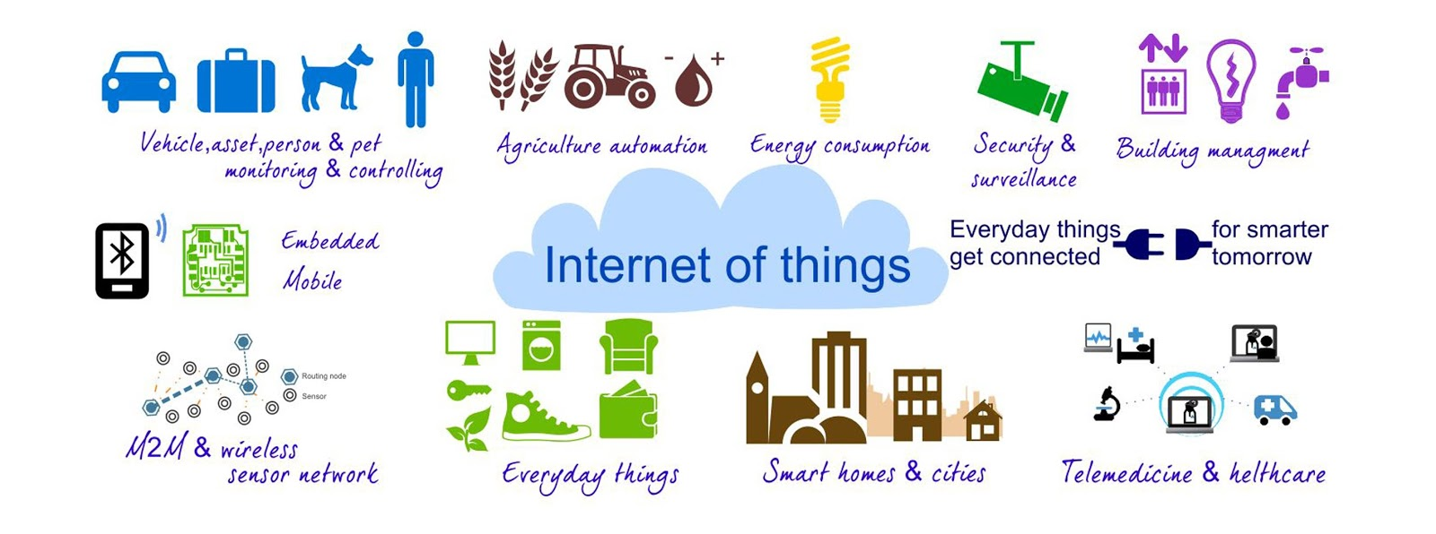
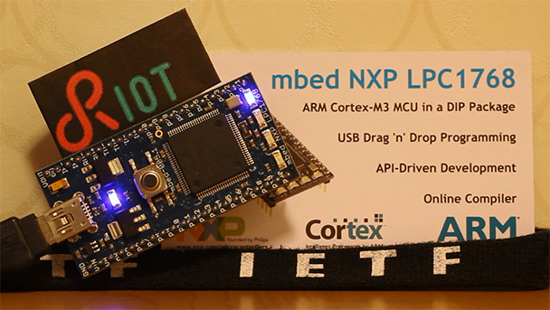
The Internet of Things
Cars, animals, people,
monitoring
Agriculture
Energy
Security,
surveillance
Building automation
Embedded
systems
Machine-to-machine com.,
Sensor networks
Everyday things
Smart Home / City
Health care
Source: The Telecare Blog, thetelecareblog.blogspot.de, 24.10.14
One common technology for everything!
Source: RIOT OS, www.riot-os.org
1,5 kByte RAM, 5 kByte ROM,
real-time, multi-threaded

Slide 146
Questions & Tasks
  What is the difference between a symmetric multiprocessor and a distributed shared multiprocessor? What do they have in common? Pros and cons?
  What are the advantages and disadvantages of cache coherence?
  How to really scale computer systems?
  What type of problems are well suited for distributed systems and when to use a super computer?
  What are pros and cons of distributed systems?
  The terms are somewhat fuzzy, but what distinguishes grid from cloud and edge computing?
  What is specific about embedded systems?

Slide 147
Summary
Memory hierarchy
Main memory
Cache memory
Virtual memory
Multiprocessor systems
Distributed systems

Slide 148
Content
Introduction
  Single Processor Systems
  Historical overview
  Six-level computer architecture
Data representation and Computer arithmetic
  Data and number representation
  Basic arithmetic
Microarchitecture
  Microprocessor architecture
  Microprogramming
  Pipelining
Instruction Set Architecture
  CISC vs. RISC
  Data types, Addressing, Instructions
  Assembler
Memories
  Hierarchy, Types
  Physical & Virtual Memory
  Segmentation & Paging
  Caches

