Slide 1

CONTENT of this CHAPTER
DNS
HTTP and WWW
EMAIL
SNMP

Slide 2
Electronic Mail (Email)
The first killer application of the Internet!
Early systems started in the 1980s
Mail via command line of a terminal: simple file transmission took place, with the convention that the first line contains the address of the receiver of the file.
Rise of webmail in the 1990s
Hotmail popularized web-based email access service, launched in 1996
Rise of mobile email in the 2000s
The first killer app for mobile Internet, before the advent of smartphones!
Merging email/IM/SMS/posts in the 2010s
Social networks are currently trying to “swallow” email (and everything else too)
Notes:
Mail command in linux: (you can still run that nowadays)
mail -s “Hello world” you@youremailid.com
echo “This will go into the body of the mail.” | mail -s “Hello world” you@youremailid.com
So if you just listen to the communication channel during the Authorization phase: with a little luck you can hear in clear text the user/pass from the client!!
In the example login=alice, and pass=hungry
That‘s why people have worked on security extensions of these protocols.
But at the beginning, the goal was not high security standards, but just the basic email functionality.
This is the typical story why Internet protocols are often secured in a second phase, not natively, although people try to change that nowadays.

Slide 3
Electronic Mail (Email): Architecture
User Agent (UA)
Message Transfer Agent (MTA)
User Agent (UA)
Email clients
Runs on the computer of the user
Intermittently on
Receipt and presentation of email
Compose new or answer received email
Implementations: Thunderbird, Outlook…
Message Transfer Agent (MTA)
Email servers
Runs on a remote machine
Stores/forwards emails on behalf of UAs
Always on, but best-effort service
UAs each attach to an MTA
Implementations: Microsoft Exchange, Zimbra, Open-Xchange…
User Agent (UA)
Internet
Message Transfer Agent (MTA)
User Agent (UA)
Notes:
Best Effort:
If MTA1 needs to forward an email to MTA2 that is currently unreachable, it tries to resend periodically (until it gives up).
No guarantee that the email will reach destination in time or at all.
Sometimes you get an error message. But no always.

Slide 4
Electronic Mail (Email): Architecture
Phase 1: email transfer
Phase 2: email access
Message Transfer Agent (MTA)
User Agent (UA)
Sender
Internet
Message Transfer Agent (MTA)
User Agent (UA)
Destination

Slide 5
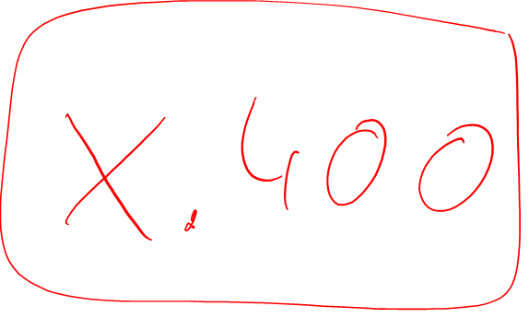
About Electronic Mail (Email)
Transfer: email push with SMTP
Access: email pull with POP3, IMAP or HTTP
Email Format

Slide 6

Email Transfer: SMTP
Mail Submission Agent (MSA)
SMTP
Message Transfer Agent (MTA)
Simple Mail Transfer Protocol (SMTP)
RFC 5321
Sends messages through port 25
SMTP is a simple ASCII protocol
No checksums, no encryption
SMTP uses port 587 to reach MSA (RFC 6409), with authentication
User Agent (UA)
Sender
Internet
SMTP
Message Transfer Agent (MTA)
User Agent (UA)
Destination
Notes:
Initially another spec, X.400 was proposed as standard for email transfer.
This specification was however too complex and badly designed.

Slide 7
Email Transfer with SMTP
sender
User 1: writes an email
Client 1 (UA 1): formats the email, produces the receiver list, and sends the email to its mail server (MSA of MTA 1, through port 587)
Server 1 (MTA 1): Sets up a connection to the destination’s SMTP server (MTA 2) on port 25 and sends a copy of the email
Server 2 (MTA 2): Produces the header of the email and places the email into the destination’s mailbox
SMTP
MSA
MTA 1
SMTP
Internet
MTA 2
destination
Notes:
Email has functionned just like that for many years, with MIME dealing with non-ASCII email content.
However, it‘s basic email service.
E.g. no encryption etc.

Slide 8

SMTP Command Sequence between MTAs
Example of communication between two MTAs (from abc.com to beta.edu) - Messages are in ASCII 7 bits.
S: 220 <beta.edu> Service Ready
/* Receiver is ready/*
C: HELO <abc.com>
/* Identification of the sender/*
S: 250 <beta.edu> OK
/* Server announces itself */
C: MAIL FROM:<bob@abc.com>
/* Sender of the email */
S: 250 OK
/* Sending is permitted */
C: RCPT TO:<alice@beta.edu>
/* Receiver of the email */
/* Receiver known */
S: 250 OK
/* The data is following */
C: DATA
S: 354 Start mail inputs; end with “<crlf>.<crlf>” on a line by itself
C: Hi dude, let’s meet at 8PM.<crlf>.<crlf>
/* Transfer of the whole email, including all headers. */
S: 250 OK
C: QUIT
/* Terminating the connection */
S: 221 <beta.edu> Server Closing
S = server, receiving MTA / C = Client, sending MTA
Notes:
You can write whatever you want for MAIL FROM for example, this is not verified in anyway.
The first fake emails were sent like this
Data sent must be in ASCII 7 bits and end by the sequence RETURN . RETURN (crlf = carriange-return line-feed)
This is in-band-signaling from client to server to signal the end of the content of the email.
QUIT: we‘re done. The mail is transfered.
So even today: all that you send, attachments etc. is coded in 7bit ASCII...
Because this is how the standard SMTP protocol is specified!

Slide 9
About Electronic Mail (Email)
Transfer: email push with SMTP
Access: email pull with POP3, IMAP or HTTP
Email Format

Slide 10
Email Access
Still needs to pull emails from your mail server!
Email access protocols
Post Office Protocol version 3 (POP3)
Internet Message Access Protocol (IMAP)
HTTP
Message Transfer Agent (MTA)
User Agent (UA)
Sender
Internet
email access
Message Transfer Agent (MTA)
User Agent (UA)
Destination

Slide 11
Accessing Emails with POP3
Specified in RFC 1939
Pull emails from the server over a connection on port 110
Text-based (ASCII)
Basic functionality. Only:
Logging in/out
Copy emails to the local computer
Deleting emails from the server
Phase 1: Authorization
Commands: USER name, PASS string
Phase 2: Transaction
Commands: LIST [msg], RETR msg, DELE msg, QUIT, NOOP, RSET, STAT
Get emails from the server with POP3
POP3 Server
(MTA)
Client (UA)
connection on port 110
Greetings
Commands
Replies
Notes:
Login/password (no encryption!)
Skip transaction phase.
Then you can only copy emails (download from the server) or delete emails from the server, that‘s it.
No fancy management functionalities, no encryption...

Slide 12

Accessing Emails with POP3: Example
Authorization phase
user identifies the user
pass is its password
+OK or -ERR are possible server answers
Transaction phase
list for the listing of the message numbers and the message sizes
retr to requesting a message by its number
dele deletes the appropriate message
Another retr/dele and then quit
S: +OK POP3 server ready
C: user alice
S: +OK
C: pass hungry
S: +OK user successfully logged in
C: list
S: 1 498
S: 2 912
S: .
C: retr 1
S: <message 1 contents>
S: .
C: dele 1
C: retr 2
S: <message 2 contents>
S: .
C: dele 2
C: quit
S: +OK
Notes:
So if you just listen to the communication channel during the Authorization phase: with a little luck you can hear in clear text the user/pass from the client!!
In the example login=alice, and pass=hungry
That‘s why people have worked on security extensions of these protocols.
But at the beginning, the goal was not high security standards, but just the basic email functionality.
This is the typical story why Internet protocols are often secured in a second phase, not natively, although people try to change that nowadays.
Transaction phase sequence:
Listing of the messages (ID, size in bytes)
Retrieve message 1
Delete message 1
Retrieve message 2
Delete message 2
quit
The drawback is that once the message is deleted, you cannot see it with another client though.
This is one of the reasons why alternative protocol like IMAP was developed.

Slide 13
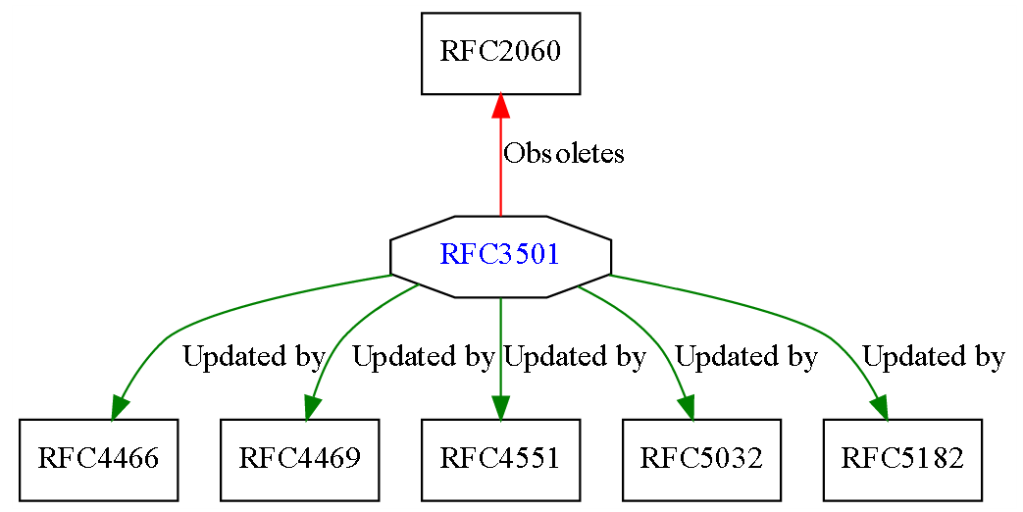
Accessing Email with IMAP
Issues with POP3:
no encryption,
no folders to sort emails,
no efficient of access through more than one host…
Solution: Internet Message Access Protocol (IMAP version 4)
RFC 3501
Most modern email clients implement both POP3 and IMAP
Updated by
Updated by
RFC5738
RFC6186
Notes:
IMAP was developed as a more modern enhancement of POP3.
Today, most mail solutions implement IMAP as specified in RFC 3501.
IMAP can do less things than an Exchange server (does not synchronize calenders/contacts etc. for instance)
But is the default solution nowadays, most email clients feature both POP3 and IMAP.

Slide 14
Accessing Email with IMAP
IMAP protocol details
Connection over port 143
Emails are not downloaded, but remain on the server
The client performs all actions remotely
The vast work is shifted to the server (search, change, delete, ...)
A user can access the same email environment from different hosts
Great for nomadic users
Allows multiple clients for same user
But IMAP is more complex than POP3
Set up and manage remote mailboxes
Download only header or parts of an email
Notes:
Webmail uses HTTP (that we will see next) instead of IMAP, but the email management is similar to IMAP, and most webmail service also provide IMAP and POP access on top of HTTP access (for example you can use Thunderbird as client for gmail).

Slide 15
Accessing Email with HTTP
Webmail
email clients interaction through your browser
HTTP proxy on mail server, used both for mail transfer to MSA and mail access
Popular implementations: Yahoo, Gmail, gmx, web.de…
VERY popular (Gmail has about 500 million active users)
Notes:
Browser -> Proxy Client -> Mail Server, where the "Proxy Client" is the web server.
Gmail: about more than 425 million active users worldwide…

Slide 16
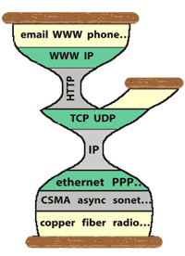
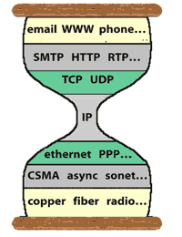
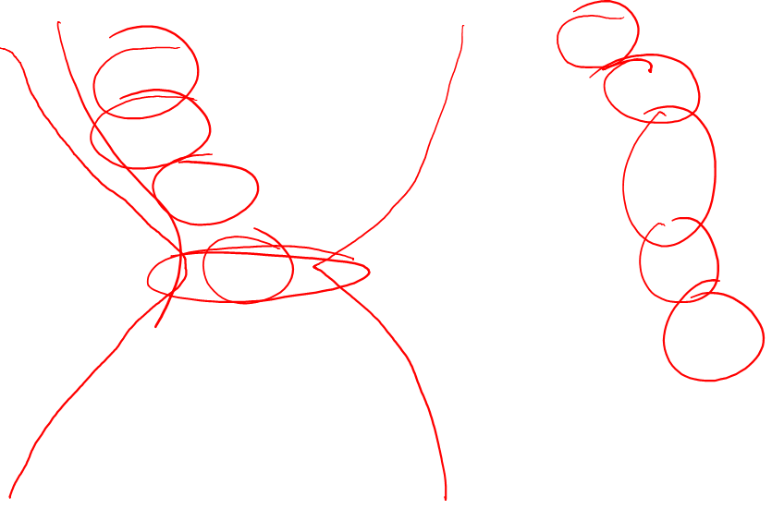
Email, and Many Other Things over HTTP
Email, voice communication, www, video streaming, web services architecture, and even… IP!!
Why? Proxys, firewalls and NATs which block end-to-end communications, except… HTTP traffic!
Is HTTP the new slim waist of the hourglass?
From D. Thaler’s « Evolution of the IP Model », 2009
Notes:
Today devices such as NATs, proxys and firewalls support only UDP and TCP or, even worse, support only HTTP. As a result, many applications and protocols (such as the whole Web Services architecture) today are built on top of HTTP instead of TCP or UDP, and we even see IP over HTTP, resulting in an new slim waist at the application layer.

Slide 17
About Electronic Mail (Email)
Transfer: email push with SMTP protocol
Access: email pull with POP3, IMAP or HTTP
Email Format

Slide 18

Email Structure: Internet Message Format
Information needed from the sender of an email:
The message itself: usually text + attachments
Destination address: generally in the form mailbox@location.com
Optional parameters concerning priority, security, etc.
Internet Message Format (RFC 2822) defines email format as:
a simple “envelope”
created by the Message Transfer Agent based on the data in the email header
a set of header fields
each one line ASCII text
a blank line
the message (Message Body)

Slide 19
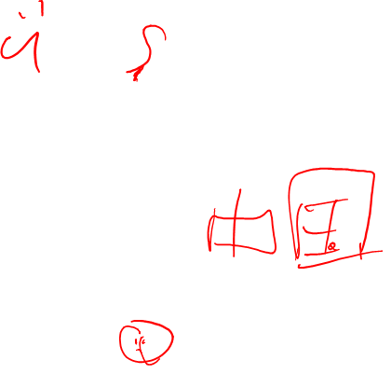
Email Structure: MIME
Problem: RFC 2822 only deals with ASCII text. What about:
Emails in languages with special characters, e.g. French, German, Turkish
Emails in languages not using the Latin alphabet, e.g. Russian, Arabic
Emails in languages not at all using an alphabet, e.g. Japanese, Chinese
Emails not completely consisting of pure text, e.g. audio, video, image
Solution: Multipurpose Internet Mail Extensions (MIME, RFC 2045)
extends the RFC 2822 format
additional headers in the message body and coding rules for non-ASCII characters.
Header Field | Meaning
MIME-Version: | Used version of MIME is marked
Content-Description: | String which describes the contents of the message
Content-Id: | Clear identifier for the contents
Content-Transfer-Encoding: | Coding which was selected for the contents of the email (some networks understand e.g. only ASCII characters). Examples: base64, quoted-printable
Content-Type: | Type/Subtype regarding RFC 1521, e.g., text/plain, image/jpeg, multi-part/mixed
Notes:
There is a basic standard specified in RFC2882 for ASCII-only emails.
But of course there is demand to transport more than ASCII in emails.
So there is an extenstion MIME the specifies a structure for email content other than ASCII.
Here is the header defined by this structure.
Focus on:
Version of MIME
Encoding field: method used to encode the non-ASCII content into ASCII
Type of content (text, image...)

Slide 20

MIME Content Types
Content-Type
Specifies the type of the body in the format: type/subtype. Examples:
Type | Subtype | Description
Text | Plain | Unformatted text
 | Enriched | Text including simple formatting commands
Image | Gif | Still picture in GIF format
 | Jpeg | Still picture in JPEG format
Audio | Basic | Audible sound
Video | Mpeg | Movie in MPEG format
Application | Octet-stream | An uninterpreted byte sequence
 | Postscript | A printable document in PostScript
Message | Rfc822 | A MIME RFC 822 message
 | Partial | Message has been split for transmission
 | External-body | Message itself must be fetched over the net
Multipart | Mixed | Independent parts in the specified order
 | Alternative | Same message in different formats
 | Parallel | Parts must be viewed simultaneously
 | Digest | Each part is a complete RFC 822 message
Notes:
Examples of Content-Type values
Focus on Image: subtypes jpeg or Gif for instance
Video: MPEG
There are a lot of types http://reference.sitepoint.com/html/mime-types-full
There are also some proprietary types like application/msword for word

Slide 21
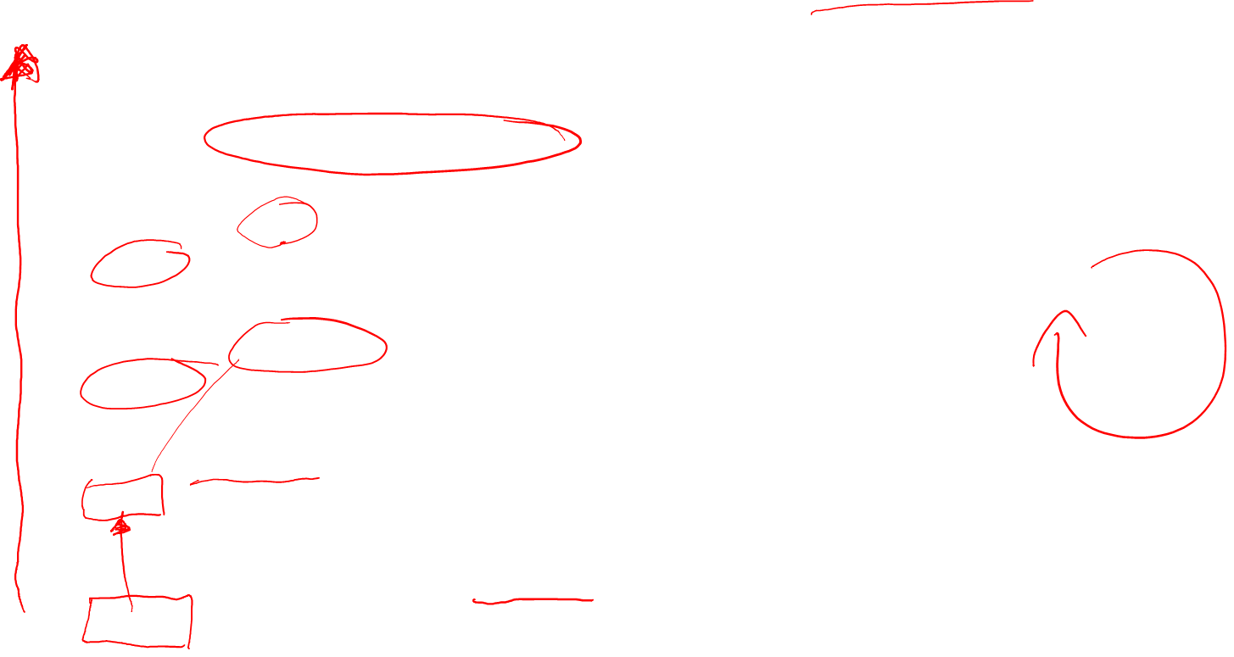
Example Email Header: The Trail of MTAs
Microsoft Mail Internet Headers Version 2.0
Received: from mail.math.fu-berlin.de ([160.45.40.10]) by spree.pcpool.mi.fu-berlin.de with Microsoft SMTPSVC(6.0.3790.3959);
Thu, 24 Jan 2008 17:48:26 +0100
Received: (qmail 9044 invoked by alias); 24 Jan 2008 17:48:26 +0100
Delivered-To: schiller@inf.fu-berlin.de
Received: (qmail 9038 invoked from network); 24 Jan 2008 17:48:26 +0100
Received: from lusin.mi.fu-berlin.de (HELO mi.fu-berlin.de) (160.45.117.141)
by leibniz.math.fu-berlin.de with SMTP; 24 Jan 2008 17:48:26 +0100
Received: (qmail 8626 invoked by uid 9804); 24 Jan 2008 17:48:26 +0100
Received: from localhost (HELO mi.fu-berlin.de) (127.0.0.1)
by localhost with SMTP; 24 Jan 2008 17:48:06 +0100
Received: (qmail 23135 invoked by uid 9804); 24 Jan 2008 17:15:01 +0100
Received: from leibniz.math.fu-berlin.de (HELO math.fu-berlin.de) (160.45.40.10)
by lusin.mi.fu-berlin.de with SMTP; 24 Jan 2008 17:15:01 +0100
Received: (qmail 152 invoked from network); 24 Jan 2008 17:15:01 +0100
Received: from sigma.informatik.hu-berlin.de (HELO mailslv1.informatik.hu-berlin.de) (141.20.20.51)
by leibniz.math.fu-berlin.de with (DHE-RSA-AES256-SHA encrypted) SMTP; 24 Jan 2008 16:15:01 -0000
MTA used by email recipient
Loop! Spam/virus filter running on lusin
from Math server to MI server
from HU to FU
Notes:
An email trail from 2008 in a email header:
Follow the trail bottom up:
From one of Humboldt Universität‘s mail server sigma.informatik.hu-berlin.de to leibniz.math.fu-berlin.de
Then from leibniz.math.fu-berlin.de to lusin.mi.fu-berlin.de
Then from lusin.mi.fu-berlin.de to leibniz.math.fu-berlin.de (loop!! spam filter running in lusin probably?)
Then from math.fu-berlin.de to spree.pcpool.mi.fu-berlin.de which was the mail server used by the email recipient at the time.
Normally no-one is interested in this information, but sometimes it is useful to look at this trail in order to detect problems or email spoofing.

Slide 22

Example Email Header: Continued
Source email server
Received: from ex.sar.informatik.hu-berlin.de (sar.informatik.hu-berlin.de [141.20.23.63])
by mailslv1.informatik.hu-berlin.de (8.13.8+Sun/8.13.8/INF-2.0-MA-SOLARIS-2.10-25) with ESMTP id m0OGEabt015579 for <schiller@inf.fu-berlin.de>; Thu, 24 Jan 2008 17:14:36 +0100 (CET)
X-Envelope-Sender: mm@informatik.hu-berlin.de
X-Virus-Scanned: by AMaViS 0.3.12pre7-L41+ClamAV[8175](NAI-uvscan@mi.fu-berlin.de)
X-Remote-IP: 141.20.20.51
Content-class: urn:content-classes:message
MIME-Version: 1.0
Content-Type: multipart/alternative;
boundary="----_=_NextPart_001_01C85EA4.35AB5B2E"
Subject: RE: Frohes neues Jahr
X-MimeOLE: Produced By Microsoft Exchange V6.5
Date: Thu, 24 Jan 2008 17:14:33 +0100
Message-ID: <BD8398D4C88E2C458083D1D2B04C4DA3207F4A@ex.sar.informatik.hu-berlin.de>
In-Reply-To: <6FE71171187F564EA019A177D00043B230418A@spree.pcpool.mi.fu-berlin.de>
X-MS-Has-Attach:
X-MS-TNEF-Correlator:
Thread-Topic: Frohes neues Jahr
Virus scan information
Subject and Date
Notes:
Next part in the header
Source server: ex.sar.informatik.hu-berlin.de
Virus scan information
Subject:
Date:
MIME version:
Boundary: different parts of the email

Slide 23
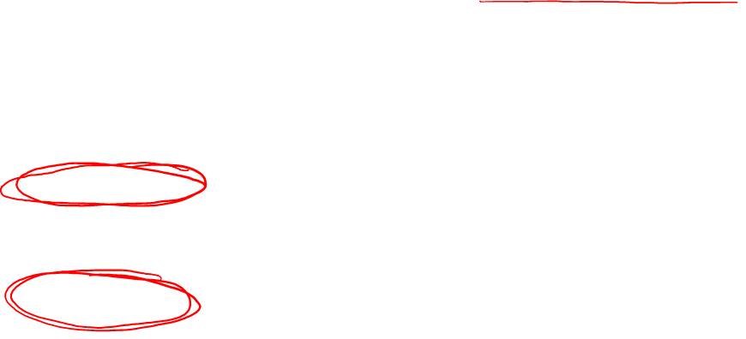
Example Email Header: Continued
Thread-Index: AchNIy4Op6zY/HruSXS/HroQsbGWmgBgaQBwApbvmuABYRONYAAGTKOgAAF20KA=
References: <6FE71171187F564EA019A177D00043B2304027@spree.pcpool.mi.fu-berlin.de> <BD8398D4C88E2C458083D1D2B04C4DA3207E49@ex.sar.informatik.hu-berlin.de> <6FE71171187F564EA019A177D00043B2304108@spree.pcpool.mi.fu-berlin.de> <BD8398D4C88E2C458083D1D2B04C4DA3207F47@ex.sar.informatik.hu-berlin.de> <6FE71171187F564EA019A177D00043B230418A@spree.pcpool.mi.fu-berlin.de>
From: "Max Mustermann" <mm@informatik.hu-berlin.de>
To: "Jochen Schiller" <schiller@inf.fu-berlin.de>
X-Greylist: Sender IP whitelisted, not delayed by milter-greylist-3.0 (mailslv1.informatik.hu-berlin.de [141.20.20.51]); Thu, 24 Jan 2008 17:14:36 +0100 (CET)
X-Virus-Status: No (sigma)
Return-Path: mm@informatik.hu-berlin.de
X-OriginalArrivalTime: 24 Jan 2008 16:48:26.0547 (UTC) FILETIME=[F0AD6030:01C85EA8]
------_=_NextPart_001_01C85EA4.35AB5B2E
Content-Type: text/plain; charset="iso-8859-1"
Content-Transfer-Encoding: quoted-printable
------_=_NextPart_001_01C85EA4.35AB5B2E
Content-Type: text/html; charset="iso-8859-1"
Content-Transfer-Encoding: quoted-printable
------_=_NextPart_001_01C85EA4.35AB5B2E--
From and To
2 parts to follow:
a plain text part
an HTML part
Notes:
Next in header:
From: field
To: field
Then which parts are in the message (we see a plain text part and then a html part)

Slide 24

Example Email Header: MIME Parts
MIME substructure starts
MIME-Version: 1.0
Content-Type: MULTIPART/MIXED; BOUNDARY= "8323328-2120168431-824156555=:325"
--8323328-2120168431-824156555=:325
Content-Type: TEXT/PLAIN; charset=US-ASCII
A picture is in the appendix
--8323328-2120168431-824156555=:325
Content-Type: IMAGE/JPEG; name="picture.jpg"
Content-Transfer-Encoding: BASE64
Content-ID: <PINE.LNX.3.91.960212212235.325B@localhost>
Content-Description:
/9j/4AAQSkZJRgABAQEAlgCWAAD/2wBDAAEBAQEBAQEBAQEBAQEBAQIBAQEBAQIBAQECAgICAgICAgIDAwQDAwMDAwICAwQDAwQEBAQEAgMFBQQEBQQEBAT/2wBDAQEBAQEBAQIBAQIEAwIDBAQEBA […]
KKACiiigAooooAKKKKACiiigAooooAKKKKACiiigAooooAKKKKACiiigAooooAKKKKACiiigAooooAKKKKACiiigAooooAKKKKACiiigAooooAKKKKACiiigAooooAD//Z
---8323328-2120168431-824156555=:325 —
Content of type Text
Content of type Image (picture.jpg)
JPEG encoding
Advantage: emails can feature more varied content, multimedia etc.
Drawback: complexity w.r.t. command line mechanism from the 80s
Notes:
Then MIME content starts.
MIME has ist own format encapsulated in the email
Content-Description: content starts
There is some text, and then a jpg picture, the name of the picture, and the indication of how it is encoded etc.
As you can see, email is much more complex that the plain text of the 80s with the mail command line in linux...
We wanted to get more and more done in email, and the complexity has increased dramatically

