Slide 1


The SeqAn C++ library for efficient NGS sequence analysis
Applications and HPC modernization using generic programming
René Rahn, Freie Universität Berlin
This work is licensed under a Creative Commons Attribution 4.0 International License.

Slide 2
The SeqAn IPCC
@ Freie Universität

Slide 3

Initial goals
Introduce abstraction layer for SIMD vectorization
hiding SSE, AVX, AVX512 intrinsics
Introduce abstraction layer for multithreading
Address both, Xeon and Xeon Phi
Use SeqAn generic design to accelerate core algorithms wherever possible by multiplying SIMD and multithreading speedups IN the library

Slide 4
Milestones/Deliverables
M/D |  | S
M 1.1 | Planning | +
M 1.2 | SeqAn benchmark app. | +
D 1 | SeqAn benchmark app. | +
M 1.3 | Prim. Implemented | +
M 2.2 | 1-1,1-x DP alignment par. | +
D 3 | Alignment module par. | ++
M 2.1 | Myers bitvector par. | (+)
D 2 | Container par. | o
M 1.4 | JST supports core par. | o
D 4 | Data parallel containers par. | o
M 2.3 | String index parallelized | (+)
M 2.4 | I/O parallelized | (+)
D 5 | SeqAn parallel release | o
First SIMD version implemented, not tested
yet (Marcel Ehrhardt)
René Rahn will finish after alignment paper
Postponed to end of the year until EPR is included into SDSL and SDSL is adapted
(Christopher Pockrandt)
BAM I/O is parallelized
Release end of the year

Slide 5
This presentation
SIMD primitives
DP alignment module
SIMD/MC parallelization
Applications
What's next

Slide 6
SIMD primitives

Slide 7

Different SIMD Back-ends
By default -DSEQAN_SEQANSIMD_ENABLED
  SeqAn Back-end, supports SSE4 (128bit), AVX2 (256bit), auto-vec
  uses the compiler vector extension (works not on all platforms)
-DSEQAN_UMESIMD_ENABLED enables UME::SIMD Back-end
  developed by Przemysław Karpiński @CERN, also IPCC
  supports (mostly) AVX2 (256bit), AVX512 (512bit)
  extremely portable, because it uses vanilla intrinsics
  https://github.com/edanor/umesimd/
> g++-6 -O3 -mavx2 -Iinclude/ -DSEQAN_UMESIMD_ENABLED seqan_simd_example.cpp -o umesimd_avx2

Slide 8
Different SIMD Back-ends
By default -DSEQAN_SEQANSIMD_ENABLED
  SeqAn Back-end, supports SSE4 (128bit), AVX2 (256bit), auto-vec
  uses the compiler vector extension (works not on all platforms)
-DSEQAN_UMESIMD_ENABLED enables UME::SIMD Back-end
  developed by Przemysław Karpiński @CERN, also IPCC
  supports (mostly) AVX2 (256bit), AVX512 (512bit)
  extremely portable, because it uses vanilla intrinsics
  https://github.com/edanor/umesimd/
> g++-6 -O3 -mavx2 -Iinclude/ -DSEQAN_UMESIMD_ENABLED seqan_simd_example.cpp -o umesimd_avx2

Slide 9
Different SIMD Back-ends II
 | UME::SIMD |  |  |  |  | seqan::SIMD
 | sse4 | avx2 | knl | skx | cnl | sse4 | avx2 | knl | skx | cnl
clang ≥ 3.5.x | Yes | Yes | No |  |  | Yes |  | No
clang ≥ 3.9.1 |  |  | Yes | No* | No* |  |  | No | No* | No*
gcc ≥ 4.9.x |  |  | No |  |  | Yes | No* | No
gcc ≥ 5.x |  |  | Yes |  |  | Yes |  | No
icc ≤ 17.0.1 |  |  | Yes |  | N/A | No* |  | No*
clang/c2 ≤ 3.8.x | Yes | Yes | No |  |  | No* |  | No
msvc ≥ 14.0.x |  |  |  |  |  | No |  | No
win/icc ≥ 16.0.3 |  |  | Yes |  | N/A

Slide 10
DP alignment module
SIMD/MC parallelization

Slide 11
Alignment Module before IPCC
SeqAn 2.2 contains:
  1-1 interface (sequential)
  N-M interface (SIMD)

Slide 12
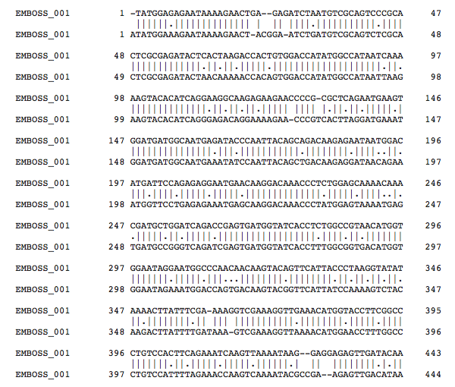
Alignment Module
Compute sequence similarity between pair of sequences (dna, amino-acid)
global/semi-global
local
Match
Deletion
CTGA--GAGATCTA
|| | || ||||
CT-ACGGA-ATCTG
Insertion
Substitution

Slide 13
Pairwise alignment
Initialization:
M(0,0) = 0;
for i = 1 to n do M(i,0) = M(i-1,0) + 1
for j = 1 to m do M(0,j) = M(0,j-1) + 1
 |  | T | T | G | T
 | 0 | 1 | 2 | 3 | 4
T | 1 | 0 | 1 | 2 | 3
T | 2 | 1 | 0 | 1 | 2
A | 3 | 2 | 1 | 1 | 2
G | 4 | 3 | 2 | 1 | 2
C | 5 | 4 | 3 | 2 | 2
 |  | T | T | G | T
T
T
A
G
C
 |  | T | T | G | T
 | 0
T
T
A
G
C
 |  | T | T | G | T
 | 0 | 1
T
T
A
G
C
 |  | T | T | G | T
 | 0 | 1 | 2
T
T
A
G
C
 |  | T | T | G | T
 | 0 | 1 | 2 | 3
T
T
A
G
C
 |  | T | T | G | T
 | 0 | 1 | 2 | 3 | 4
T
T
A
G
C
 |  | T | T | G | T
 | 0 | 1 | 2 | 3 | 4
T | 1
T | 2
A | 3
G | 4
C | 5
 |  | T | T | G | T
 | 0 | 1 | 2 | 3 | 4
T | 1 | 0
T | 2
A | 3
G | 4
C | 5
 |  | T | T | G | T
 | 0 | 1 | 2 | 3 | 4
T | 1 | 0 | 1
T | 2
A | 3
G | 4
C | 5
 |  | T | T | G | T
 | 0 | 1 | 2 | 3 | 4
T | 1 | 0 | 1 | 2
T | 2
A | 3
G | 4
C | 5
 |  | T | T | G | T
 | 0 | 1 | 2 | 3 | 4
T | 1 | 0 | 1 | 2 | 3
T | 2
A | 3
G | 4
C | 5
 |  | T | T | G | T
 | 0 | 1 | 2 | 3 | 4
T | 1 | 0 | 1 | 2 | 3
T | 2 | 1
A | 3
G | 4
C | 5
Recursion:
for j = 1 to m do
for i = 1 to n do
M(i-1, j-1) + s(X[i-1],Y[j-1])
M(i, j) = min M(i-1, j) + 1
M(i, j-1) + 1
end
end
Traceback:
T T – G T
| | |
T T A G C

Slide 14
DP-Partition
Unbanded Alignment
Banded Alignment
FullColumn
PartialColumnTop
PartialColumnMiddle
FirstCell
PartialColumnBottom
InnerCell
LastCell
Ø
DPInitialColumn
DPInner
Column
DPFinal
Column
DPInitialColumn
DPInner
Column
DPFinal
Column
scout field

Slide 15
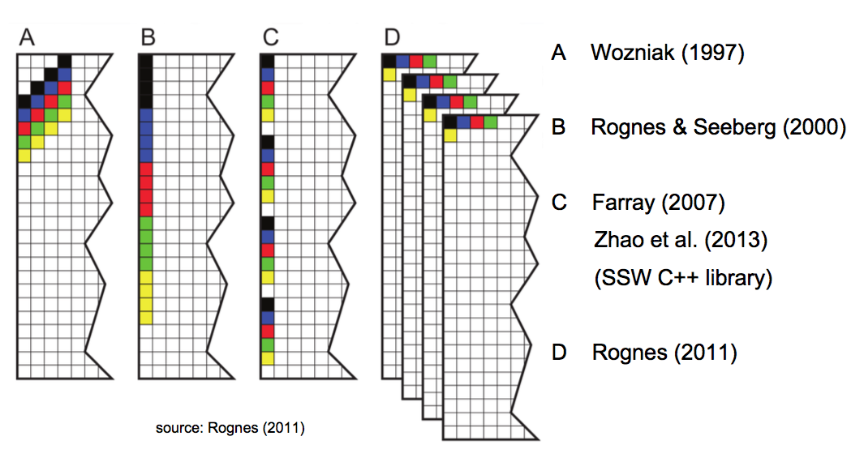
Vectorization Approaches

Slide 16
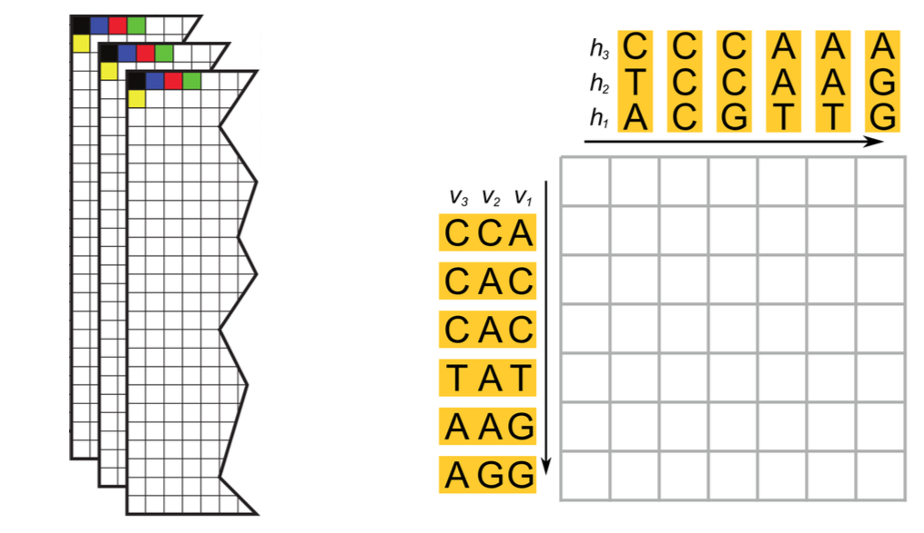
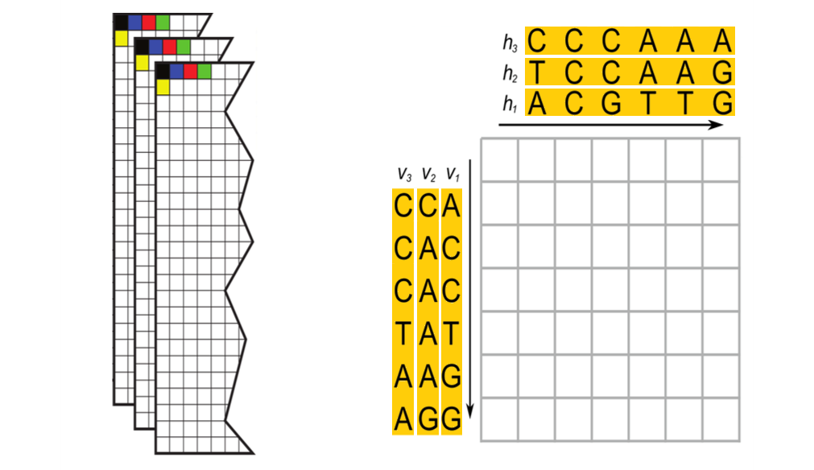

Many-many-Parallelization
<2, -3, 0>
2

Slide 17
~ 2.000.000 pairwise alignments
AVX2 with 16x16-bit integers on Xeon E5-2683v3
249,770 a/s
89.11x
Many-many interface
2,800 a/s
38,430 a/s
13.71x
37,320 a/s
13.31x
1 t, NO-SIMD
16 t, NO-SIMD
1 t, SIMD
16 t, SIMD

Slide 18
Alignment Module
SeqAn devel:
  1-1 interface (MC/SIMD)
  N-M interface (MC/SIMD)

Slide 19
MC Design – Task Graph
β
Approach
split M into tiles of size
β columns x β rows
each tile represents one task: t(i,j)
set task reference count
  t(0,0) ← 0
  t(i,0) ← t(0,j) ← 1
  t(n,m) ← 3
  t(i,j) ← 2
β
t(0,0)
t(1,0)
t(2,0)
t(3,0)
t(0,1)
t(1,1)
t(2,1)
t(3,1)
t(0,2)
t(1,2)
t(2,2)
t(3,2)
t(0,3)
t(1,3)
t(2,3)
t(3,3)

Slide 20
MC Design – Task Graph
1
0
0
0
1
1
1
0
0
2
1
1
1
0
0
0
1
2
2
0
0
1
2
2
1
1
0
3
0
2
2
1
1
0
1
2
0

Slide 21
MC Design – task graph
 |  |  |  |  |  |  |  |  |  |  |  |  |  | 0 | 1
 |  |  |  |  |  |  |  |  |  |  |  |  | 0 | 2
 |  |  |  |  |  |  |  |  |  |  | 0 | 0 | 2
 |  |  |  |  |  |  |  |  |  | 0 | 1 | 2
 |  |  |  |  |  |  |  |  | 0 | 2
 |  |  |  |  |  |  |  | 0 | 2
 |  |  |  |  |  | 0 | 0 | 2
 |  |  |  |  | 0 | 1 | 2
 |  |  |  | 0 | 2
 |  |  | 0 | 1
 |  |  | 0 | 2
 |  | 0 | 2
 | 0 | 2
0 | 1
0 | 2
1 |  |  |  |  |  |  |  |  |  |  |  |  |  |  | 3
task pool
thread 1
thread 2
thread 3
thread 4

Slide 22
MC Design – Task Graph
B_{V}
Data Synchronization
B_{H} = horizontal Buffer
B_{V} = vertical Buffer
  shared between threads
t(0,0)
t(1,0)
t(2,0)
t(3,0)
t(0,1)
t(1,1)
t(2,1)
t(3,1)
B_{H}
t(0,2)
t(1,2)
t(2,2)
t(3,2)
t(0,3)
t(1,3)
t(2,3)
t(3,3)

Slide 23
MC Design – Task Graph
B_{H}[i]
B_{H}[i+1]
Data Synchronization
B_{H} = horizontal Buffer
B_{V} = vertical Buffer
  array of array of dp_cell
  shared between threads
t(i,j) writes to B_{H}[i] and B_{V}[j]
initialize horizontal buffer of t(i,j+1) with B_{H}[i]
initialize vertical buffer of t(i+1,j) with B_{V}[j]
B_{V}[j]
t(i,j)
t(i+1,j)
B_{V}[j+1]
t(i,j+1)
t(i+1,j+1)

Slide 24
MC Design – Task Graph
Data Synchronization
B_{H} = horizontal Buffer
B_{V} = vertical Buffer
  array of array of dp_cell
  shared between threads
t(i,j) writes to B_{H}[i] and B_{V}[j]
initialize horizontal buffer of t(i,j+1) with B_{H}[i]
initialize vertical buffer of t(i+1,j) with B_{V}[j]
no race condition!
B_{H}
t(0,0)
t(1,0)
t(2,0)
t(3,0)
t(0,1)
t(1,1)
t(2,1)
t(3,1)
B_{V}
t(0,2)
t(1,2)
t(2,2)
t(3,2)
t(0,3)
t(1,3)
t(2,3)
t(3,3)

Slide 25
MC/SIMD Design
thread 1
 |  |  |  |  |  |  |  |  |  |  |  |  |  | 0 | 2
 |  |  |  |  |  |  |  |  |  |  |  |  | 0 | 2
 |  |  |  |  |  |  |  |  |  |  | 0 | 0 | 2
 |  |  |  |  |  |  |  |  |  | 0 | 1 | 2
 |  |  |  |  |  |  |  |  | 0 | 2
 |  |  |  |  |  |  |  | 0 | 2
 |  |  |  |  |  | 0 | 0 | 2
 |  |  |  |  | 0 | 1 | 2
 |  |  |  | 0 | 2
 |  |  | 0 | 1
 |  |  | 0 | 2
 |  | 0 | 2
 | 0 | 2
0 | 1
0 | 2
1 |  |  |  |  |  |  |  |  |  |  |  |  |  |  | 3
task pool
thread 2
thread 3
thread 4
FULL SIMD
or scalar

Slide 26
MC Results
MC/SIMD
MC only
500Kbp x 500Kbp
2S Intel® Xeon® processor E5-2650 v3, 2,3 GHz, 10 cores

Slide 27
MC/SIMD Results (X Phi vs Xeon)
~600x
500 Alignments
Sequence sizes:
Random between
10k and 30 k

Slide 28
MC/SIMD Results (Haswell)
500 Alignments
Sequence sizes:
Random between
10k and 30 k

Slide 29
SIMD vs Scalar call (native)

Slide 30
MC/SIMD Results (KNL)
Intel Xeon Phi 7250 (Knights Landing – KNL)
  68 cores @ 1.4 GHz @ ZIB
  setup: quad+cache mode
SIMD vs Scalar
Speedup
300 s (serial) vs
1.94/2.02s

Slide 31
MC/SIMD Results (KNL 7250, 68 cores )
500 Alignments
Sequence sizes:
Random between
10k and 30 k
Notes:
Avx2 performs badly on KNL (maybe legacy instructions)
AVX512 initially too, but we could improve it

Slide 32
Final MC/SIMD Design
thread 1
Pairwise
Alignment 1
common
task pool
thread 2
Extremely flexible design
allowing various applications
Pairwise
Alignment 2
thread 3
Pairwise
Alignment 3
thread x
Pairwise
Alignment 4

Slide 33

Comparison with Parasail
Parasail is specialized for alignment, and currently the best alignment library

Slide 34
SeqAn vs Parasail
1k Alignments
simulated PacBio
reads

Slide 35
SeqAn vs Parasail
2 million Alignments
simulated Illumina
reads @150bp

Slide 36
SeqAn vs Parasail
1 single alignment
simulated
500Kbpx500Kbp

Slide 37
Applications

Slide 38
Outlook!

Slide 39
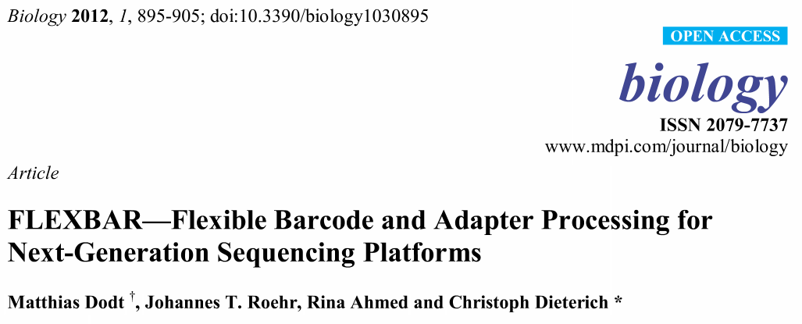
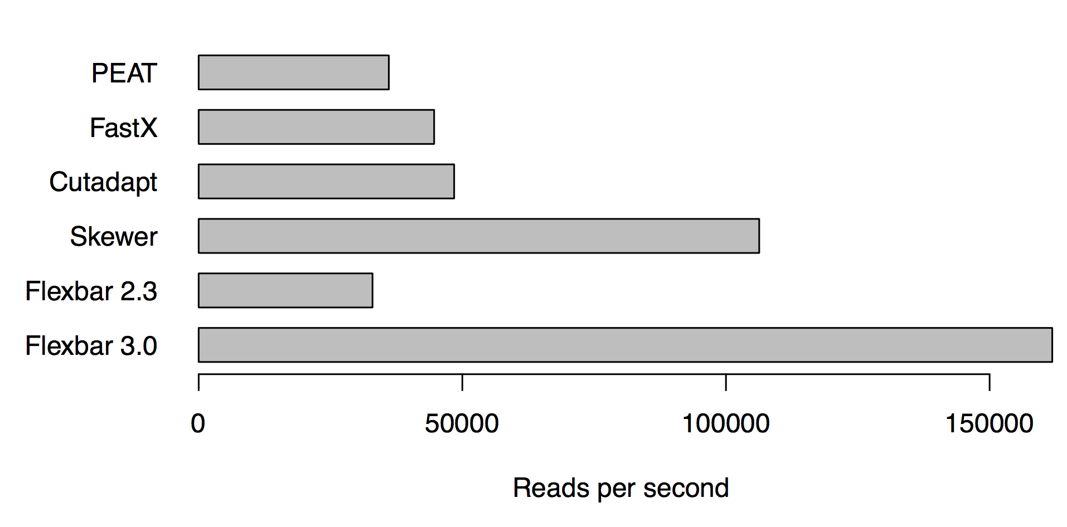
App: Preprocessing NGS reads
The Flexbar tool was in version 2.3
multithreaded with TBB
Flexbar 3.0 is fully implemented in SeqAn, uses the new alignment module and is 5x faster.
Bioinformatics, 2017, 1–2 doi: 10.1093/bioinformatics/btx330

Slide 40
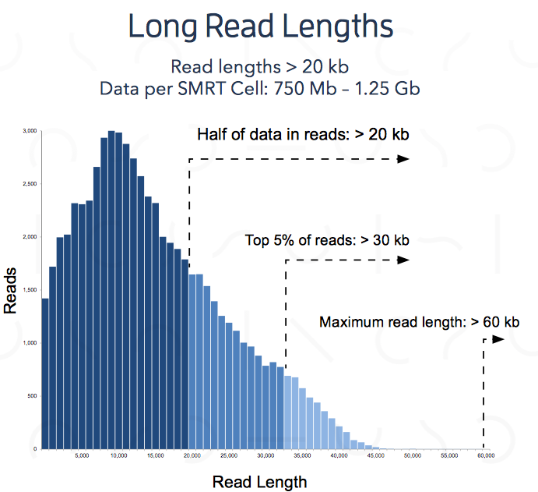
App: PacBio mapping
PacBio reads are now 20-40kb
Error rate is high ~ 15%
Techniques for low error Illumina reads are not applicable
Verification with DP based alignment is desirable
Source: pacBio website

Slide 41
App: PacBio mapping
 |  |  |  |  |  |  |  |  |  |  |  |  | 0
 |  |  |  |  |  |  |  |  |  |  |  | 0
A banded alignment would need to compute the blocks in red (about 1500) to find the correct alignment through the
blue(~200) blocks
~30.000 bps
Notes:
Add dimenions

Slide 42
App: PacBio mapping
 |  |  |  |  |  |  |  |  |  |  |  |  | 0
 |  |  |  |  |  |  |  |  |  |  |  | 0
We will determine a smaller set of necessary blocks to be computed (in green)
Process them with the alignment module
~30.000 bps
Notes:
Add dimenions

Slide 43
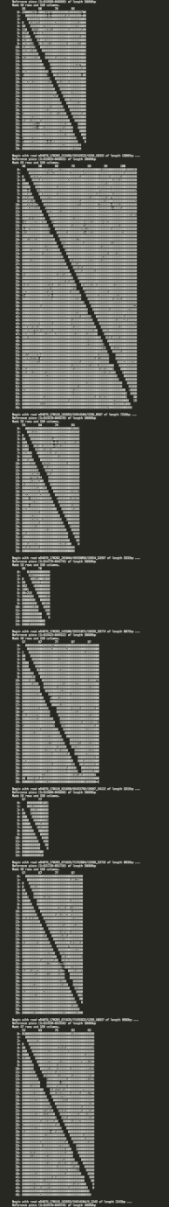
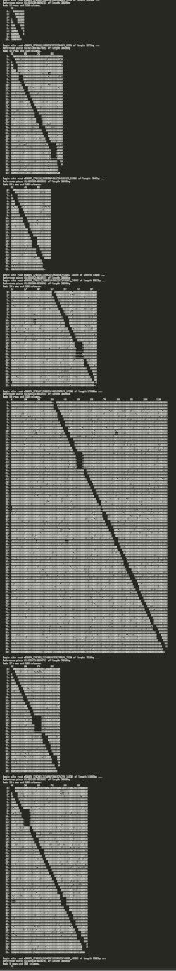
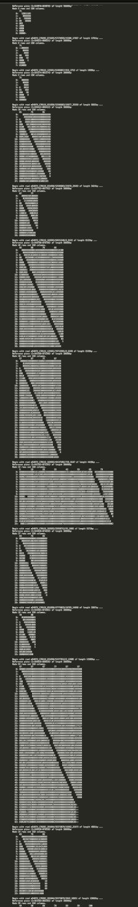
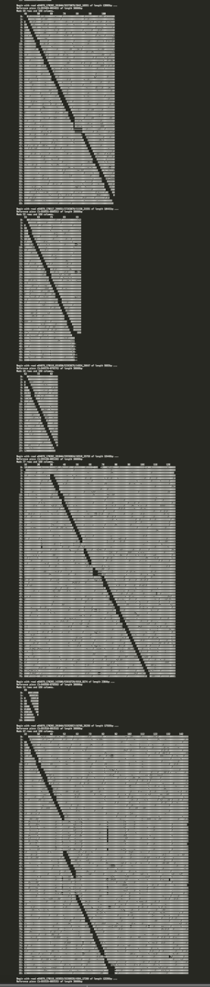
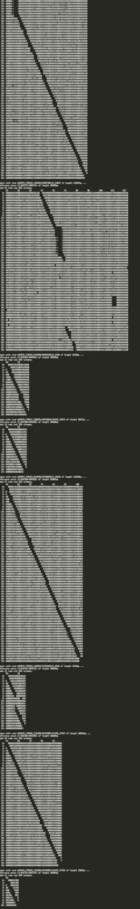
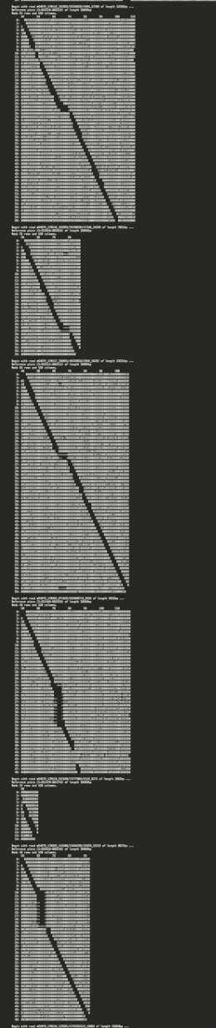
Step | Estimated runtime for 1M reads (10kb) | Parallelized
Locate window | ≅ 900 s ➔ 2M verifications | Not yet
Determine band | ≅ 2000 s ➔ 100-200 alignments/read | Not yet
Exact alignment | ≅ 1000 s | Yes (Xeon/ Xeon Phi)
TOTAL | ≅ 4000 s ≅ 1 hour
Notes:
Add dimenions

Slide 44
Presentations of work
SC Austin (Talk by Knut Reinert @ Intel event)
IPCC meeting Ostrava (Marcel Ehrhardt)
IPCC meeting Toulouse (Rene Rahn, Marcel Ehrhardt)
de.NBI Symposium ”Bioinformatics for Human Health and Disease”
The SeqAn library, Intel training, ISC Frankfurt
Engineering meets biomedicine:
The SeqAn C++ library for efficient NGS sequence analysis,
Jackson Labs, Farmington, CT
Submitted abstract to Intel HPC Developer Conference, Denver

Slide 45

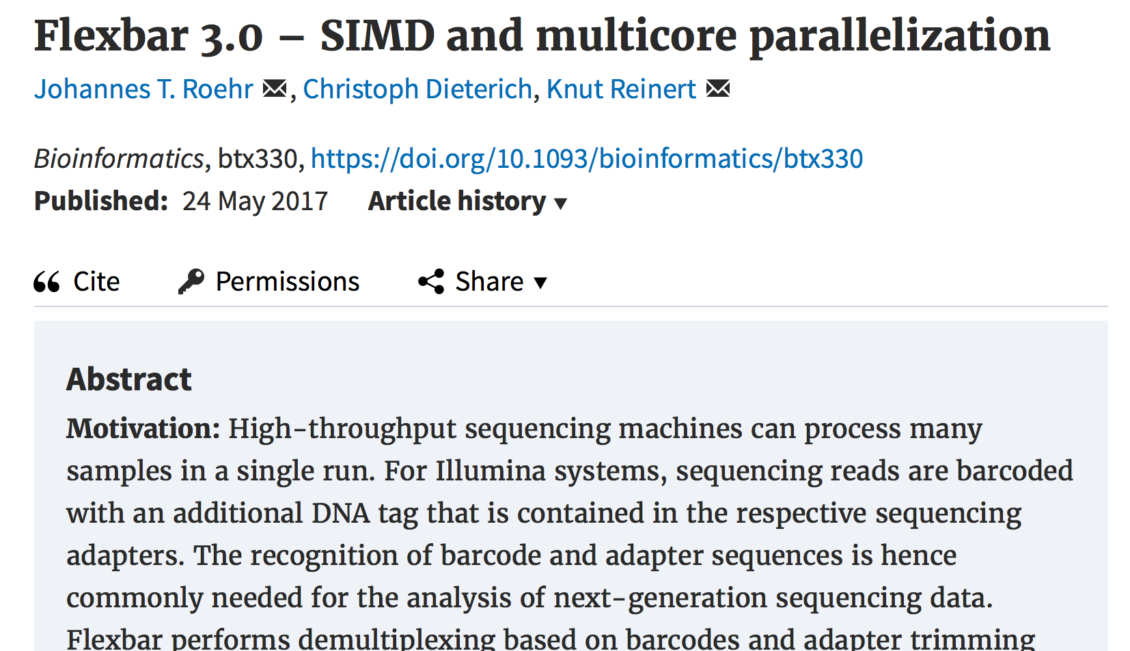

Publications of work
Technical paper of alignment module planned to submit this month
Application paper for PacBio 3rd or 4th quarter 2017

Slide 46
Future plans of IPCC
Adaption of more DP variants to the parallel wave-front model
Parallelized index based search
Parallel containers (integration of TBB)
Vectorized Myers' Bit vector algorithm
Parallel streaming over JST (Journaled String Tree)
Generic offloading of algorithmic components, e.g. index search, alignment computation, etc.
Users can easily parallelize their applications by parallel kernels of SeqAn!!!

Slide 47
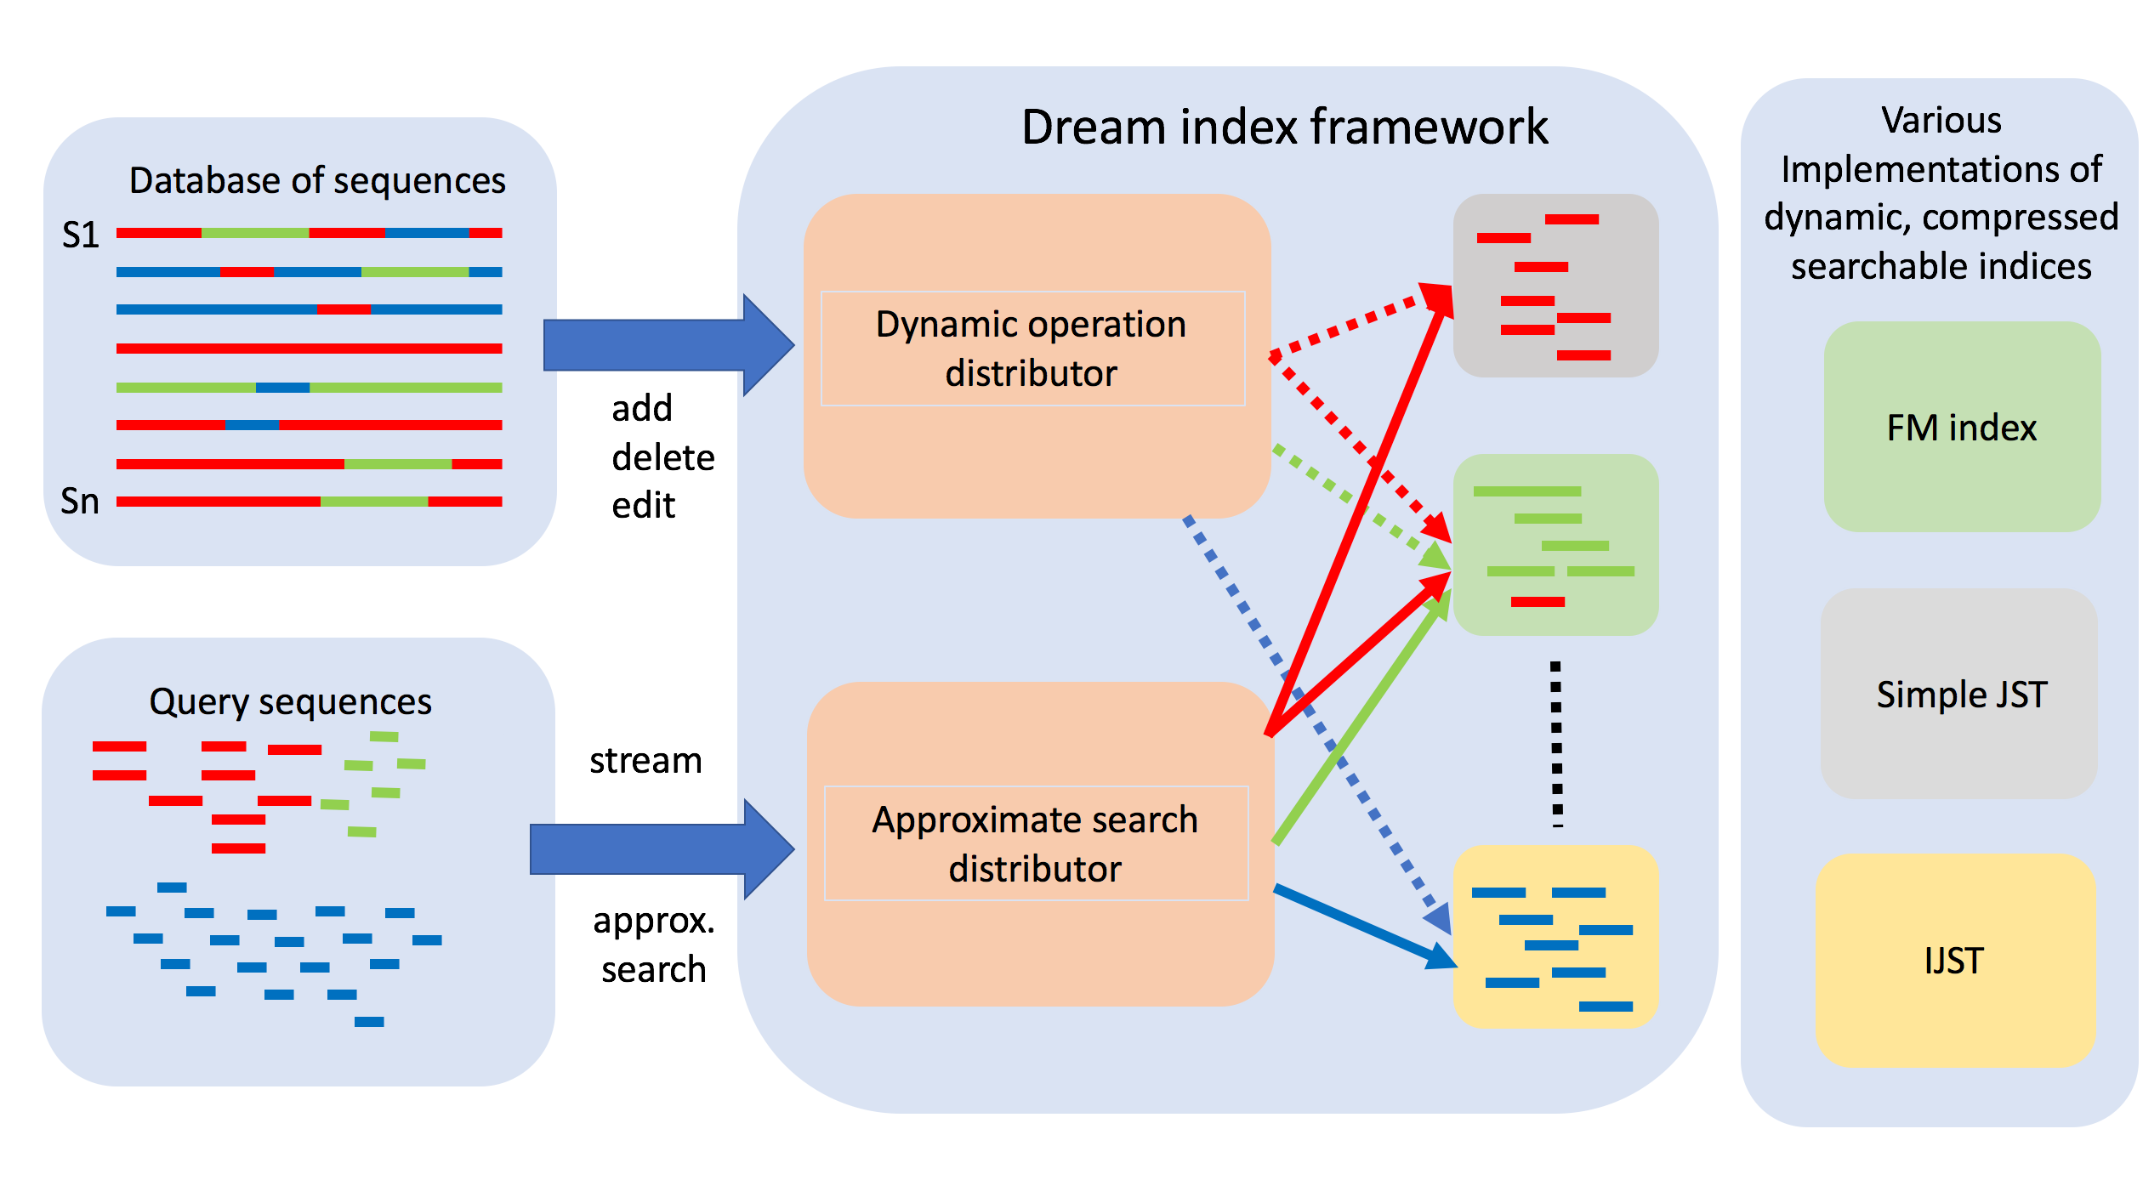
DREAM index
Dynamic seaRchablE pArallel coMpressed index

Slide 48
From IPCC 1
Alignment module
Offloading
JST
Parallel
container
and I/O
Parallel index interface

Slide 49
Acknowledgements
AG ABI
Intel
  Stefan Budach
  Marcel Ehrhardt
  René Rahn
Pascal Costanza
Jonny Hancox
ZIB
  Thomas Steinke
  Matthias Noack
All code available as part of upcoming SeqAn release 2.4 (not yet 2.3)

