Slide 1
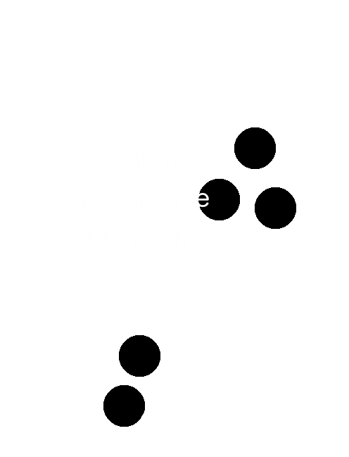

INTRODUCTION TO Programming with Seqan
de.NBI / CIBI training event
OpenMS / SeqAn User Meeting 2017

Slide 2

Software libraries bridge gap
RNA-Seq
Structural variants
Metagenomics abundance
ChIP-Seq
Sequence assembly
Cancer genomics
FM-index
Multicore
Secondary memory
K-mer filter
Suffix arrays
Fast I/O
Hardware acceleration

Slide 3
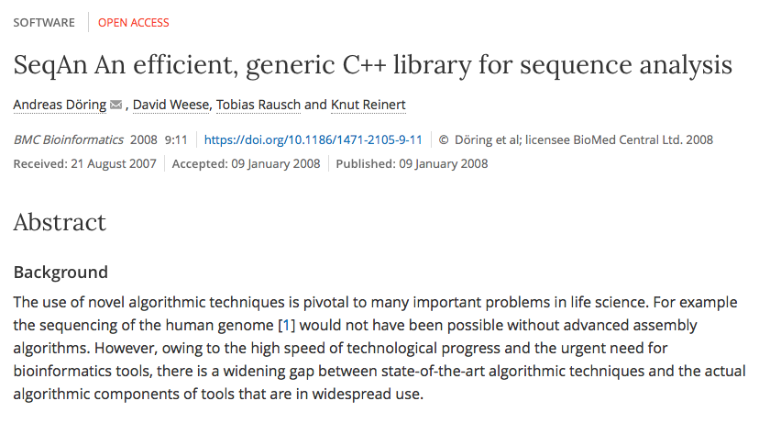
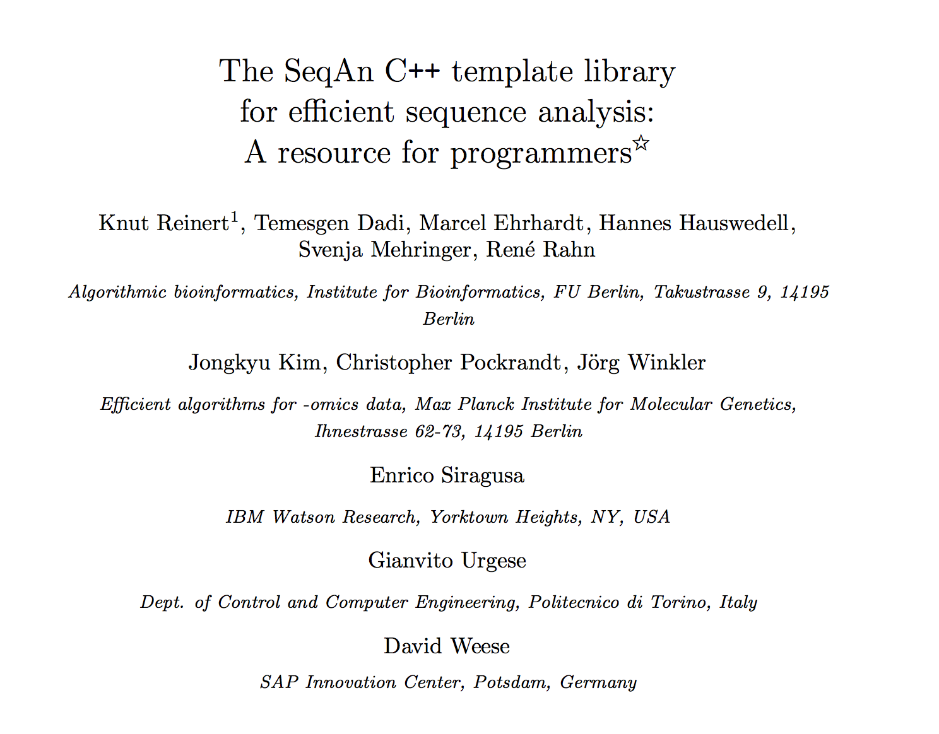
SeqAn

Slide 4
What we'll do today
Implement miniLagan
  sequence alignment for large-scale sequences
How does Lagan work?
filter seeds
CHAOS chaining
adapt seeding parameter
global chaining
banded chain alignment
yes
no
final?

Slide 5


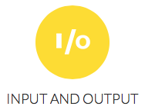
What you will learn
How to use SeqAn's
  argument parser
  sequence I/O
  index module
  seed and extend module
  alignment data structures
You will need
  editor
  g++
  cmake build system

Slide 6
Shortcut
  ftp.mi.fu-berlin.de/pub/rmaerker/um_2017

Slide 7
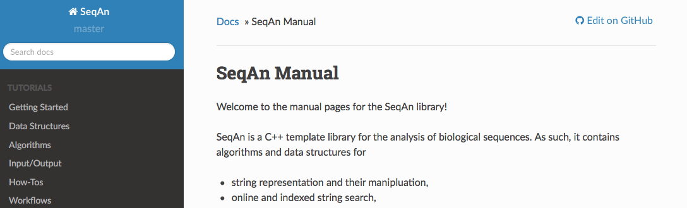
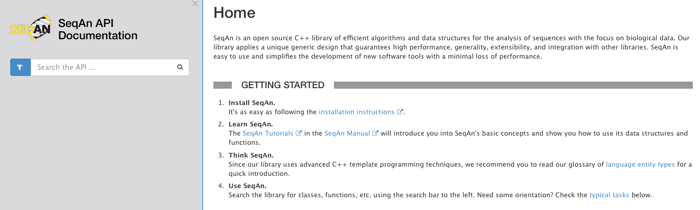
Where to find Documentation
http://seqan.readthedocs.io/en/master/
http://docs.seqan.de/seqan/master/

Slide 8
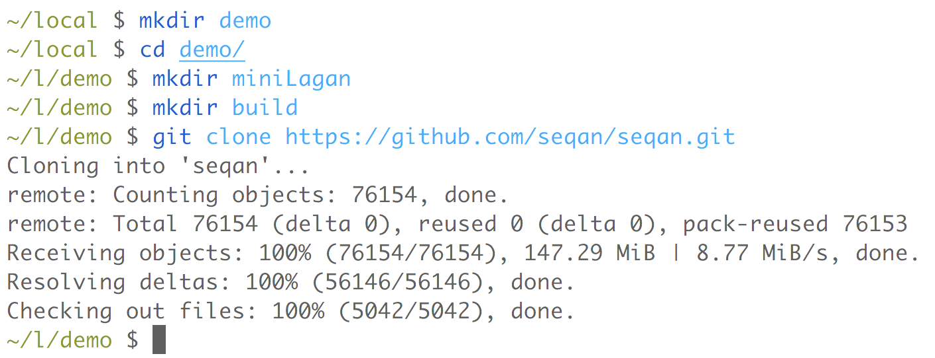
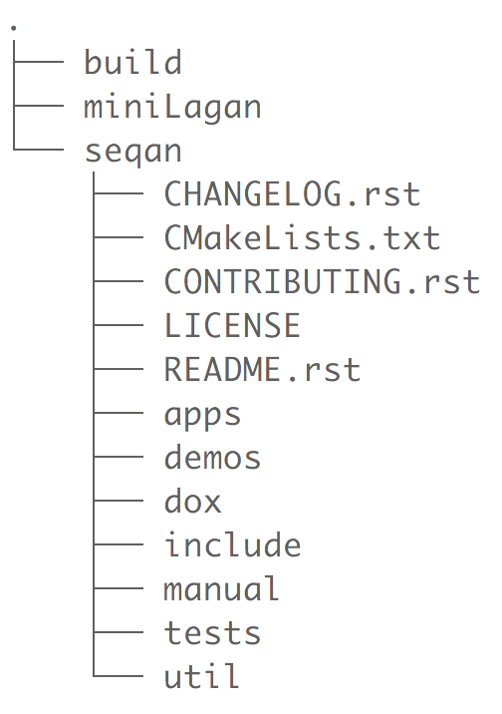
Setting up environment

Slide 9
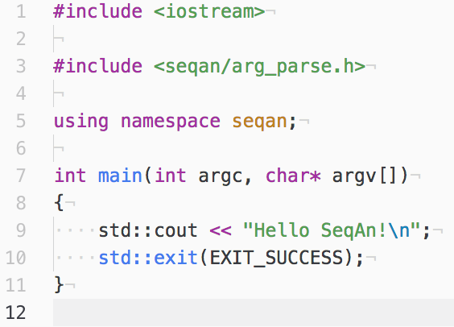
Creating our App

Slide 10
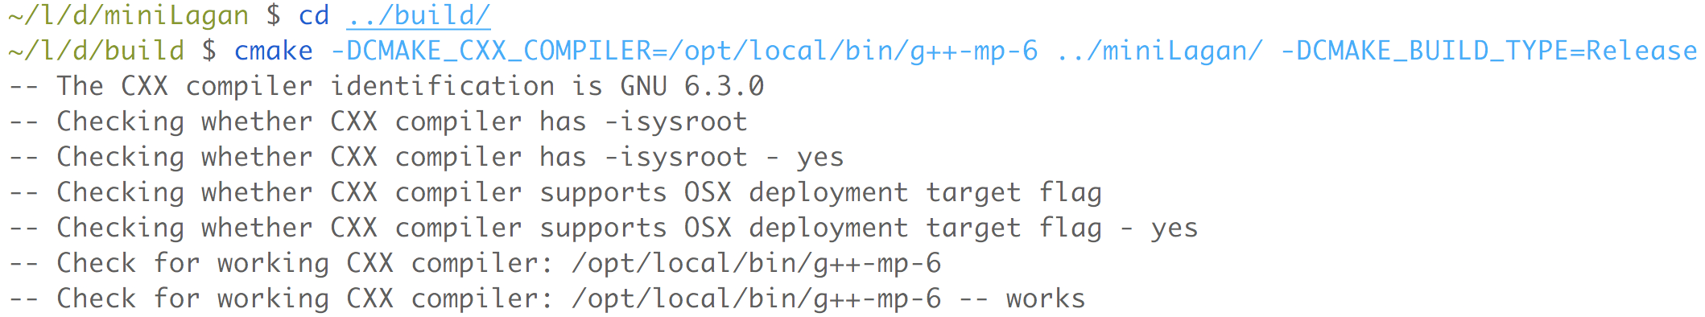
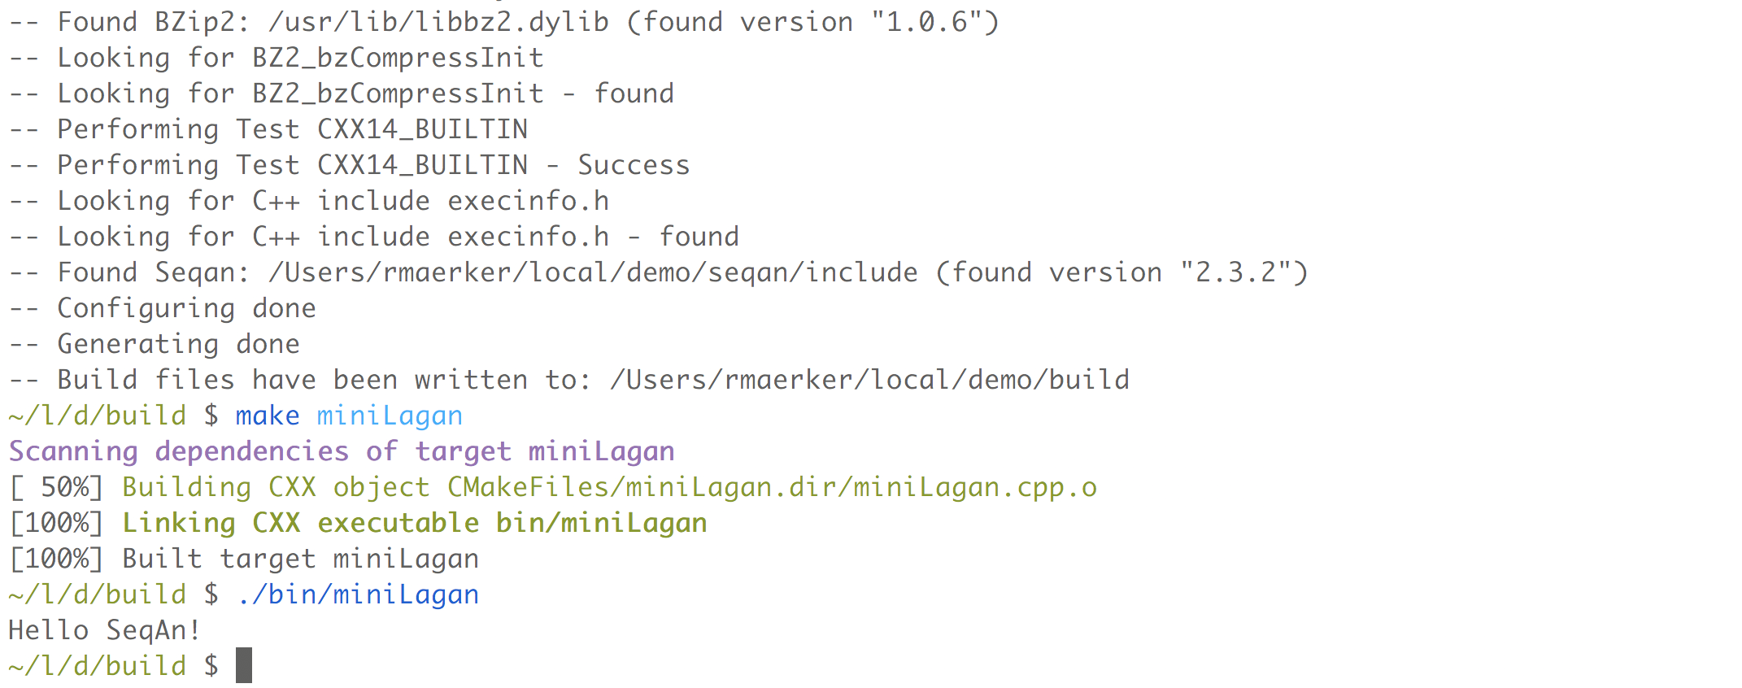
First build!
…

Slide 11
Functional Design
SeqAn uses template specialization to establish static polymorphism
pros:
  fast code due inlining
  no virtual function calls
cons:
  no standard OOP – use global function/procedural design
  no member qualifiers
BUT: SeqAn 3.0 resolves this
using Concepts (C++20)

Slide 12
Sequence I/O
FormattedFile
  FormattedFileIn for reading
  FormattedFileOut for writing
I/O operations
  open from filename or stream, e.g., std::cin, std::cout
  guess file format from content or file extension
  transparent compression/decompression
supported file formats
SeqFileIn/SeqFileOut | BamFileIn/BamFileOut | BedFileIn/BedFileOut
GffFileIn/GffFileOut | VcfFileIn/VcfFileOut | GffFileIn/GffFileOut
UcscFileIn/UcscFileOut | RoiFileIn/RoiFileOut | SimpleIntervalsFileIn/ SimpleIntervalsFileOut

Slide 13
Seeding
SeedSet:
Allows local chaining when adding seeds
  Single: Simply add seed as single entity into seed set
  Merge: Try to connect with overlapping seeds
  Chaos: Try to connect using distance and gap parameter
Chaining Algorithms
  SparseChaining
Extension Algorithms
  MatchExtend, UnGappedXDrop, GappedXDrop

Slide 14
Qgram Index
Shape:
  A shape contains information on how a qgram looks like:
    Length
    Number of gaps
    Positions of the gaps
Specialization | Modifiable at runtime | Number of Gaps
UngappedShape | - | 0
SimpleShape | + | 0
OneGappedShape | + | 0/1
GappedShape | - | any
GenericShape | + | any

Slide 15
Alignment
Align Object
Row 1
// Align instance.
Align<DnaString, ArrayGaps> align;
// Member function rows. Resize for pairwise.
resize(rows(align), 2);
assignSource(row(align, 0), “TTGT”);
assignSource(row(align, 1), “TCGAT”);
Row 2
Row 3
...
Row n-1
Row n

Slide 16
DP-Kernel
Trace
Config
Algorithm
Navigation
Spec
Gap
Costs
Scout
Spec
Matrix
Spec
COMPILER
Meta-Function
optimized fast
code

Slide 17
Seq 1
Seq 2

Slide 18

Questions?
Thank you for your attention!

