Slide 1

Meta-Proteogenomics in KNIME
Kerstin Neubert

Slide 2
Ess-BAR project
Biologische Gefahren, Analyse und Resilienz der Lebensmittelwarenketten
Biological hazards, Analysis and Resilience of the food supply chain
Development of methods for the early identification of highly pathogenic species in the food supply chain using Meta-genomics (NGS) and high-resolution mass spectrometry (Orbitrap)
Development of tools for data mining to integrate results from different labaratory methods, epidemiological data and associated metadata (production chains, food delivery)
Notes:
The two main goals of the EssBAR project

Slide 3







Ess-BAR project consortium
Specialized diagnostics/
Forensic microbiology
Project coordination
LC-MS proteomics
Specialized diagnostics/
Epidemiology
KNIME extensions
Data mining & Epidemiology
Rapid diagnostics
(phage-based)
Software & Pipeline
development

Slide 4

Three exemplified high risk pathogens
Pathogen | Food | CDC category
Brucella spp. | Milk products | High (B)
Francisella tularensis | Meat products | Very high (A)
Bacillus anthracis | Fruits and vegetables | Very high (A)

Slide 5
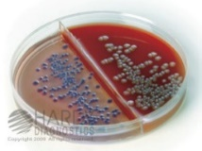

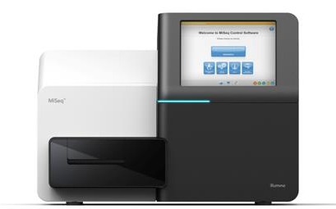
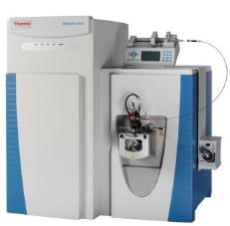
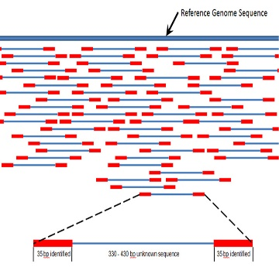
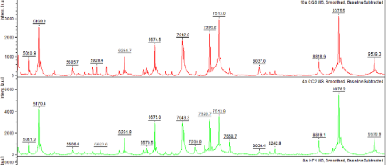
Experimental setup
Lab cultivation
Isolation & Enrichment
Sequencing
MiSeq/ HiSeq
LC-MS/MS
Q Exactive HF
Data analysis
SeqAn/ OpenMS/
external tools
KNIME

Slide 6




Data analysis pipelines
De novo assembly
Phylogeny
Reference genomes/ Assemblies
Reference DB
Protein database
Metagenomics profiling
Peptide identification
Protein profiling
workflows

Slide 7
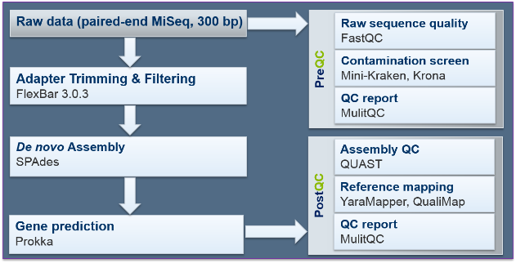
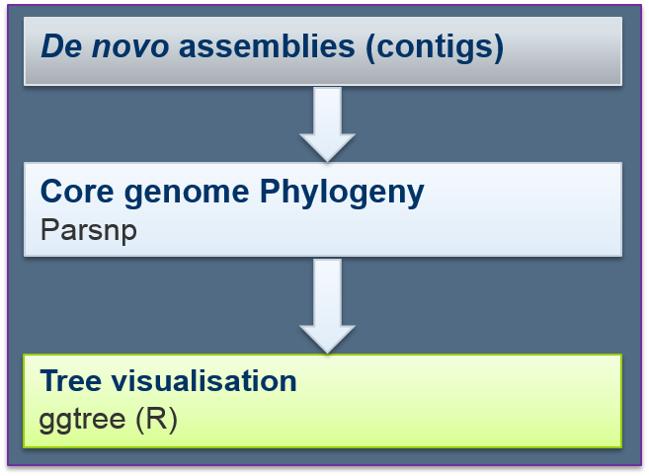
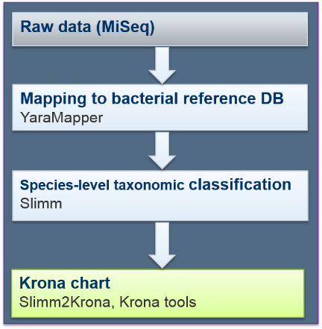
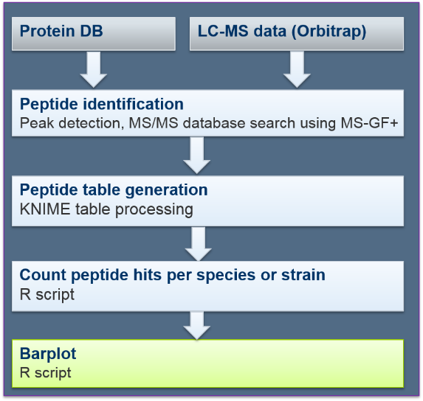
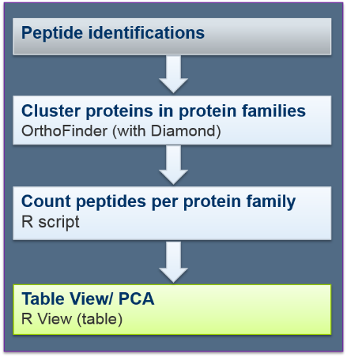
Pipeline overview
De novo Assembly
Phylogeny
Metagenomics
Peptide identification
Proteome analysis

Slide 8
De novo assembly pipeline
PreQC
Raw data (paired-end MiSeq, 300 bp)
Raw sequence quality
FastQC
Contamination screen
Mini-Kraken, Krona
Adapter Trimming & Filtering
FlexBar 3.0.3
QC report
MulitQC
PostQC
De novo Assembly
SPAdes
Assembly QC
QUAST
Reference mapping
YaraMapper, QualiMap
Gene prediction
Prokka
QC report
MulitQC

Slide 9
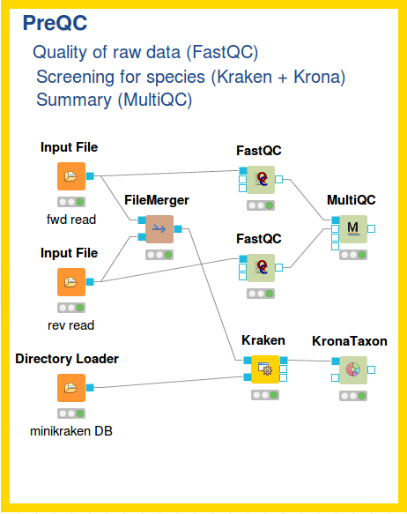
De novo assembly
Node | Function
FastQC | Raw data QC: Sequence quality
Kraken | Raw data QC: contamination screen with minikraken-DB
KronaTaxon | Krona plot visualisation of taxonomic classification
MultiQC | Summary of QC results
Flexbar3 | Preprocessing of NGS reads
SPAdes | De novo Assembly
Prokka | Assembly annotation
QUAST | Assembly QC

Slide 10
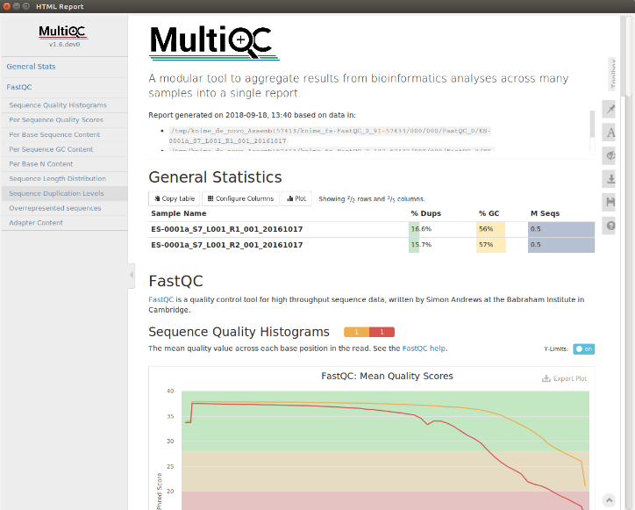
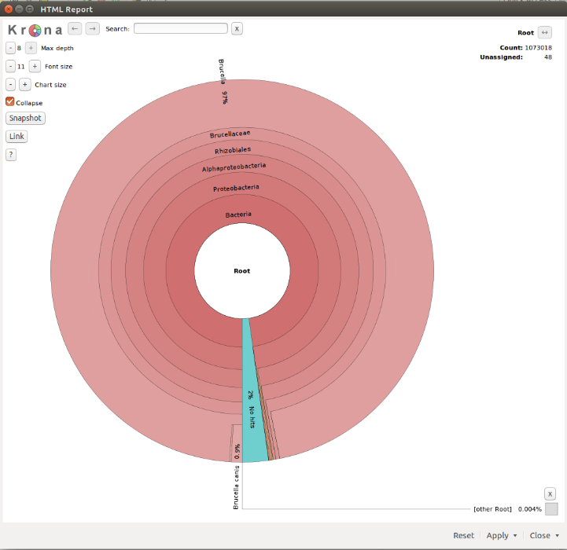
De novo assembly
HTML Views

Slide 11
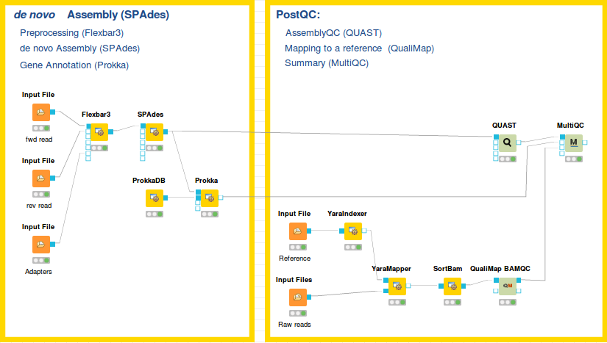
De novo assembly

Slide 12
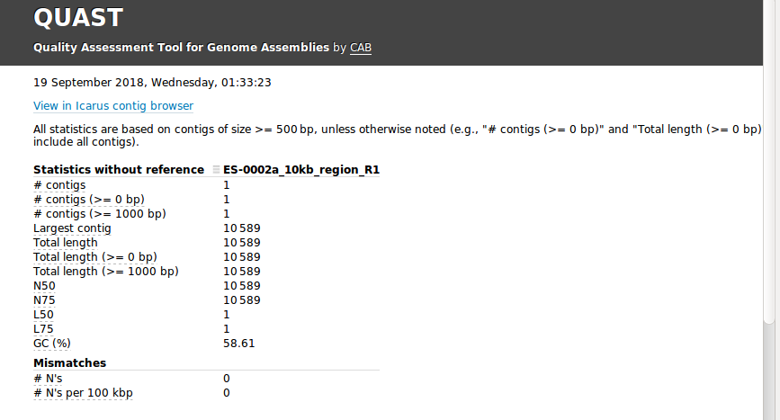
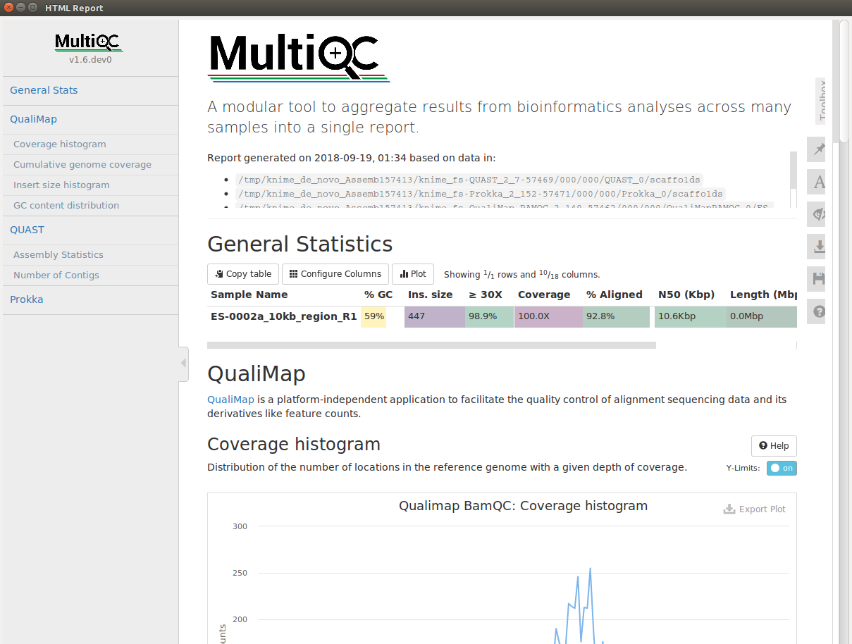
De novo assembly

Slide 13
Phylogenetic pipeline
De novo assemblies (contigs)
Raw data (MiSeq)
Core genome Phylogeny
Parsnp
Treangen TJ*, Ondov BD*, Koren S, Phillippy AM: Rapid Core-Genome Alignment and Visualization for Thousands of Microbial Genomes. bioRxiv (2014). doi: http://dx.doi.org/10.1101/007351
Mapping to bacterial reference DB
YaraMapper
Species-level taxonomic classification
Slimm
Tree visualisation
ggtree (R)

Slide 14
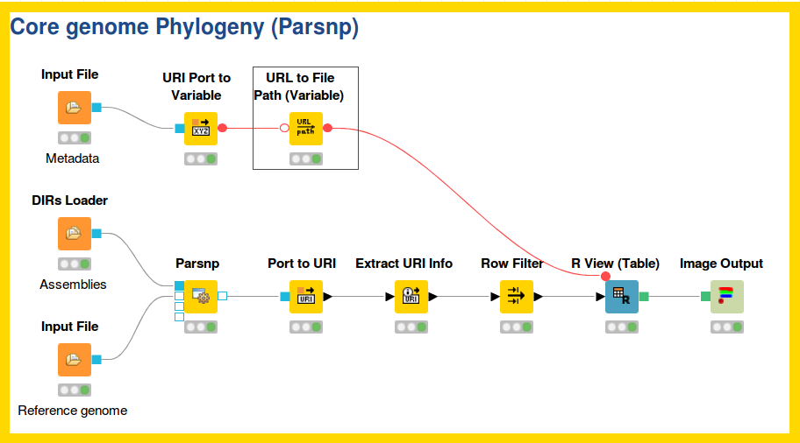
Phylogenetic pipeline

Slide 15
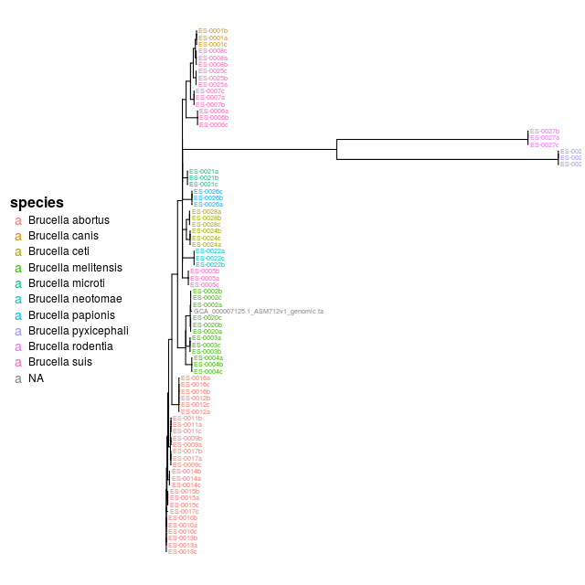
Phylogenetic pipeline
node | Function
DIRs Loader | Load directories into a URI port object
Parsnp | Core genome alignment of assemblies and phylogeny
R View (Table) | Visualization of tree with ggtree

Slide 16
Metagenomics pipeline
Raw data (MiSeq)
Mapping to bacterial reference DB
YaraMapper
Species-level taxonomic classification
Slimm
Dadi TH, Renard B, Wieler LH, Semmler T, Reinert K. (2016) SLIMM: Species level identification of microorganisms from metagenomes. PeerJ Preprints 4:e2378v1
Krona chart
Slimm2Krona, Krona tools
Ondov BD, Bergman NH, and Phillippy AM. Interactive metagenomic visualization in a Web browser. BMC Bioinformatics. 2011 Sep 30; 12(1):385.

Slide 17
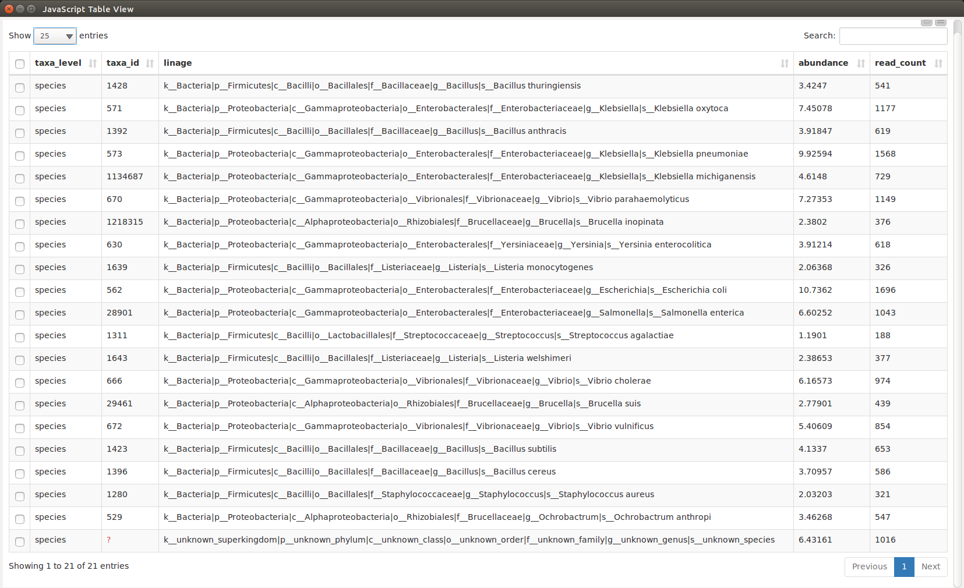
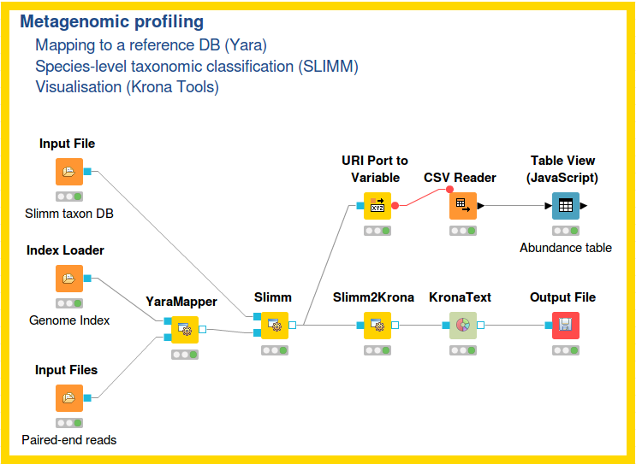
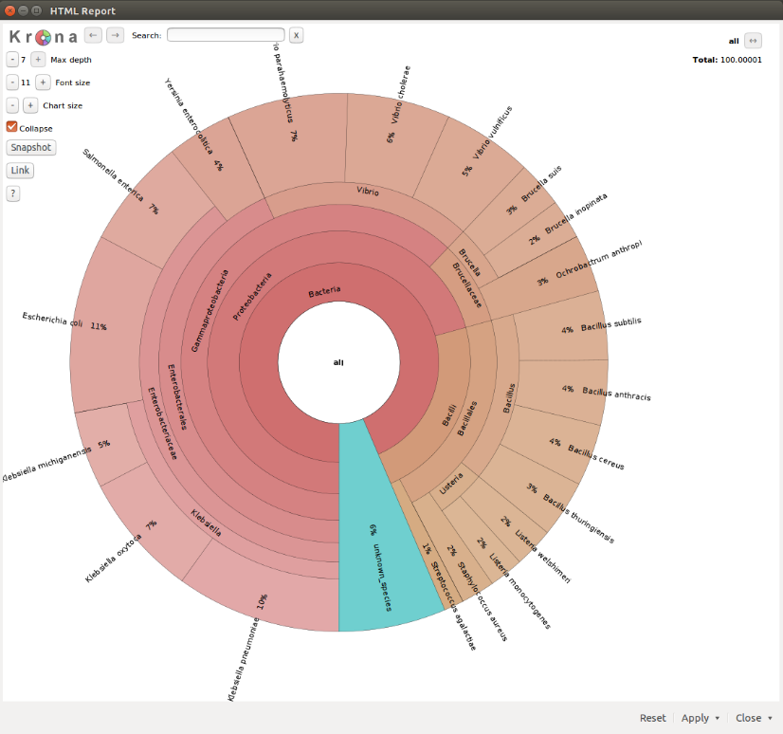
Metagenomics pipeline

Slide 18
Identification of species-specific peptides
Protein DB
LC-MS data (Orbitrap)
Peptide identification
Peak detection, MS/MS database search using MS-GF+
Peptide table generation
KNIME table processing
Count peptide hits per species or strain
R script
Barplot
R script

Slide 19
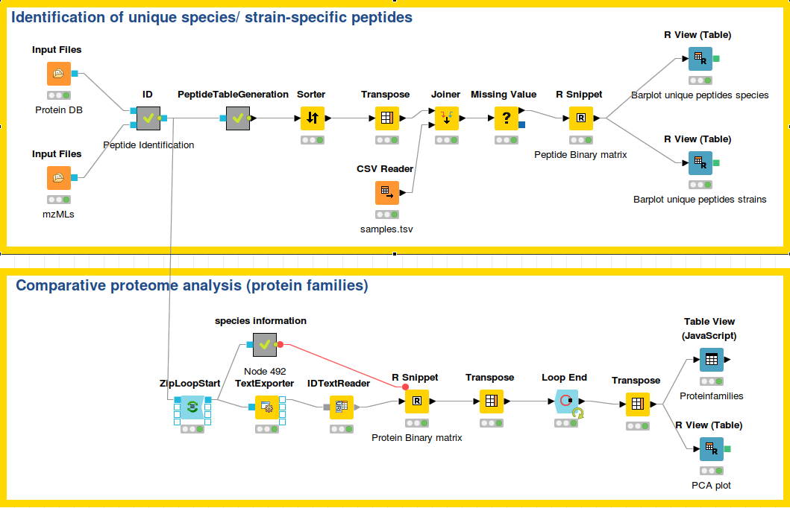
Identification of species-specific peptides

Slide 20
Proteome analysis
Peptide identifications
Cluster proteins in protein families
OrthoFinder (with Diamond)
Emms, D.M. and Kelly, S. (2015) OrthoFinder: solving fundamental biases in whole genome comparisons dramatically improves orthogroup inference accuracy. Genome Biology 16:157
Count peptides per protein family
R script
Table View/ PCA
R View (table)

Slide 21
Proteome pipelines

Slide 22
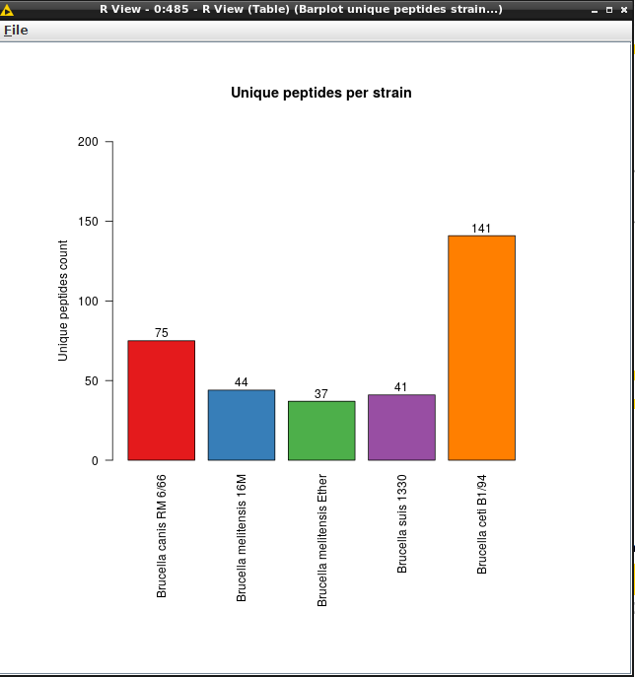
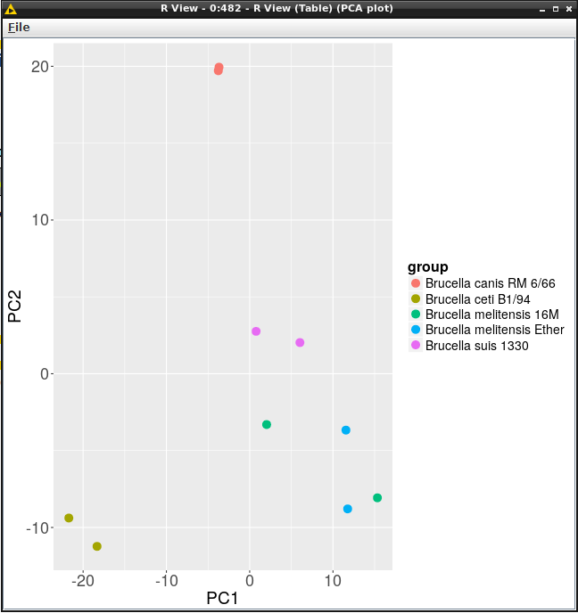
Proteome pipelines

Slide 23
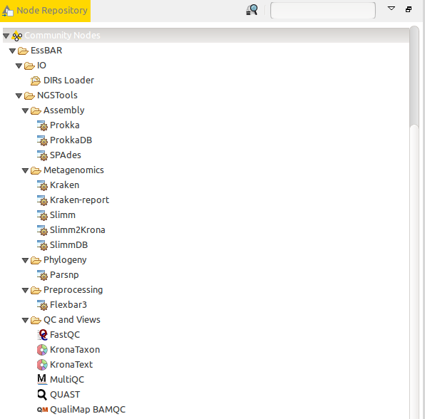
QC/View nodes
with interactive JSView

