Slide 1
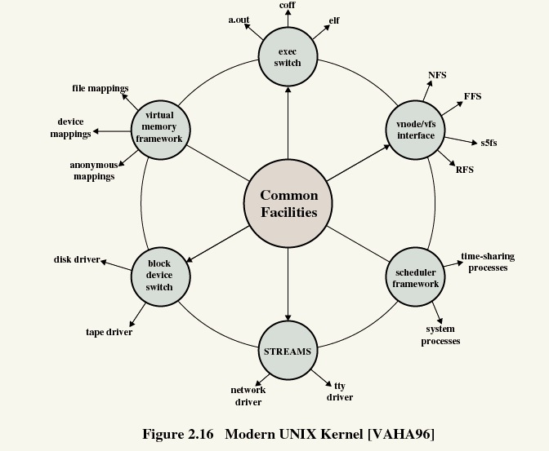
TI III: Operating Systems & Computer Networks Organization
Prof. Dr.-Ing. Jochen H. Schiller
Computer Systems & Telematics
Freie Universität Berlin, Germany

Slide 2
Structure/content of CST-Lectures
Modeling and Simulation
Modeling, Simulation and Evaluation of Systems
SW/HW-Lab mobile, embedded Systems
SDR, security architectures, IoT, localization, bring your own topic…
Embedded Internet and the IoT
Wireless sensor networks, wireless mesh networks, Internet of Things, etc.
Microprocessor Lab
Programming of embedded systems, IoT, mobile/wireless devices
Seminar Computer Systems
Presentation & discussion of current topics from all lectures
Mobile Communications
Wireless transmission, media access, GSM, 3G, LTE, WLAN, mobile IP, ad-hoc networks
Telematics / Advanced Computer Networks
Protocols, services, standards, LAN, Internet, TCP/IP, WWW, security, quality of service, DNS, routing, applications, IPv6, MPLS
Master
Bachelor
Computer Systems Lab (TI IV)
Embedded systems, interfaces, drivers, operating systems, networking, integration
You are here!
Operating Systems and Computer Networks (TI III)
Input/output, DMA/PIO, interrupts, buffer, process/thread, UNIX/Windows, networks, media access, protocols, TCP/IP, Internet
Computer Architecture (TI II)
Harvard/v. Neumann, micro architecture, RISC/CISC, branch prediction, pipelining, cache, memory hierarchy, assembler, multi-processor systems
Basics of Computer Systems (TI I)
Boolean algebra, circuits, minimization, gates, memory, semiconductors, transistors, CMOS, AD/DA conversion

Slide 3
Content
TI 3
Operating Systems
Betriebssysteme
Computer Networks
Kommunikationssysteme

Slide 4
Content
Introduction and Motivation
Tasks
Services
Virtual Resources
Historical Perspective
Examples
Tools
Subsystems, Interrupts and System Calls
System Structure
Flow of Control
System Library
POSIX
Processes
Definition
Implementation
State Model
Memory
Paging & Segmentation
Virtual Memory
Swap Policies
Scheduling
Types of Scheduling
Decision Modes
Process Priorities
Scheduling Policies
I/O and File System
Devices
Buffering and Caching
Files and Directories
Booting, Services, and Security
System Startup
System Services
Security Issues

Slide 5
Content
Networked Computer & Internet
Sockets
Internet
Layers
Protocols
Host-to-Network I
Physical Layer
Media
Signals
Modems
Host-to-Network II
Data Link Layer
Framing, Flow Control
Error Detection / Correction
Point-to-Point Protocol
Host-to-Network III
Topologies
Medium Access
Local Area Networks
Ethernet, WLAN
Internetworking
Switches, Routers
Routing
Internet Protocol
Addressing
Transport Layer
Protocol Mechanisms
TCP, UDP
Addressing, Ports

Slide 6
Content
Applications
Domain Name System
Email
World Wide Web
Network Security
Basic Concepts & Terms
Cryptology
Examples
Firewalls
Virtual Private Networks (VPNs)
IP Security
Email Security with PGP
Example
Under the Hood of Surfing the Web
Programming in C as part of the exercises

Slide 7
Course Organization
Everything virtual via Webex meetings/events!
General:
Lecture
Available online
Flipped-classroom: Q&A, discussions, Friday, 10-12h, via Webex (invitations see KVV)
Office Hours
Jochen Schiller: Tue 14:00-15:00, https://fu-berlin.webex.com/meet/jochen.schiller or via email
Tutors: during tutorials
News and Updates
KVV course site (via announcements)
Tutorials
Groups of approx. 25-30 students
Time depends on group
Registration via KVV
Assignments:
New assignments each week
Available in KVV
Discussion
During the tutorials
Practical assignments
@home, should work on all platforms
More during Q&A/tutorials
Handing in
Right on time!
Complete electronic workflow!
Solutions handed in too late will be ignored!

Slide 8
Assignments
Übungsblätter: Available on Fridays in KVV after Q&A
Submission: Two weeks later until start of class (Fri, 10:15)
Discussion: Three weeks later in tutorials
Publishing
Questions
Submit
Discussion
Lecture
Tutorials
Lecture
Tutorials
Lecture
Tutorials
Lecture
This week
… next week
… third week
… fourth week

Slide 9
Criteria for Successful Participation
Active participation in the tutorials is essential!
Minimum n-2 times present
Hand in your assignments on time
Teamwork is required with 2 students per team
Successful submission of at least n-2 assignments
Each student with a correct answer must be able to present the assignment during the tutorials
At least one presentation during the tutorials
At least 50% of the max. number of points in the exam are required
Only the exam counts for grading!
Exam: to be announced

Slide 10
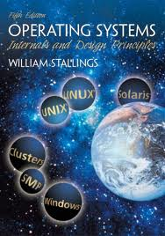
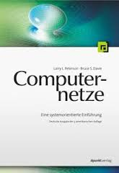
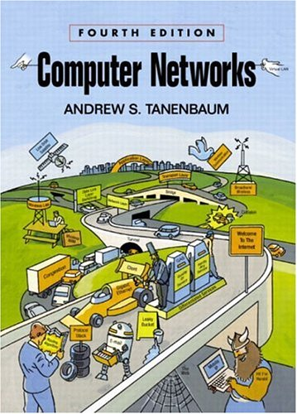
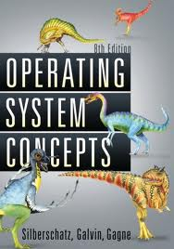
Literature
Archive of the lectures! – see KVV for links
Prepare yourself! Follow the lecture BEFORE Q&A
Prepare a list of questions & discuss during Q&A
The course is based on:
William Stallings, Operating Systems: Internals and Design Principles, Prentice Hall International
Larry L. Peterson, Bruce S. Davie, Computernetze – Eine systemorientierte Einführung, dpunkt Verlag
Additional literature:
Andrew S. Tanenbaum, Modern Operating Systems, Prentice Hall
Abraham Silberschatz, Peter B. Galvin, Greg Gagne, Operating System Concepts, John Wiley & Sons

Slide 11
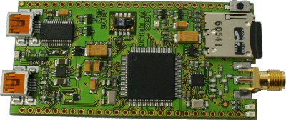
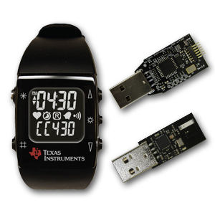
RIOT-OS
The friendly Operating System for the Internet of Things.
http://riot-os.org/

Slide 12
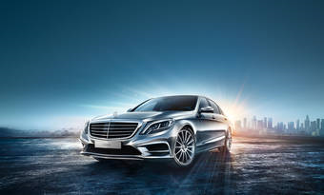
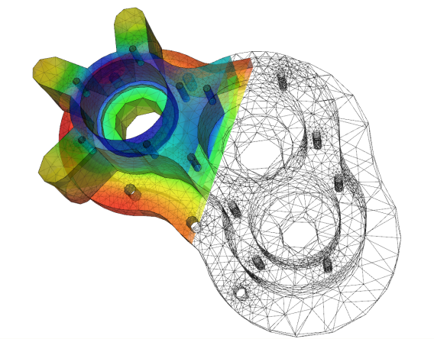
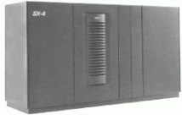
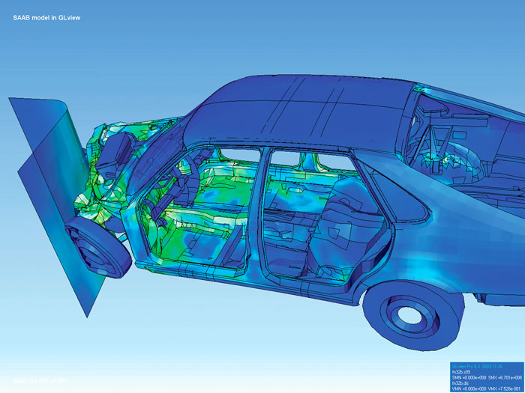
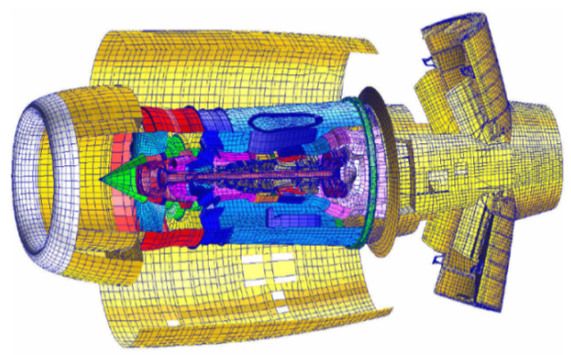
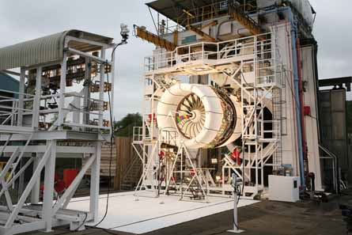
OS-support for HPC (Grids)

