Slide 1
Computational Proteomics and Metabolomics
Oliver Kohlbacher, Sven Nahnsen, Knut Reinert
12. Quantitative Metabolomics

Slide 2
Learning Unit 12A
Non-targeted Quantification
Differences and similarities to label-free proteomics
Feature finding for metabolites
XCMS
OpenMS feature-finding algorithm

Slide 3
Metabolite Quantification
Label-free proteomics is similar to non-targeted metabolomics
Overall workflow is identical
  Feature finding
  Map alignment
  Feature linking
Feature-finding approaches are algorithmically similar to those used in proteomics
  Mass traces usually at the heart of the algorithm
  Assembly into features can be done similarly
However, there are some differences
  Isotopic patterns differ from proteomics (no averagine!)
  Mass range and charge states are different

Slide 4
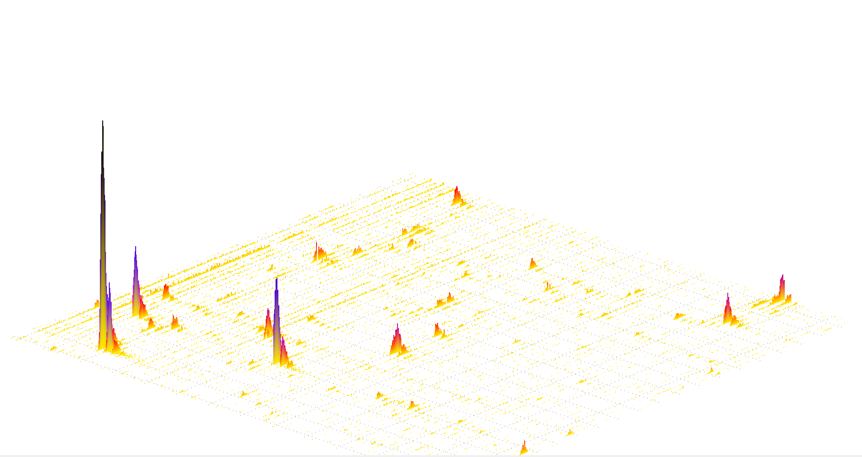
Feature Finding – Terms
Map:
Two-dimensional data set (RT, m/z) containing the MS signal from one LC-MS run.
Feature:
  The sum of all the MS signals caused by the same analyte in a specific charge state.
  Different adducts will result in distinct features. Primarily characterized by RT, m/z, charge, intensity.
Feature finding:
Finding the set of features explaining as much of the signal in a map as possible.

Slide 5
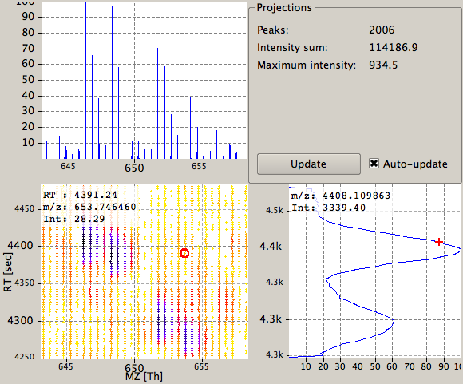
Metabolic Profiling
Find features in all maps

Slide 6
Metabolic Profiling
Find features in all maps
Align maps

Slide 7
Metabolic Profiling
Find features in all maps
Align maps
Link corresponding features

Slide 8
Metabolic Profiling
Find features in all maps
Align maps
Link corresponding features
Identify features
Carnitine

Slide 9
Metabolic Profiling
Find features in all maps
Align maps
Link corresponding features
Identify features
Quantify
Carnitine
4.0 : 1.1 : 0.8

Slide 10
Feature Finding in MTX – Issues
Proteomics feature finding algorithms make extensive use of the averagine hypothesis: peptides have a well-defined average composition
Metabolites are chemically much more diverse than peptides
Feature finding algorithms are often very sensitive to the choice of parameters
Tuning these parameters can be a challenge
Sensitivity is often an issue in feature finding: distinguishing signal from noise can be a challenge
Lack of sensitivity is often a problem for large-scale studies – missing values

Slide 11
XCMS
XCMS is a Bioconductor package, written in R
Key ideas
  Extract mass traces by binning peaks w.r.t. m/z
  Treat mass bins as distinct mass traces
  Detect peaks in these mass traces using standard methods from signal processing
  Align detected mass traces in the RT dimension across maps using nonlinear de-warping

Slide 12
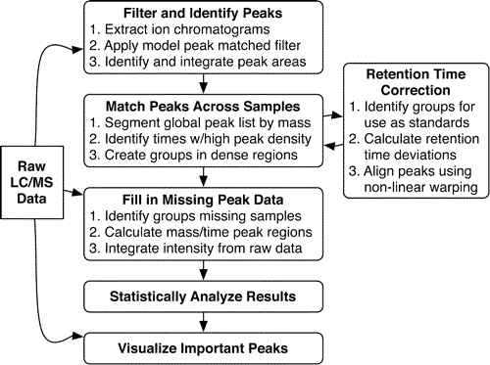
XCMS
Smith et al., Anal. Chem., 2006, 78, 779-787

Slide 13
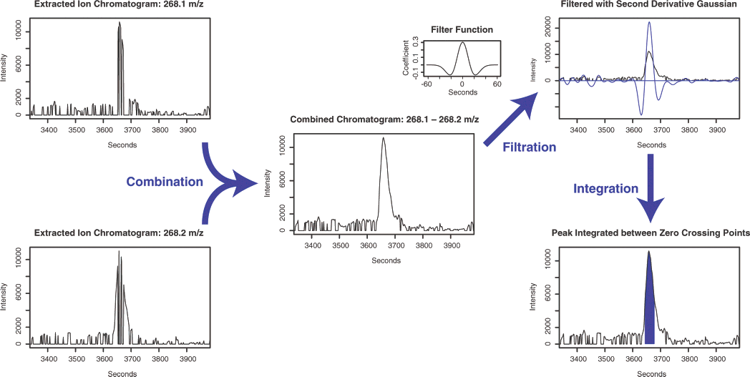
XCMS
Smith et al., Anal. Chem., 2006, 78, 779-787

Slide 14
XCMS
XCMS has become the quasi standard for LC-MS metabolomics data analysis
Recent versions include more advanced methods, including wavelet peak detection
For many tasks (e.g., biomarker detection), the identification of differential mass traces is sufficient (lower complexity of metabolomics data sets)
Other software packages also assemble mass traces back to features (e.g., OpenMS FeatureFinderMetabo)
Advantages here:
  Profit from additional information, increase specificity
  Reduced number of signals (multiple mass traces per feature)

Slide 15
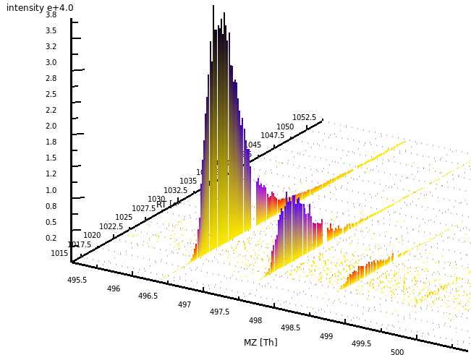
OpenMS - Metabolite Feature Finding
MS data condensed to feature list:
Feature ID | RT | m/z | intensity
F₁ | 403.25 | 309.13455 | 345923.1
F₂ | 302.89 | 235.20503 | 8109.5
... | ... | ... | ...
F_{new} | 1027.5 | 496.11304 | 45209.8
feature F_{new}
(RT, m/z, int)
intensity
mass trace detection
retention time
isotope pattern assembly
by intensity
data reduction
isotope pattern assembly
by m/z
mass-to-charge m/z
Kenar et al., Mol. Cell. Prot., 2014, 13(1):348-59. doi: 10.1074/mcp.M113.031278
Notes:
----- Besprechungsnotizen (28/06/2012 18:20) -----
Introduction -> Methods
data reduction -> move
append feature to list
border around Fnew row

Slide 16
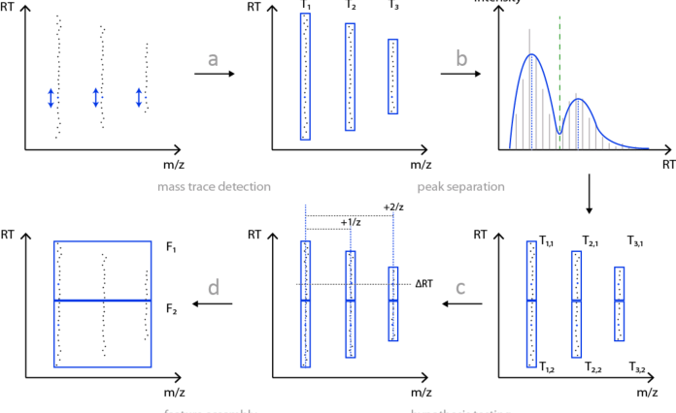
Algorithmic Overview
Kenar et al., Mol. Cell. Prot., 2014, 13(1):348-59. doi: 10.1074/mcp.M113.031278

Slide 17
Mass Trace Detection
A mass spectrometric peak p is given by
A mass trace T is a list of peaks:
m/z error model is adaptive
Online Gaussian density estimation
RT
t : retention time, m : mass-to-charge ratio, i : intensity
m/z
centroid m/z
m/z error
weight
m/z constraint
Kenar et al., Mol. Cell. Prot., 2014, 13(1):348-59. doi: 10.1074/mcp.M113.031278
Notes:
heteroscedasticity: m/z errors dependent on the intensity.
Online density estimation: stichwort RECRUITMENT of candidate peaks
Automatic refining of m/z error
----- Besprechungsnotizen (28/06/2012 18:20) -----
save more time… explanation
dense region… fade in the ends…

Slide 18
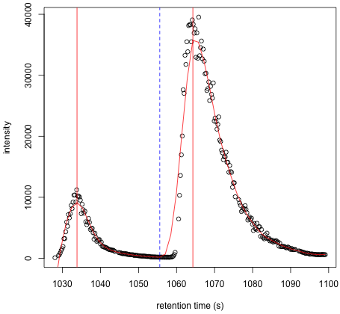
Peak Separation
Split chromatographic peaks overlapping in retention time
Full-Width-at-Half-
Maximum (FWHM)
Kenar et al., Mol. Cell. Prot., 2014, 13(1):348-59. doi: 10.1074/mcp.M113.031278

Slide 19
Feature Assembly
Identify mass traces belonging to the same feature
Multiple explanations are possible
Create all potential hypotheses and score them
intensity
retention time
monoisotopic
trace
¹³C satellite
traces
mass-to-charge m/z

Slide 20
Feature Scoring – m/z
m/z distances T₀ and T_{j}:
Theoretical m/z distances:
Mass errors for T₀ and T_{j}:
Pairwise scoring function:
intensity
retention time
T₀
T₁
T₂
T₃
mass-to-charge m/z

Slide 21
Feature Scoring – RT
RT shifts between T₀ and T_{j}:
Gaussian error model with
Pairwise scoring function:
intensity
retention time
mass-to-charge m/z

Slide 22
Feature Scoring – Intensity
Problem: There is no ‘averagine’ for metabolites
Idea
  Enumerate metabolite compositions and learn intensities
  ‘Golden rules’ describe likely chemistry (Kind & Fiehn, BMC Bioinfo, 2007)
  Generate all compositions, remove unlikely ones based on heuristics
intensity
i₀
24 mio.
compositions
retention time
T₀
T₁
i₁
Random subsample: 115 k compositions
T₂
i₂
i₃
T₃
SVM
(RBF kernel)
mass-to-charge m/z

Slide 23
Feature Scoring – Intensity
Intensity ratio of T₀ and T_{j}:
Assess if valid isotope ratios:
intensity
i₀
retention time
T₀
T₁
i₁
T₂
i₂
SVM
RBF kernel
i₃
T₃
mass-to-charge m/z
Yes, it is a legal isotope pattern, keep it
Or
No, it is not a legal isotope pattern,
discard it

Slide 24
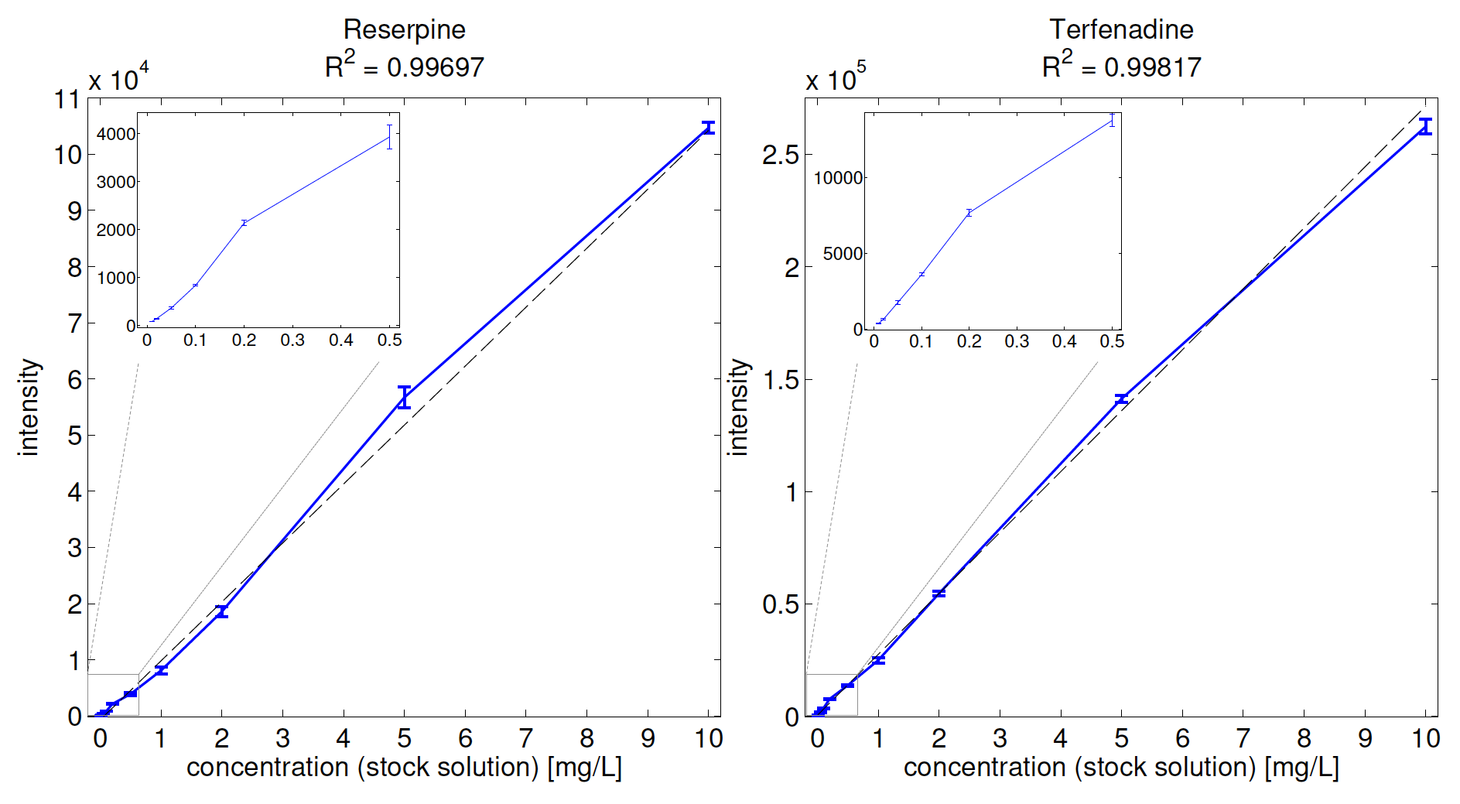
Quantification Linearity – Spike-In
Kenar et al., Mol. Cell. Prot., 2014, 13(1):348-59. doi: 10.1074/mcp.M113.031278

Slide 25
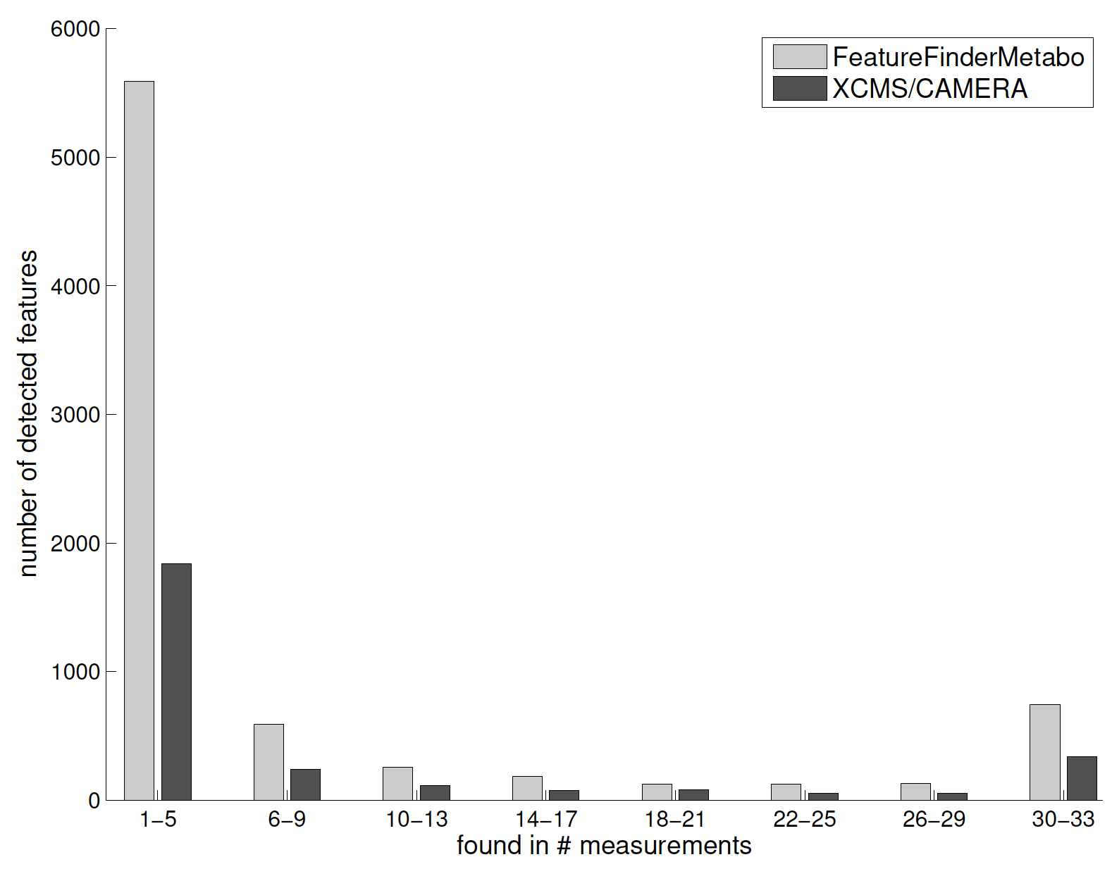
Sensitivity – Human Plasma
Kenar et al., Mol. Cell. Prot., 2014, 13(1):348-59. doi: 10.1074/mcp.M113.031278

Slide 26
Specificity – Synthetic Data
Benchmarking feature detection algorithms is HARD
  Multiple metrics are required: linearity, sensitivity, specificity
  Sensitivity needs to be balanced with specificity
  Experimental data does not come with a well-defined ground truth
Idea
  Simulated LC-MS data with known composition
  Take a well-defined experimental dataset (identification lists from a metabolomics study, plant metabolites)
  OpenMS LC-MS simulator was expanded to generate metabolite data
Method | Recall | Precision | F-score
OpenMS | 96% | 97% | 0.97
XCMS/Camera | 88% | 37% | 0.52

Slide 27
LU 12B
Non-targetd Metabolomics with OpenMS
Workflows for non-targeted metabolomics
Metabolomics workflows with OpenMS in KNIME
Integration into Compound Discoverer

Slide 28
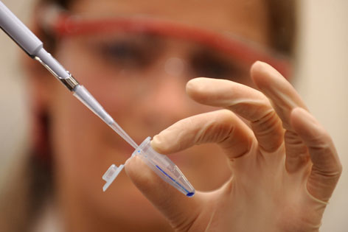

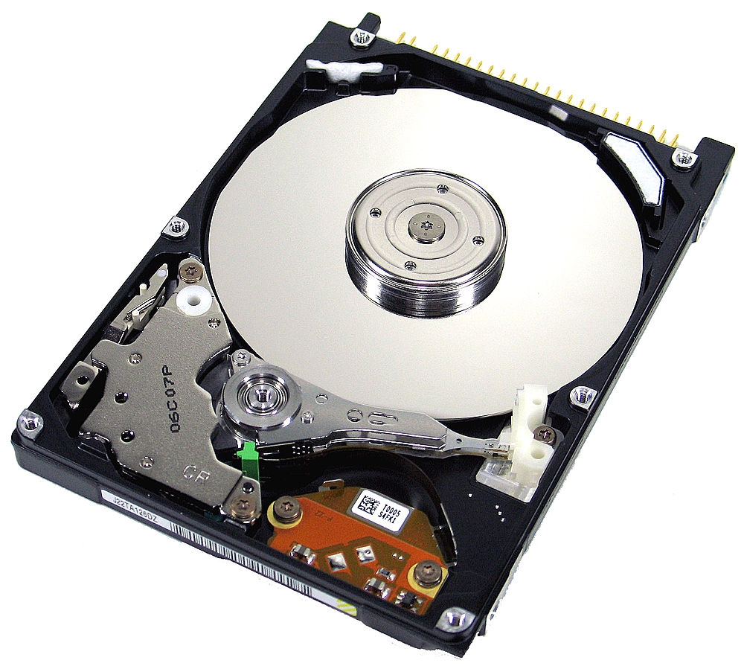
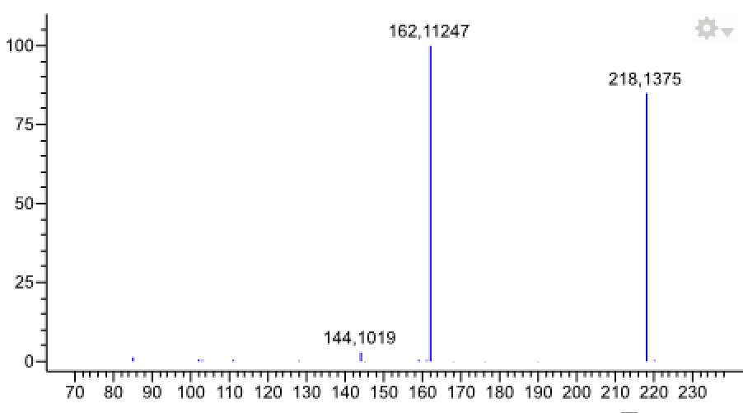
High Throughput vs. Low Throughput

Slide 29
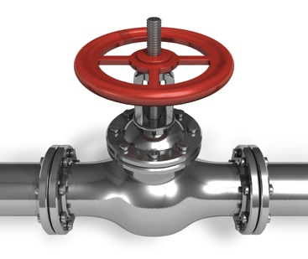
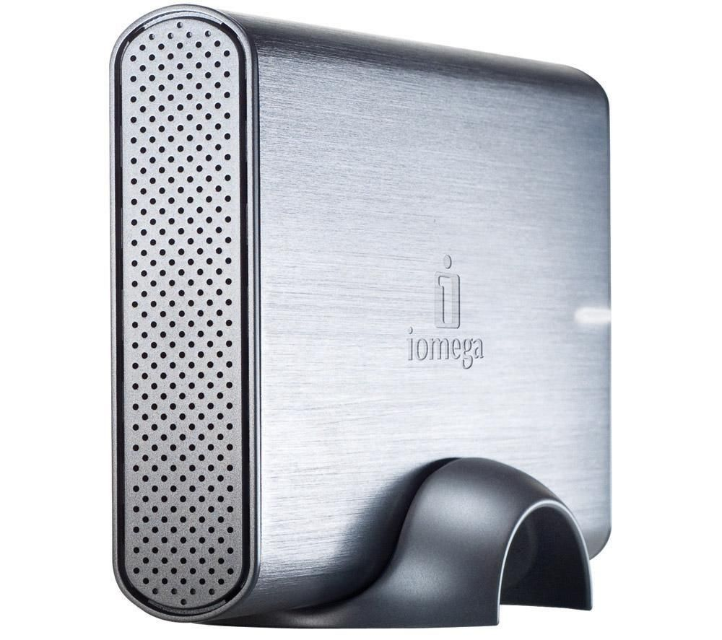





The Holy Grail

Slide 30
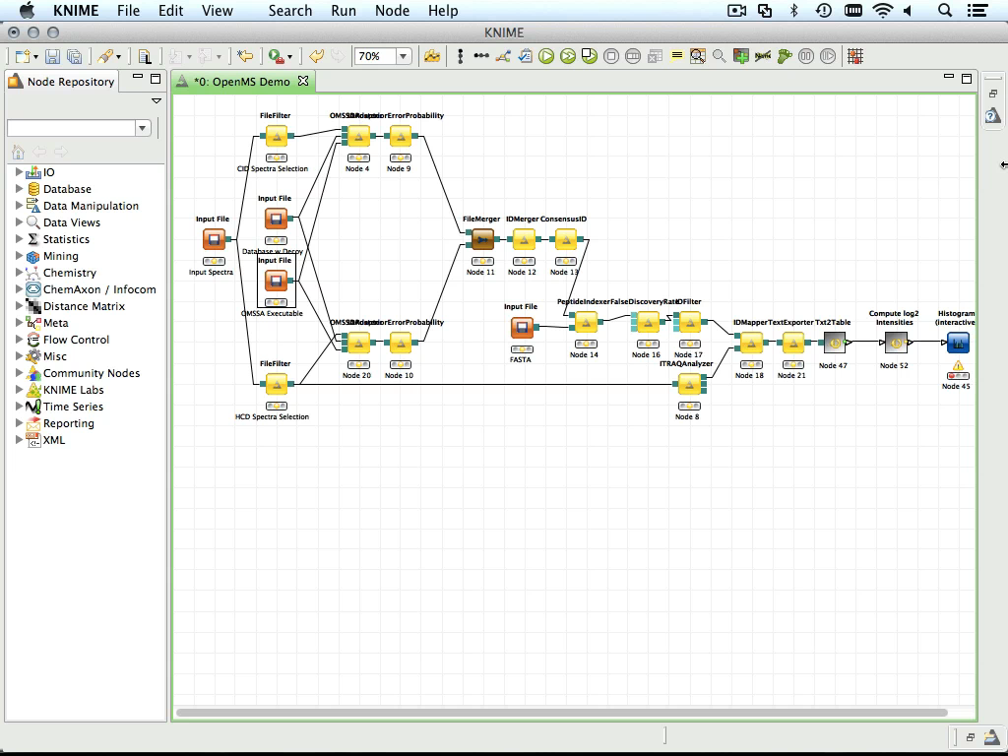
Outlook: OpenMS 1.10 & KNIME

Slide 31
Metabolomics – Biomarker ID
Complex workflow analyzing a diabetes-related metabolomics biomarker study
  Data preprocessing (yellow)
  Quantification (purple)
  Identification based on accurate mass/HMDB (gray)
  Detection of distinctive features, statistics (green/gray)
  Reporting of differential features and their structures (orange)

Slide 32
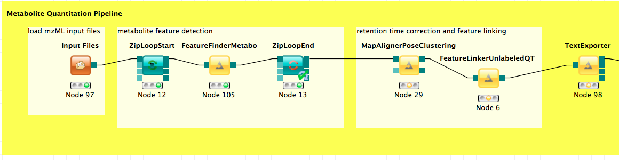
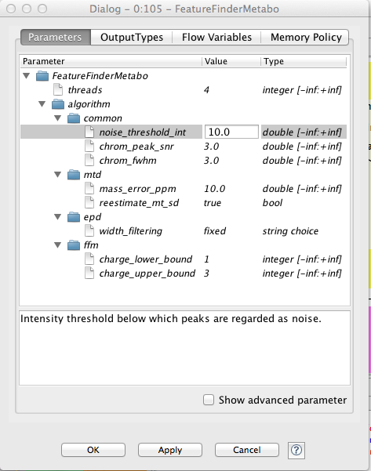

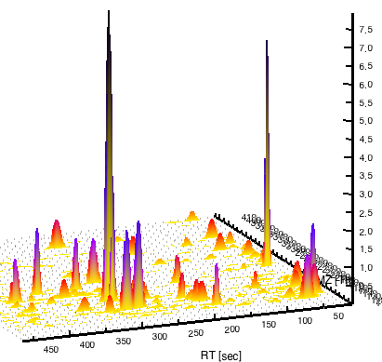
Metabolite Quantitation
CONSENSUS FEAT ID | centroid rt | centroid m/z | ... | charge | sample 1 intensity | sample 2 intensity
FEATURE 1 | 267.2673 | 163.0753568 | ... | 1 | 5288099840 | 50020923440
FEATURE 2 | 318.71268 | 163.0753568 | ... | 1 | 18835900 | 17835200
FEATURE 3 | 336.29508 | 163.0753568 | ... | 1 | 7285210 | 6285210
FEATURE 4 | 419.17302 | 179.0702718 | ... | 1 | 175022000 | 105022000
FEATURE 5 | 274.60434 | 179.0702718 | ... | 1 | 44317400 | 33317400
FEATURE 6 | 325.94712 | 179.0702718 | ... | 1 | 11875200 | 12879200
FEATURE 7 | 550.42272 | 179.0702718 | ... | 1 | 4871360 | 5071360
FEATURE 8 | 351.40896 | 179.0702718 | ... | 1 | 2919350 | 1019350
FEATURE 9 | 460.4874 | 179.0702718 | ... | 1 | 2021340 | 3221340
FEATURE 10 | 571.89324 | 179.0702718 | ... | 2 | 1546820 | 1446820
FEATURE 11 | 380.23242 | 179.0702718 | ... | 2 | 1993120 | 1893120
FEATURE 12 | 264.16152 | 195.0651868 | ... | 2 | 269592992 | 279592532
FEATURE 13 | 403.72314 | 195.0651868 | ... | 2 | 21862600 | 20342600
FEATURE ... | ... | ... | ... | ... | ... | ...
5 controls vs. 5 samples
Notes:
GENERIC KNIME NODES FOR OPENMS INTEGRATION

Slide 33
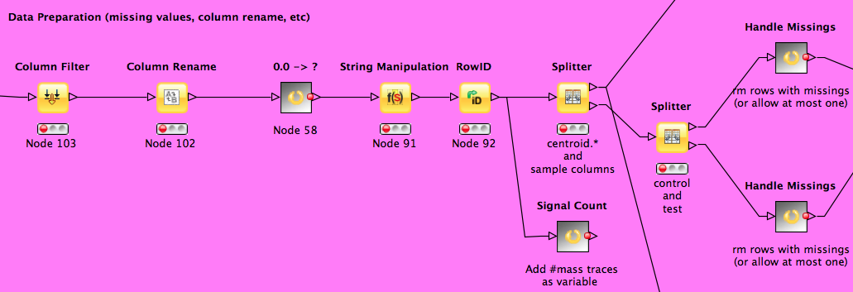
Data Table Magic
Row ID | centroid.rt | centroid.mz | ... | charge | Control_1 | Control_2 | Sample_2 | Sample_2
FEATURE 1 | 267.2673 | 163.0753568 | ... | 1 | 5288099840 | 50020923440 | 5288099840 | 50020923440
FEATURE 2 | 318.71268 | 163.0753568 | ... | 1 | 18835900 | 17835200 | 18835900 | 17835200
FEATURE 3 | 336.29508 | 163.0753568 | ... | 1 | 7285210 | 6285210 | 7285210 | 6285210
FEATURE 4 | 419.17302 | 179.0702718 | ... | 1 | 175022000 | 105022000 | 175022000 | 105022000
FEATURE 5 | 274.60434 | 179.0702718 | ... | 1 | 44317400 | 33317400 | 44317400 | 33317400
FEATURE 6 | 325.94712 | 179.0702718 | ... | 1 | 11875200 | 12879200 | 11875200 | 12879200
FEATURE 7 | 550.42272 | 179.0702718 | ... | 1 | 4871360 | 5071360 | 4871360 | 5071360
FEATURE 8 | 351.40896 | 179.0702718 | ... | 1 | 2919350 | 1019350 | 2919350 | 1019350
FEATURE 9 | 460.4874 | 179.0702718 | ... | 1 | 2021340 | 3221340 | 2021340 | 3221340
FEATURE 10 | 571.89324 | 179.0702718 | ... | 2 | 1546820 | 1446820 | 1546820 | 1446820
FEATURE 11 | 380.23242 | 179.0702718 | ... | 2 | 1993120 | 1893120 | 1993120 | 1893120
FEATURE 12 | 264.16152 | 195.0651868 | ... | 2 | 269592992 | 279592532 | 269592992 | 279592532
FEATURE 13 | 403.72314 | 195.0651868 | ... | 2 | 21862600 | 20342600 | 21862600 | 20342600
FEATURE ... | ... | ... | ... | ... | ... | ... | ... | ...

Slide 34
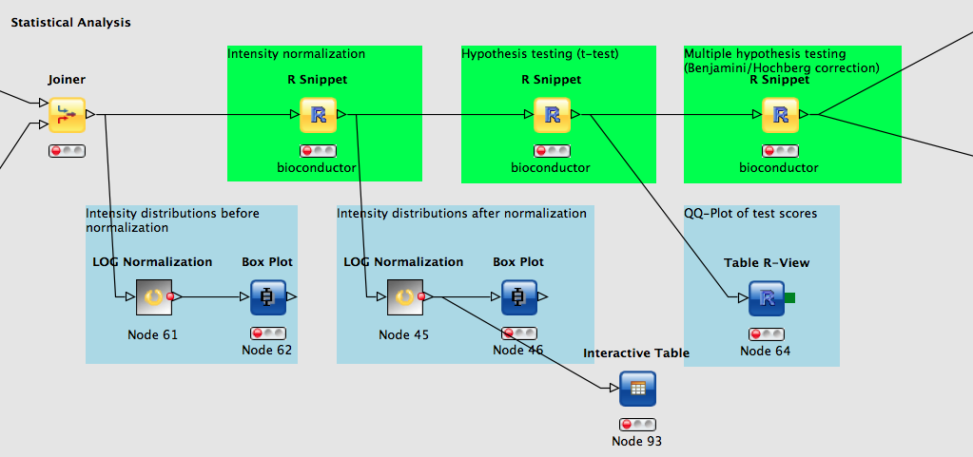
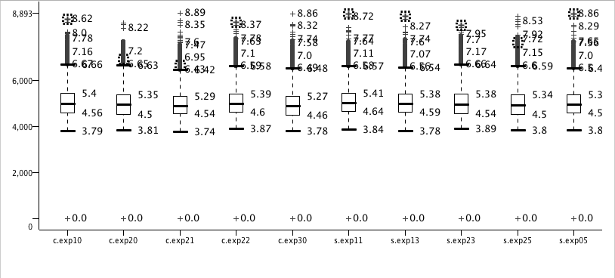
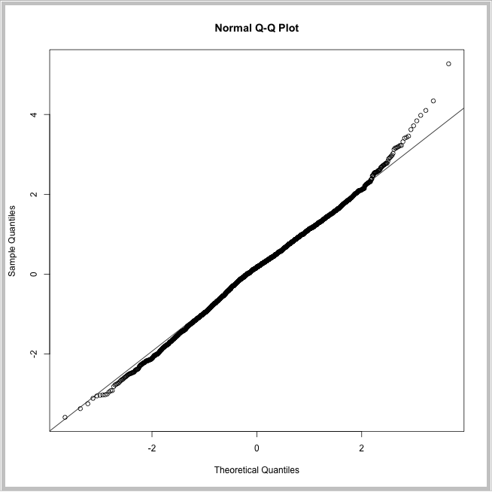
Multiple Hypothesis Testing
Notes:
* R INTEGRATION ERWÄHNEN
* MULTIPLE HYPOTHESIS TESTING

Slide 35
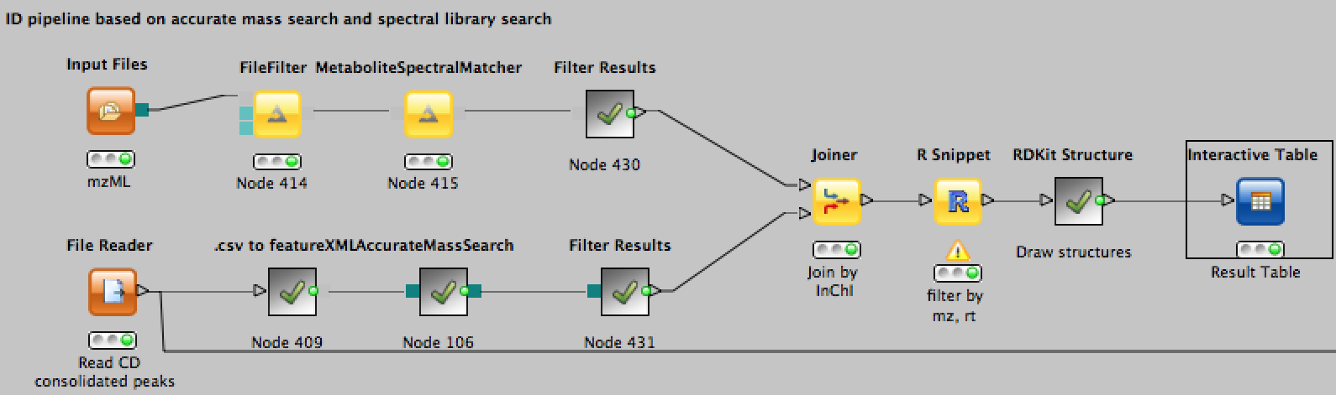
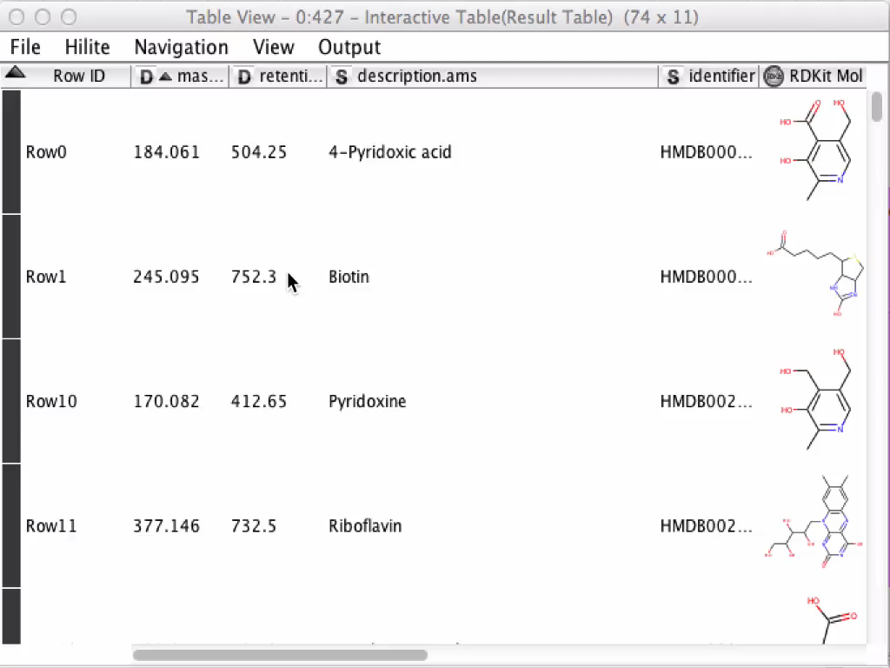
Metabolite ID
Multiple ID strategies
Accurate mass
Retention time database
Retention time prediction
Spectral matching
KNIME provides
Online access to structure
databases
Structure visualization
Cheminformatics
    Metabolization
    Substructure search
Notes:
Accurate Mass Search einführen erklären:
Pseudomolecular ion list modifiable
Mimics HMDB search, adjust to other DBs
Visualization SMILES->Molecule
mzTab Reporting format

Slide 36
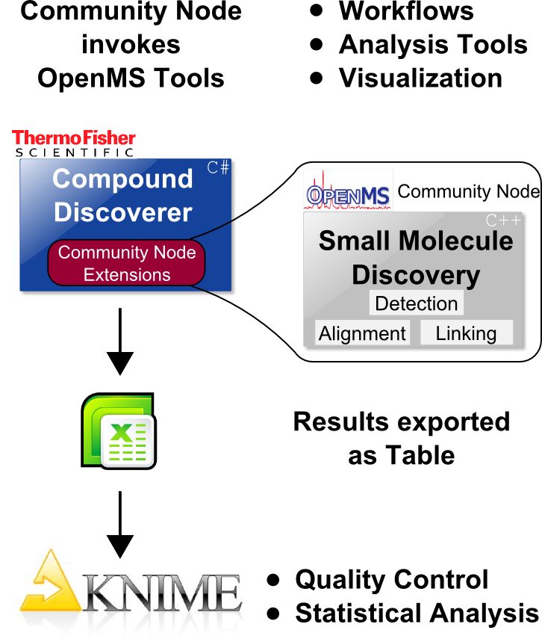
Thermo Fisher Compound Discoverer

Slide 37
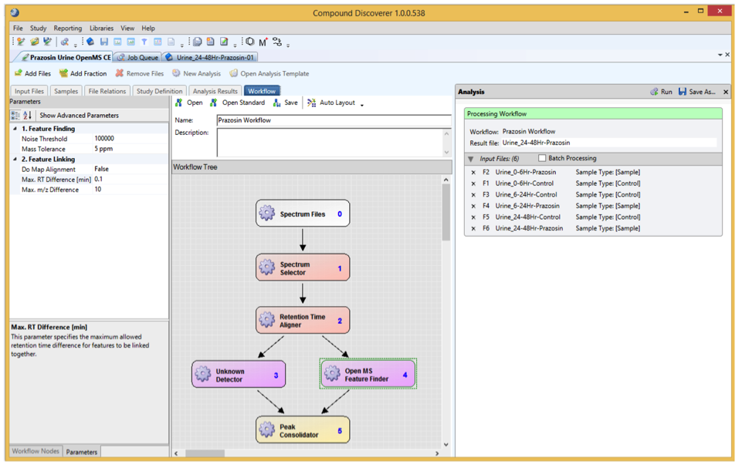
Metabolomics – Biomarker ID
Compound Discoverer
Complex workflow for a diabetes-related metabolomics biomarker study (normal vs. disease)
  Data preprocessing (yellow)
  Quantification (purple)
  Identification based on accurate mass/HMDB (gray)
  Detection of distinctive features, statistics (green/gray)
  Reporting of differential features and their structures (orange)

Slide 38
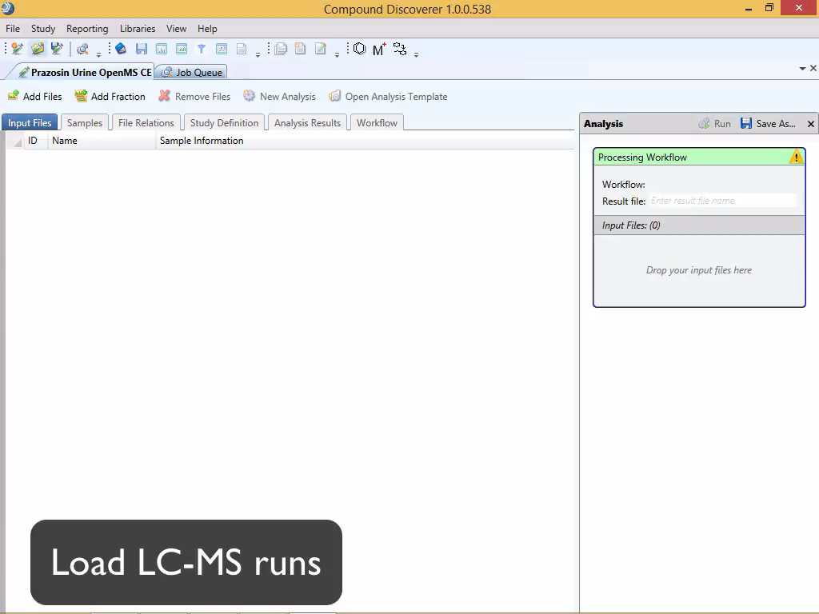

Slide 39
References
XCMS
  C.A. Smith, E.J. Want, G.C. Tong, R. Abagyan, and G. Siuzdak. XCMS: Processing Mass Spectrometry Data for Metabolite Profiling Using Nonlinear Peak Alignment, Matching, and Identification. Anal. Chem., 2006,
FeatureFinderMetabo
  Kenar, E, Franken, H, Forcisi, S, Wörmann, K, Häring, H, Lehmann, R, Schmitt-Kopplin, P, Zell, A, and Kohlbacher, O (2014). Automated Label-Free Quantification of Metabolites from LC-MS Data. Mol. Cell. Prot., 13(1):348-59. http://dx.doi.org/10.1074/mcp.M113.031278

Slide 40
Materials
Learning Units 12A, 12B

