Slide 1
Computational Proteomics and Metabolomics
Oliver Kohlbacher, Sven Nahnsen, Knut Reinert
11. Metabolite Identification

Slide 2
Learning Unit 11A Metabolites and Metabolomics
Differences between proteomics and metabolomics
Targeted vs. nontargeted metabolomics

Slide 3
Metabolism
Metabolism = sum of all the chemical processes occurring in an organism at one time
Concerned with the management of material and energy resources within the cell
Two types of metabolic processes
Anabolic processes – processes constructing larger molecules from smaller units (building up)
Catabolic processes – processes breaking down larger units (degradation or energy generation)
Metabolites are both educts and products of metabolic processes
Enzymes (proteins) usually catalyze these metabolic processes (reactions)
A sequence of several coupled metabolic processes is called a metabolic pathway

Slide 4
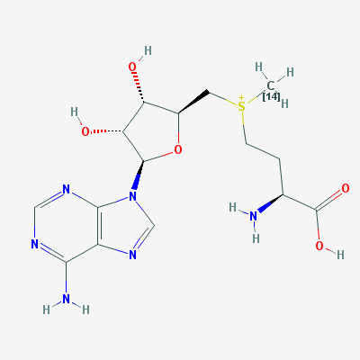
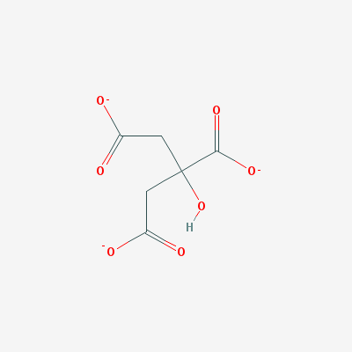
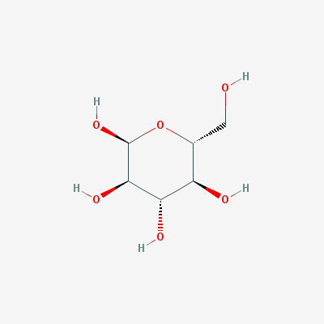
Metabolomics vs. Proteomics
Proteomics
Metabolomics
FGGTSVANAER
VADILESNAR
MSIAIMAGVLEAR
TISGQDALPNISDAER
TFVDQEFAQIK
ITNHLVAMIEK
QGQVATVLSAPAK

Slide 5
Metabolome vs. Proteome
Size and complexity of the metabolome still largely unknown
Similar to protein sequence databases, there are also metabolite databases listing all known metabolites (usually contains tens of thousands of metabolites)
Differences between proteome and metabolome
Metabolites belong to wider ranger of chemical compound classes (lipids, sugars, amino acids)
Proteins have a more homogenous chemistry (20 proteinogenic amino acids)
Metabolites can have complex structures that require a structural formula for a comprehensive description
Proteins have a simple, linear structure that can be represented by a sequence
Metabolites are light: average metabolite mass a 100-300 Da
Proteins are heavy: median protein length around 300-500 aa, about 40,000 Da molecular weight
Notes:
TODO: distribution of MW in SWISS-PROT (-> Knut: Let them do it as exercise)
TODO: plot distribution of MW in KEGG and/or HMDB (Knut: -> let them do it as exercise)

Slide 6
Metabolomics Techniques
Fundamentally two types of approaches
Targeted metabolomics
Identify only a well-defined subset of metabolites, but those with higher accuracy (hundreds?)
All of these metabolites can then be identified
Non-targeted metabolomics (metabolic profiling)
Try to see as much of the metabolome as possible (thousands and more)
Majority of metabolites can be seen
Only a small fraction will be identified
Similarly, there is also targeted and non-targeted proteomics
In proteomics, the identification problem is less difficult, though, which is why this distinction is more relevant in metabolomics (where identification is much harder)

Slide 7
Metabolomics vs. Proteomics
We will restrict ourselves to LC-MS(/MS)-based metabolomics in this course
LC-MS can be used for quantification of metabolites in the same fashion as for peptides/proteins
Labeled and unlabeled quantification approaches can be used
Identification differs significantly
Metabolites (in the general case) are not linear polymers, thus there is no sequence
Their chemistry is much more diverse and their fragmentation behavior as well
no search against sequence database, no ion series

Slide 8
Metabolomics vs. Proteomics
Quantification
Wide range of chemical structures does not permit a simple in vitro labeling for arbitrary metabolites (as, for example, iTRAQ)
Labeling has to be done in vivo (metabolic labeling)
Feature detection is complicated
Frequent occurrence of S, Cl, Br leads to complex isotope patterns
Averagine hypothesis does not hold

Slide 9
Learning Unit 11B Metabolite Databases
Databases for mass spectra
Databases for compounds
Databases for pathways
Comparison of databases

Slide 10
Databases
Metabolomics has to rely on different types of databases
Structural databases – contain structures of metabolites
Pathway databases – contain metabolic networks
Spectrum databases – contain information on mass spectra
In contrast to sequencing data, many of the databases are commercial
Freely accessible spectrum databases for metabolites are still rare

Slide 11
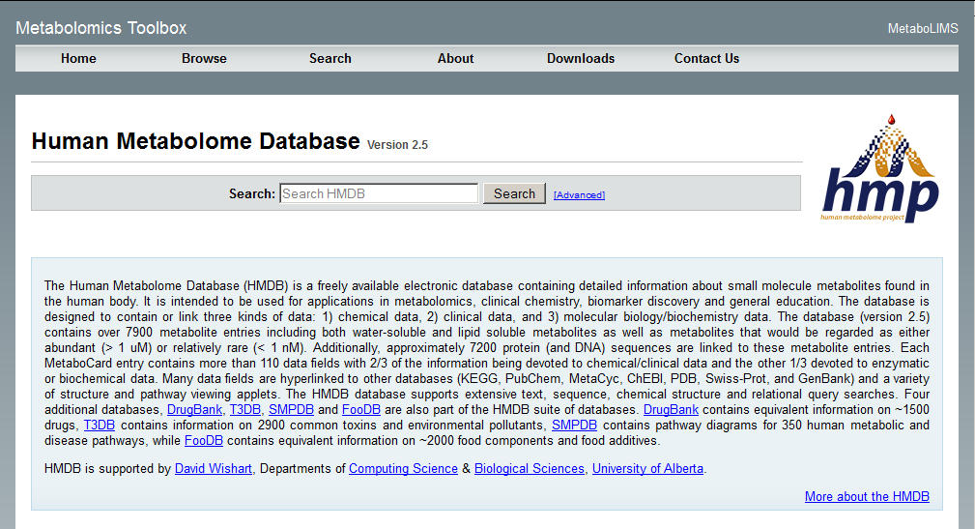
HMDB
Database of known human metabolites. Rich in metadata and annotation, no mass spectra.
hmdb.ca

Slide 12
Human Metabolome Database
hmdb.ca

Slide 13
Human Metabolome Database
hmdb.ca

Slide 14
Human Metabolome Database
hmdb.ca

Slide 15
Human Metabolome Database
hmdb.ca

Slide 16
Human Metabolome Database
hmdb.ca

Slide 17
Human Metabolome Database
HMDB contains mass spectra of metabolites,
but data is not downloadable in bulk.
Search against the spectra database is only
possible through the web interface.
Identification by accurate mass or MS/MS
spectrum comparison.
hmdb.ca

Slide 18
Human Metabolome Database
hmdb.ca

Slide 19
METLIN
Database containing a large number of metabolites (240,000+) and spectra for those (12,000 metabolites). Permits search of metabolites via their mass spectra.
http://metlin.scripps.edu/

Slide 20
MassBank
Database containing mass spectra of a large number of metabolites and metadata for these compounds.
Permits search of metabolites via their mass spectra.
http://www.massbank.jp/

Slide 21
mzCloud
mzCloud (currently) contains only a very limited number of metabolites, but very high quality spectra and is growing quickly.

Slide 22
KEGG
KEGG (Kyoto Encyclopedia of Genes and
Genomes) contains structural information
of metabolites as well as pathway
information.
http://www.genome.jp/kegg/

Slide 23
HumanCyc
HumanCyc contains a very comprehensive set of metabolic pathways.

Slide 24
PubChem
PubChem contains structures and names of around 30 mio. compounds, including
most structurally characterized metabolites.

Slide 25
Database Comparison
DB | # cpds | # MS² spectra
HMDB (2.5) | 41,818 | 10,869
METLIN (2015) | 240,000 | 62,204
MassBank (2015) | ? | 40,889
NIST (commercial, 2011) | 4,694 | ~100,000
mzCloud (2015) | 2,091 | 142,690
PubChem (2015, cpds only!) | 63,156,000 | -

Slide 26
Raw Data Repositories
MetaboLights stores original experimental data (raw data) and interpreted data from metabolomics studies.
http://www.ebi.ac.uk/metabolights

Slide 27
Raw Data Repositories
Datasets are identified via the MetaboLights ID (here:MTBLS17). Metadata for the study describes the samples and method employed (here: HCC study using LC-MS).

Slide 28
Raw Data Repositories
For every study there is also information available on each of the individual samples/runs (here: instrument, separation, sample description).

Slide 29
Raw Data Repositories
Usually the raw data for each run/sample (as acquired on the instrument) can be downloaded for (re-)analysis.

Slide 30
Raw Data Repositories
Data can also be browsed by (identified) compound to see what metabolites have been identified by which method (here: MS) or in a certain organism (here: human).

Slide 31
Growth of Metabolomics Data
Illustration: Christoph Steinbeck, EBI
Notes:
Fig: pers. Comm. Chris Steinbeck (2014-10-03)

Slide 32
Learning Unit 11C Metabolite ID via Spectral Matching and Accurate Mass
Distribution of metabolite masses
Matching MS/MS spectra against databases
Accurate mass search

Slide 33
Identification Algorithms
Identification by accurate mass
Given a sufficient mass resolution, the mass alone contains valuable information on the metabolite
Usually, these masses are not unique
Problem: structural isomers are isobaric!
Identification through spectrum comparison
Library search
Compare the experimental spectrum against other experimental spectra
Requires library of experimental spectra (difficult)
Fragment tree approaches
Try to predict fragmentation patterns
Compare spectrum against theoretical fragmentation pattern

Slide 34
Mass Distribution
Mass Range | # of PubChem Hits
50-51 Da | 71
100-101 Da | 2,180
150-151 Da | 9,163
200-201 Da | 23,867
250-251 Da | 48,909
300-301 Da | 78,577
350-351 Da | 112,566
400-401 Da | 130,737
Mass Range | # of PubChem Hits
100.0-100.1 Da | 367
100.1-100.2 Da | 1,628
100.2-100.3 Da | 60
100.3-100.4 Da | 10
100.4-100.5 Da | 21
100.5-100.6 Da | 28
100.6-100.7 Da | 3
100.7-100.8 Da | 3
100.8-100.9 Da | 21
100.9-101.0 Da | 39
Limited number of different isotope masses gives rise to ‘lumpy’ distribution across the mass range.

Slide 35
Mass Distribution
# of decompositions
Böcker et al., Bioinformatics (2009); 25(2):218–224.

Slide 36
Isomers
Example: Structural isomers with mass 117.0790 Da, formula: C₅H₁₁NO₂

Slide 37
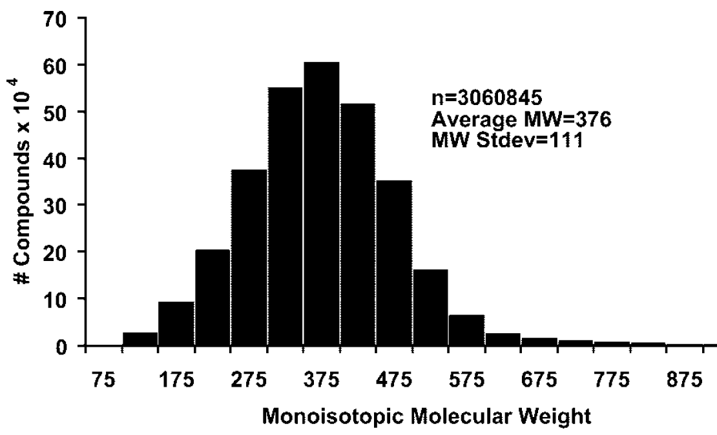
Metabolite Masses
Metabolites have a rather limited mass range (compared to peptides)
They cluster mostly in a mass range usually not relevant to proteomics (proteomics: 500+ Da)
Most metabolites have between 50-100 atoms and a mass between 300-500 Da
Hill et al., Anal. Chem., 2008, 80:5574

Slide 38
METLIN MS/MS Search
METLIN provides search options based on
Accurate mass
Return all metabolites matching a specific mass
Tandem spectra
Return all metabolites with a matching tandem spectrum
As with HMDB, spectra cannot be downloaded in bulk, image display only

Slide 40
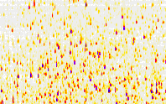
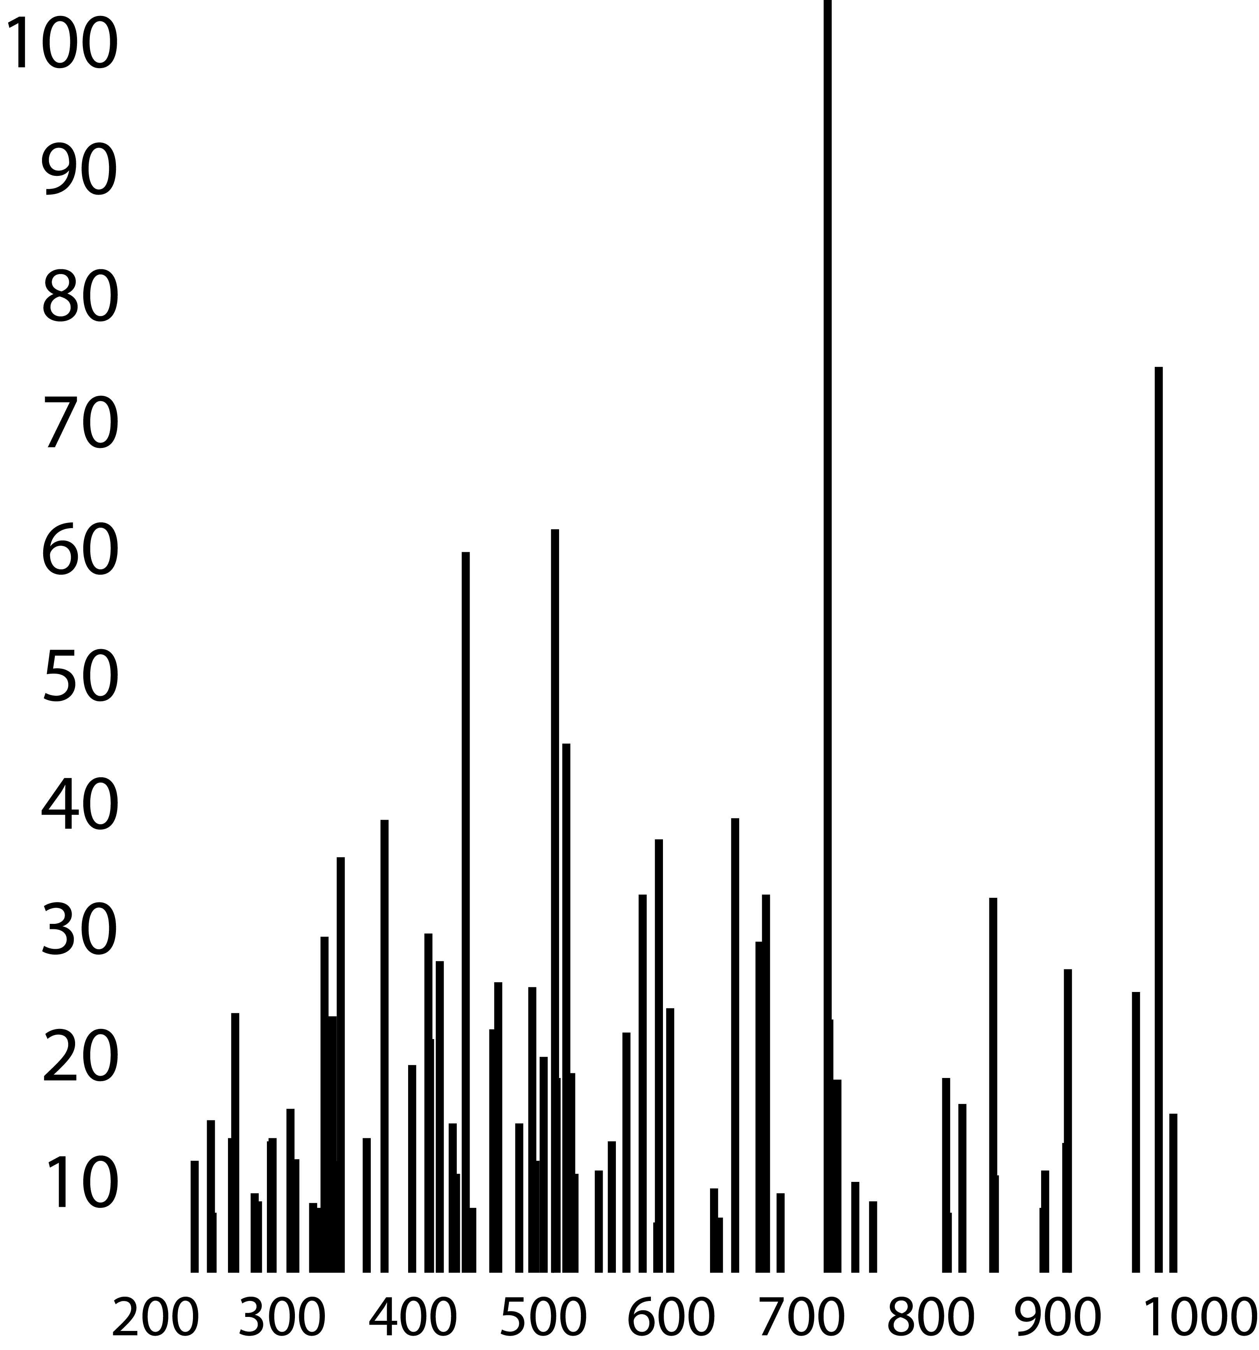
Spectral Library Search
LC-MS/MS experiment
Experimental MS/MS spectra
Fragment m/z values
569.24
572.33
580.30
581.46
582.63
606.32
610.24
616.14
RT
[%]
m/z
m/z
Compare
Score hits
569.24
572.33
580.30
581.46
582.63
606.32
610.24
616.14
1 | Glucose | 0.92
2 | Myo-inositol | 0.78
3 | Sorbose | 0.63
569.24
572.33
580.30
581.46
582.63
606.32
610.24
616.14
569.24
572.33
580.30
581.46
582.63
606.32
610.24
616.14
569.24
572.33
580.30
581.46
582.63
606.32
610.24
616.14
569.24
572.33
580.30
581.46
582.63
606.32
610.24
616.14
569.24
572.33
580.30
581.46
582.63
606.32
610.24
616.14
Library spectra
[%]
Spectrum DB
m/z
569.24
572.33
580.30
581.46
582.63
606.32
610.24
616.14
569.24
574.83
580.70
580.92
579.99
603.92
611.14
616.74
570.84
571.72
580.40
591.18
579.35
607.25
611.42
614.45
[%]
m/z
Fragment m/z lists from library spectra
[%]
m/z

Slide 41
Spectral Library Search
Searching spectra against a library is done with similarity functions similar to those used in peptide ID (e.g., correlation, shared peak count)
Success of the spectrum depends on similar experimental conditions:
Instrument type
Instrument resolution
Fragmentation method and parameters (e.g., collision energy)
Acquiring a library of spectra requires acquisition of spectra, which in turn requires the physical ownership of reference metabolites
Not all metabolites are readily commercially available

Slide 42
Spectral Library Search
Key issues
Metabolite spectra often less information-rich than peptide spectra
Few readily available (downloadable!) databases of metabolite spectra
Coverage of spectra thus much worse than in proteomics – we usually can identify only a negligible fraction of the metabolome
Fragmentation differs drastically between instruments, depends on collision energy

Slide 43
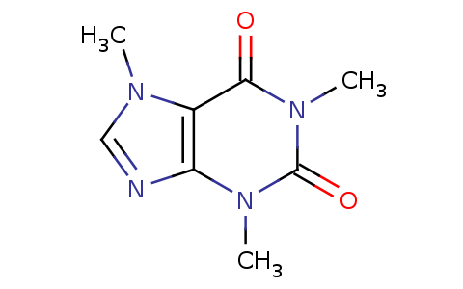
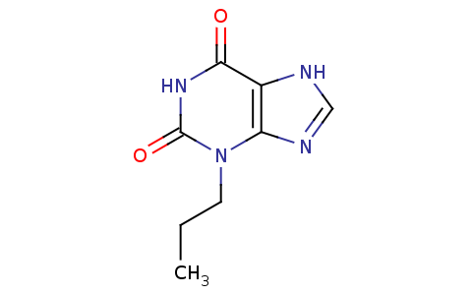
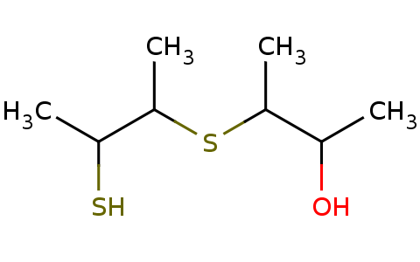
Accurate Mass Search
LC-MS/MS experiment
Experimental MS spectra
Accurate feature masses
m/z 195.0877
RT
[%]
m/z
m/z
Compare
Hit List
Δm/z < δ?
1 | Caffeine
2 | Isocaffeine
Metabolite Structures
Metabolite
DB
195.0876
195.0877
195.0882
195.0872
195.0869
M+H
M+NH₄
M+Na
M+K
M+ACN+H
...
Exact candidate masses w/ adducts
Adduct List

Slide 44
Accurate Mass Search
If spectra are not available for a compound, search can be done
The metabolite m/z differs from the metabolite monoisotopic mass:
Ionization adds or removes proton(s)/electron(s)
Metabolites often appear as adducts
Addition of counter ions (sodium, ammonium)
Solvent adducts (acetonitril, methanol)
Searching each for each compound with multiple possible adducts increases search space
Search critically depends on instrument mass accuracy (recalibration helps)

Slide 45
Accurate Mass Search w/ METLIN

Slide 46
Accurate Mass Search w/ METLIN

Slide 47
Accurate Mass Search w/ METLIN

Slide 48
Accurate Mass Search - Caveats
Limiting factors are
Instrument accuracy: big mass error implies huge search space
Database completeness: we still search against a (metabolite structure) database – compounds need to be known to be identifiable
Isobaric ambiguities: isobaric metabolites cannot be distinguished
Consequence: identified metabolites are validated again experimentally (standard compounds, reference spectra) whenever possible

Slide 49
Learning Unit 11D Fragmentation Trees
Fragmentation tree concepts
Algorithmic approaches
Software packages

Slide 50
Fragmentation Trees
Fragmentation trees are directed acyclic graphs relating the molecular structure of a metabolite to potential fragment masses
Idea
Fragmentation means breaking bonds in the metabolite
By systematically and repeatedly breaking all bonds in a structure and its fragments, one can construct the set of all possible fragments
Fragmentation occurs preferentially along low-energy dissociation pathways
Problems
Not all fragments will be observed
Gas phase fragmentation chemistry is more complex
Rearrangement reactions lead to different structures
Neutral losses are not covered by this
Cycles in molecular graphs pose problems

Slide 51
Fragmentation Trees
There are different ways for constructing fragmentation trees
Decomposition of molecular structures
Decomposition of molecular formulas
The first method requires – and leverages – information from available molecular structures
The second approach relies solely on sufficiently accurate masses
We will first discuss the approach based on structures as suggested by Heinonen (2006) and then discuss the algorithmic strategies of the second approach by Böcker & Rasche (2008)
Heinonen et al., Proc. German Conf. Bioinfo (GCB 2006)
Böcker & Rasche, Bioinformatics (2008), 24:i49-i55.

Slide 52
Structural Fragmentation Trees
Heinonen et al. suggest to start with a molecular graph G = (V, E) where V represent atoms and E bonds between atoms and decompose this graph by breaking bonds, i.e. removing edges from G
Any connected subgraph of G = (V, E) is a possible fragment that can be formed from G
More formally:
The fragmentation tree G_{F} = (F, E_{F}, c) of G is an acyclic directed graph where
F is the set of nodes corresponding to all fragments that can be formed of G (i.e., all possible connected subsets E’ E)
E_{F} is the set of directed edges from each fragment in F to its subfragments (i.e., fragments that are themselves connected subsets of a fragment or the original molecule)
c: E_{F} R associates each edge with a cost for forming this fragment
Heinonen et al., Proc. German Conf. Bioinfo (GCB 2006)

Slide 53
Structural Fragmentation Trees
Source molecules can be fragmented in a single step (yielding MS2 spectra) or iteratively until no further fragments can be found (yielding multiple fragmentations as in MS^{n} spectra)
The cost function models the likelihood for forming a particular fragment
Cost function can be modeled by bond energies (more stable bonds are more ‘expensive’, less likely to break)
The best explanation for a tandem spectrum (or for fragment masses observed across multiple fragmentation experiments) should thus be the most likely fragmentation pattern
Heinonen et al., Proc. German Conf. Bioinfo (GCB 2006)

Slide 54
Structural Fragmentation Trees
Identification
Given a spectrum S = (s₁, …, s_{k}) with distinct peak masses s_{i}
Find the lightest connected subtree G_{F}* of G_{F} of the fragmentation tree that explains all masses s_{i} in the spectrum
This can be repeated for a set of possible structures and results can be scored
The lightest subtree needs to break the fewest/weakest bonds and still explains all fragments
Masses are represented by internal nodes as well as leaves of G_{F}*
It has to be connected, because the ions represented by leaves cannot be formed if the fragments represented by internal nodes are not formed

Slide 55
Structural Fragmentation Trees
Heinonen et al. suggest that lightest fragmentation trees can be found using mixed integer linear programming (MILP) – for details see their paper
They tested the method on a small set of metabolite spectra
For the majority of metabolites, their method could explain 80-90% of the fragments
Their method was not used to perform a thorough identification benchmark, though

Slide 56
Compositional Fragmentation Trees
Heinonen’s structural fragmentation trees are the metabolomics equivalent of protein database search: a set of structures is fragmented and theoretical fragmentation trees can then be compared to an experimental spectrum
Compositional fragmentation trees can be used in a way similar to de novo identification in proteomics
The idea is based on the concept of mass decomposition
A fragment/molecule mass has to correspond to the molecular mass of an existing chemical structure
It thus has to correspond to the sum of integer multiples of atomic masses
Given a mass measurement accuracy , each measured fragment mass m_{i} has to satisfy
m_{i} - ∑_{ι} a_{i} c_{i} m_{i} +
for monoisotopic atomic masses a_{i} of all elements involved and c_{i} N₀
Coefficients c_{i} define the composition of the fragment/molecule, i.e. its chemical formula (number of atoms of each element)

Slide 57
Rapid Mass Decomposition
Given a fragment mass m_{i} and monoisotopic atomic masses corresponds to an integer knapsack problem (‘find all possible ways to pack the atoms into a knapsack such that it has the required fragment mass’)
Given a limited set of elements (CHNOPS), one can easily enumerate all possible compositions for a given mass (e.g., using dynamic programming, but more efficient solutions exist)
For CHNOPS, there are about 700 mio. different compositions with a mass below 1,000 Da (Böcker et al., 2006)
Given a sufficient mass accuracy (1-2 ppm), it is usually possible to uniquely identify the composition of a molecule
Accordingly, it is possible to reconstruct the compositions for fragment ions
Böcker et al., WABI 2006, LNBI 4175, pp. 12-23, Springer, 2006

Slide 58
Compositional Fragmentation Trees
A compositional fragmentation graph is then constructed from the observed masses m_{i} of fragment ions and the molecular mass M obtained in a set of experiments
A composition c = (c₁, …, c_{k}) (molecular formula) of a fragment is kept for a mass, if it is a submolecule of the metabolite composition C = (C₁, …, C_{k}), i.e. if
The compositional fragmentation graph G_{C}(V, E) is then a directed acyclic graph with nodes representing each possible composition of any of the fragment masses in the spectrum and the mass of the original metabolite
A directed edge (u, v) is inserted if node v represents a submolecule of the fragment represented by node u
Each node is assigned a color based on the mass its composition was derived from

Slide 59
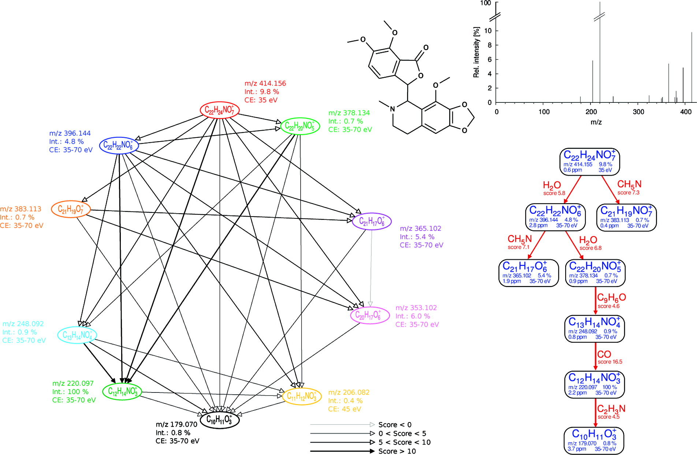
Compositional Fragmentation Trees
Rasche et al., Anal. Chem., 2011, 83:1243–1251

Slide 60
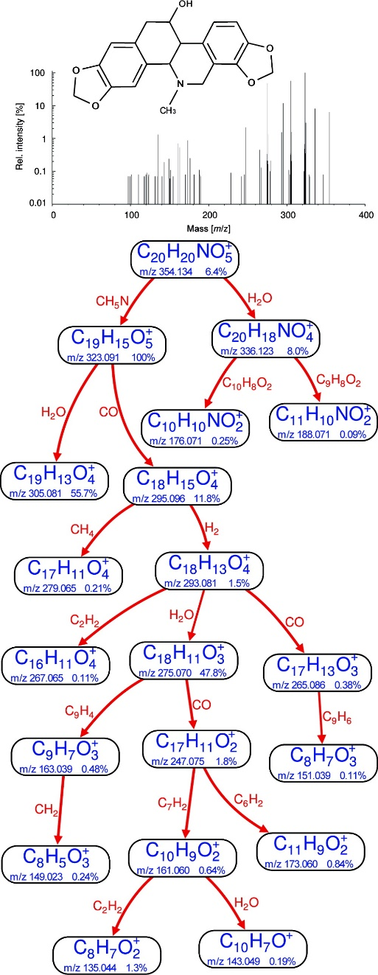
Compositional Fragmentation Trees
Notes:
Nodes represent compositions and thus many nodes may represent the same peak
Multiple nodes can thus have the same color
The graph is transitive: (u, v), (v, w) E also implies (u, w) E
Information from multiple spectra (MS^{n} or MS² at varying collision energies) can be freely combined
Rasche et al., Anal. Chem., 2011, 83:1243–1251

Slide 61
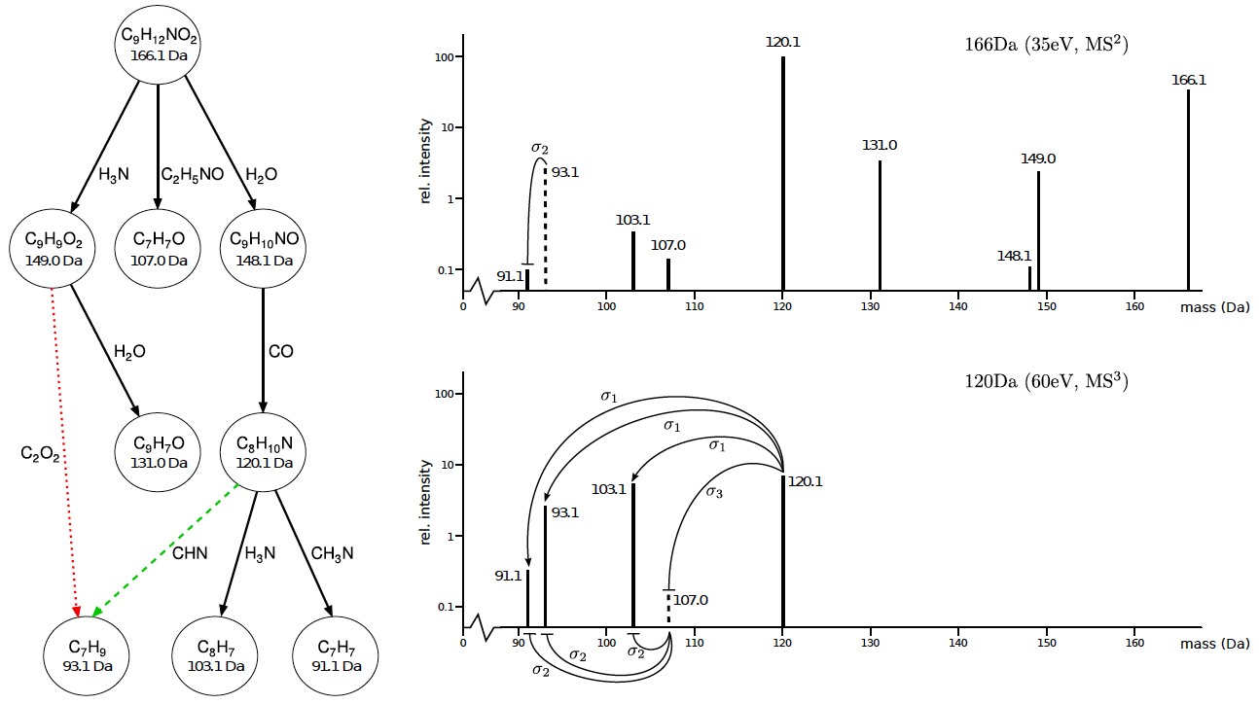
Compositional Fragmentation Trees
Scheubert et al., RECOMB 2011, LNBI 6577, pp. 377-391, 2011

Slide 62
Maximum Colorful Subtree
Assumption
Every peak is explained by a single molecular fragment
This implies, that a valid fragmentation tree
is a subtree of the fragmentation graph and
contains at most one node of each color
We can define a colorful subtree T = (V_{T}, E_{T}) of a vertex-colored DAG G as a subtree of G which uses each color at most once
If we are given edge weights that correspond to fragmentation probabilities, we can try to identify the most likely fragmentation tree
This corresponds to finding the maximum colorful subtree, i.e. the colorful subtree of G with the maximal weight

Slide 63
Maximum Colorful Subtree
Finding a maximum colorful subtree is in general NP-hard even for unit weights
Böcker & Rasche show this by a reduction from SAT
Accordingly, standard methods for solving NP-hard problems have been applied
Branch & bound
FPT algorithms (fixed-parameter tractable)
Dynamic programming
Heuristic solutions
All these methods yield good solutions for the identification of fragmentation trees and can be used to identify metabolites
Notes
Identification of the chemical formula does not yet uniquely identify the metabolite!
Structural isomers still have the same chemical formula

Slide 64
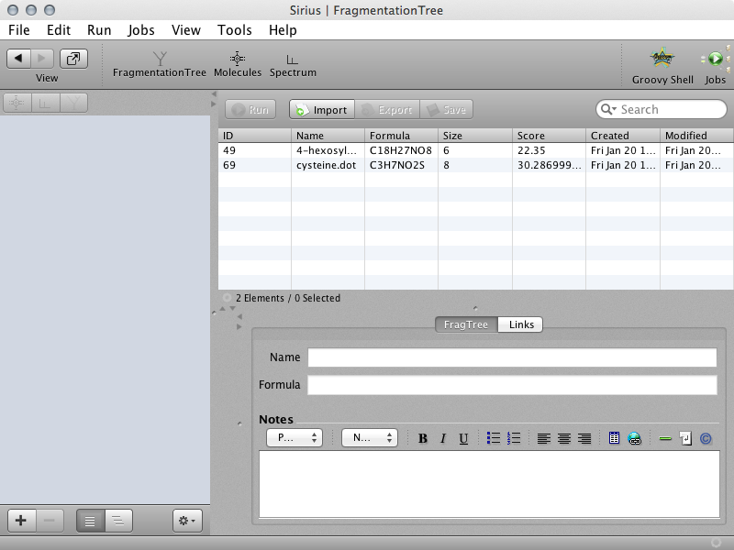
Sirius²
Sirius² is a software solution implementing fragmentation tree approaches for metabolite identification developed by Sebastian Böcker’s group in Jena
It permits the calculation of theoretical fragmentation trees from sets of spectra and a scoring of fragmentation trees against spectra and structures
The scoring is based an a modified Bayesian formulation for fragmentation trees
http://bio.informatik.uni-jena.de/sirius

Slide 65
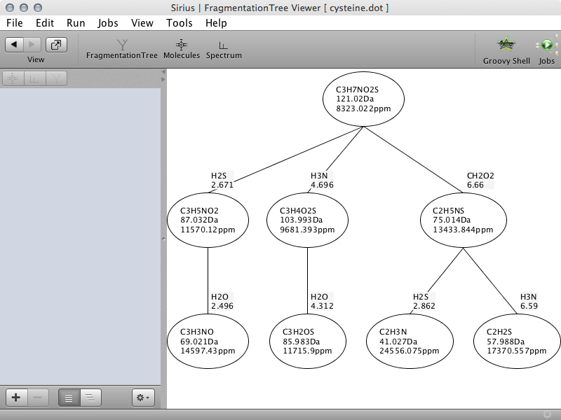
Sirius²
Rasche et al., Anal. Chem., 2011, 83:1243–1251

Slide 66
References
Databases
HMDB
http://hmdb.ca
METLIN
http://metlin.scripps.edu
mzCloud
http://mzcloud.org
MassBank
http://massbank.org
MetaboLights
http://www.ebi.ac.uk/metabolights
Papers
Hill DW, Kertesz TM, Fontaine D, Friedman R, Grant DF. Mass spectral metabonomics beyond elemental formula: chemical database querying by matching experimental with computational fragmentation spectra. Anal Chem. 2008, 80:5574-82.
Heinenen M, Rantanen A, Mielikäinen, Pitkänen E, Kokkonen J, Rousu J, Ab initio prediction of molecular fragments from tandem mass spectrometry data, Proc. German Conference on Bioinformatics (GCB 2006), LNI P-83, 2006, Gesellschaft für Informatik
Scheubert K, Hufsky F, Rasche F, Böcker S. Computing Fragmentation Trees from Metabolite Multiple Mass Spectrometry Data, RECOMB 2011 (2011), LNBI 6577, pp. 377-391, Springer, Heidelberg, 2011.
Böcker S, Letzel MC, Liptak Z, Pervukhin A. Decomposing Metabolomic Isotope Patterns, WABI 2006, LNBI 4175, pp. 12-23 ,2006, Springer, Heidelberg
Böcker S and Rasche F. Towards de novo identification of metabolites by analyzing tandem mass spectra. Bioinformatics, 2008, 24:i49-i55.
Florian Rasche, Aleš Svatoš, Ravi Kumar Maddula, Christoph Böttcher, and Sebastian Böcker. Computing Fragmentation Trees from Tandem Mass Spectrometry Data. Analytical Chemistry (2011) 83 (4): 1243–1251

Slide 67
Materials
Learning Units 11A-C

