Slide 1
Computational Proteomics and Metabolomics
Oliver Kohlbacher, Sven Nahnsen, Knut Reinert
4. Quantification I: General concepts, isobaric tags

Slide 2
Overview
Quantification using mass spectrometry
  Basic terms from analytical chemistry
  Quantitative behavior of mass spectrometers
Experimental quantification strategies
    Absolute and relative quantification
    Label-free vs. labeled techniques
    Selected experimental techniques
    Isobaric tags

Slide 3
Analytical Chemistry
“Analytical chemistry is the study of the separation, identification, and quantification of the chemical components of natural and artificial materials.”
“Quantification […] is the act of counting and measuring that maps human sense observations and experiences into members of some set of numbers.”
Quantitative Mass Spectrometry :=
  use of a mass spectrometer to turn amounts of analytes into numbers
http://en.wikipedia.org/wiki/Analytical_chemistry [accessed 12.11.2011, 10:40 CET]
http://en.wikipedia.org/wiki/Quantification [accessed 12.11.2011, 10:45 CET]

Slide 4
Some Terms
Analyte – the stuff we want to analyze (proteins, peptides, metabolites)
Matrix – the components of the sample that are not analytes
The matrix can significantly impact the way the whole analysis is performed
Example
  Proteomics analysis from urine
  Urine contains
    Proteins and peptides – the analytes
    Water
    Metabolites
    Urea
    …
matrix

Slide 5
Matrix Effects in LC-MS
Components of the matrix are being separated just like the analytes
Parts of the matrix can be ionized as well and then also show up as signals in the MS
A priori it is unknown, which part of the signal stems from matrix or analytes
Matrix can interfere with the analysis by
  Competing with analytes for ionization -> reduce the number of analyte molecules ionized
  Adsorb, precipitate or even react with the analyte

Slide 6
Quantifying Analytes
Analytes have to be in solution for proteomics and metabolomics
We thus deal with concentrations: amounts per volume of sample V
Molar concentration
  c_{i} = n_{i} / V [SI unit: mol/m³]
Mass concentration
  ρ_{i} = m_{i} / V [SI unit: kg/m³]
Translating molar concentrations into mass concentrations can be done via the molecular weight M_{i} of the analyte
  ρ_{i} = c_{i} M_{i}

Slide 7
Precision and Accuracy
good accuracy,
poor precision
good precision,
poor accuracy
Accuracy: closeness to the true value (mostly influenced by systematic error) – repetition of the experiment will not improve the result
Precision: repeatability of the measurement (mostly influenced by random error) – repetition of the experiment will yield a value closer to the true value
An ideal experiment combines high accuracy with high precision

Slide 8
Measurement Errors
Each measurement is associated with an error
There are two basic types of error:
  Random error: defines the variance of repeated measurements (e.g., due to high noise level) – this is always present in every measurement
  Systematic error (bias): shifts the mean of repeated experiments (e.g., due to an incorrect calibration)

Slide 9
Calibration Curve
detector
response
concentration
Measurement of the detector response for various (known) concentrations allows the construction of a calibration curve
Most detector responses are chosen in a way that the response changes linearly with the concentration
Once the calibration curve has been measured, it allows the determination of the concentration of an unknown sample

Slide 10
Response
saturation
detector
response
slope = sensitivity
linear range
noise
concentration
LOD
LOQ
LOL
LOD: level of detection – at what concentration can we decide that the analyte is present
LOQ: level of quantification – at what concentration can we accurately quantify it
LOL: limit of linearity – saturation effects start here
Linear range (dynamic range): the concentration range where we get a response that is linear in the concentration

Slide 11
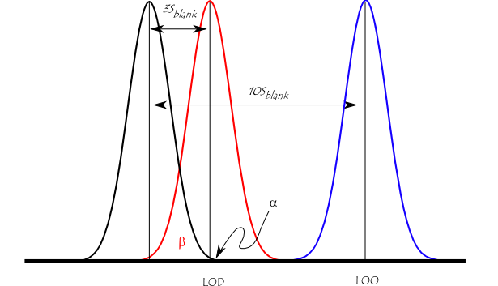
Detection Limit
Limit of detection (detection limit) -- LOD: the lowest analyte concentration that can be distinguished from the absence of the analyte (blank) within a stated confidence limit (generally 99% confidence)
Limit of quantification – LOQ: the concentration at which we can distinguish two values with reasonable confidence
Both depend on the noise level, the matrix, the instrument, the sensitivity for a specific analyte, etc.
http://en.wikipedia.org/wiki/Detection_limit [accessed 15.11.2011, 14:00 CET

Slide 12

LOD/LOQ
“Suppose you are at an airport with lots of noise from jets taking off. If the person next to you speaks softly, you will probably not hear them. Their voice is less than the LOD. If they speak a bit louder, you may hear them but it is not possible to be certain of what they are saying and there is still a good chance you may not hear them. Their voice is >LOD but <LOQ. If they speak even louder, then you can understand them and take action on what they are saying and there is little chance you will not hear them. Their voice is then >LOD and >LOQ. Likewise, their voice may stay at the same loudness, but the noise from jets may be reduced allowing their voice to become >LOD. Detection limits are dependent on both the signal intensity (voice) and the noise (jet noise).”
http://en.wikipedia.org/wiki/Detection_limit [accessed 12.11.2011, 10:20 CET

Slide 13
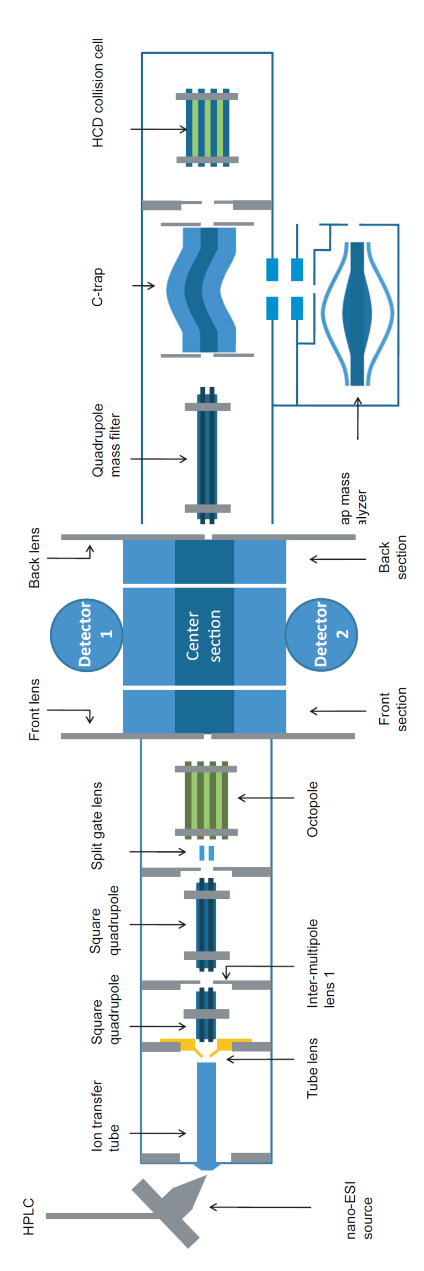
Quantitative Mass Spectrometry
Ionization: number of ionized analyte molecules proportional to the total amount present
MS detector: proportional to the number of ions (the ion current)
Caveats:
  Saturation: there is an upper limit to the response
  Noise: does the signal really come from the analyte?

Slide 14
Quantitative LC-MS
Fixed volume of the sample is injected
Total amount of analyte eluting from the column is the same amount as the amount injected (normally, nothing gets ‘lost’ on the column)
Analyte spreads out, elutes over a certain timespan from the column: maximum concentrations at the end of the column depend on retention time (peak broadening)
Only a fraction of the analyte really enters the MS (skimmer!)
Ionization efficiency differs between analytes

Slide 15

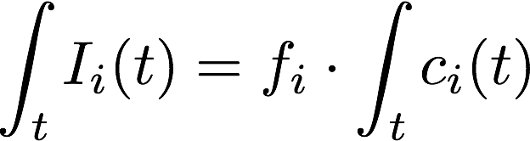
Quantitative LC-MS
MS signal intensity for peptide i at time t is proportional to concentration c_{i}(t) eluting off the column.
The area under the (chromatographic) peak is proportional to the total amount c_{i}^{tot} of analyte eluting and thus to the amount in the sample. Hence we want to integrate over time.
Notes:
LatexIT formula:
I_i(t) & = f_i\cdot \int_t c_i(t)
\int_t I_i(t) & = f_i\cdot \int_t c_i(t)

Slide 16

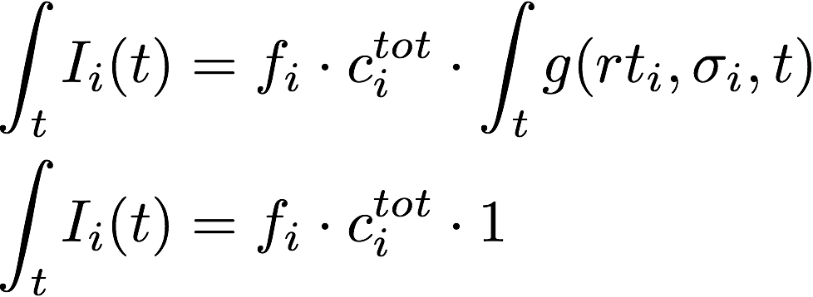
Quantitative LC-MS
Elution profiles are (roughly) Gaussians. Hence we can model the the elution as a product of the total concentration spread by a retention time model
Strategy
  Integrate over the MS signal (intensity I_{i}(t)) caused by the analyte i over the total elution time of an analyte (centered around rt_{i,} peak width defined by standard deviation of the Gaussian)
  Response factor f_{i} is unknown
Notes:
LatexIT formula:
c_i(t) & = g(rt_i,\sigma_i,t)c^{tot}_i \\
\int_t I_i(t) & = f_i \cdot c^{tot}_i \cdot \int_t g(rt_i,\sigma_i,t) \\
\int_t I_i(t) & = f_i \cdot c^{tot}_i \cdot 1
0_i

Slide 17
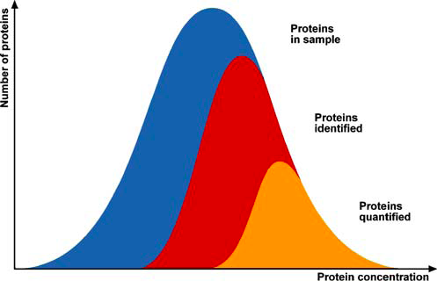
Detection, Identification, Quantification
Proteomics
  More peptides/proteins are usually identified than quantified
  Identification: MS/MS, quantification usually by MS -> independent processes
  Many things can be seen (detected) but cannot be identified or quantified
Metabolomics
  Identification here is particularly difficult
  We can identify only a fraction of what we can quantify
LOD
LOI
LOQ
LOI: “Level of identification”
Bantscheff et al., Anal Bioanal Chem (2005), 389, 1017-1031.

Slide 18
Quantitative Data – MS Spectra
Different ionized species in the same MS spectrum result in different peaks
Example
  Each peptide leads to a distinct set of peaks (isotope patterns!)
  Intensity of each peak is proportional to the concentration at the time of elution

Slide 19
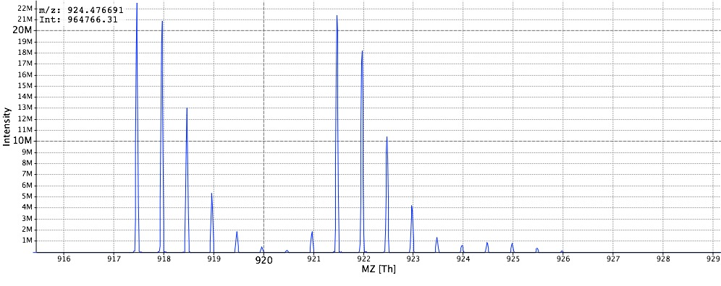
Quantitative Data – MS Spectra
Direct comparison of intensities of different analytes in the same spectrum is not possible because they have different response factors!
Exception: peptides/metabolites that differ only by a stable isotope label will have identical response factors – their intensities can be compared within the same spectrum! This is the basis for isotopic labels.
light
heavy

Slide 20
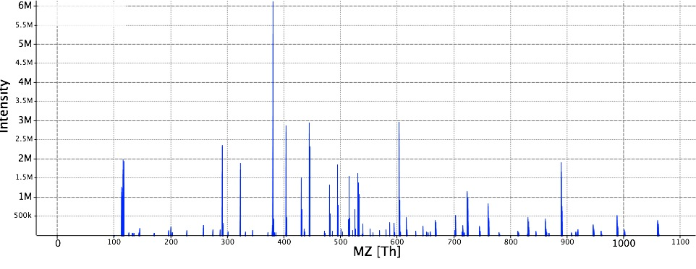
Quantitative Data – MS² Spectra
Fragment spectra can be used for quantification as well
  Under identical fragmentation conditions, the fragment ion intensity is proportional to the parent ion concentration/intensity
  Key methods: MRM, iTRAQ
iTRAQ MS² spectrum (4-plex) with reporter ions at 114, 115, 116, 117 Da (intensities roughly 0.6:0.6:1:1)

Slide 21
Chromatograms
Except for quantification techniques where a direct comparison is made within the same spectrum (iTRAQ, SILAC), elution profiles have to be considered
Accurate quantification requires accurate integration over the retention time profile
Since the peak area remains the same, this means the quantification will be independent of changes in the peak shape and width
Elution profiles are often assumed to be Gaussian, but in reality they can deviate significantly (tailing/heading leads to asymmetric peak shapes – in the model of theoretical plates, this corresponds to incomplete equilibration)
For details, see Learning Unit 2A
Notes:
Here ends the LU 4A

Slide 22
Quantification Strategies
Quantitative Proteomics
Relative Quantification
Labeled
Label-Free
Absolute Quantification
AQUA
SISCAPA
Spectral Counting
Feature-Based
In vivo
In vitro
¹⁴N/¹⁵N
SILAC
iTRAQ
TMT
¹⁶O/¹⁸O
MRM
After: Lau et al., Proteomics, 2007, 7, 2787

Slide 23
Labeling Techniques
Many labeling techniques exploit stable isotope labeling
  Different isotopes of the same element behave chemically basically identically (often used: ^{1/2}H, ^{12/13}C, ^{14/15}N, ^{16/18}O)
  Their masses differ, however, so the MS can distinguish them
Introducing a label in one sample and a different (or no label) in another, mixing allows a relative quantification between two (or more) samples
Advantages
  Both samples are treated identically, systematic errors affect them in the same way
  Can be easily annotated manually (e.g., look for pairs of peaks)
Disadvantages
  Labels can be expensive, difficult, unreliable to introduce
  Labeling in vivo is not always possible, not all techniques support in vitro labeling

Slide 24
Labeling Techniques
Chemical labeling
  Peptides are modified chemically after extraction
  Label is usually attached covalently at specific functional groups
  (N-terminus, specific side chains, …)
  Does not involve a perturbation of the in vivo system
  Labeling occurs late (during sample preparation) and thus does not account for variance introduced in the early steps
Metabolic labeling
  Stable isotope labels are integrated by ‘feeding’ the organism with labeled metabolites (amino acids, nitrogen sources, glucose, …)
  Full incorporation of the label can take a while
  Requires perturbation of the in vivo system, depending on the size quite expensive
  Labeling occurs early in the study, results in higher reproducibility

Slide 25
SILAC
SILAC – Stable Isotope Labeling with
Amino Acids in Cell Culture
  Introduce stable labels by feeding labeled amino acids to the cell culture
  Labels will be integrated into all proteins after a reasonable amount of time
  Mix and compare with an unlabeled sample
  Tryptic digest ensures that each peptide contains at most one lysine!
  Peptides with heavy and light label are otherwise identical and coelute
  Spectra contain isotope patterns for both heavy and light peptides
light
heavy
SILAC pair with charge 2 and approximately a 1:1 ratio (unperturbed)

Slide 26
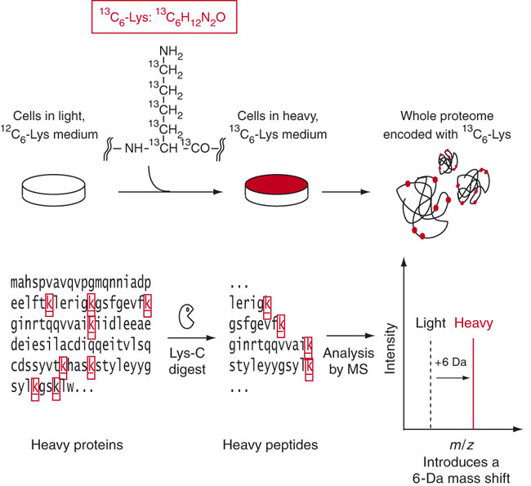
SILAC
Ong, Mann, Nat Prot 1 (2007), 2650-2660.

Slide 27
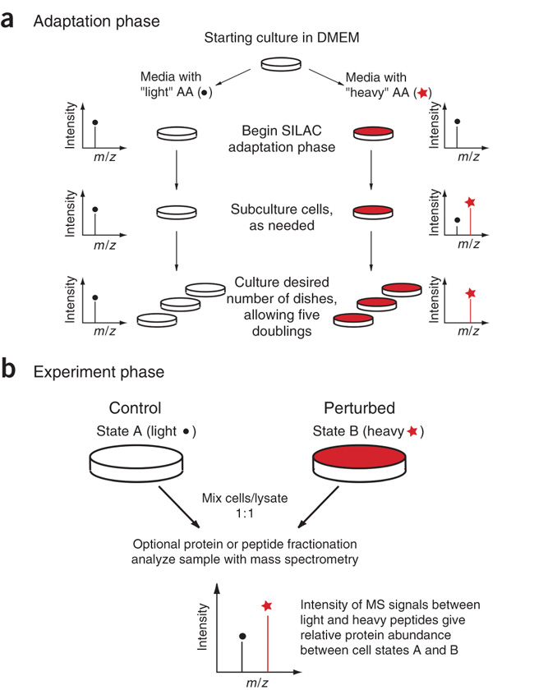
SILAC
Ong, Mann, Nat Prot 1 (2007), 2650-2660.

Slide 28
SILAC
Ong, Mann, Nat Prot 1 (2007), 2650-2660.

Slide 29
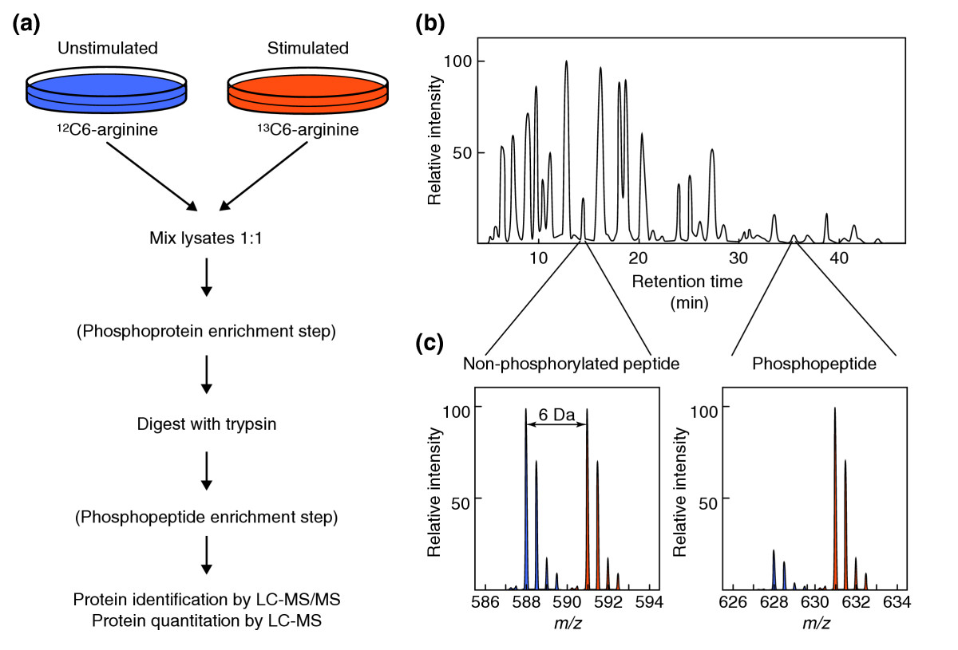
SILAC
Mumby, Brekken, Genome Biol (2005), 6:230

Slide 30
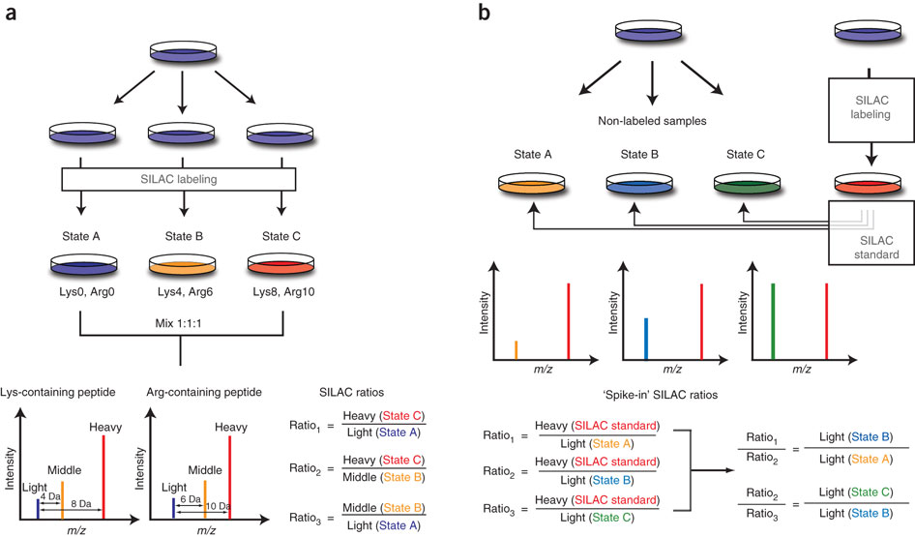
Spike-In SILAC
Geiger et al., Nat Prot 6 (2011), 147-157.

Slide 31
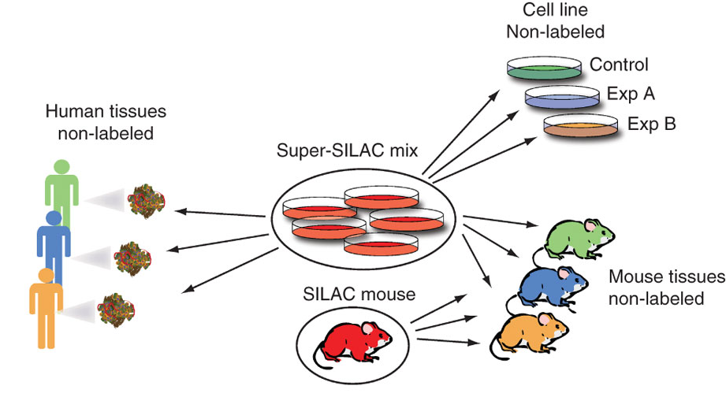
Spike-In SILAC
Geiger et al., Nat Prot 6 (2011), 147-157.

Slide 32
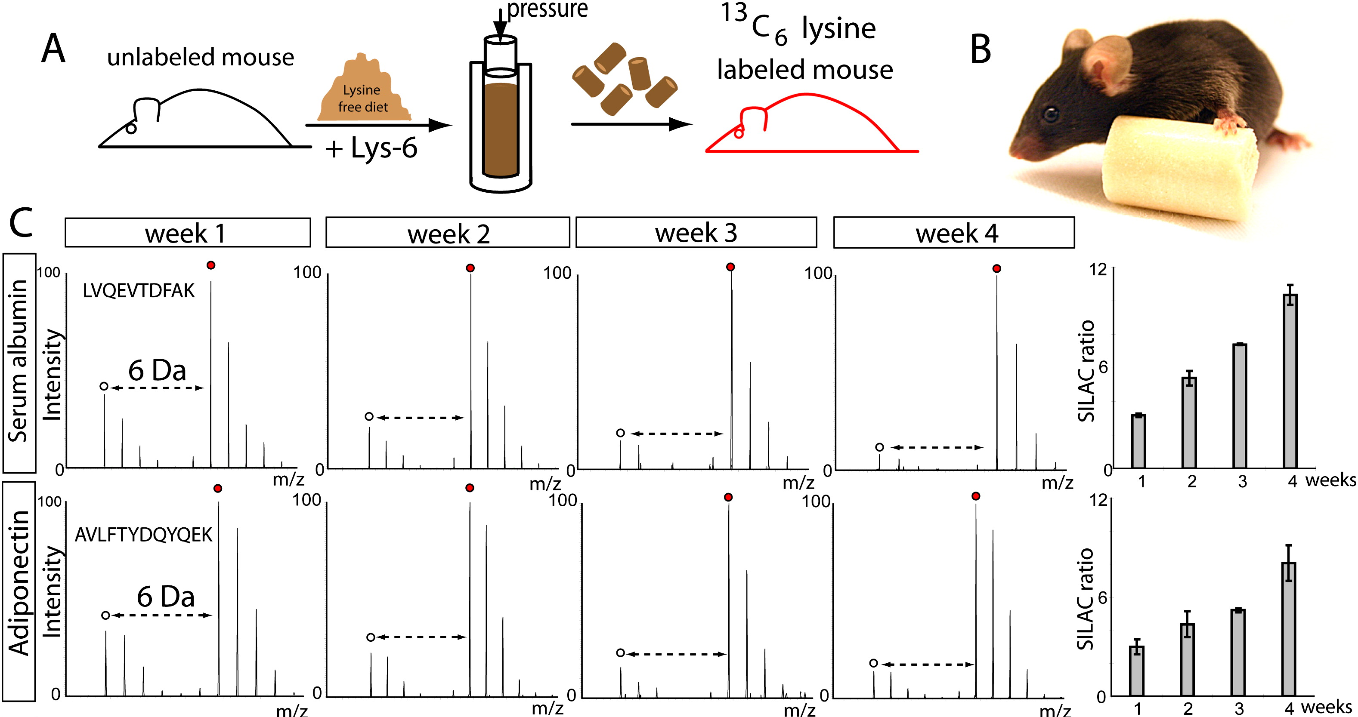
SILAC Mouse
Krüger et al., Cell (2008), 134:353-364.

Slide 33
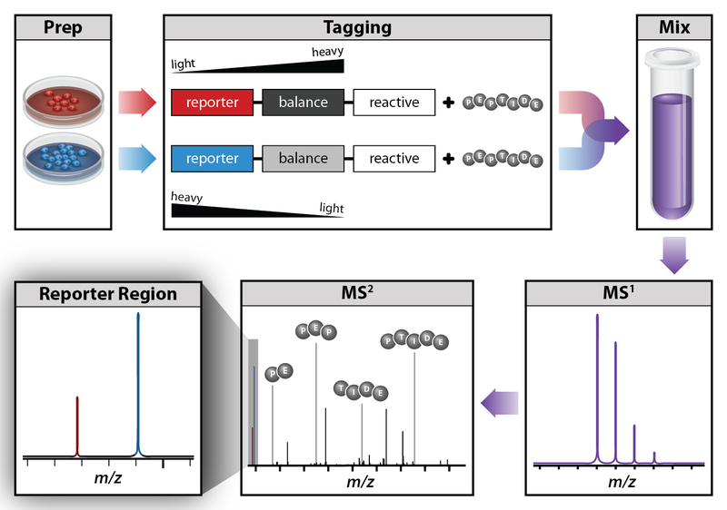
Isobaric Labeling
http://en.wikipedia.org/wiki/File:Isobaric_labeling.png [accessed 19.11.11, 19:48 CET]

Slide 34
Isobaric Labeling
Idea
  Label the different samples with labels of the same mass (isobaric)
  Design the label in a way that they fragment differently upon collision-induced dissociation
  MS² spectra will then contain reporter ions
  Quantification and identification are then both based on tandem spectra only
Key method: iTRAQ – isobaric tags for relative and absolute quantification
  Based on covalent modification of N-terminus of peptides
  Labeling performed after digestion (also applicable to clinical samples)
  Kits available for 4 or 8 distinct labels (‘quadroplex’, ‘octoplex’)

Slide 35
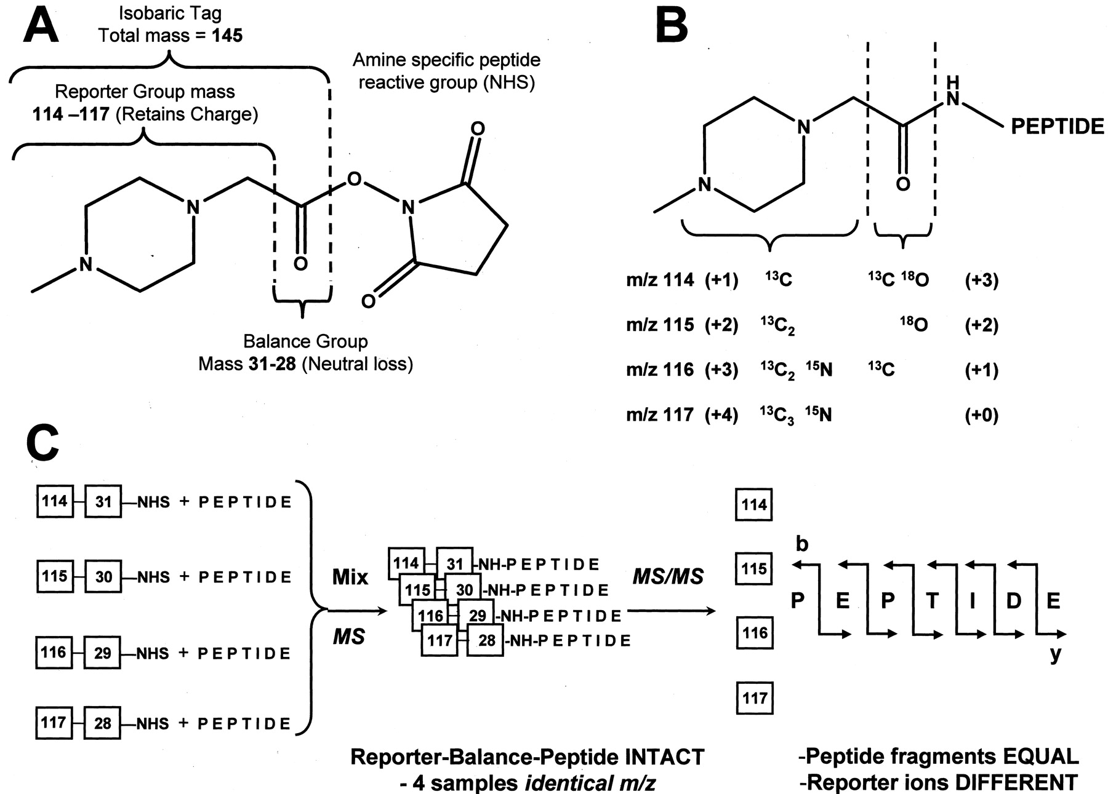
iTRAQ
Ross et al., Mol Cell Prot (2004), 3, 1154-1169.

Slide 36
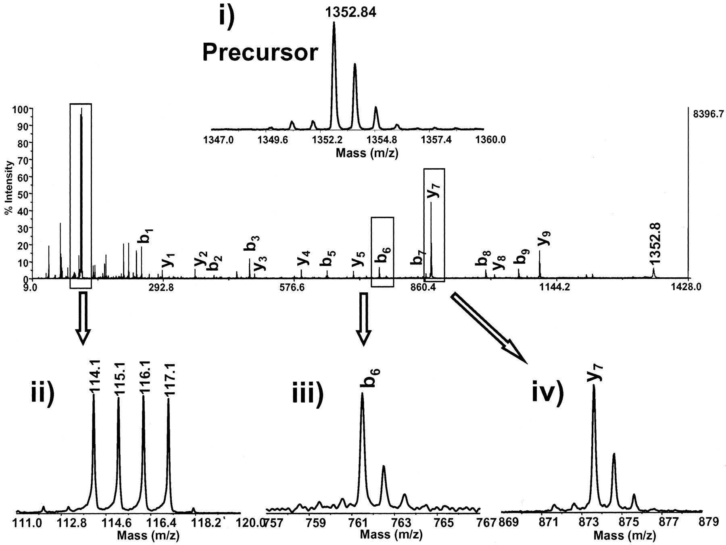
iTRAQ
Ross et al., Mol Cell Prot (2004), 3, 1154-1169.

Slide 37
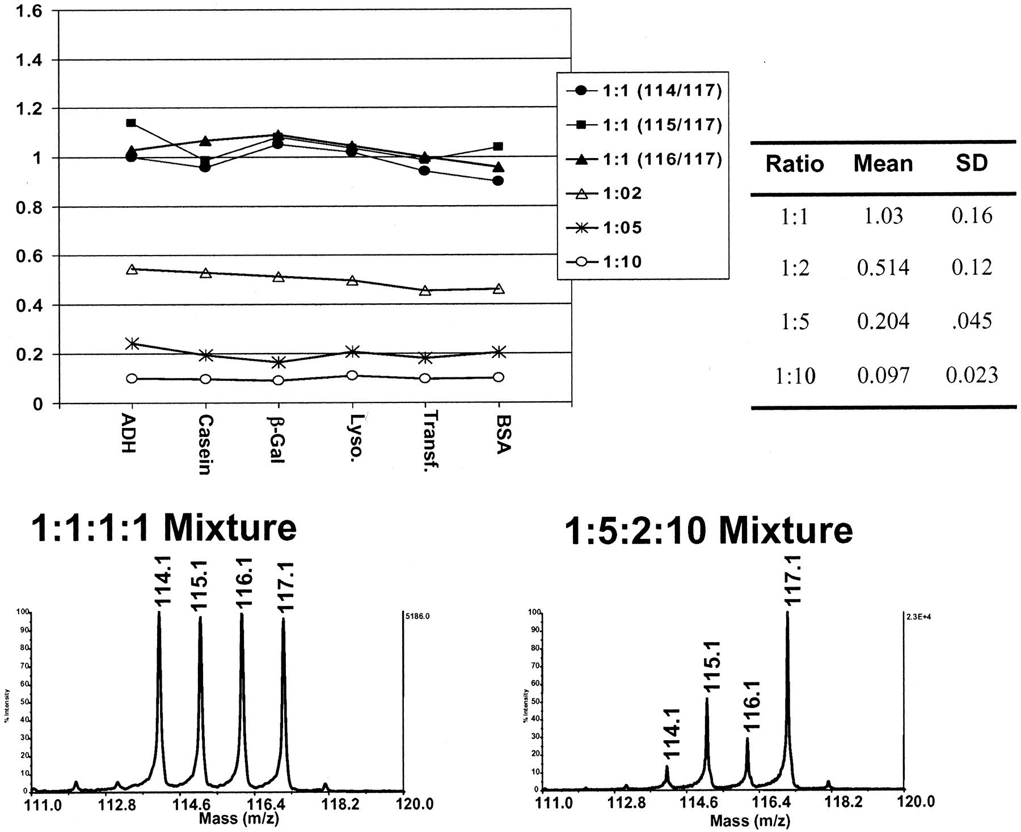
iTRAQ
Ross et al., Mol Cell Prot (2004), 3, 1154-1169.

Slide 38





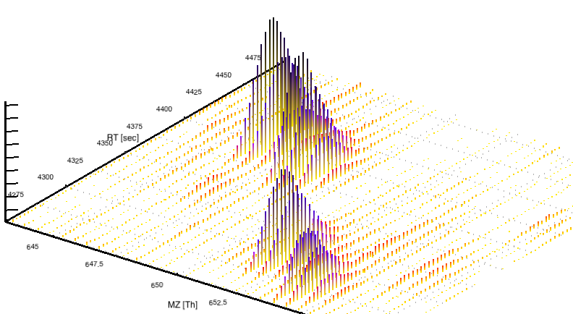


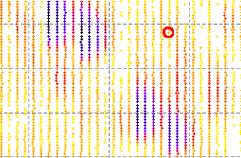












Quantitative Data – LC-MS Maps
Spectra are acquired with rates up to dozens per second
Stacking the spectra yields maps
Resolution:
  Up to millions of points per spectrum
  Tens of thousands of spectra per LC run
Huge 2D datasets of up to hundreds of GB per sample
MS intensity follows the chromatographic concentration

Slide 39
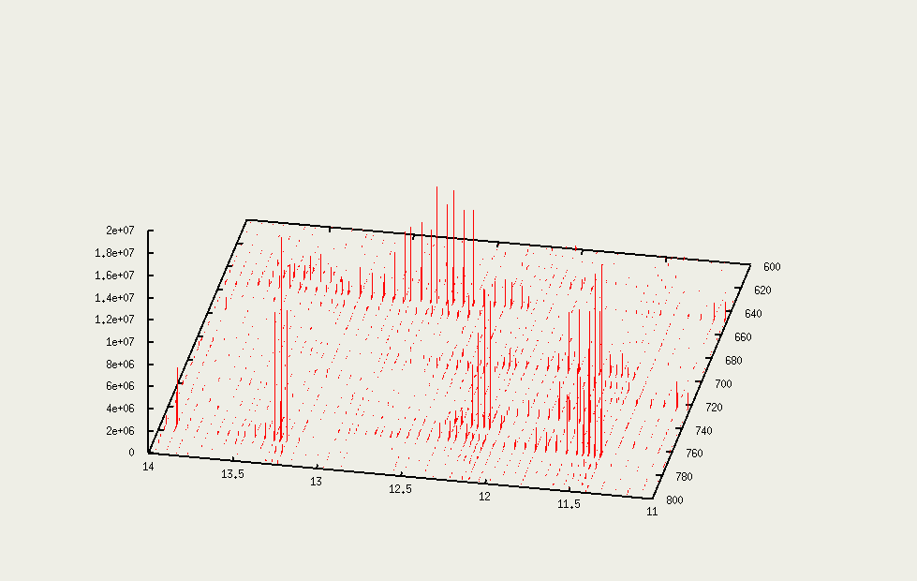
LC-MS Data (Map)
  Quantification
  (15 nmol/µl, 3x over-expressed, …)

Slide 40
Label-Free Quantification (LFQ)
Label-free quantification is probably the most natural way of quantifying
  No labeling required, removing further sources of error, no restriction on sample generation, cheap
  Data on different samples acquired in different measurements – higher reproducibility needed
  Manual analysis difficult
  Scales very well with the number of samples, basically no limit, no difference in the analysis between 2 or 100 samples

Slide 41
LFQ – Analysis Strategy
Find features in all maps

Slide 42
LFQ – Analysis Strategy
Find features in all maps
Align maps

Slide 43
LFQ – Analysis Strategy
Find features in all maps
Align maps
Link corresponding features

Slide 44
LFQ – Analysis Strategy
Find features in all maps
Align maps
Link corresponding features
Identify features
GDAFFGMSCK

Slide 45
LFQ – Analysis Strategy
Find features in all maps
Align maps
Link corresponding features
Identify features
Quantify
GDAFFGMSCK
1.0 : 1.2 : 0.5

Slide 46
Feature-Based Alignment
LC-MS maps can contain millions of peaks
Retention time of peptides and metabolites can shift between experiments
In label-free quantification, maps thus need to be aligned in order to identify corresponding features
Alignment can be done on the raw maps (where it is usually called ‘dewarping’) or on already identified features
The latter is simpler, as it does not require the alignment of millions of peaks, but just of tens of thousands of features
Disadvantage: it replies on an accurate feature finding

Slide 47


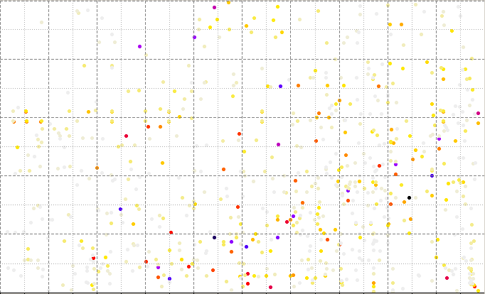
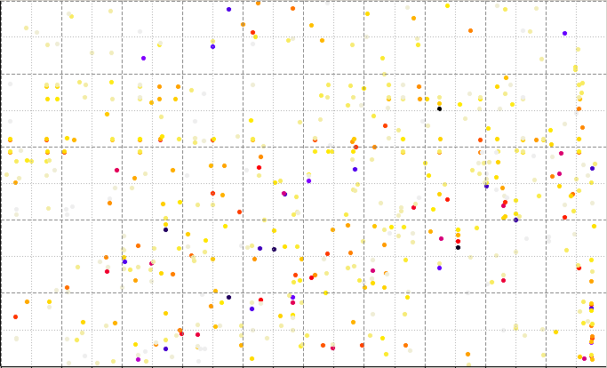
Feature-Based Alignment
~350,000 peaks
~ 700 features

Slide 48
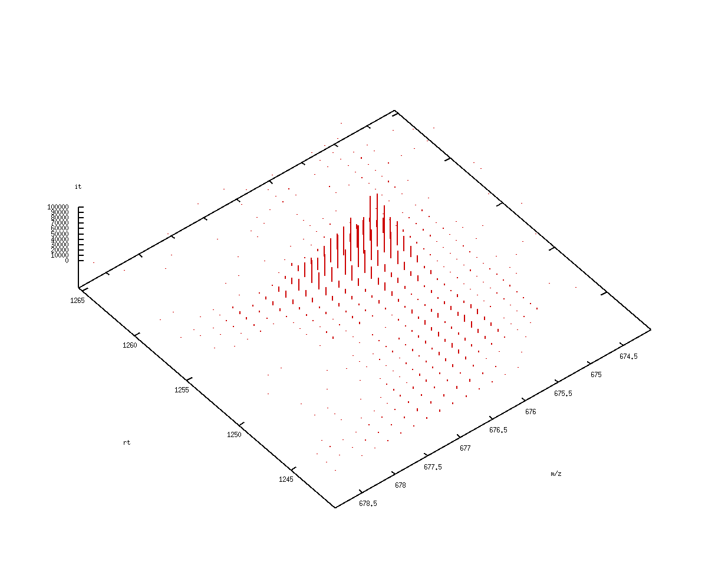
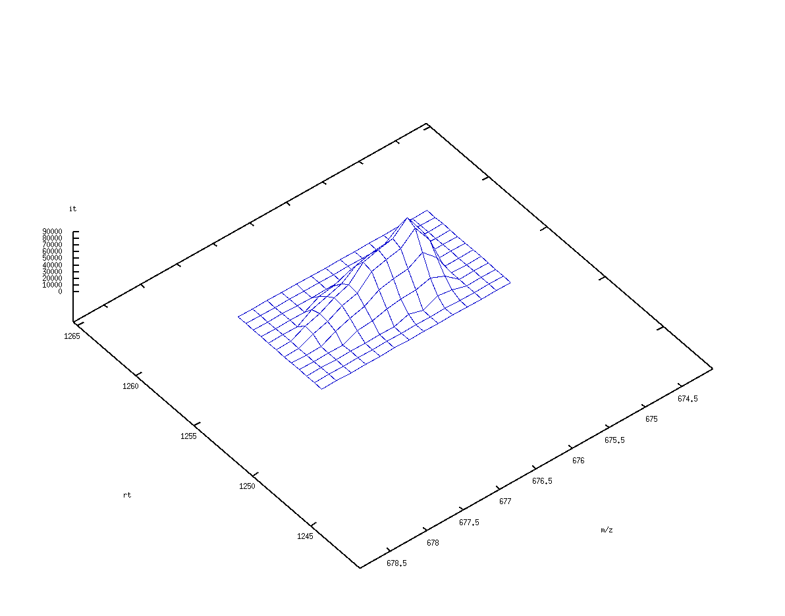
Feature Finding
Identify all peaks belonging to one peptide
Key idea:
  Identify suspicious regions
  Fit a model to that region and identify peaks explained by it

Slide 49
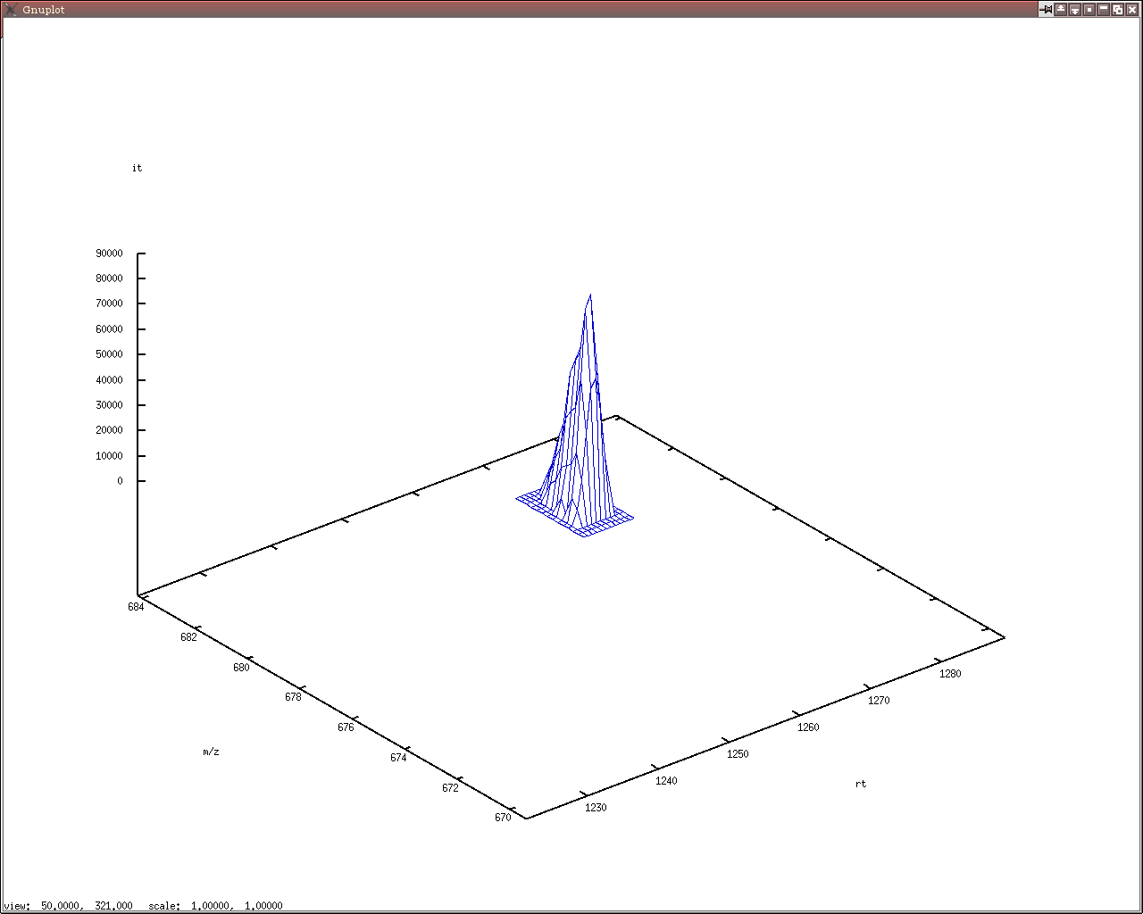
Feature Finding
Extension: collect all data points close to the seed
Refinement: remove peaks that are not consistent with the model
Fit an optimal model for the reduced set of peaks
Iterate this until no further improvement can be achieved

Slide 50
Linear Alignment
Lange et al. proposed an efficient feature-based alignment of maps based on pose clustering
The algorithm takes a pair of maps and computes an optimal linear alignment
It can be applied for multiple alignment of an arbitrary amount of maps by applying it multiply and align the maps in a star-like fashion onto one reference map (k-1 alignments for k maps)
The algorithm relies on accurate feature detection but is rather runtime efficient
Lange et al., Bioinformatics (2007), 23:i273-i281

Slide 51
Multiple Alignment
Dewarp k maps onto a comparable coordinate system
Choose one map (usually the one with the largest number of features) as reference map (here: map 2 -> T₂ = 1)
Map 1
T₁
Map 2
T₂
…
…
Consensus map
Map k
m/z
T_{k}
rt
rt

Slide 52
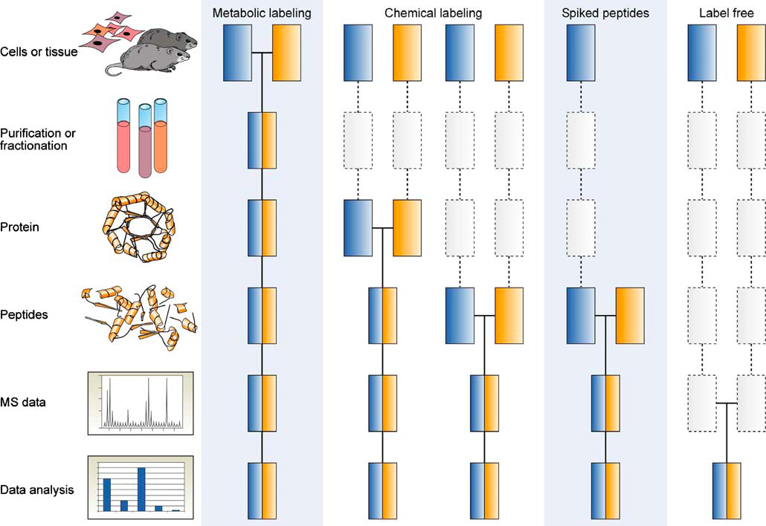
Quantification Strategies
Common quantitative mass spectrometry workflows. Boxes in blue and yellow represent two experimental conditions. Horizontal lines indicate when samples are combined. Dashed lines indicate points at which experimental variation and thus quantification errors can occur.
Bantscheff et al., Anal Bioanal Chem (2005), 389, 1017-1031.
Notes:
?? Was soll die hier?

Slide 53
Materials
Quantification in general:
  Bantscheff et al., Quantitative mass spectrometry in proteomics: a critical review, Anal Bioanal Chem (2005), 389, 1017-1031 [PMID: 17668192]
Experimental methods
  SILAC: Ong, Mann, Nat Prot 1 (2007), 2650-2660.
  iTRAQ: Ross et al., Mol Cell Prot (2004), 3, 1154-1169.
Pose clustering algorithm
  Lange et al., A geometric approach for the alignment of liquid-chromatography—mass spectrometry data, Bioinformatics (2007), 23:i273-i281 [PMID: 17646306]
Nonlinear alignment
  Podwojski et al., Retention time alignment algorithms for LC/MS data must consider non-linear shifts, Bioinformatics (2009), 25 (6): 758-764. [PMID: 19176558]

Slide 54
Materials
Online Materials
  Learning Unit 4[A,B,C]
Background
  Chromatography: Learning Unit 2A
  Statistical concepts: Learning Unit 3A

