Slide 1
Computational Proteomics and Metabolomics
Oliver Kohlbacher, Sven Nahnsen, Knut Reinert
02. Chromatography and Mass Spectrometry

Slide 2
LU 2A - CHromatography
History of chromatography
Add description and experiments (chalk chrom. video)?
Types of chromatography (TLC, LC, GC)
Separation principles (RP, SAX, SEC)
Model of theoretical plates, simulation, plate number, capacity
Peak shapes and properties, asymmetry

Slide 3
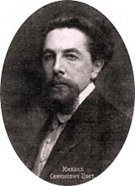
Chromatography
Chromatography is a separation technique
From greek chroma and graphein – color and to write
Initially developed by Mikhail Semyonovich Tsvet
Simple fundamental idea:
  Two phases: stationary and mobile
  Analytes are separated while mobile phase passes along the stationary phase
Various separation mechanisms, various choices for mobile/stationary phases possible
M. S. Tsvet (1872-1919)
Notes:
TODO: image source

Slide 4
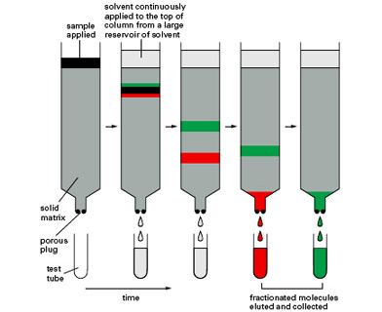
Column Chromatography
http://fig.cox.miami.edu/~cmallery/255/255hist/ecbxp4x3_chrom.jpg

Slide 5
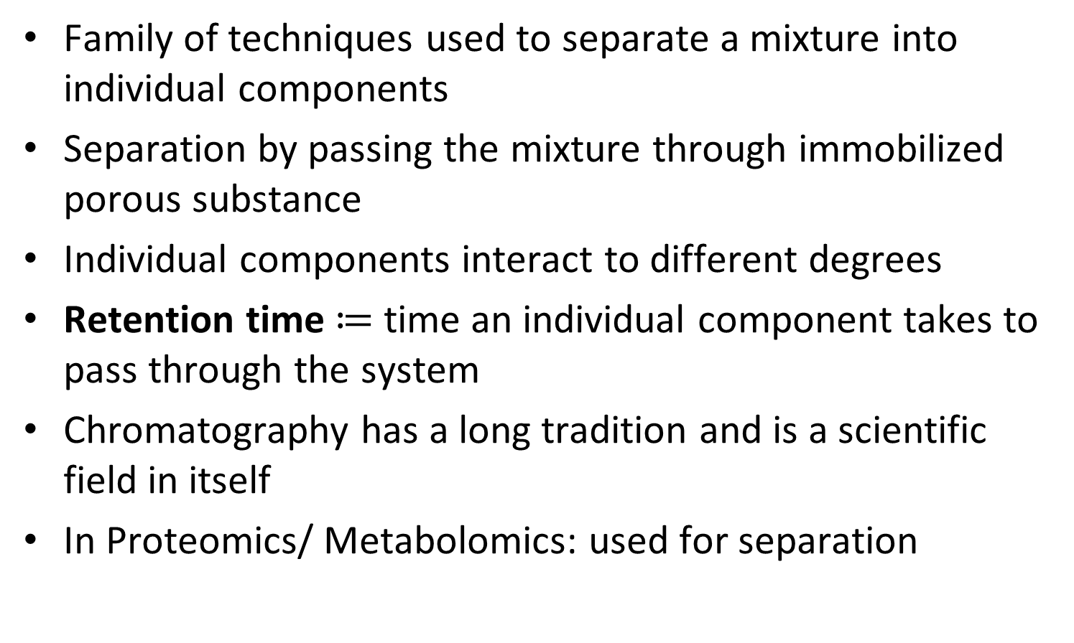
Chromatography
Family of techniques used to separate a mixture into individual components
Separation by passing the mixture through immobilized porous substance
Individual components interact to different degrees
Retention time $≔$ time an individual component takes to pass through the system
Chromatography has a long tradition and is a scientific field in itself
In Proteomics/ Metabolomics: used for separation

Slide 6
Chromatography
The mobile phase (containing the sample) moves through a stationary phase
At any time a component is interacting either with the stationary or with the (moving) mobile phase
The more a component interacts with the stationary phase relative to the mobile phase, the longer the migration takes
This leads to different retention times for different components

Slide 7
Column chromatography
Most commonly used type of chromatography in proteomics/ metabolomics
Consists of column (glass, metal, synthetic material) containing the stationary phase through which the mobile phase is passing
Types of column chromatography used for organic components:
  Liquid chromatography (dominates the field of proteomics)
  Gas chromatography (principle see last lecture)
Other chromatography types:
  Paper chromatography
  Thin-layer chromatography

Slide 8
High-pressure liquid chromatography (HPLC)
Liquid as the mobile phase and a porous solid as the stationary phase
Surface of the solid can be shaped for specific properties
High-pressure pumps are used to pump liquid through the system
Some further definitions:
  The stationary phase is also called packing
  The mobile phase is also called solvent or eluent
Technical information:
  Columns are typically 10-25 cm long (can be up to several meters)
    µ-LC columns have an inner diameter (ID) of approx. 1 mm (preparative use)
    Capillary LC columns: ID < 300 µM
    nanoLC columns: ID 50-100 µm

Slide 9
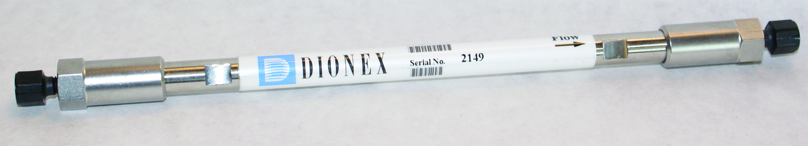
Columns
Tsvet used an open glass column
Better separation and low sample amounts require columns with smaller inner diameter
Smaller, tightly packed columns require higher eluent pressures (Tsvet: hydrostatic pressure only) to achieve rapid separations
HPLC steel column
(internal diameter 4.6
mm, length 150 mm)
Capillary column
(internal diameter 4.6
mm, length 150 mm)
Notes:
http://chemwiki.ucdavis.edu/%40api/deki/files/12415/Figure12.39.jpg

Slide 10

HPLC (High Performance Liquid Chromatography)
pump
detector
column
(stationary phase)
retention time (RT)
mobile phase

Slide 11
HPLC (High Performance Liquid Chromatography)
injection valve
pump
analyte mixture
eluent
column
detector

Slide 12
HPLC (High Performance Liquid Chromatography)
injection valve
pump
analyte mixture
eluent
column
detector

Slide 13
HPLC (High Performance Liquid Chromatography)
injection valve
pump
analyte mixture
eluent
column
detector

Slide 14
HPLC (High Performance Liquid Chromatography)
injection valve
pump
analyte mixture
eluent
column
detector

Slide 15
HPLC (High Performance Liquid Chromatography)
injection valve
pump
analyte mixture
eluent
column
detector

Slide 16
HPLC (High Performance Liquid Chromatography)
injection valve
pump
analyte mixture
eluent
column
detector

Slide 17
HPLC (High Performance Liquid Chromatography)
injection valve
pump
analyte mixture
eluent
column
detector

Slide 18
HPLC (High Performance Liquid Chromatography)
injection valve
pump
analyte mixture
eluent
column
detector

Slide 19
HPLC (High Performance Liquid Chromatography)
injection valve
pump
analyte mixture
eluent
column
detector

Slide 20
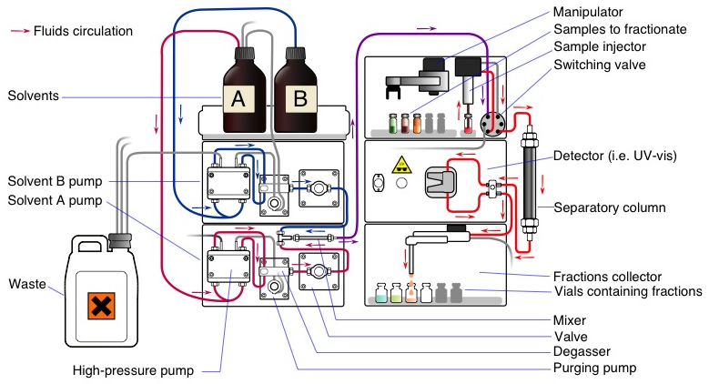
Modern HPLC
Schematic representation of a modern HPLC system
Yassine Mrabet; http://en.wikipedia.org/wiki/Chromatography#mediaviewer/File:Preparative_HPLC.svg
Notes:
http://en.wikipedia.org/wiki/Chromatography#mediaviewer/File:Preparative_HPLC.svg

Slide 21
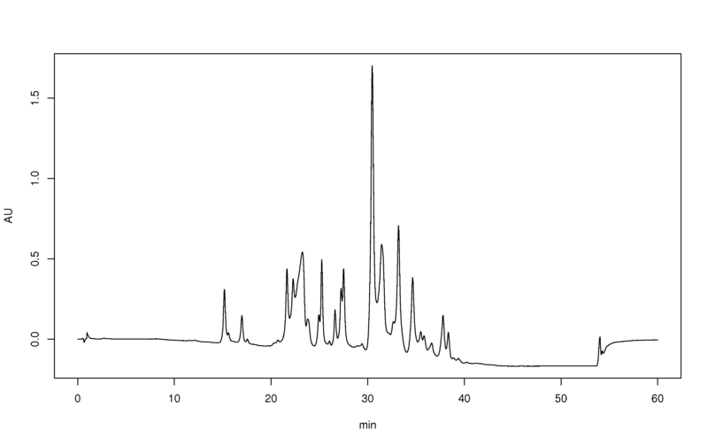
Detectors Used for HPLC
Detectors registers the components as they elute off the column
Common detectors use
  Light absorption (photometric detector)
  Fluorescence
  Change in diffraction index
  Mass spectrometers
Detector registers some sort of intensity as function of time
Detector response over time is called a chromatogram
Intensity [a.u.]
Retention time

Slide 22
Good HPLC performance
Find an optimal balance between the components’ affinity for the stationary phase and the solubility of the components in the mobile phase
  Different components should migrate at different rates
  Narrow elution peak of different components
  Ideally elution peaks of different components should not overlap
Challenge
  Achieve different rates of migration for the different components
  Narrow elution peaks
Difficulties
  Noise. Signal-to-noise ratios can be used to quantify how well a real signal can be differentiated from background signal
  Baseline drift. The baseline is recorded when only the mobile phase elutes. This can vary over time.

Slide 23
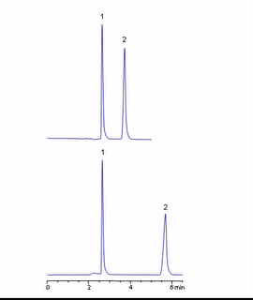
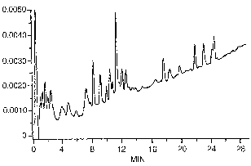
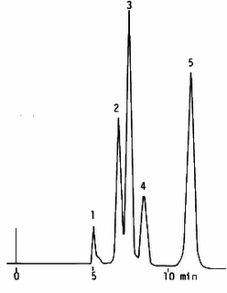
HPLC Performance
Good separation
Poor separation
Peaks are well separated
Peaks are sharp
Peaks come down to baseline
Peaks are not well resolved
Baseline is drifting upwards
epharmacist.blogspot.com/2008_04_01_archive.html

Slide 24
HPLC methods
Essential components are
  Stationary phase
    Interaction of stationary phase with components
  Mobile phase
    Solubility of components in mobile phase
Most common HPLC methods
  Reversed-phase (RP) chromatography
  Strong cation/anion exchange (SCX/SAX) chromatography
  Affinity chromatography
  Size exclusion chromatography

Slide 25
Reversed-Phase Chromatography
Stationary phase
  surface-modified silica (most commonly alkyl chains: (C₄, C₈ or C₁₈); comparable to fatty acid chains)
  ‘Reversed phase’ – while silica is generally hydrophilic, the hydrophobic modifications turn it into a hydrophobic phase
Mobile phase (eluent)
  Usually a mixture of water and an organic solvent (e.g., acetonitrile [ACN])
  Composition of the eluent usually changes (‘gradient’) with time
  Start with hydrophilic eluent (mostly water)
  Higher ACN content towards the end to elute hydrophobic peptides ‘sticking’ to the column)

Slide 26
Strong Cation Exchange (SCX) Chromatography
Opposite charges attract each other
Net charge of a peptide depends on pH
Stationary phase is an SCX
  Surface modified by sulfonic acid groups (neg. charged at pH above 2-3)
Peptides injected at low pH (~3), thus positively charged (cations)
The more positive the charges – the stronger the interaction
For elution, increase ionic strength within solution B (using salt)

Slide 27
Multidimensional Chromatography
To increase the separation power two or more different separation techniques can be used in series
For proteomics this is called MudPIT (multidimensional protein identification technology)
  Wolters DA, Washburn MP, Yates JR, 73[23]: 5683-90. Analytical Chemistry. 2001

Slide 28
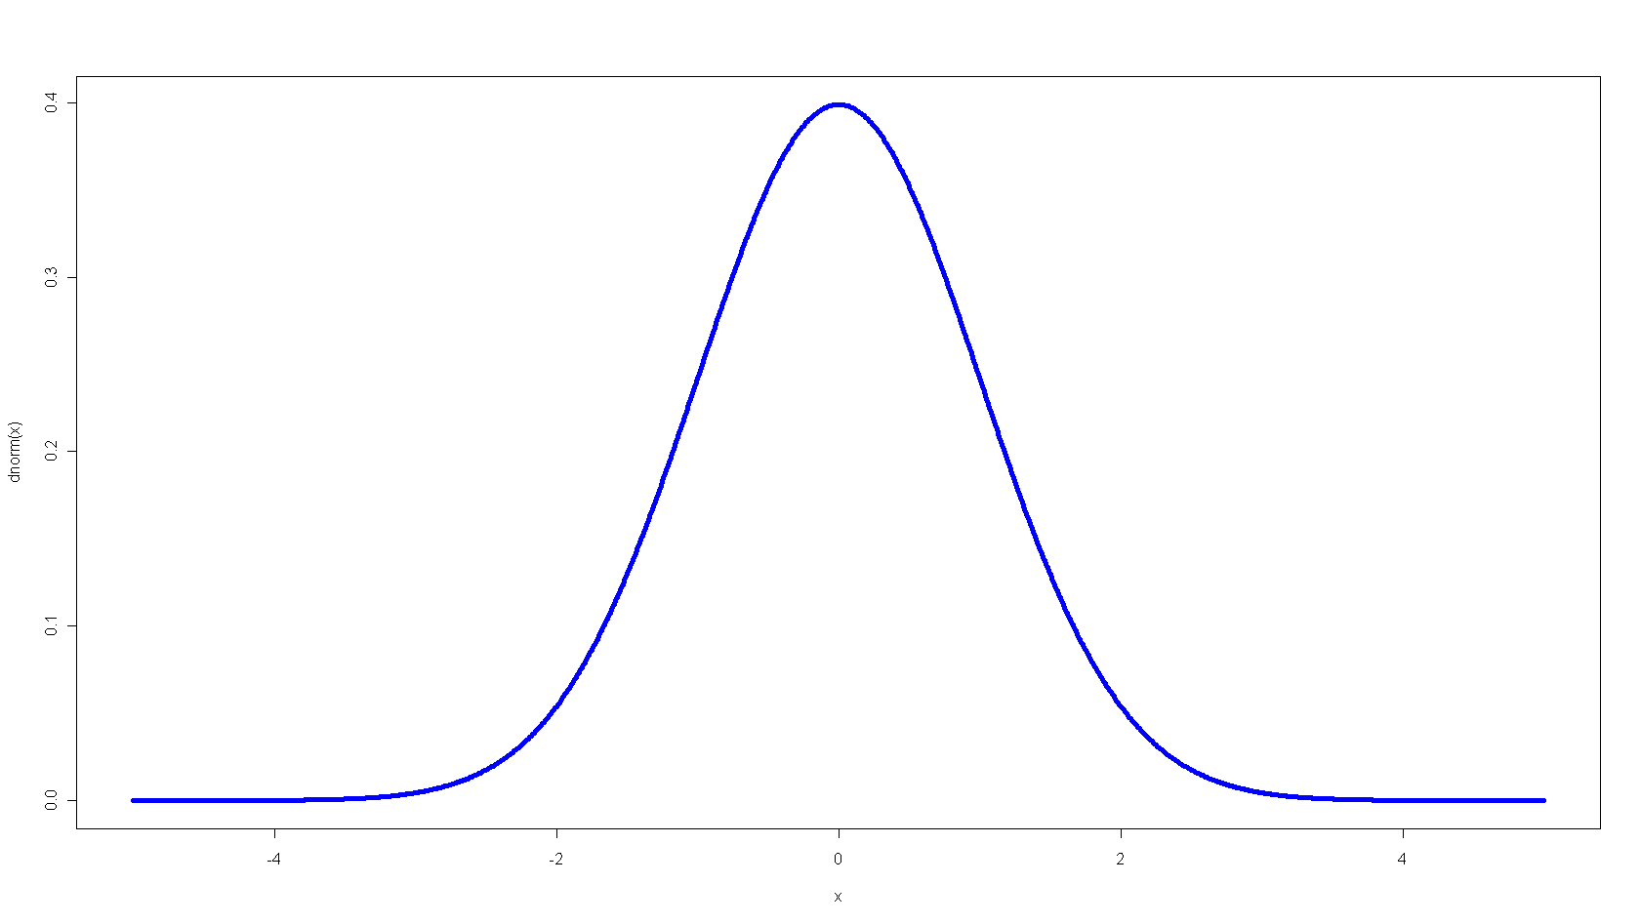
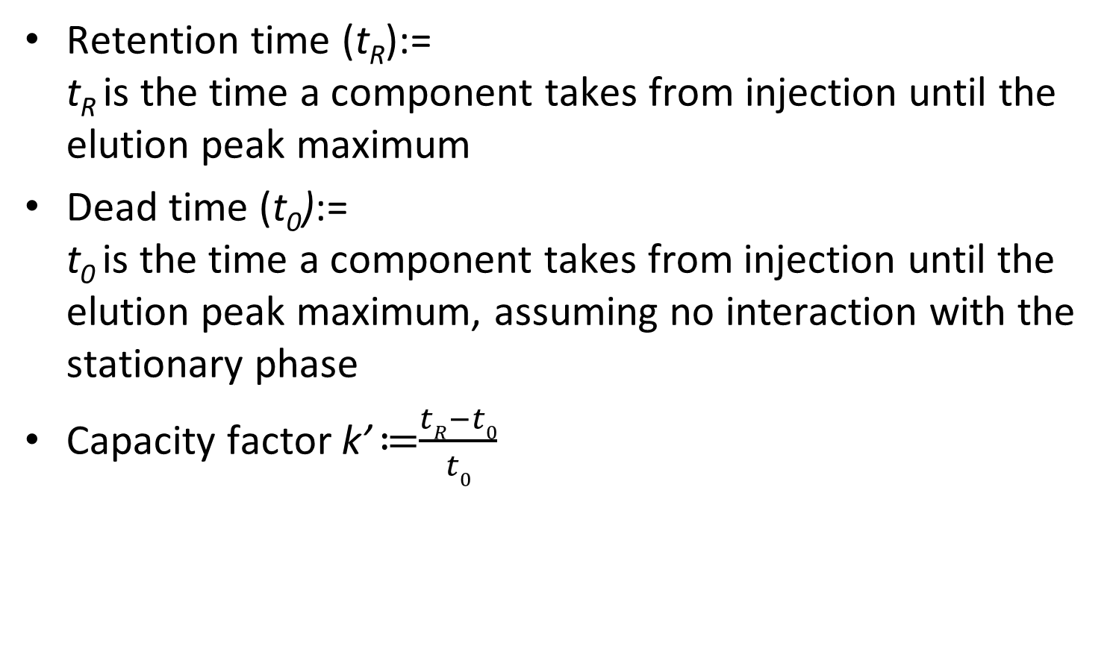
Component Migration
Retention time (t_{R}):=
t_{R} is the time a component takes from injection until the elution peak maximum
Dead time (t₀):=
t₀ is the time a component takes from injection until the elution peak maximum, assuming no interaction with the stationary phase
Capacity factor k’ ≔$\frac{tR−t0}{t0}$
ΔD
w_{h}
x₁₀
y₁₀
x₅
y₅
t₀
w_{b}
w_{b2c}
t_{R}

Slide 29
Peak Width in Chromatography
flow
Peaks broaden with retention time
Early peaks are sharp and narrow
Later peaks tend to be broader
  Diffusion along the column during the separation
  Analytes eluting later had more time to diffuse
Peak area remains constant, though
  No analyte is getting lost
  Increased width is compensated by reduced height
diffusion

Slide 30
Peak Shape
Baseline width:= w_{b} is the width of the baseline
Half-height width := w_{h} is the width at 50% at the half peak height. This is also called FWHM (full width at half maximum)
Peaks should be narrow and symetrical, but peak width generally increases with the retention time
  Plate number is a better indicator (than peak width) to show how good an LC performs in producing narrow eluent peaks
  Symmetry is very rarely observed. Tailing is frequently observed
  Resolution is a measure of how well two adjacent peaks are separated

Slide 31
Theoretical Plates
Conceptual model of the chromatographic process
Term ‘plates’ originates from fractionated distillation
Same mathematical formalism is used
A plate represents a stage of discrete equilibration between two phases (in chromatography there are no physical plates, but only “theoretical plates”)
plate
mobile
phase
stationary
column

Slide 32
Theoretical Plates - Model
Analyte enters the head of the column dissolved in the eluent
Analyte equilibrates between both phases in each plate
Mobile phases moves on in a discrete step and brings mobile phases into contact with the next plate
Plates equilibrate, process continues as above

Slide 33
Theoretical Plates – Example
Analytes distribute between mobile phase and stationary phase (here: equally)
Mobile phase moves again, equilibrates, etc.
Numbers express the concentration in each plate
This simple model yields a Gaussian shape for an infinite number of plates
Note that the sum over all plates always remains the same (no analyte is lost) until it starts eluting from the column
1
16 | 0 | 0 | 0 | 0 | 0 | 0 | 0 | 0 | 0
0 | 0 | 0 | 0 | 0 | 0 | 0 | 0 | 0 | 0
2
8 | 0 | 0 | 0 | 0 | 0 | 0 | 0 | 0 | 0
8 | 0 | 0 | 0 | 0 | 0 | 0 | 0 | 0 | 0
3
0 | 8 | 0 | 0 | 0 | 0 | 0 | 0 | 0 | 0
8 | 0 | 0 | 0 | 0 | 0 | 0 | 0 | 0 | 0
4
4 | 4 | 0 | 0 | 0 | 0 | 0 | 0 | 0 | 0
4 | 4 | 0 | 0 | 0 | 0 | 0 | 0 | 0 | 0
5
0 | 4 | 4 | 0 | 0 | 0 | 0 | 0 | 0 | 0
4 | 4 | 0 | 0 | 0 | 0 | 0 | 0 | 0 | 0
6
2 | 4 | 2 | 0 | 0 | 0 | 0 | 0 | 0 | 0
2 | 4 | 2 | 0 | 0 | 0 | 0 | 0 | 0 | 0
7
0 | 2 | 4 | 2 | 0 | 0 | 0 | 0 | 0 | 0
2 | 4 | 2 | 0 | 0 | 0 | 0 | 0 | 0 | 0
8
1 | 3 | 3 | 1 | 0 | 0 | 0 | 0 | 0 | 0
1 | 3 | 3 | 1 | 0 | 0 | 0 | 0 | 0 | 0
9
0 | 1 | 3 | 3 | 1 | 0 | 0 | 0 | 0 | 0
1 | 3 | 3 | 1 | 0 | 0 | 0 | 0 | 0 | 0

Slide 34
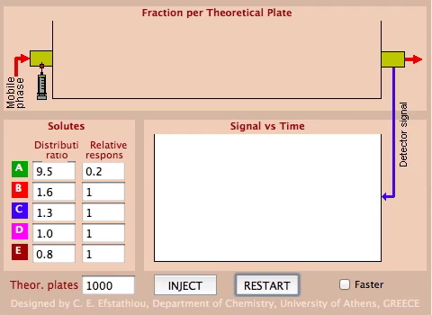
Theoretical Plates – Simulation
http://www.chem.uoa.gr/applets/appletchrom/appl_chrom2.html

Slide 35
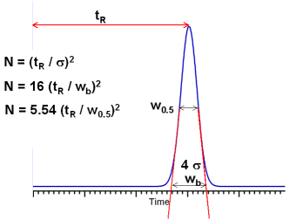
Plate Number
Model of theoretical plates gives (asymptotically) rise to a Gaussian peak shape
Ratio of retention time and peak width
Three different ways to calculate the plate number N
  From the retention time
  From the baseline width
  From the half-height width
http://www.lcresources.com/resources/TSWiz/PlateCalc.gif

Slide 36
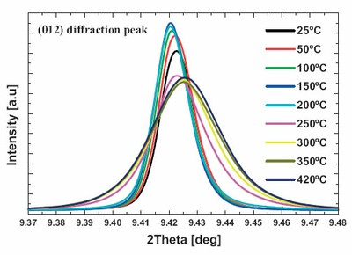
Peak Broadening and Asymmetry
Many factors affect peak shape and symmetry
Column “secondary interactions”
Column packing voids
Column contamination
Column aging
Column loading
Extra-column effects
Temperature (column
and environment)
Retention time
http://www.esrf.eu/UsersAndScience/Experiments/StructMaterials/ID31/Applications/calcite.jpg/image_preview

Slide 37
LU2B – MasS SPECTROMETRY
Basic components of a mass spectrometer
Ionization methods: MALDI, ESI
Mass analyzers (TOF, quadrupole, ion trap, orbitrap)
Detectors
Tandem MS, MS/MS fragmentation methods
Product ion generation, ion types, charge states
Mass accuracy and resolution
Technical characteristics of typical instruments
DDA and DIA

Slide 38
Schema Mass spectrometer
Source
Analyzer
Detector
Vacuum pumps/ electronics
LC/ GC
Data

Slide 39
Ionization methods
ElectroSpray Ionization (ESI) -soft ionization-
Matrix Assisted Laser Desorption/ Ionization (MALDI)
-soft ionization-
Electron Impact (EI) -hard ionization-
Other methods:
  Particle bombardment; Field Desorption; Field Ionization;
The following (ionization) is partly based on education material from the Genetics department, Wisconsin University, USA, http://skop.genetics.wisc.edu/AhnaMassSpecMethodsTheory.ppt

Slide 40
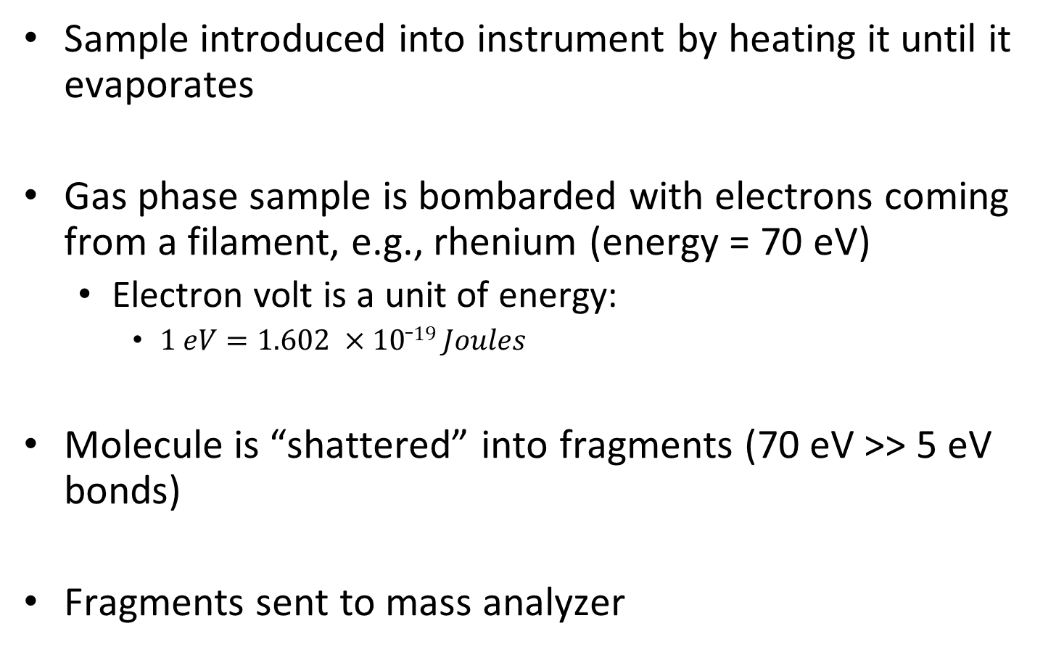
Electron impact ionization
Sample introduced into instrument by heating it until it evaporates
Gas phase sample is bombarded with electrons coming from a filament, e.g., rhenium (energy = 70 eV)
  Electron volt is a unit of energy:
    $1 eV=1.602 ×10_19 Joules$
Molecule is “shattered” into fragments (70 eV >> 5 eV bonds)
Fragments sent to mass analyzer

Slide 41
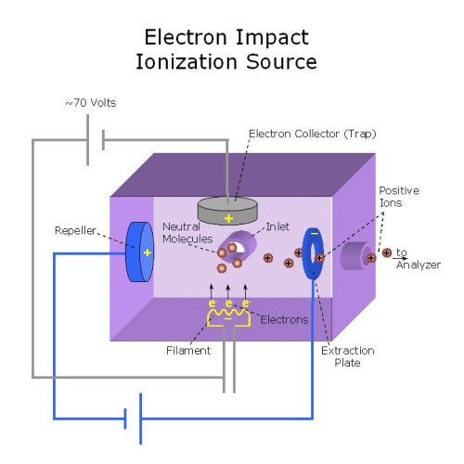
Electron impact ion source

Slide 42
EI ionization of CH₃OH (Methanol)
CH₃OH
CH₃OH⁺
CH₃OH
CH₂O=H⁺
+ H
CH₃OH
⁺ CH₃
+ OH
CH₂O=H⁺
CHO=H⁺
+ H
Why wouldn’t Electron Impact be suitable for analyzing proteins?

Slide 43
EI is not for proteomics
EI shatters chemical bonds
A peptide/protein contains (20 different) amino acids
EI would shatter the peptide not only into amino acids but also amino acid sub-fragments
Result is tens of thousands of different signals from a single peptide -- too complex to interpret
EI might be well suited for some applications in metabolomics

Slide 44
Soft ionization methods
Soft ionization techniques keep the molecule of interest fully intact
Electro-spray ionization first conceived in 1960’s by Malcolm Dole but put into practice in 1980’s by John Fenn (Yale)
MALDI first introduced in 1985 by Franz Hillenkamp and Michael Karas (Frankfurt)
Made it possible to analyze large molecules via inexpensive mass analyzers such as quadrupole, ion trap and TOF

Slide 45
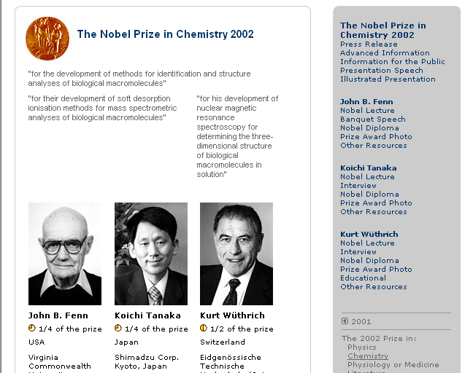

Slide 46
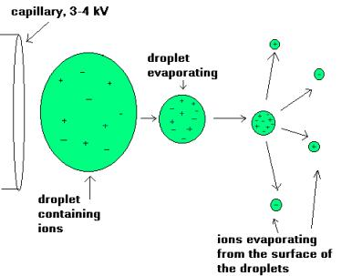
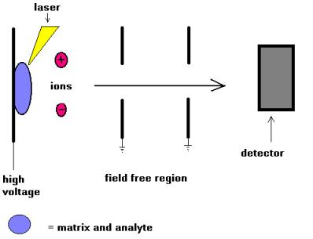
Soft ionization methods
Electrospray mass spectrometry (ESI-MS)
  Liquid containing analyte is forced through a steel capillary at high voltage to electrostatically disperse analyte. This induces charged droplets. Ions are formed by extensive evaporation
Matrix-assisted laser desorption ionization (MALDI)
  Analyte (protein) is mixed with large excess of matrix (small organic molecule)
  Irradiated with short pulse of laser light. Wavelength of laser is the same as absorbance maximum of matrix.

Slide 47
Electrospray ionization
Sample dissolved in polar, volatile buffer (no salts) and pumped through a stainless steel capillary (70 - 150 μm) at a rate of 10-100 μL/min (for nano spray this can also be at 200 nl/min)
High voltage (3-4 kV) applied at tip along with flow of nebulizing gas causes the sample to “nebulize” or aerosolize
Aerosol is directed through regions of higher vacuum until droplets evaporate to near atomic size (still carrying charges)

Slide 48
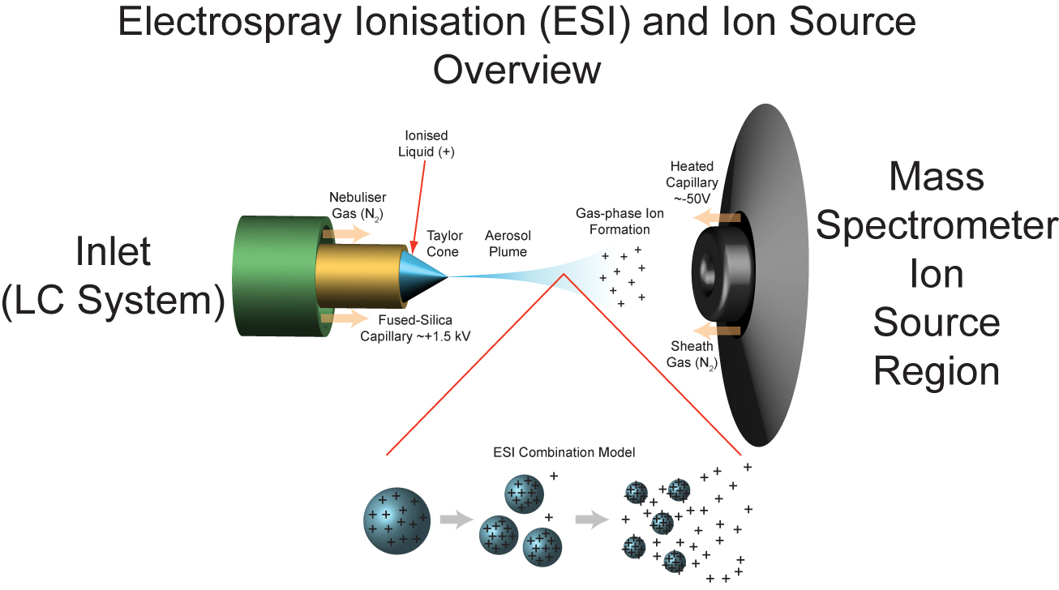
ESI
ESI image
http://www.lamondlab.com/MSResource/images/lcms/ESI.jpg

Slide 49
ESI
Very sensitive technique, requires less than a picomole of material
Strongly affected by salts and detergents
Positive ion mode measures (M + H)⁺ (add formic acid to solvent)
Negative ion mode measures (M - H)⁻ (add ammonia to solvent)

Slide 50
Positive or negative mode
Functional groups that readily accept H⁺ (such as amide and amino groups found in peptides and proteins) can be ionized using positive mode ESI.
Functional groups that readily lose a proton (such as carboxylic acids and hydroxyls as found in nucleic acids and sugars) should be ionized using negative mode ESI

Slide 51
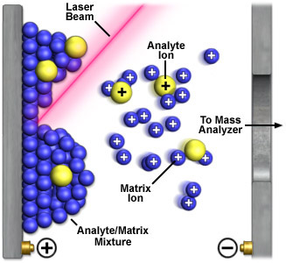
MALDI

Slide 52
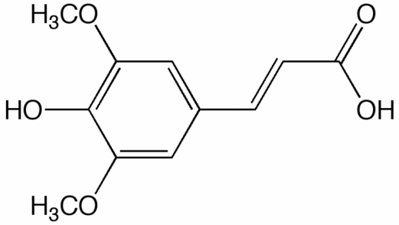
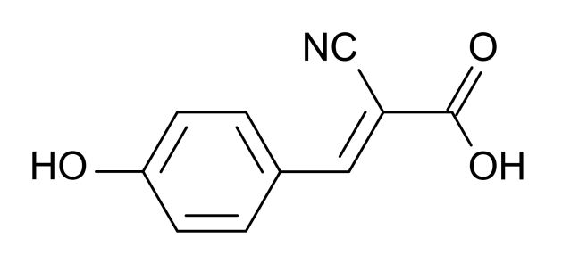
MALDI
Sample is ionized by bombarding sample with laser light
Sample is mixed with a UV absorbant matrix (sinapinic acid for proteins, 4-hydroxycinnamic acid for peptides)
Light wavelength matches that of absorbance maximum of matrix so that the matrix transfers some of its energy to the analyte (leads to ion sputtering)
Sinapinic acid
4-hydroxycinnamic acid
http://upload.wikimedia.org/wikipedia/commons/6/6f/Sinapinic_acid.gif
https://commons.wikimedia.org/wiki/File:%CE%91-cyano-4-hydroxycinnamic_acid.svg

Slide 53
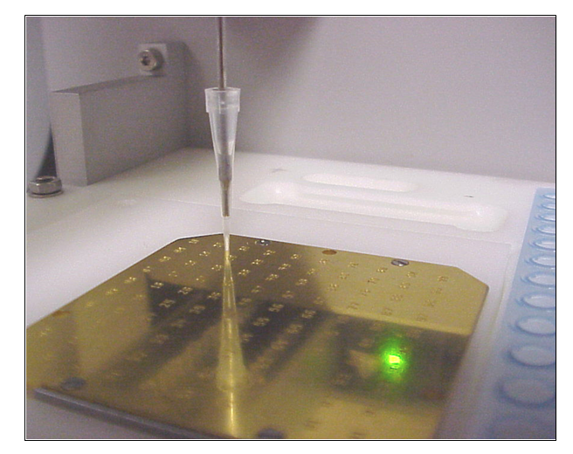
Spotting on a MALDI plate

Slide 54
MALDI ionization
+
Matrix
+
+
-
Absorption of UV radiation by chromophoric matrix and ionization of matrix
Dissociation of matrix, phase change to super-compressed gas, charge transfer to analyte
Expansion of matrix, analyte trapped in expanding matrix plume (explosion/”popping”)
-
Laser
-
+
Analyte
+
+
+
-
+
+
-
-
+
-
+
+
+
+
+
+

Slide 55
MALDI
Unlike ESI, MALDI generates spectra that have just a singly charged ion
Positive mode generates ions of (M + H)⁺
Negative mode generates ions of (M – H)⁻
Generally more robust that ESI (tolerates salts and nonvolatile components)
Easier to use and maintain, capable of higher throughput
Requires 10 μL of 1 pmol/μL sample

Slide 56
Mass analyzers
Main operations:
  Separate peptides
  Selection of ions (within appropriate m/z)
  (Fragmentation of selected precursor ions)
  Measure the m/z of ions

Slide 57
Mass analyzers
TOF
Ion trap
Quadrupole
Orbitrap
…

Slide 58
Mass Analyzer: Time of Flight
Detector
-
+
-
+
-
+
-
+
Drift zone
+
-
Reflectron
U_{a}
Time-of-flight mass analyzer (TOF):
Ions are extracted from the ion source through an electrostatic field in pulses in a field-free drift zone
An ‘electrostatic mirror’ (reflectron) reflects the ions back onto the detector
Detector counts the particles and records the time of flight between extraction pulse and a particle hitting the detector

Slide 59
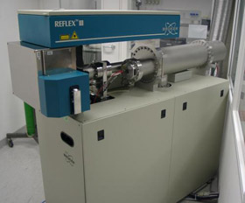
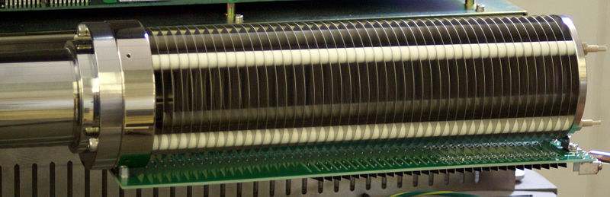
Mass Analyzer: Time of Flight
Drift tubes have sizes of over a meter in real-world instruments
A reflectron doubles the drift length, and thus the instrument’s resolution
It also focuses the ions onto the detector
Drift tube
Reflectron
http://www.biochem.mpg.de/nigg/research/koerner/instruments/absatz_pic_reflexIII.jpg
http://upload.wikimedia.org/wikipedia/commons/thumb/d/d8/Reflectron.jpg/800px-Reflectron.jpg

Slide 60
Mass Analyzer: Time of Flight
Detector
-
+
-
+
-
+
-
+
Drift zone
+
-
Reflectron
U_{a}
The kinetic energy transferred to the ions depends on the acceleration voltage U_{a} and the particle’s charge
Lighter particles fly faster that heavier particles of the same charge
Hence, they arrive later at the detector
The time of flight is thus a measure of the particle’s mass

Slide 61
Mass Analyzer: Time of Flight
Energy transferred to an ion with charge q accelerated by an electrostatic field with acceleration voltage U_{a}:
E_{pot} = qU_{a}
This energy is obviously converted into kinetic energy as the ion accelerates:
E_{kin} = ½ mv² = qU_{a}
For a given path length s from extraction to detector, the time of flight t is thus
t = s / v
Time of flight for a given path length and acceleration voltage, which are instrument parameters, depends on the ion’s charge and mass only

Slide 62
Mass Analyzer: Quadrupole
Oscillating electrostatic fields stabilize the flight path for a specific mass-to-charge ratio – these ions will pass through the quadrupole
Ions with different m/z will be accelerated out of the quadrupole
Changing the frequency allows the selection of a different m/z
stable ion path
unstable ion path

Slide 63
Ion Trap
Ions are captured in a region of a vacuum system or tube
Trapping of ions is based on a combination of magnetic and electric fields
There is a long history of ion trapping and a variety of different technologies have emerged over the years
  Penning trap
  Paul trap
  Kingdon trap

Slide 64
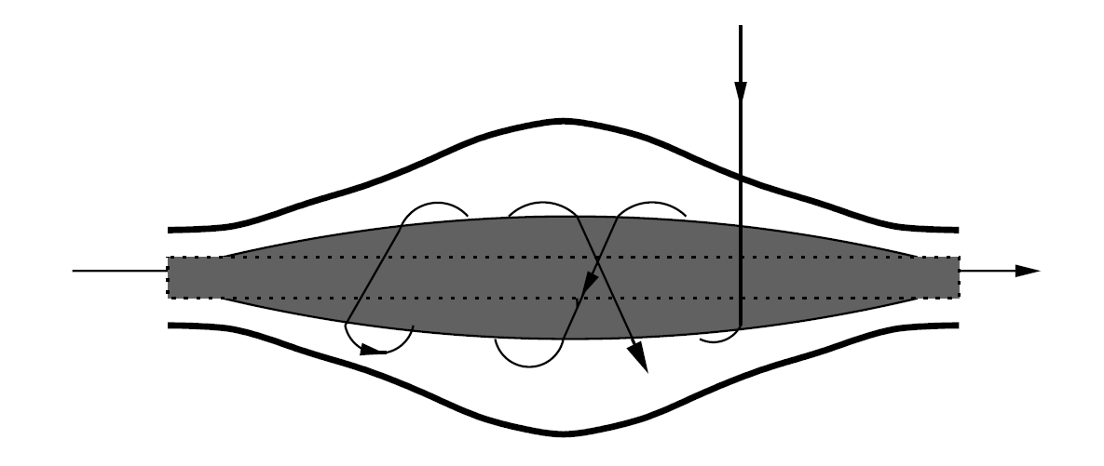
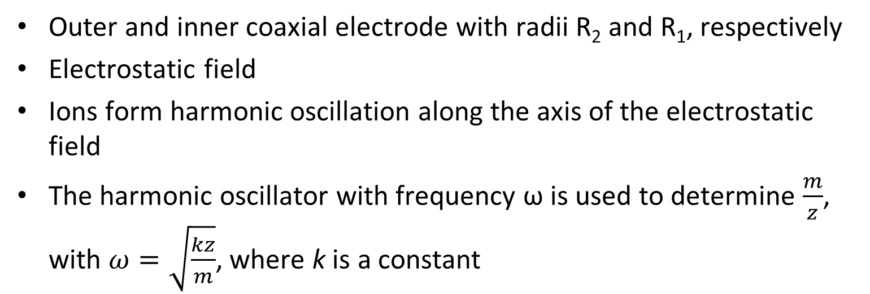
Orbitrap (based on Kingdon trap)
R₂
R₁
Outer and inner coaxial electrode with radii R₂ and R₁, respectively
Electrostatic field
Ions form harmonic oscillation along the axis of the electrostatic field
The harmonic oscillator with frequency ω is used to determine $\frac{m}{z}$, with $ω=\sqrt{\frac{kz}{m}}$, where k is a constant

Slide 65
Tandem MS
Uses two mass-to-charge measurements to analyze precursor and product ions
Fragmentation is used to dissociate the analytes into smaller fragments
MS/MS capable instruments
  Same mass analyzers are used: in-time set-up
  Different analyzers are used (hybrid instruments):
  in-space set-up

Slide 66
Tandem MS fragmentation methods
Different fragmentation techniques
  Collision-Induced-Dissociation (CID)
  Pulsed Q Dissociation (PQD)
  Electron transfer dissociation (ETD)
  Electron capture dissociation (ECD)

Slide 67
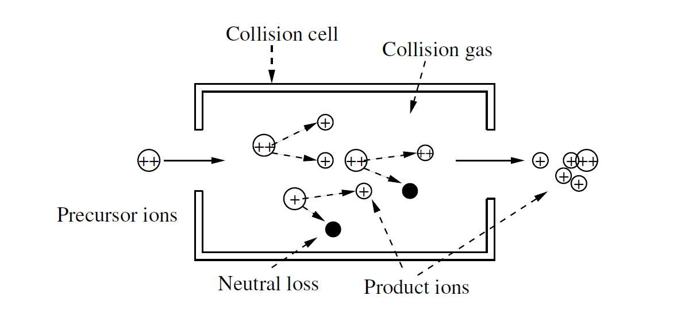
Collision-induced dissociation
Two colliding molecules
Fragmentation is performed in collision cell
Inert collision gas (e.g., Ar, He) is used for collision
Precursor that reaches energy threshold will fragment into products and/or neutral losses
Typical settings: high (>1000 eV) or low energy (<100 eV) CID
Peptides are fragmented at the peptide bond !

Slide 68
Hybrid mass spectrometer
Different hybrid mass spectrometers are used for different applications. The most frequently used combinations are
  Q-TOF
  Q-Trap
  LTQ (linear ion trap)- Orbitrap

Slide 69
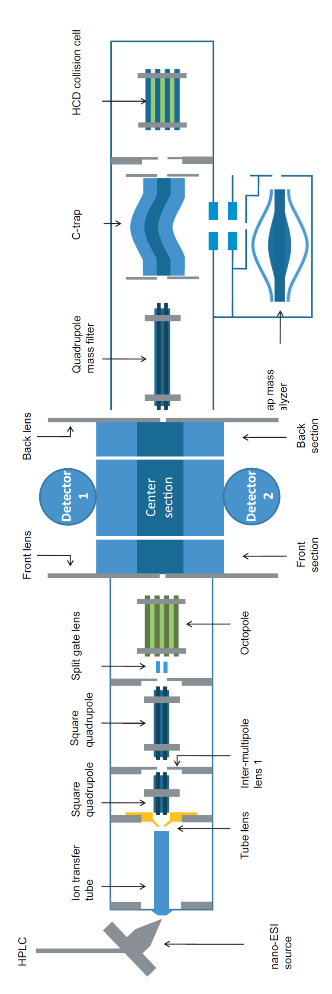
LTQ-Orbitrap – MS
Mass-to-charge ratios (m/z) are recorded. The unit is Thomson [Th].
m…mass of precursor ion
z…charge of precursor ion
Orbitrap mass analyzer
Introduction
Intensity
mass / charge
Dr. Sven Nahnsen
Notes:
A mass spectrometer is basically used to sort ions according to their mass

Slide 70
LTQ-Orbitrap – MS/MS
Mass-to-charge ratios (m/z) are recorded. The unit is Thomson [Th].
m…mass of product ion
z…charge of product ion
Orbitrap mass analyzer
Introduction
Intensity
Intensity
mass / charge
mass / charge
Dr. Sven Nahnsen

Slide 71
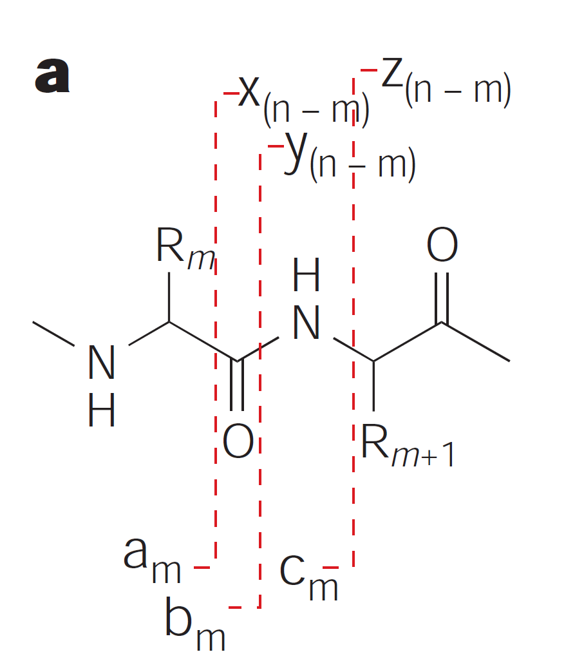
Product ion generation
A peptide of length n can potentially give rise to a,b,c and x,y,z ions. This example shows the fragments that can be produced between amino acids R_{m} and R_{m+1}
Steen and Mann. Nature Reviews, Molecular Cell Biology, Vol. 5 2004

Slide 72
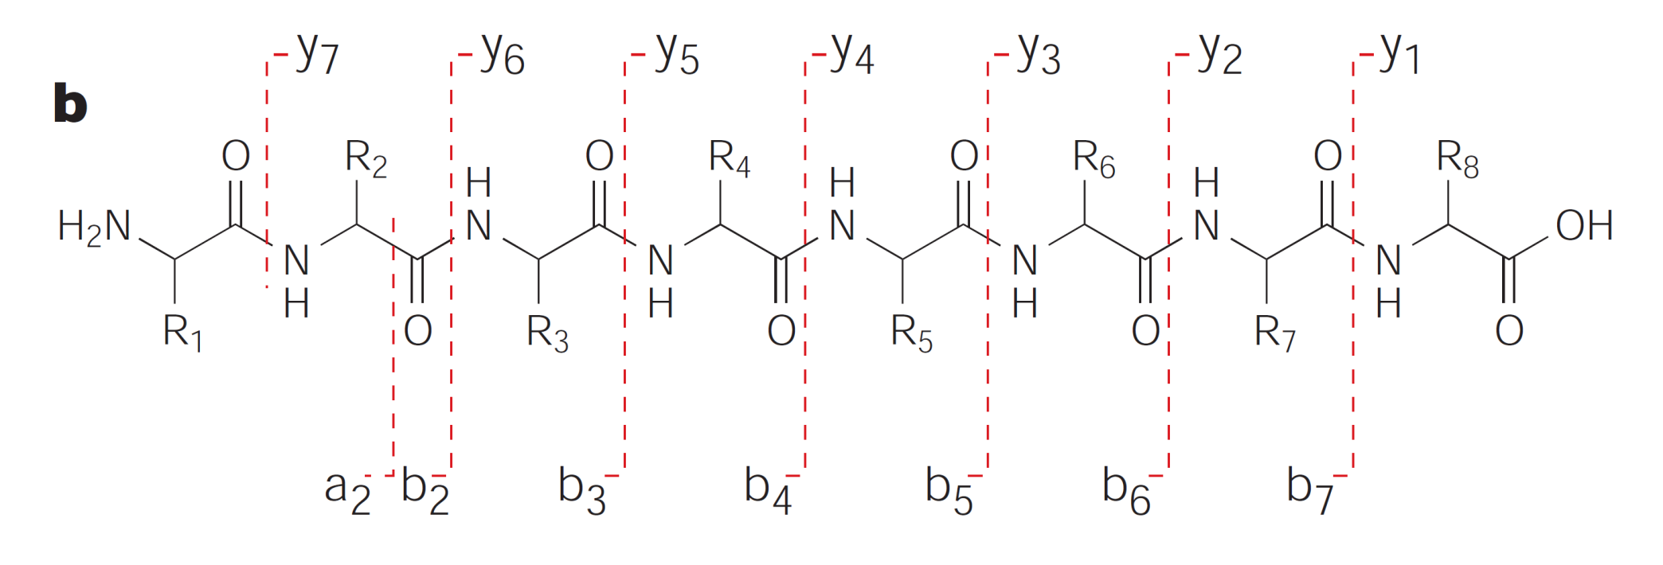
b/y ions in CID
CID fragmentation predominately produces b and y ions
Steen and Mann. Nature Reviews, Molecular Cell Biology, Vol. 5 2004

Slide 73
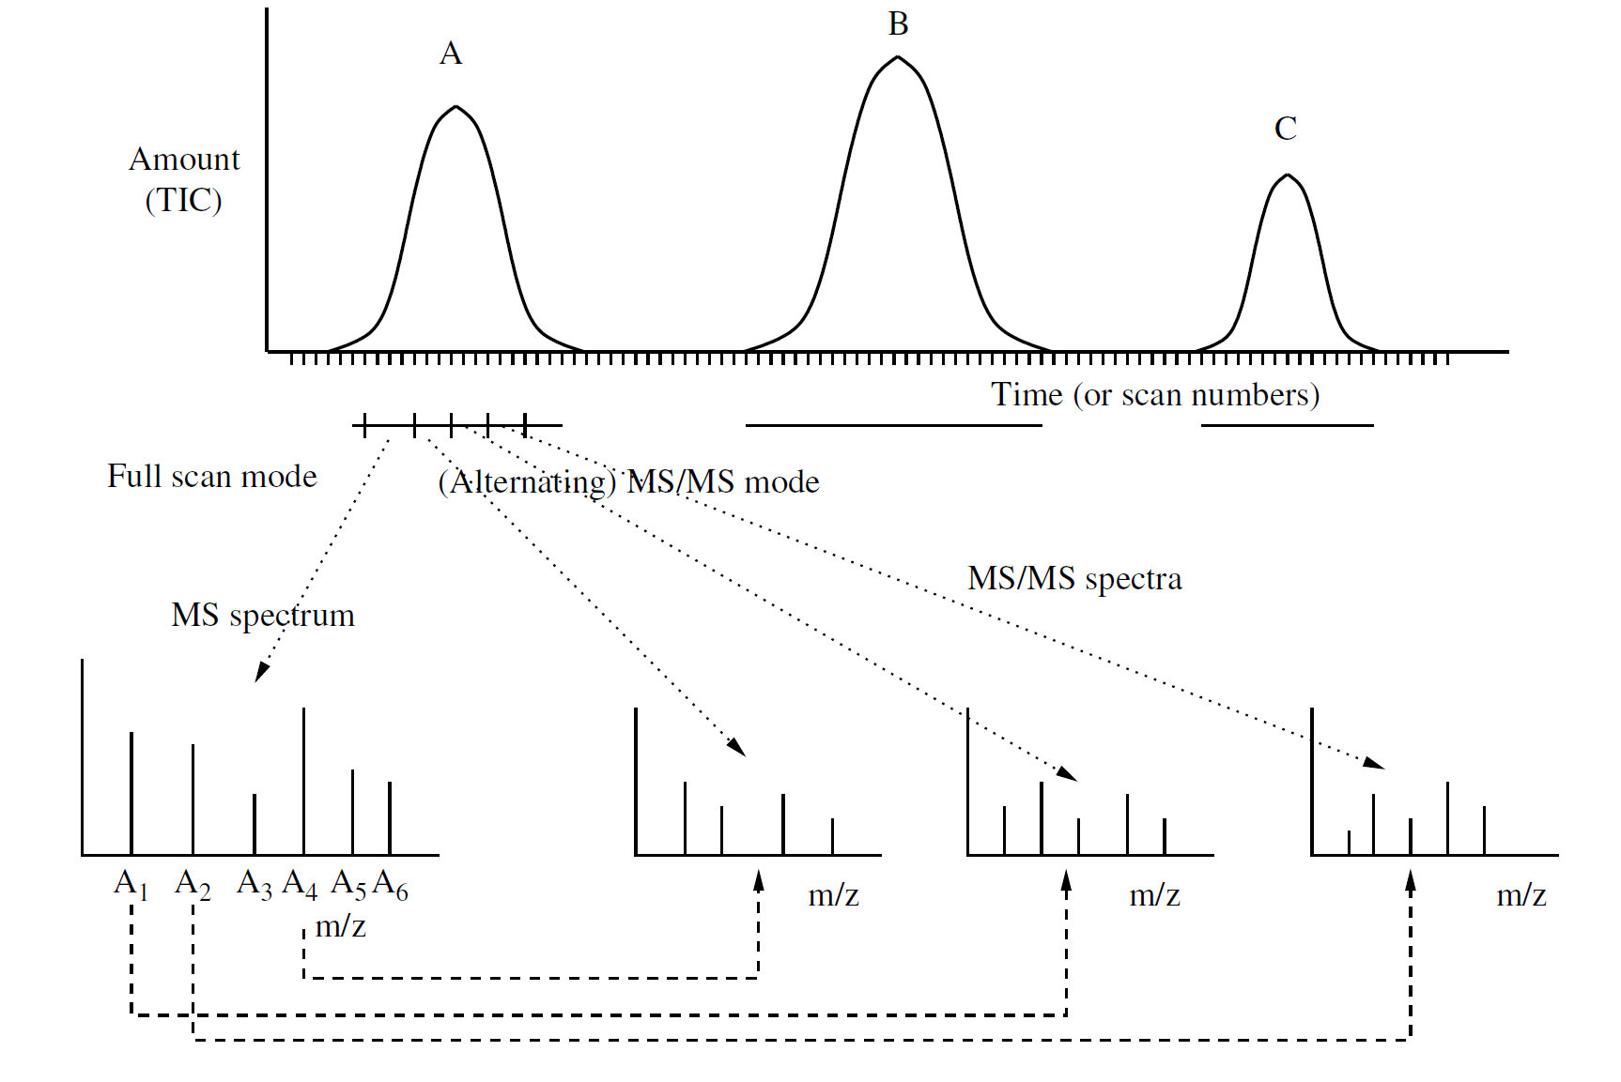

Processes for MS/MS recording
Select n most abundant peaks (usually $3≤n≤20$) are selected for fragmentation
Select for specific charge states
Inclusion list to specify m/z values for fragmentation

Slide 74
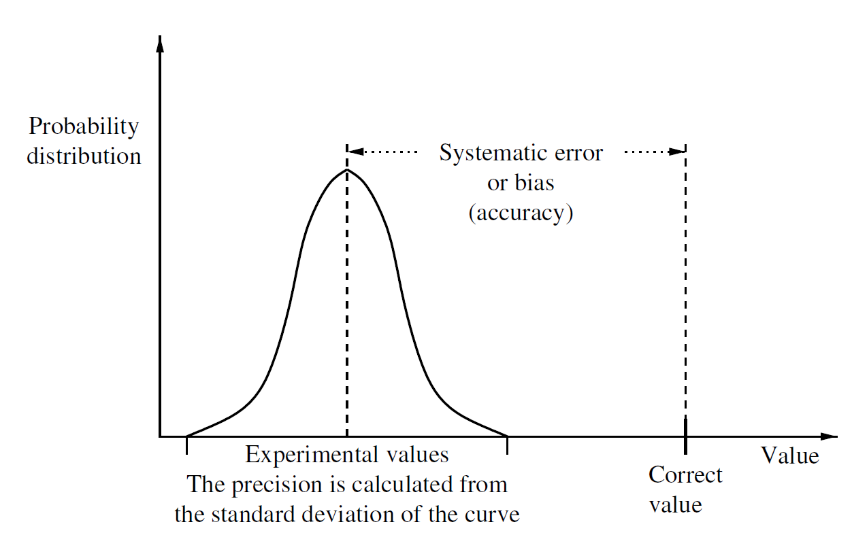
Accuracy vs. precision …
… (of a mass measurement)

Slide 75
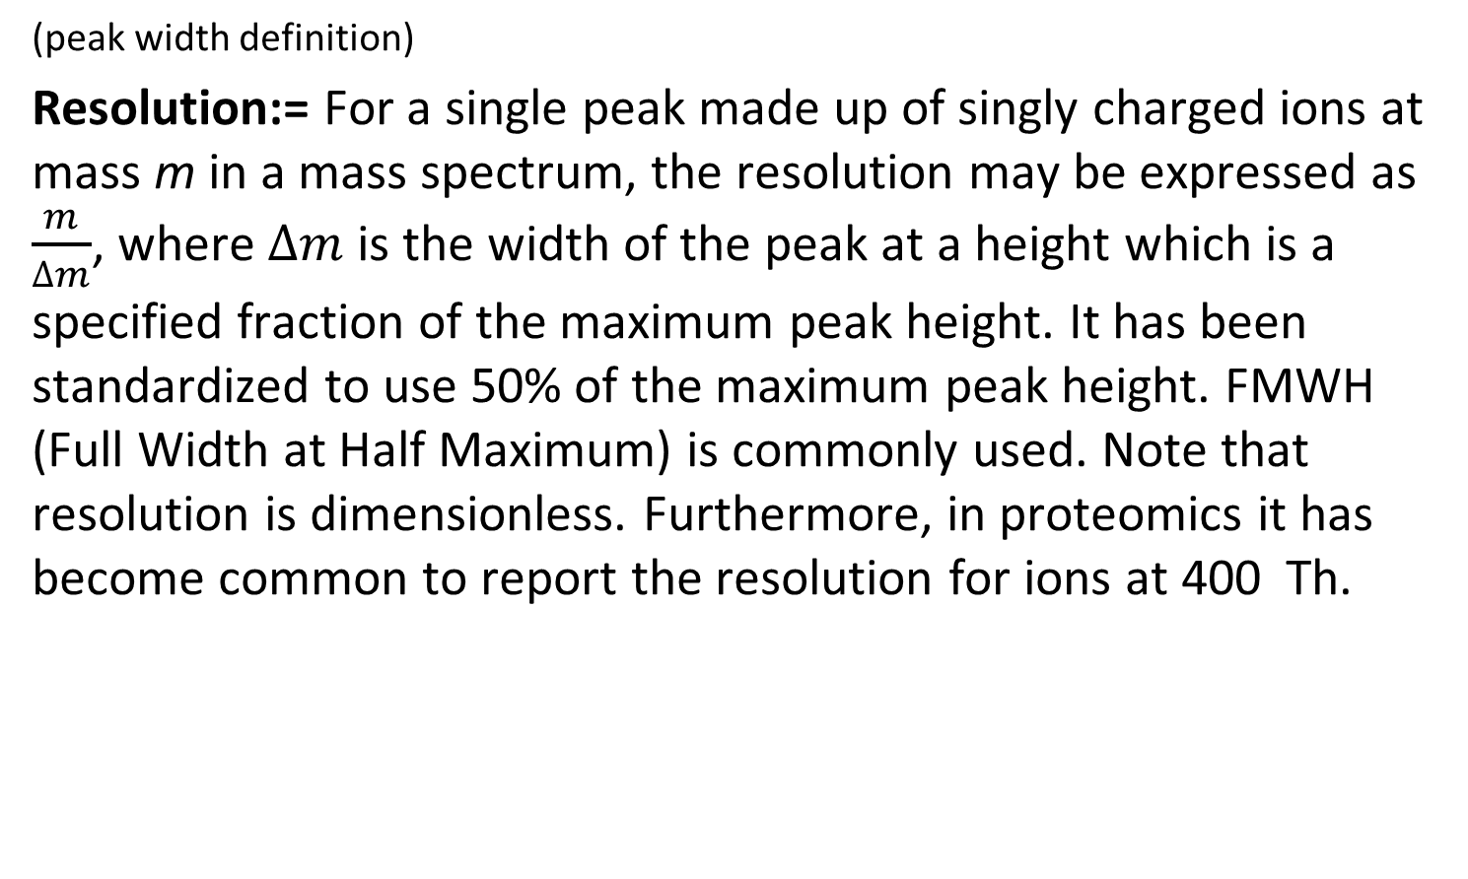
Resolution
(peak width definition)
Resolution:= For a single peak made up of singly charged ions at mass m in a mass spectrum, the resolution may be expressed as $\frac{m}{∆m}$, where $∆m$ is the width of the peak at a height which is a specified fraction of the maximum peak height. It has been standardized to use 50% of the maximum peak height. FMWH (Full Width at Half Maximum) is commonly used. Note that resolution is dimensionless. Furthermore, in proteomics it has become common to report the resolution for ions at 400 Th.

Slide 76
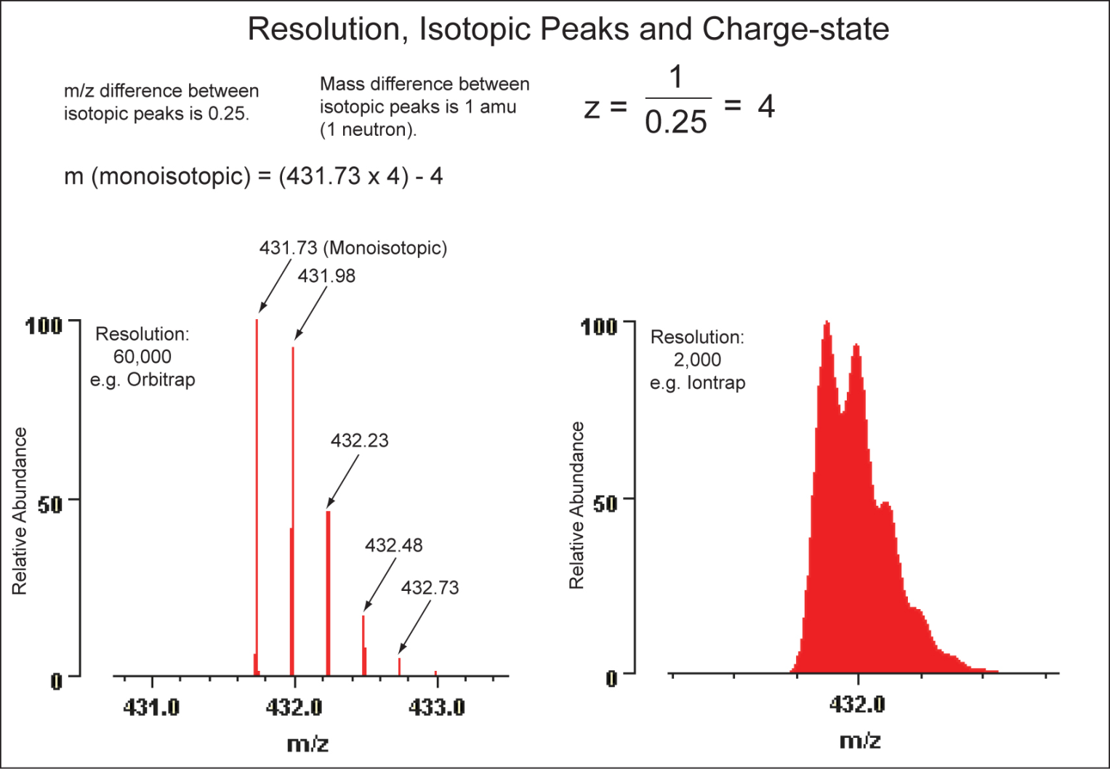
Charge states
Charge state determination is easy if the resolution is high enough
For low resolution data this can become difficult
http://www.lamondlab.com/MSResource/LCMS/MassSpectrometry/chargeState.php

Slide 77

HPLC-MS
I
HPLC ESI TOF
Spectrum (scan)
RT
Separation 1
separate peptides
by their retention
time on column
Ionization
electrospray,
transfers charge
to the peptides
Separation 2
MS separates by mass-to-charge
ratio (m/z)

Slide 78
Materials
Learning Units 2A and 2B
Video on the separation of plant pigments (Tsvet’s experiment) on YouTube
http://www.youtube.com/watch?v=3N1Rt6nWczY

