Slide 1
Computational Proteomics and Metabolomics
Oliver Kohlbacher, Sven Nahnsen, Knut Reinert
1. Proteomics and Metabolomics

Slide 2
LU 1A – Introduction to PROTEOMICS and Metabolomics
Omics techniques and systems biology
Difference between sequence-based techniques and MS-based techniques
Applications of proteomics, metabolomics, lipidomics

Slide 3
Systems Biology – Definition
“Systems biology is a relatively new biological study field that focuses on the systematic study of complex interactions in biological systems, thus using a new perspective (integration instead of reduction) to study them. Particularly from year 2000 onwards, the term is used widely in the biosciences, and in a variety of contexts. Because the scientific method has been used primarily toward reductionism, one of the goals of systems biology is to discover new emergent properties that may arise from the systemic view used by this discipline in order to understand better the entirety of processes that happen in a biological system.”
http://en.wikipedia.org/wiki/Systems_biology (06/06/2008)

Slide 4
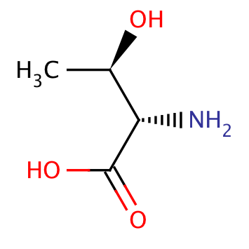
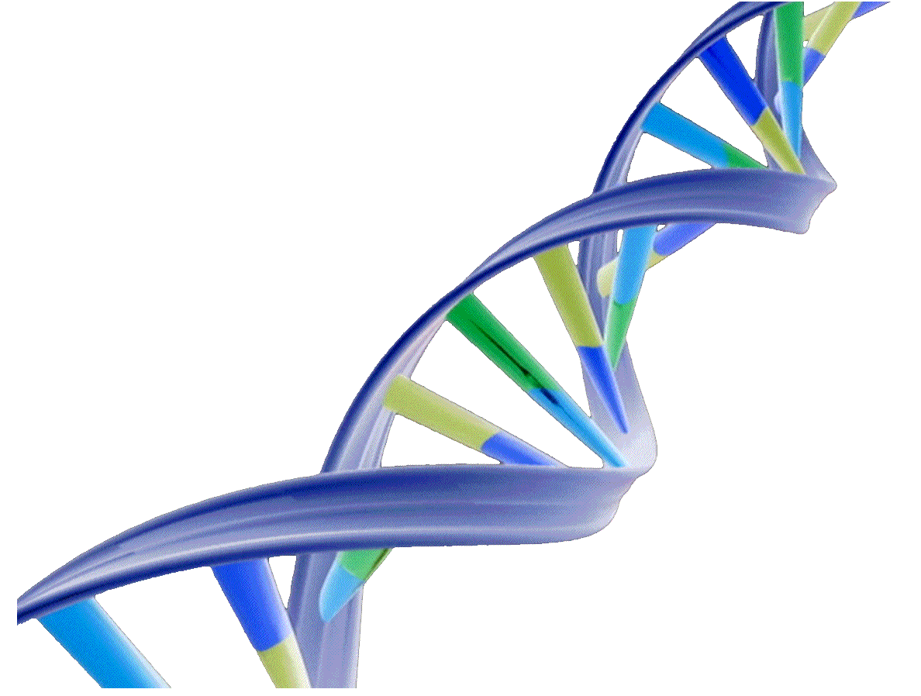
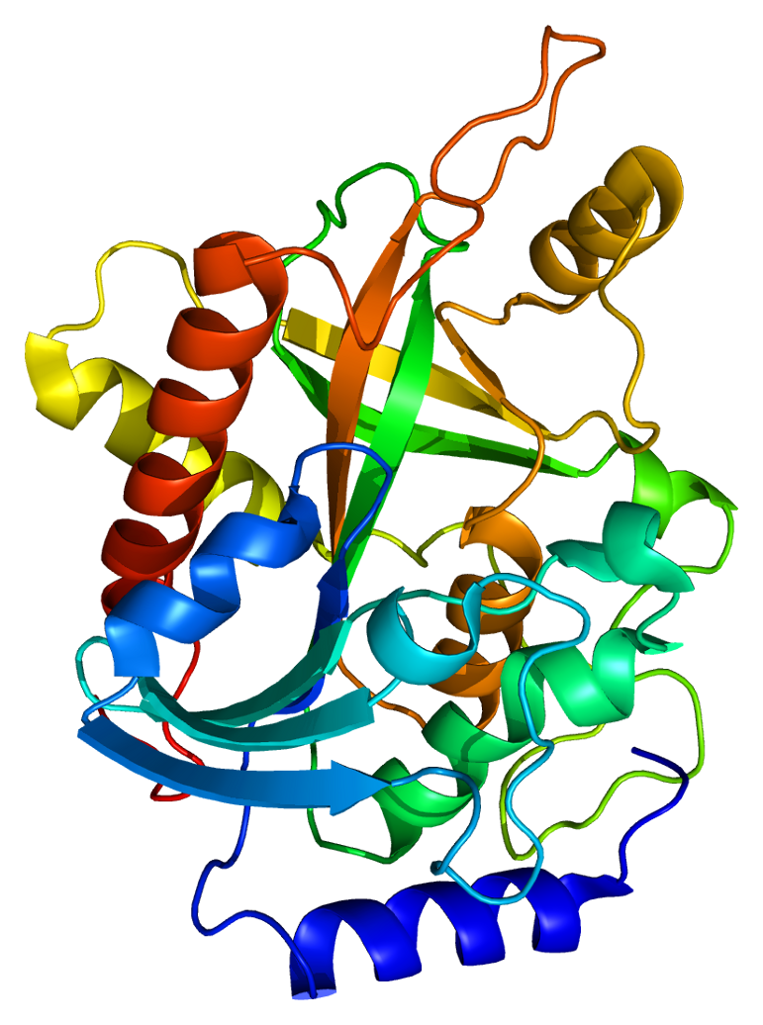
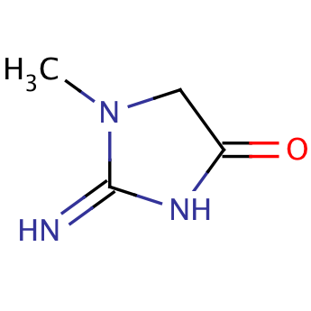
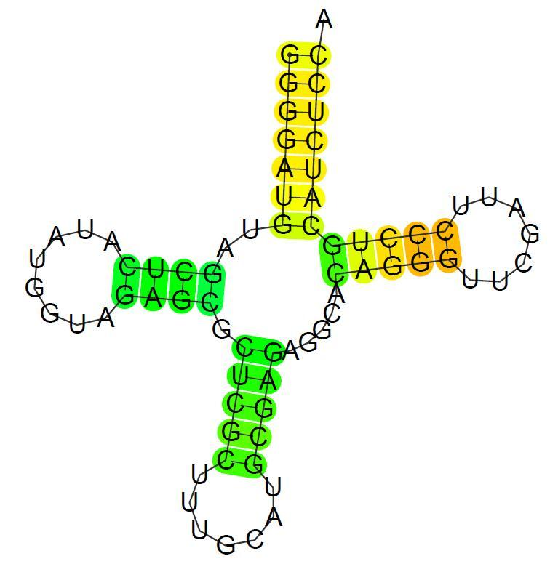
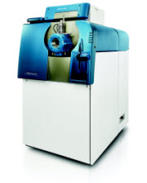
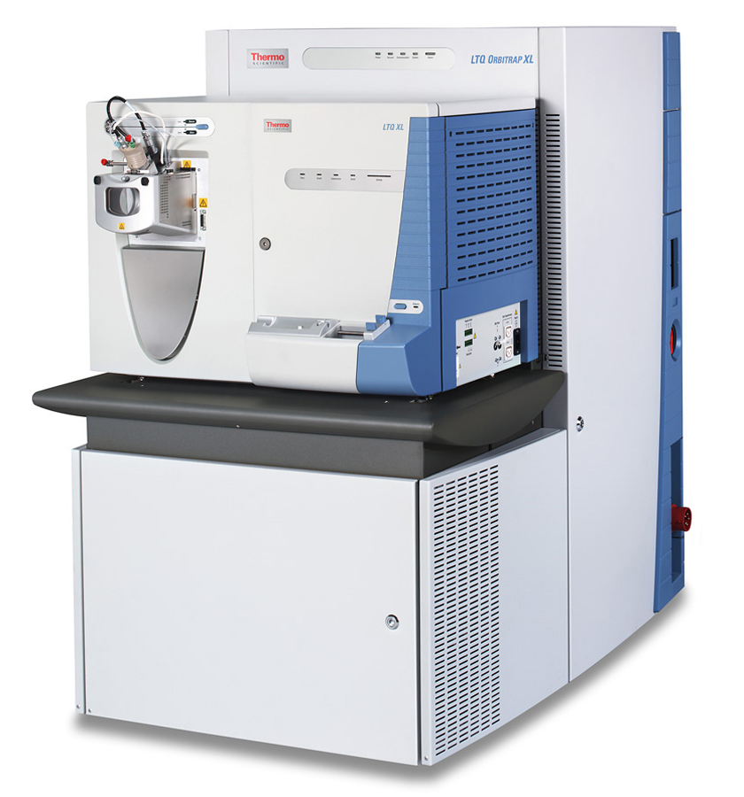
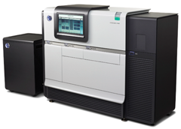
Technologies
Genome
Epigenome
Transcriptome
RNOme
Proteome
Interactome
Metabolome
Lipidome
Next-Generation Sequencing
Mass Spectrometry
Notes:
TODO missing image sources

Slide 5
Amplification
Sequencing-based methods have one massive advantage: DNA can be amplified
PCR (polymerase chain reaction) can exponentially amplify existing DNA fragments with a low error rate
10 rounds of PCR increase the concentration of DNA in the sample by three orders of magnitude
Metabolites and proteins cannot be amplified
Methods for detecting and identifying metabolites and proteins thus need to be more sensitive

Slide 6
Omics Technologies
http://en.wikipedia.org/wiki/File:Metabolomics_schema.png , accessed 2014-03-10, 11:42:00 UTC

Slide 7
LU 1B - Overview of separation techniques
Overview separation techniques (GE, LC, GC)
Chromatographic techniques
Separation principles (size, isoelectric point, hydrophobicity)

Slide 8
Sample Preparation Methods
Samples for omics methods come from a wide range of sources: cell culture, primary tissue, body fluids
Extraction of the required biomolecules is often difficult
Cells need to be broken up (mechanically, with detergents)
Proteins need to be denatured
Enzyme inhibitors, e.g., protease and phosphatase inhibitors, avoid enzymatic degradation
Small molecules are extracted by precipitating larger molecules (proteins) using strong organic reagents (e.g., methanol)
Metabolomics sample preparation must be very fast, since metabolites (intermediates of metabolism) can be rapidly degraded
Different solvents are required to extract/precipitate metabolites/proteins
Buffers and reagents should be compatible with MS!

Slide 9
Separation Methods
Metabolomes and proteomes can be very complex (hundreds of thousands of analytes)
Analyzing them at the same time reduces sensitivity and comprehensiveness of the analysis
Idea:
Reduce the complexity
Split up the sample into smaller, less complex samples
Fractionation
Separation is done before the analysis and results in a (small) number of new samples (usually dozens)
Online separation
Separation happens simultaneously with the MS analysis

Slide 10
Overview Separation Methods
Protein separation methods
1D-PAGE (Polyacrylamide Gel Electrophoresis)
2D-PAGE
(Capillary Electrophoresis)
Peptide separation methods
Liquid chromatography
Isoelectric focusing of peptides
Metabolite separation methods
Liquid chromatography
Gas chromatography

Slide 11
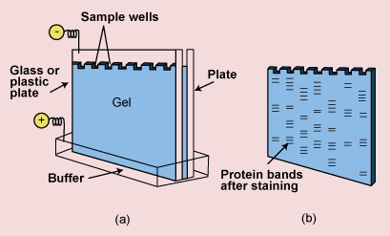
Gel Electrophoresis – Principles
Primarily used to separate proteins and DNA
Proteins are charged (charge depends on pH, c.f. isoelectric point)
Migrate through a gel if an external electrostatic field is applied
Migration distance depends on charge (and/or size)
http://pharmaexposure.blogspot.de/2011/06/gel-electrophoresis.html

Slide 12
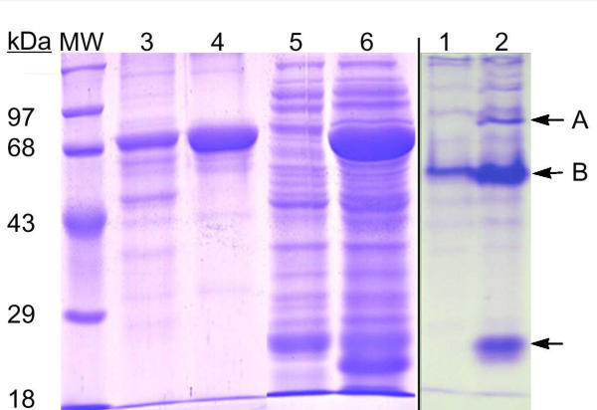
Gel Electrophoresis
1D-Polyacrylamide gel electrophoresis (PAGE)
Cut gel into slices
Analyze slices separately
Senejani et al. BMC Biochemistry. 2001

Slide 13
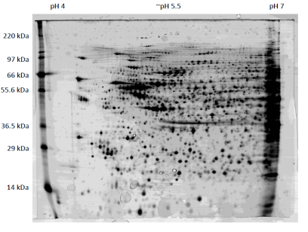
Gel Electrophoresis
2D-Polyacrylamide gel electrophoresis (PAGE)
Initial separation on a pH gradient, then second separation (orthogonal to the first) based on size
Excise single protein spots
Analyze the protein spots separately

Slide 14
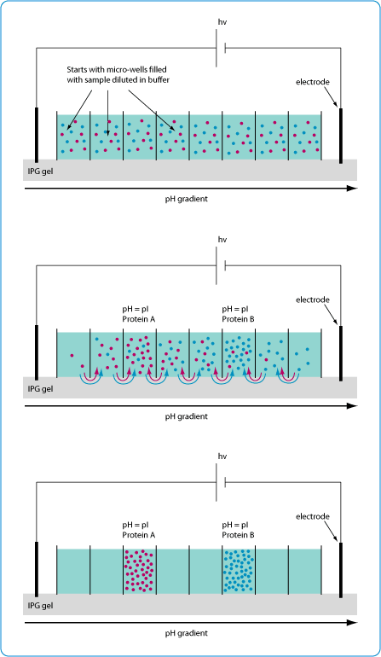
Off-Gel Separation
Fractionation of peptides (or proteins) according to their pI)
Reduce sample complexity: mixture will be split into several fraction
Each fraction can be analyzed separately
Analytes are kept in solution (they are kept off the gel)
Potential problems:
very basic or acidic peptides will not be captured
Measurement time is multiplied by the number of fractions
Protein quantification will have to include peptides from different fractions
http://www.chem.agilent.com

Slide 15
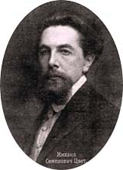
Chromatography
Chromatography is a separation technique
From greek chroma and graphein – color and to write
Initially developed by Mikhail Semyonovich Tsvet
Simple fundamental idea:
Two phases: stationary and mobile
Analytes are separated while mobile phase passes along the stationary phase
Various separation mechanisms, various choices for mobile/stationary phases possible
M. S. Tsvet (1872-1919)
Notes:
TODO: image source

Slide 16
Column Chromatography
http://fig.cox.miami.edu/~cmallery/255/255hist/ecbxp4x3_chrom.jpg

Slide 17
Chromatography
Liquid chromatography (LC)
Mobile phase liquid, stationary phase usually solid
Very versatile technique
High-Performance Liquid Chromatography (HPLC) for analytical purposes
Gas chromatography (GC)
Mobile phase is a gas passing over the solid phase
Usually at higher temperatures
Limited to volatile compounds
Others
Thin-Layer Chromatography (TLC)
Paper Chromatography (PC)
…

Slide 18
HPLC
High-performance liquid chromatography (HPLC) uses small columns (μm inner diameter) and very high pressure (600 bar)
Reversed-phase (RP) chromatography is the most common type: hydrophobic stationary phase, hydrophilic eluent (water/acetonitrile) as mobile phase
More hydrophobic analytes elute later than hydrophilic analytes
pump
detector
column
(stationary phase)
mobile phase

Slide 19
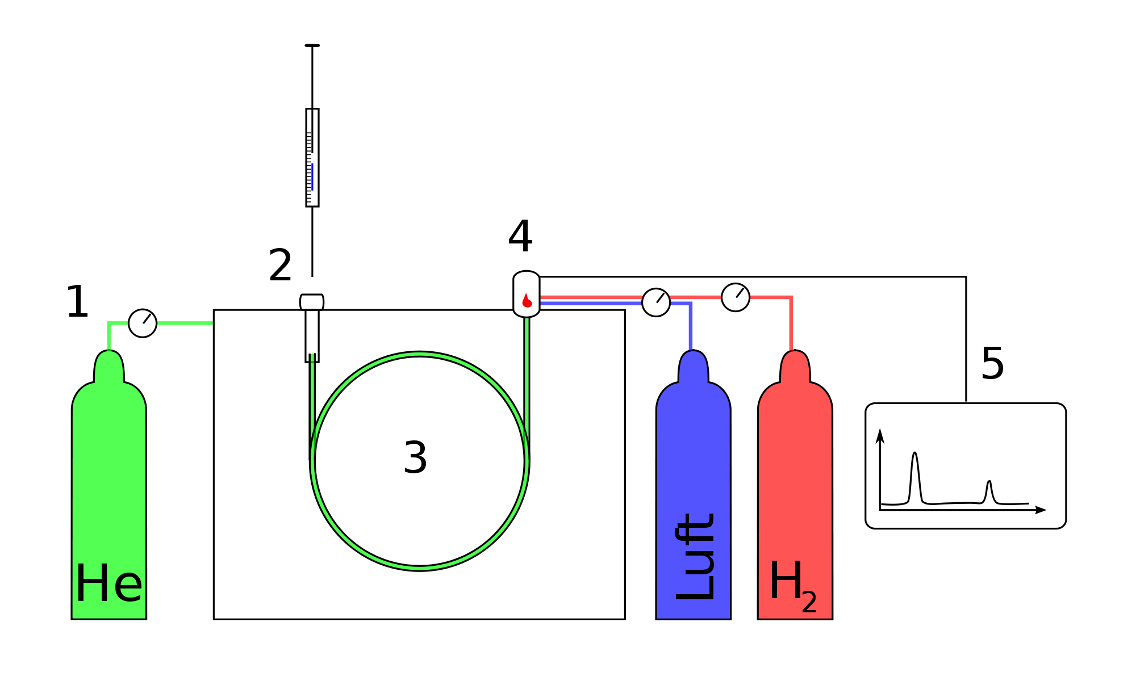
Gas chromatography
Long column (10-200 m)
Column is operated at very high temperatures (up to 450 °C)
Requires analytes that are gaseous or evaporate easily
Derivatisation: Convert non-volatile compounds to a volatile derivatives
Injector
Column
oven
Carrier gas
http://de.wikipedia.org/wiki/Gaschromatographie
Notes:
Knut: Why add numbers if not used?
Knut: Is derivatisation in glossary?

Slide 20
Computational Proteomics and Metabolomics
Oliver Kohlbacher, Sven Nahnsen, Knut Reinert
1. Proteomics and Metabolomics

Slide 21
LU 1C - Introduction to Mass Spectrometry
Definition of mass spectrometry, mass spectrum
Overview of the three components of an MS (ion source, mass analyzer, detector)
Molecular and atomic masses
Isotope pattern/distribution, fine structure of isotope distribution

Slide 22
Mass Spectrometry
Definition: Mass spectrometry is an analytical technique identifying type and amount of analytes present in a sample by measuring abundance and mass-to-charge ratio of analyte ions in the gas phase.
Mass spectrometry is often abbreviated mass spec or MS
The term mass spectroscopy is related, but its use is discouraged
Mass spectrometry can cover a wide range of analytes and usually has very high sensitivity

Slide 23
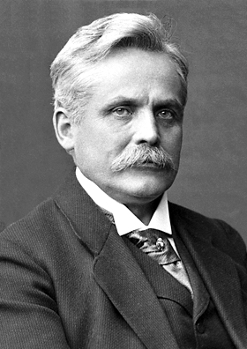
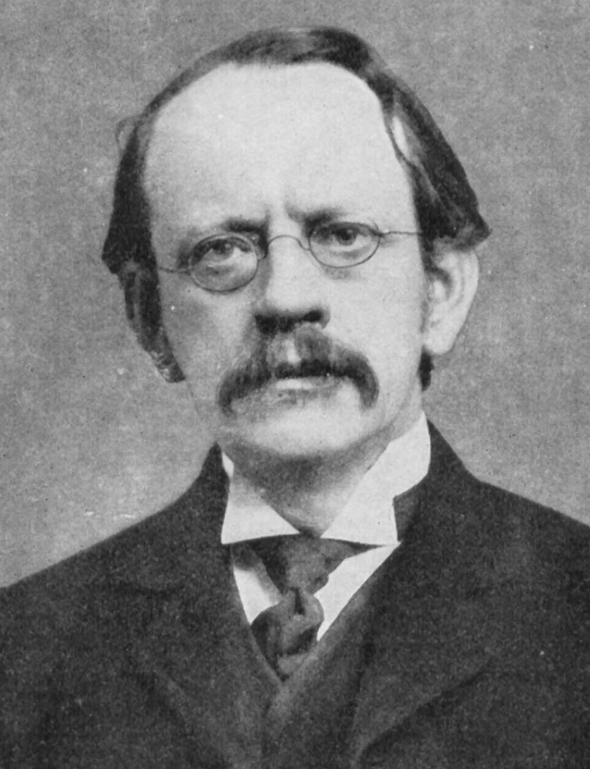
Mass Spectrometry – Early History
Wilhelm Wien was the first to separate charged particles with magnetic and electrostatic fields in 1899
Sir Joseph J. Thomson improved on these designs
Sector mass spectrometers were used for separating uranium isotopes for the Manhattan project
In the 1950s and 1960s Hans Dehmelt and Wolfgang Paul developed the ion trap
Wilhelm Wien
(1864-1928)
J.J. Thomson
(1856-1940)
http://www.nobelprize.org/nobel_prizes/physics/laureates/1911/wien.jpg
http://en.wikipedia.org/wiki/J._J._Thomson#mediaviewer/File:J.J_Thomson.jpg

Slide 24
Components of a Mass Spectrometer
mass spectrometer
Int
ion
source
mass
analyzer
detector
sample
m/z
2,200 x
+
+
+
+
+
900 x
+
+
2,900 x
+
+
A mass spectrometer has three key components
Ion source – converting the analytes into charged ions
Analyzer – determining (and filtering by) mass-to-charge ratio
Detector – detecting the ions and determining their abundance

Slide 25
Combining LC and Mass Spectrometry
MS can be used as a very sensitive detector in chromatography
It can detect hundreds of compounds (metabolites/peptides) simultaneously
Coupling mass spectrometry to HPLC is then called HPLCS-MS (so-called ‘hyphenated technique’)
Idea: analytes elute off the column and enter the MS more or less directly
mass spectrometer
Int
ion
source
mass
analyzer
detector
m/z
Notes:
Knut: is the empty graph (spectrum) on the right intended? I would add some sticks….

Slide 26
Key Ideas in MS
Ions are accelerated by electrostatic and electromagnetic fields
Neutral molecules are unaffected
Same idea: gel electrophoresis – but MS in vacuum/gas phase
Force acting into a charged particle is governed by Lorentz force:
where
q is the charge of the particle, v is the velocity of the particle
E is the electric field, B is the magnetic field
F the force acting on the particle
Together with Newton’s second law of motion we see that the acceleration a of the particle relates to the mass-to-charge ratio m/q:
Acceleration of the ions is then used to determine m/q
Notes:
F= q\cdot (E+v\times B)
F=m \cdot a
a=\frac{(E+v \times B)}{m/q}

Slide 27
Key Ideas in MS
Acceleration:
Example:
Applying the same electrostatic field E to different ions (e.g., different peptide ions) will result in a different acceleration, if they differ in the mass-to-charge ratio
An ion with the twice the mass, but the same charge, will thus experience half the acceleration – and will hit the detector later!
E
Ion Source
Detector
m
a = q E / m
2 m
a = q E / (2 m)

Slide 28
Molecular Mass and Atomic Mass
Atoms (and thus molecules) have a mass
Isotopes: all chemical elements have naturally occurring isotopes that have the same atomic number but different masses
Masses are generally given in units of kg (SI unit), however, there are a few conventions for atomic and molecular masses
Atomic mass is the rest mass of an atom in its ground state
Atomic mass is generally expressed in unified atomic mass units, which corresponds to 1/12 of the weight of ¹²C (1.6605402 x 10⁻²⁷ kg)
Commonly used is also the non-SI unit 1 Dalton [Da], which is equivalent to the unified atomic mass unit
Another deprecated unit equivalent to Da still found in literature is atomic mass unit (amu)
IUPAC definition: doi:10.1351/goldbook.A00496
Notes:
Knut: Are those in the glossary?

Slide 29
Molecular Mass
Mass of a molecule is the sum of the masses of its atoms
Accurate mass of a molecule is an experimentally determined mass
Exact mass of a molecule is a theoretically calculated mass of a molecule with a specified isotopic composition
Molecular weight or relative molecular mass is the ratio of a molecule’s mass to the unified atomic mass unit
For ions the mass of the missing/extra electron resp. proton needs to be included as well!
Note:
Terms are not always used properly in the literature
Be cautious with masses you google somewhere
Reference: masses defined by IUPAC commission
Murray et al., Pure Appl. Chem., Vol. 85, No. 7, pp. 1515–1609, 2013
http://www.iupac.org/home/about/members-and-committees/db/division-committee.html?tx_wfqbe_pi1%5bpublicid%5d=210

Slide 30
Isotopes
Isotopes are atom species of the same chemical element that have different masses
Same number of protons and electrons, but different number of neutrons
For proteomics: main elements occurring in proteins are C, H, N, O, P, S
Isotope | Mass [Da] | Nat. abun- dance [%] | Isotope | Mass [Da] | Nat. abun- dance [%]
¹H | 1.007 825 0322(6) | 99.985 | ¹⁶O | 15.994 914 620(2) | 99.76
²H | 2.014 101 7781(8) | 0.015 | ¹⁷O | 16.999 131 757(5) | 0.038
¹²C | 12 (exact) | 98.90 | ¹⁸O | 17.999 159 613(6) | 0.2
¹³C | 13.003 354 835(2) | 1.1 | ³¹P | 30.973 761 998(5) | 100
¹⁴N | 14.003 074 004(2) | 99.63 | ³²S | 31.972 071 174(9) | 95.02
¹⁵N | 15.000 108 899(4) | 0.37 | ³³S | 32.971 458 910(9) | 0.75
 |  |  | ³⁴S | 33.967 8670(3) | 4.21
http://www.ciaaw.org/

Slide 31
Mass Number, Nominal, and Exact Mass
The mass number is the sum of protons and neutrons in a molecule or ion
The nominal mass of an ion or molecule is calculated using the most abundant isotope of each element rounded to the nearest integer
The exact mass of an ion or molecule is calculated by assuming a single isotope (most frequently the lightest one) for each atom
Exact mass is based on the (experimentally determined!) atomic masses for each isotope – numbers are regularly updated by IUPAC (International Union for Pure and Applied Chemistry)
Example:
Nominal mass of glycine (C₂H₅NO₂):
2 x 12 + 5 x 1 + 14 x 1 + 16 x 2 = 75
Exact mass of glycine (C₂H₅NO₂) using the lightest isotopes:
2 x 12.0 + 5 x 1.00782503226 + … = 75.0320284…

Slide 32
Monoisotopic Mass, Mass Defect
Monoisotopic mass of a molecule corresponds to the exact mass for the most abundant isotope of each element of the molecule/ion
Note that for small elements (e.g., C,H,N,O,S) the most abundant isotope is also the lightest one
Mass defect is the difference between the mass number and the monoisotopic mass
Mass excess is the negative mass defect
Example
Monoisotopic mass of glycine (C₂H₅NO₂): 75.0320284…
Nominal mass of glycine: 75
Mass excess of glycine: 0.0320284…

Slide 33
Average Mass
The average mass of a molecule is calculated using the average mass of each element weighted for its isotope abundance
These average masses (weighted by natural abundance) are also the masses tabulated in most periodic tables
Example:
Average mass of glycine (C₂H₅NO₂):
2 x (0.9890 x M(¹²C) + 0.0110 x M(¹³C))
+ 5 x (0.99985 x M(¹H) + 0.00015 x M(²H))
+ 1 x (0.09963 x M(¹⁴N) + 0.00037 x M(¹⁵N))
+ 2 x (0.9976 x M(¹⁶O) + 0.00038 x M(¹⁷O) + 0.002 x M(¹⁸O))
= 75.0666 Da
Simpler alternative: use average atomic weights from PTE!

Slide 34
Accurate Mass and Composition
Accurate mass is an experimentally determined mass of an ion or molecule and it can be used to determine the elemental formula
Accurate mass comes with a known accuracy or (relative) error, which is usually determined in ppm (10⁻⁶ = parts per million)
Most mass spectrometers have a constant relative mass accuracy - absolute mass error often increases linearly with the measured mass
Example: Measured accurate mass of valine (C₅H₁₁NO₂): 117.077 Da
Monoisotopic mass of valine: 117.078979 Da
Absolute mass error: -0.0178979 Da
Relative mass error: -0.0178979 Da/117.078979 Da = -16.9 ppm

Slide 35
IUPAC Terms
IUPAC (International union of pure and applied chemistry) defines the meaning of all the terms – so if you are unsure, look them up in the IUPAC Gold Book and in the IUPAC recommendations:
Exact mass
Monoisotopic mass
Average mass
Mass number
Nominal mass
Mass defect
Mass excess
Accurate mass
Murray et al., Pure Appl. Chem., Vol. 85, No. 7, pp. 1515–1609, 2013
http://goldbook.iupac.org/index.html

Slide 36
Isotope Patterns
Molecule with one carbon atom
Two possibilities:
light variant ¹²C
Heavy variant ¹³C
98.9% of all atoms will be light
1.1% will be heavy
¹²C | 98.90% | ¹³C | 1.10%
¹⁴N | 99.63% | ¹⁵N | 0.37%
¹⁶O | 99.76% | ¹⁷O | 0.04% | ¹⁸O | 0.20%
¹H | 99.98% | ²H | 0.02%

Slide 37
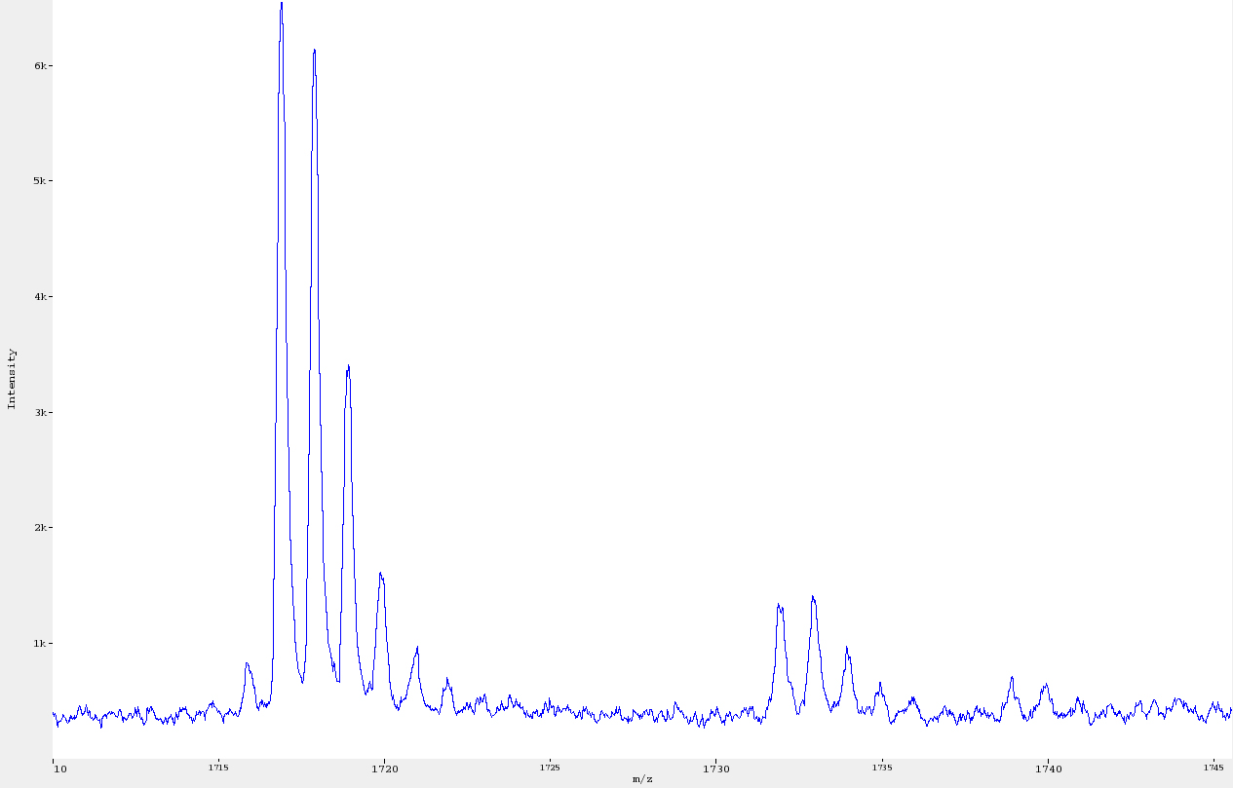
Isotope Patterns
Molecule with 10 carbon atoms
Lightest variant contains only ¹²C
This is called ‘monoisotopic’
Others contain 1-10 ¹³C atoms, these are heavier by 1-10 Da than the monoisotopic one
In general, the relative intensities follow a binomial distribution, depending on the number of atoms
For higher masses (i.e., a larger number of atoms), the monoisotopic peak will be no longer the most likely variant

Slide 38
Isotope Patterns
It is possible to compute approximate isotope patterns for any given m/z, by estimating the average number of atoms
Heavier molecules have smaller monoisotopic peaks
In the limit, the distribution approaches a normal distribution
m [Da] | P (k=0) | P (k=1) | P (k=2) | P (k=3) | P (k=4)
1,000 | 0.55 | 0.30 | 0.10 | 0.02 | 0.00
2,000 | 0.30 | 0.33 | 0.21 | 0.09 | 0.03
3,000 | 0.17 | 0.28 | 0.25 | 0.15 | 0.08
4,000 | 0.09 | 0.20 | 0.24 | 0.19 | 0.12
Notes:
Nun ist es aber leider so, dass wir die peptide noch nicht kennen und somit ihre chemische Zsuammensetzung unbekannt ist.
Wir koennen aber die chemische Zusammensetzung approximieren und somit allein anhand der Masse die ein theoretisches Isotopen Muster berechnen.

Slide 39
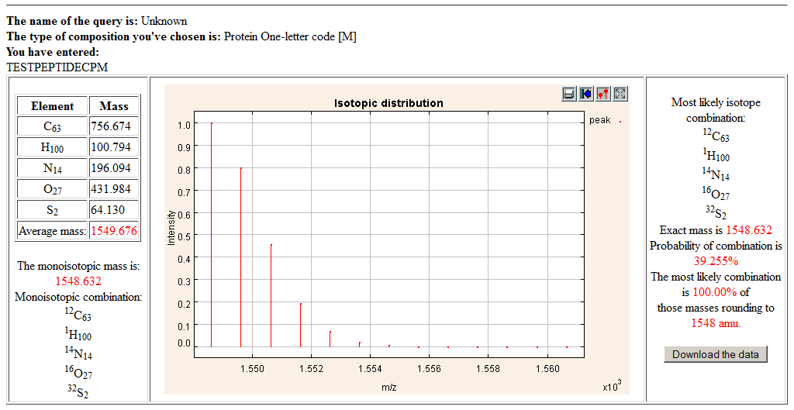
Online Calculator
http://education.expasy.org/student_projects/isotopident/

Slide 40
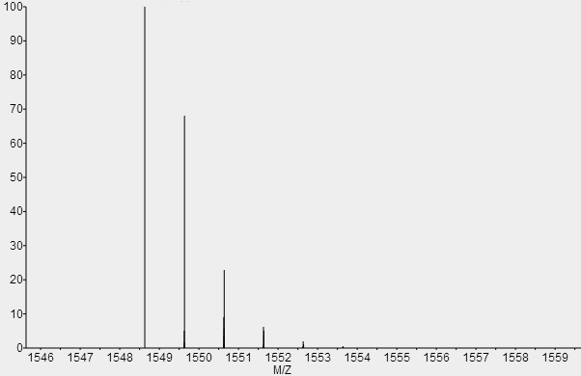
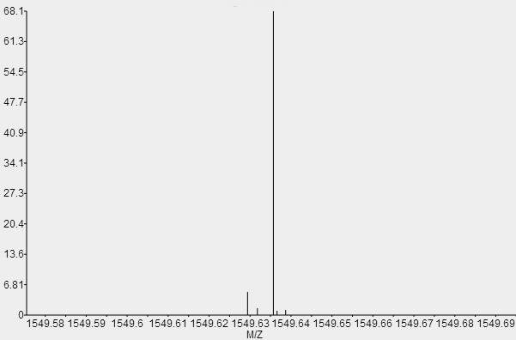
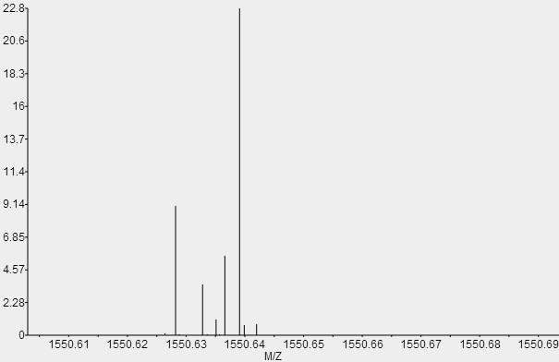
Isotopic Fine Structure
High-resolution MS reveals isotopic fine structure (Why?)
-¹²C+¹³C = 1.0034 Da/z shift
-2 * ¹²C + 2 * ¹³C = 2.0068 Da/z shift
-¹⁴N+¹⁵N = 0.9971 Da/z shift

Slide 41
Computing the Isotopic Distribution
For simplicity’s sake, we will consider only nominal masses and no isotopic fine structure here
Let E be a chemical element (e.g. H or N).
Let π_{E}[i] be the probability (i.e., natural abundance) of the isotope of E with i additional neutrons (i = 0 for the lightest isotope of E)
Relative intensities of pure E are given by (π_{E}[0], π_{E}[1], … π_{E}[k_{E}], where k_{E} = nominal mass shift of heaviest isotope of E)
Given a molecule composed of two atoms of elements E and E’
Probability for additional neutrons in the molecule is then the sum over all possible combinations and their respective probabilities

Slide 42
Computing the Isotopic Distribution
This is known as a convolution and we can write
with the convolution operator *
Convolution powers Let p¹ := p and p^{n} :- p^{n-1} * p for any isotope distribution p
p⁰ with p⁰[0] = 1, p⁰[l] = 0 for l > 0 is the neutral element with respect to the operator *
Example: Compute the isotope distribution of CO
π_{CO}[0] = π_{C}[0] π_{O}[0]
π_{CO}[1] = π_{C}[1] π_{O}[0] + π_{C}[0] π_{O}[1]
π_{CO}[2] = π_{C}[2] π_{O}[0] + π_{C}[1] π_{O}[1] + π_{C}[0] π_{O}[2]
Notes:
\pi_{EE'}=\pi_E * \pi_{E'}

Slide 43
Computing the Isotopic Distribution
The isotopic distribution for the chemical formula
consisting of n_{i} atoms of elements E¹…E^{l} can be computed as
Runtime: quadratic in the number of atoms
Number of convolution operators is n₁ + n₂ + … n_{l} – 1 and is thus linear in the number of atoms n
Convolution operator involves a summation for each π[i]
If the highest isotopic rank for E is k_{E}, then the highest isotopic rank of E_{n} is n k_{E} – again, linear in the number of atoms
There are several tricks and practical considerations to speed up these calculations

Slide 44
LU 1D – Basic proteomic techniques and applications
Definition and size of the proteome
Protein databases
Amino Acid masses, posttranslational modifications, protein isoforms
Top-down proteomics
Shotgun proteomics, tryptic digest
Applications: clinical proteomics, signaling

Slide 45
Top-Down vs. Bottom-Up Proteomics
Two fundamentally different approaches in proteomics
Top-down proteomics: intact proteins are analyzed
Bottom-up proteomics (shotgun proteomics): proteins are digested to peptides, peptides are analyzed
Bottom-up approaches are currently more popular
Absolute mass error increases with measured mass to charge (m/z) value
Hard to determine mass for a protein – broad mass distribution
The sensitivity of mass measurements at a protein range is significantly worse than at peptide level
The existence of modifications complicates the analysis of complete proteins
Peptides are easier to separate using HPLC than proteins

Slide 46
Bottom-Up Proteomics
Note that bottom-up and shotgun proteomics are used equivalently most of the time
There are two conceptually different approaches in bottom-up proteomics
Peptide mass fingerprinting
Peptide sequencing
Peptide masses are used to identify the protein
Often used in combination with 2D gels
Peptides are fragmented
Fragments are used to interfere the sequence
Shotgun proteomics

Slide 47
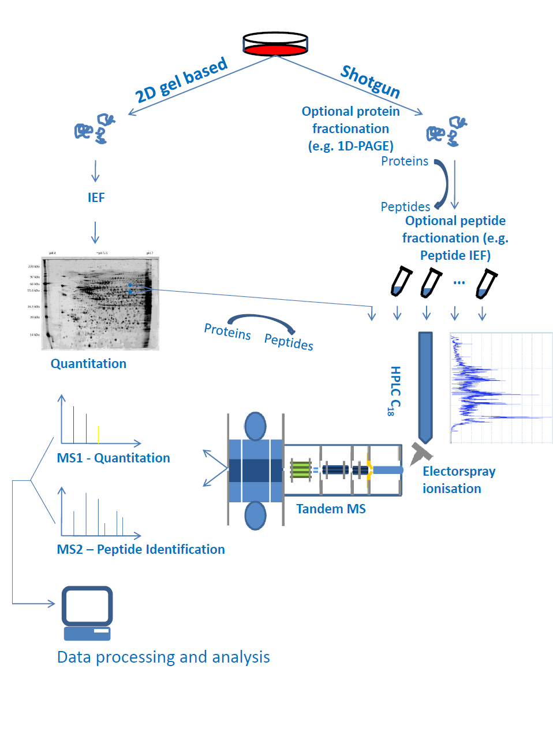

Slide 48
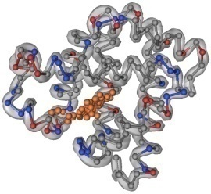
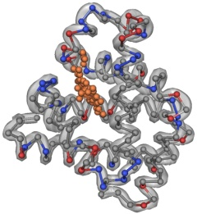
Shotgun Proteomics
K
Y
K
A
L
F
K
N
D
M
A
A
K
E
L
F
R
H
P
G
D
H
K
A
S
E
D
L
K
I
P
V
K
F
G
H
L
K
G
H
P
E
T
L
E
K
S
E
D
E
M
K
H
K
K
A
D
F
D
K
V
Y
K
K
H
L
K
K
S
Q
A
Q
L
F
K
E
A
L
F
L
L
G
I
P
V
K
D
M
M
I
V
A
G
H
G
G
K
G
W
V
A
A
L
E
L
F
R
digestion
E
L
G
G
E
Q
E
G
V
V
G
Q
M
Separation
K
F
Q
G
L
I
N
L
G
I
S
S
E
D
E
M
K
K
M
G
L
R
V
L
T
A
I
A
K
N
D
M
A
A
K
F
D
K
F
S
D
G
E
W
Q
L
L
E
S
A
S
E
D
L
K
G
H
H
E
A
E
L
T
P
L
A
Q
S
H
A
T
K
V
T
N
G
H
F
I
E
L
G
F
Q
G
Proteins
Peptid-
digest
Y
L
E
G
H
P
E
T
L
E
K
H
P
G
D
F
G
A
D
A
Q
G
A
M
S
K
V
E
A
D
V
A
G
H
G
Q
E
V
L
I
R
Y
L
E
F
I
S
E
A
I
I
Q
V
L
Q
S
K
Key ideas
Separation of whole proteins possible but difficult, hence digestion preferred
Usually: trypsin – cuts after K and R and ensures peptides suitable for MS (positive charge at the end)
Separate peptides; this is easier than separating proteins
Identify proteins through peptides
G
H
H
E
A
E
L
T
P
A
Q
S
H
A
T
K
M
G
L
S
D
G
E
W
Q
L
V
L
N
V
W
G
K

Slide 49
Amino Acid Masses
AA | Chemical formula | Mono-isotopic [Da] | Average [Da]
Ala | C₃H₅ON | 71.03711 | 71.0788
Arg | C₆H₁₂ON₄ | 156.10111 | 156.1875
Asn | C₄H₆O₂N₂ | 114.04293 | 114.1038
Asp | C₄H₅O₃N | 115.02694 | 115.0886
Cys | C₃H₅ONS | 103.00919 | 103.1388
Glu | C₅H₇O₃N | 129.04259 | 129.1155
Gln | C₅H₈O₂N₂ | 128.05858 | 128.1307
Gly | C₂H₃ON | 57.02146 | 57.0519
His | C₆H₇ON₃ | 137.05891 | 137.1411
Ile | C₆H₁₁ON | 113.08406 | 113.1594
AA | Chemical formula | Mono-isotopic [Da] | Average [Da]
Leu | C₆H₁₁ON | 113.08406 | 113.1594
Lys | C₆H₁₂ON₂ | 128.09496 | 128.1741
Met | C₅H₉ONS | 131.04049 | 131.1926
Phe | C₉H₉ON | 147.06841 | 147.1766
Pro | C₅H₇ON | 97.05276 | 97.1167
Ser | C₃H₅O₂N | 87.03203 | 87.0782
Thr | C₄H₇O₂N | 101.04768 | 101.1051
Trp | C₁₁H₁₀ON₂ | 186.07931 | 186.2132
Tyr | C₉H₉O₂N | 163.06333 | 163.1760
Val | C₅H₉ON | 99.06841 | 99.1326
Note: these masses are for amino acid residues – HN-CHR-CO, not the full amino acid! It is thus the mass by which a protein mass increases, if this amino acid is inserted in the sequence.

Slide 50
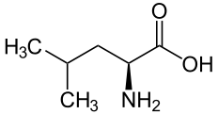
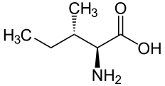
Amino Acid Masses
Leu and Ile (L/I) are structural isomers
They thus have identical mass and cannot be distinguished by their mass alone!
Fragments with same mass are called isobaric
Gln and Lys (Q/K) have nearly identical masses: 128.09496 Da and 128.05858 Da
For low-resolution instruments they are indistinguishable, too
AA | Chemical formula | Mono-isotopic [Da] | Average [Da]
Leu | C₆H₁₁ON | 113.08406 | 113.1594
Ile | C₆H₁₁ON | 113.08406 | 113.1594
Gln | C₅H₈O₂N₂ | 128.05858 | 128.1307
Lys | C₆H₁₂ON₂ | 128.09496 | 128.1741
Leu
Ile

Slide 51
Post-Translational Modifications
Alterations to the chemical structure of proteins after the translation are called post-translational modifications (PTMs)
Chemical modifications (e.g., isotopic labels) are not PTMs
The UniMod database (www.unimod.org) contains a wide range of potential modifications to
PTMs play very important roles in cellular signaling
Best known example: phosphorylation
Phosphorylation of amino acids (primarily Ser, Thr, Tyr) can activate or inactivate protein function
Example: MAP kinase pathway

Slide 52
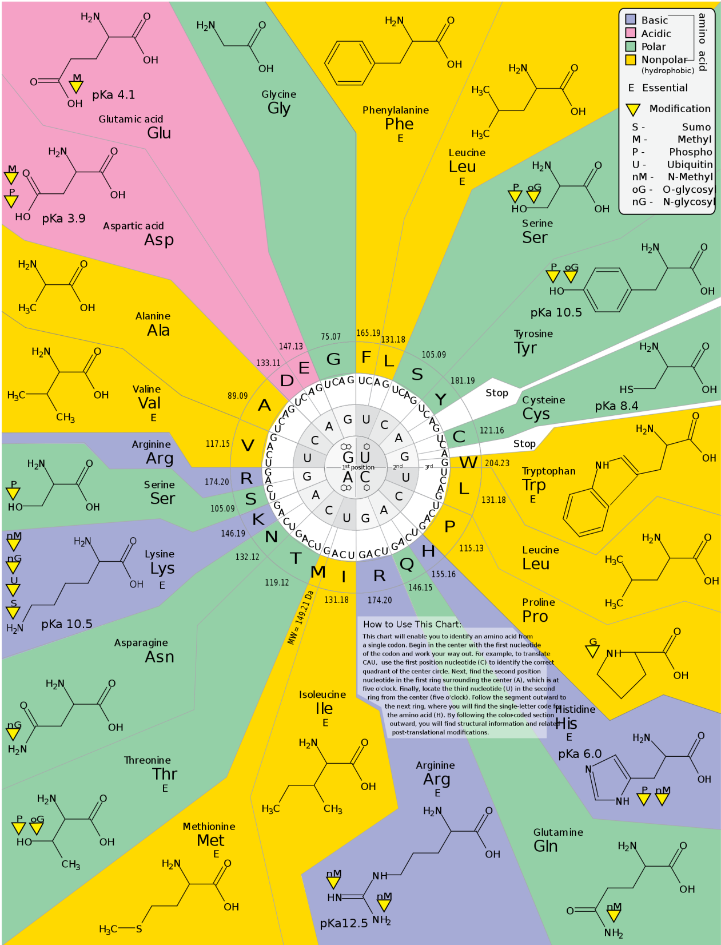
Post-Translational Modifications
Most common in vivo PTMs
Phosphorylation
Acetylation
Oxidation
Methylation
Glycosylation
…
Mechanisms inducing PTMs
Enzymes
Covalent linking to other proteins
Change of cellular conditions
http://www.enotes.com/topic/Posttranslational_modification
Notes:
Knut: Cannot find anyhting on this URL

Slide 53
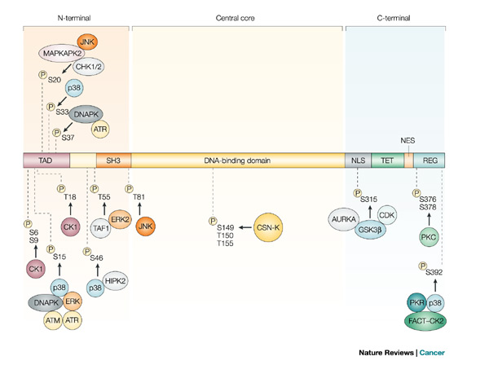
P53 Phosphorylation Sites
Notes:
TODO: image source

Slide 54
Protein Sequence Databases
Protein sequence databases are important to link mass spectra to proteins
These databases do not only provide sequence information, but also:
Names
Taxonomy
Polymorphisms, isoforms, PTMs, etc.
Important databases
UniProt Knowledgebase (SwissProt/ TrEMBL, PIR)
NCBI non redundant database
The International Protein Index (IPI)
NextProt

Slide 55
UniProtKB
Is built on three established databases: SwissProt, TrEMBL and PIR (Protein Information Resource)
It contains:
Accession number that serves as an unique identifier for the sequence
Sequence
Molecular mass
Observed and predicted modifications

Slide 56
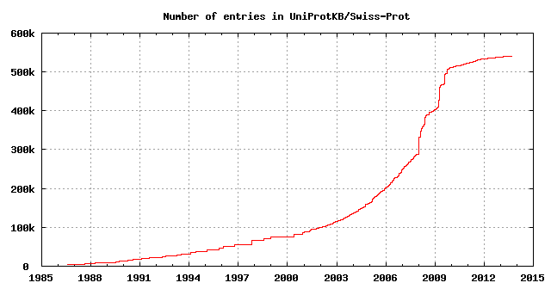
UniProtKB/SwissProt
http://www.uniprot.org/
SwissProt is the manually curated section of the UniProt Knowledgebase (UniProtKB)
Curated by ExPASy (Expert Protein Analysis System)
manually annotated with minimal redundancy
> 500k entries and 20,271 human proteins (Note: 20,248 in 2011)
http://web.expasy.org/docs/relnotes/relstat.html

Slide 57
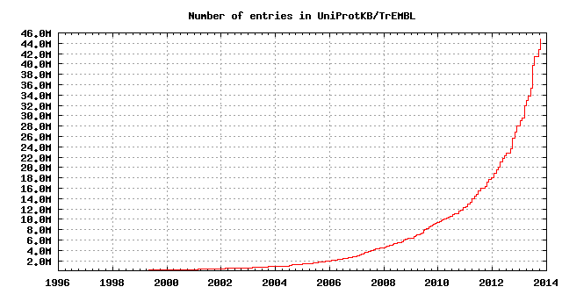
TrEMBL
http://www.uniprot.org/
Translated EMBL nucleotide sequences
European Molecular Biology Laboratory / European Bioinformatics Institute (EBI)
Computer annotated section of the UniProt Knowledgebase (UniProtKB)
42,821,879 entries among them: 113,507 human proteins
2011: 16,886,838 and 794,190 -> no saturation!

Slide 58
NCBI NR
NCBI: National Center for Biotechnology Information
Groups different information: SwissProt, TrEMBL and RefSeq
RefSeq consists of XP and NP entries. For NP entries there is experimental evidence and XP entries are purely predicted
NCBI is non-redundant at the absolute protein level -> no two sequences are identical
History management is provided via the Entrez web interface

Slide 59
NextProt
http://www.nextprot.org
neXtProt is an on-line knowledge platform on human proteins
Integrates various sources of information, such as UniProt, GeneOntology, ENZYME and PubMed
Potentially best curated knowledgebase for human proteins: Oct. 2013: 20,133 human proteins

Slide 60
Other Databases
MSDB (Mass Spectrometry DataBase): combination of different databases
HPRD (Human Protein Reference Database): manually curated from literature
PDB (Protein Data Bank): protein structure database

Slide 61
LU 1E – Basic metabolomic techniques and applications
Metabolome - differences, similarities to proteome, MW distribution
Metabolic pathways, connection between proteome and metabolome
Metabolomics databases
Metabolomics techniques (targeted, non-targeted; LC, GC, NMR
Metabolomics applications: biomarker discovery

Slide 62
Metabolism
Metabolism = sum of all the chemical processes occurring in an organism at one time
Concerned with the management of material and energy resources within the cell
Two types of metabolic processes
Anabolic processes – processes constructing larger molecules from smaller units (building up)
Catabolic processes – processes breaking down larger units (degradation or energy generation)
Metabolites are both educts and products of metabolic processes
Enzymes (proteins) usually catalyze these metabolic processes (reactions)
A sequence of several coupled metabolic processes is called a metabolic pathway

Slide 63
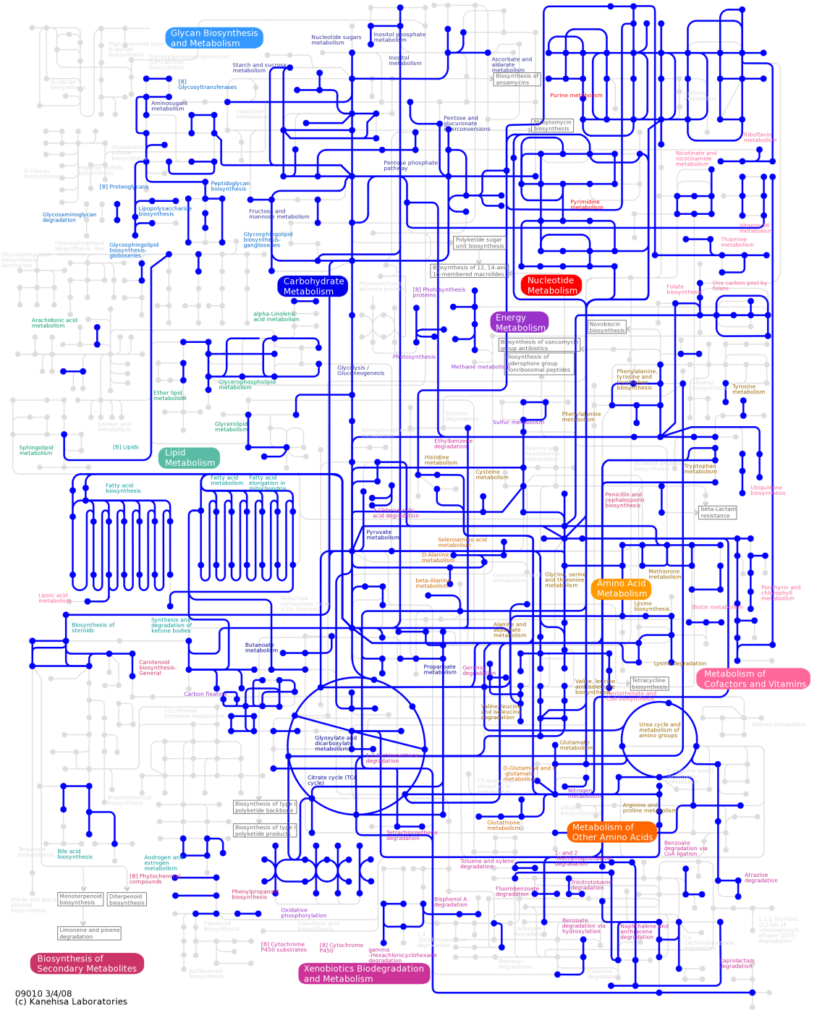
Metabolism
Metabolic map Rhodobacter capsulatus
Highly complex network structure

Slide 64
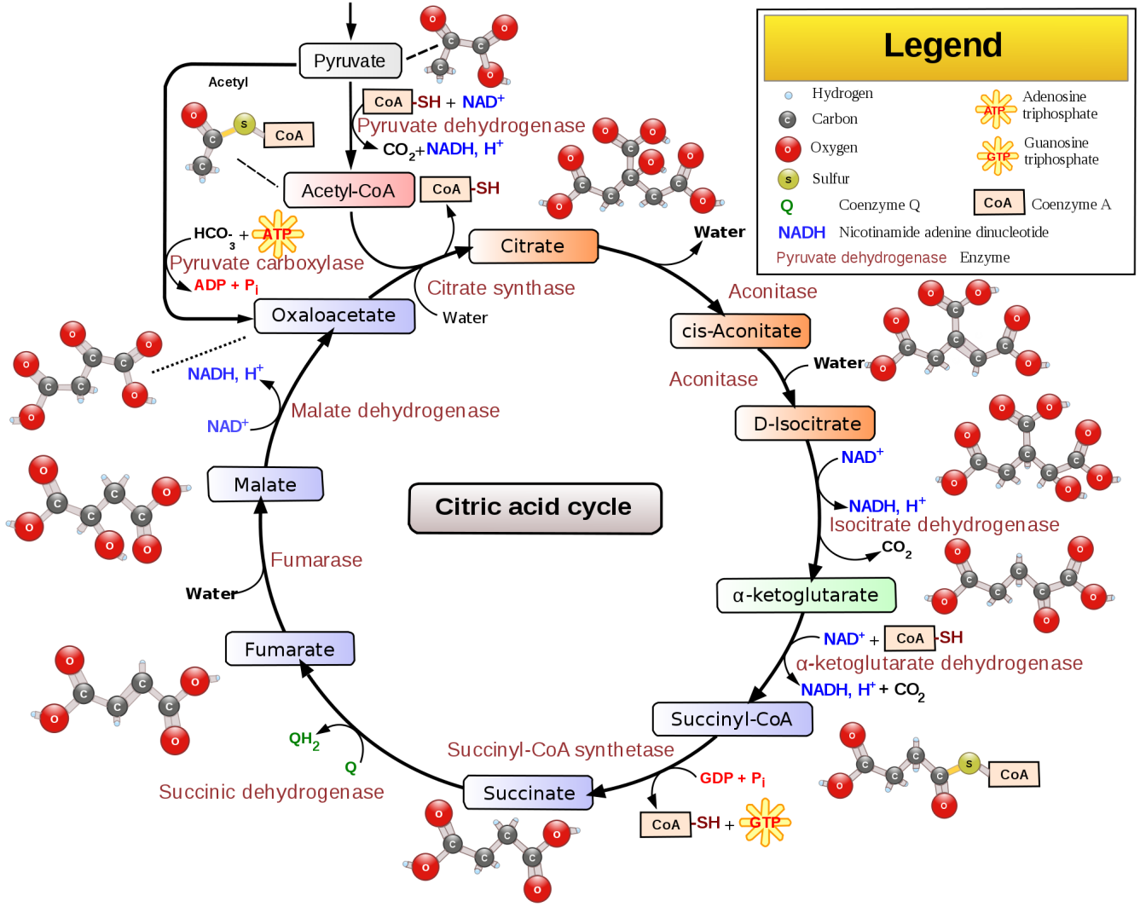
Catabolic Pathways
Pathways that release energy by reaction that catabolize complex molecules to simpler compounds
Example: Krebs cycle Cellular respiration: C₆H₁₂0₆ + 6O₂→6CO₂ +6H₂0 + ENERGY
http://en.wikipedia.org/wiki/Citric_acid_cycle

Slide 65
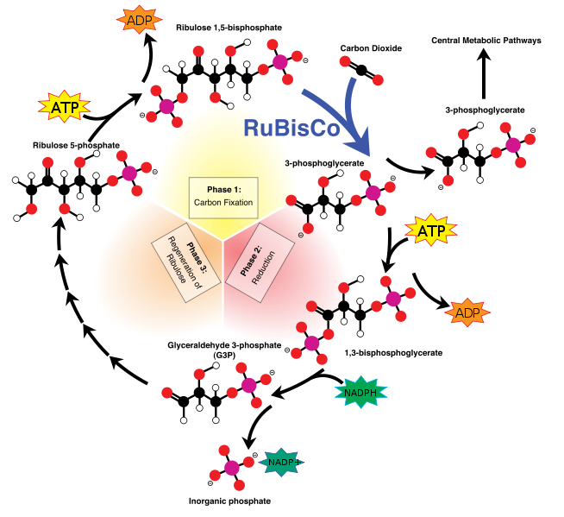
Anabolic Pathways
Pathways that consume energy to anabolize more complex molecules from simpler compounds
Example: Calvin cycle: 3 CO₂ + 9 ATP + 6 NADPH + 6 H⁺ → C₃H₆O₃-phosphate + 9 ADP + 8 P_{i} + 6 NADP⁺ + 3 H₂O
http://no.wikipedia.org/wiki/Fil:Calvin-cycle3.png

Slide 66
Metabolites
Metabolites comprise a heterogeneous set of biomolecules: all small molecules in a system excepting salts and macromolecules (proteins, long peptides, RNA, DNA)
Lipids and sugars are metabolites as well
There are separate fields dealing with lipids and sugars (lipidomics, glycomics), techniques are very similar
Examples:
Extracted from Bennett et al.: some of the most abundant small molecules in E. coli
Bennett et al. Nature Chemical Biology.
Bennett et al. Nature Chemical Biology. 2009

Slide 67
Metabolome vs. Proteome
Size and complexity of the metabolome still largely unknown
Similar to protein sequence databases, there are also metabolite databases listing all known metabolites (usually contains tens of thousands of metabolites)
Differences between proteome and metabolome:
Metabolites belong to wider ranger of chemical compound classes (lipids, sugars, amino acids)
Proteins have a more homogenous chemistry (20 proteinogenic amino acids)
Metabolites can have complex structures that require a structural formula for a comprehensive description
Proteins have a simple, linear structure that can be represented by a sequence
Metabolites are light: average metabolite mass a 100-300 Da
Proteins are heavy: median protein length around 300-500 aa, about 40,000 Da molecular weight
Notes:
TODO: distribution of MW in SWISS-PROT (-> Knut: Let them do it as exercise)
TODO: plot distribution of MW in KEGG and/or HMDB (Knut: -> let them do it as exercise)

Slide 68
Metabolomics Techniques
Fundamentally two types of approaches
Targeted metabolomics
Identify only a well-defined subset of metabolites, but those with higher accuracy (hundreds?)
All metabolites can be identified
Non-targeted metabolomics (metabolic profiling)
Try to see as much of the metabolome as possible (thousands and more)
Majority of metabolites can be seen
Only a small fraction will be identified
Similarly, there is also targeted and non-targeted proteomics
In proteomics, the identification problem is less difficult, though, which is why this distinction is more relevant in metabolomics (where identification is much harder)

Slide 69
KEGG
kegg.org

Slide 70
PubChem

Slide 71
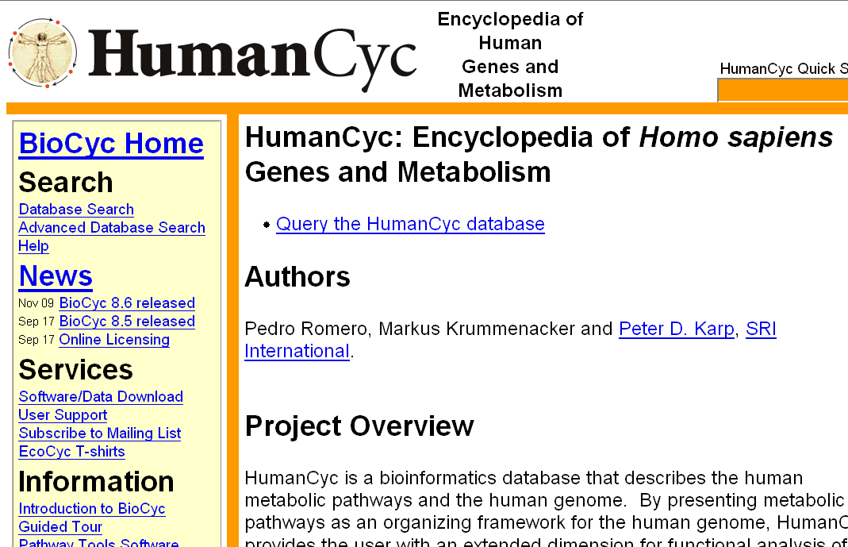
HumanCyc

Slide 72
METLIN
Database containing a large number of metabolites (240,000+) and spectra for those (12,000 metabolites). Permits search of metabolites via their mass spectra.
http://metlin.scripps.edu/

Slide 73
MassBank
Database containing mass spectra of a large number of metabolites and metadata for these compounds.
Permits search of metabolites via their mass spectra.
http://www.massbank.jp/

Slide 74
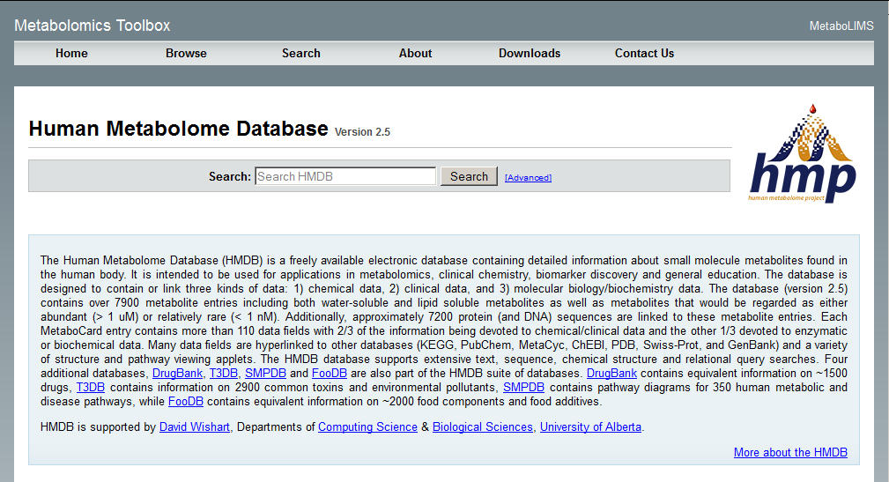
HMDB
Database of known human metabolites. Rich in metadata and annotation, no mass spectra.
hmdb.ca

Slide 75
Materials
Learning units 1A-E

